Slide 1
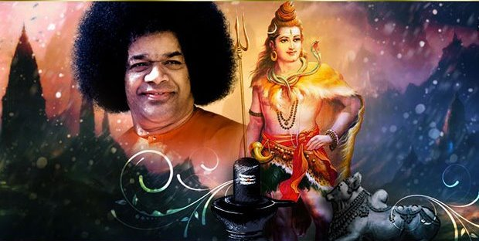
Om Sri Sai Ram
Inner Significance
of Maha Shivarathri Festival

Slide 2
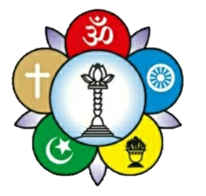
Om Sri Sai Ram
Sri Sathya Sai Seva Organisation
Karnataka South
Shivarathri is a very significant festival observed in Prashanthi Nilayam when Bhagawan gave important messages every year on its inner significance.
Lets understand the core message of Swami on Shivarathri and share this to all the devotees of our organisation through our Samithis and Bhajan Mandalis.
Yours in Sai Seva
Spiritual Wing
Sri Sathya Sai Seva Organisation
Karnataka South

Slide 3
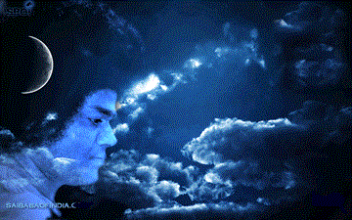
Shivarathri
SHIVARAATHRI is a very auspicious day for all. It is the fourteenth day of the lunar fortnight, when the Moon is waning and the Sun is in the sign of Aquarius. The festival is, however, related to the Moon rather than the Sun. That is the reason why it is called Shivarathri . Unlike other nights, this particular night is the night consecration, of dedication, of illumination
-7th March 1978

Slide 4

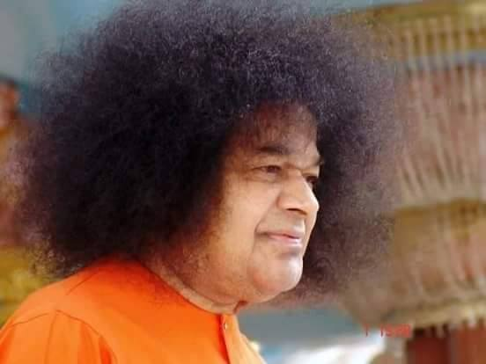
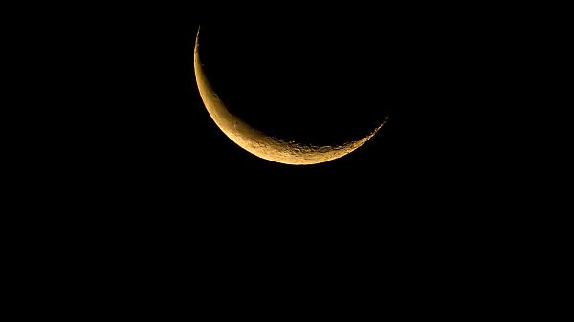
Importance of Prayer during Shivarathri
The Moon has sixteen digits. Likewise the mind has sixteen digits. On Shivarathri night, fifteen of the Moon's sixteen digits are invisible, and only one digit can be seen. The mind also is in the same state. If during Shivarathri one meditates on God, one can achieve nearness to the Divine. Supreme sacredness of Shivarathri consists in realising oneness with the Divine through meditation on God.
-11th February 1983

Slide 5
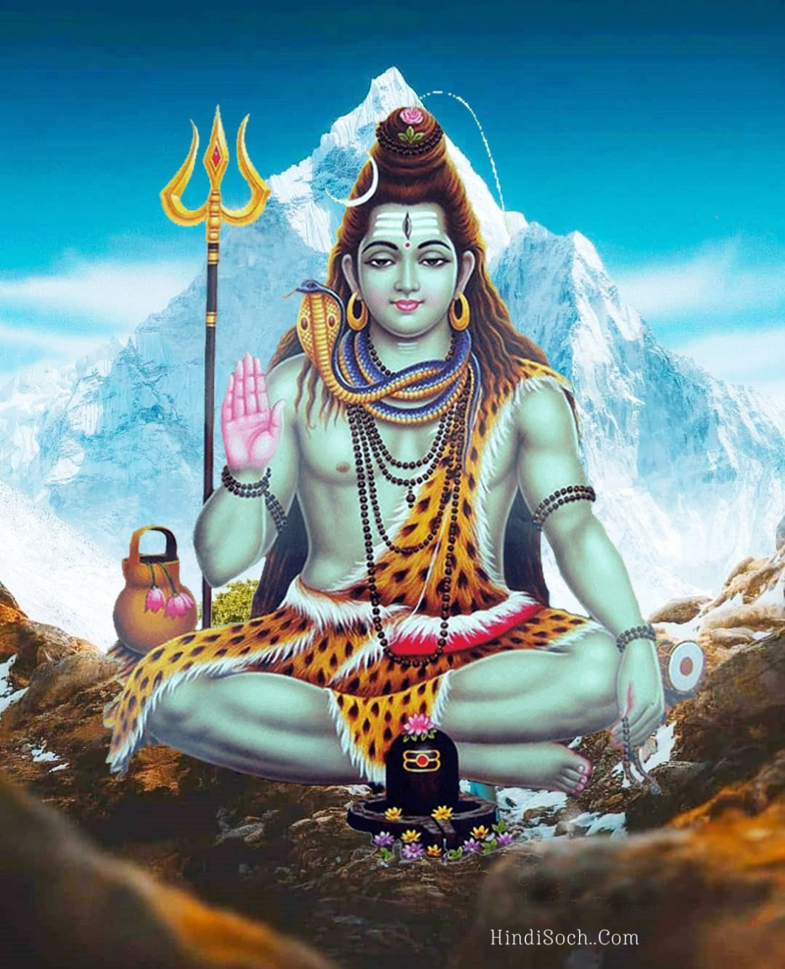
Significance of Shiva’s Form
The crescent moon on Siva's head symbolises the consciousness in human beings, the Ganga symbolises the Life-Force and the snakes on Siva's body represent the myriads of living beings. He resides on a silver mountain. His dearest friend is Kubera, the Lord of Wealth. Despite being endowed with all these, why was He obliged to carry the begging bowl? To demonstrate to the world that every kind of wealth is a hindrance to spiritual advancement, Siva renounced everything. It is through renunciation Siva became the eternal embodiment of supreme bliss.
-23rd February 1990

Slide 6
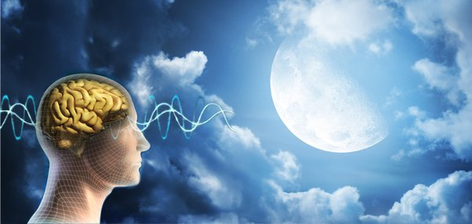
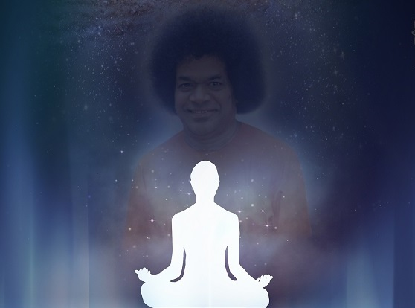
Significance of Rituals
“On this night there is just a minute part of the mind left to be conquered and that can be done by keeping vigil and dwelling on the Glow of God. The vigil that is prescribed is symbolic of the eternal vigil one has to observe, while the rite of fasting is symbolic of divesting the senses of the pleasures they crave for. The night-long Bhajan is significant of the lifelong consciousness of the Divine Presence that every one should cultivate. The rites and vows laid down for Shivarathri being absent on other nights of the year, their observance on this day comes as a reminder that they are useful.”
-7th March 1978

Slide 7
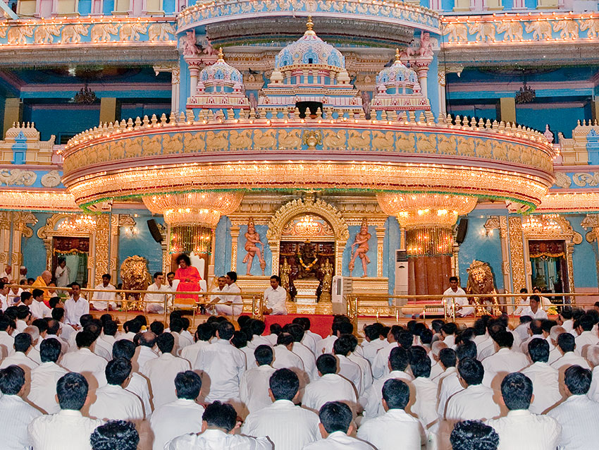
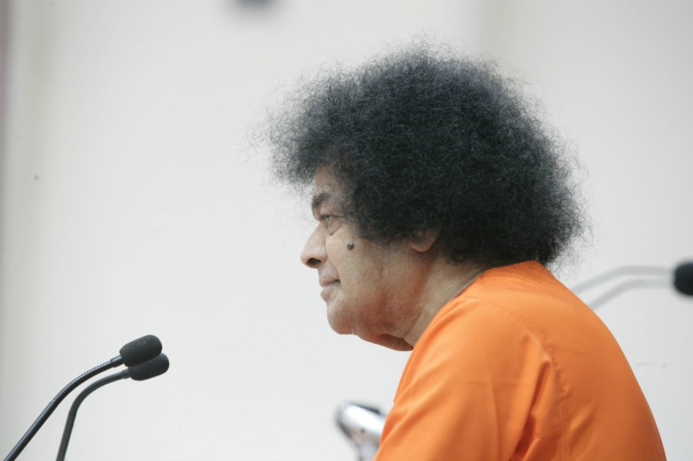
Rathri & Shivarathri
”What is the difference between Rathri and Shivarathri? For the man who has recognised his divinity, every night is Shivarathri. For the man immersed in worldly concerns, all nights are the same. That night is marked by darkness. This night is marked by light. Spirituality is the lighthouse that spreads light for the man who is full of despair, immersed in insatiable desires. The name of God is the lighthouse. By chanting the name, the bearer of the name can be realised. “
-19th February 1993

Slide 8
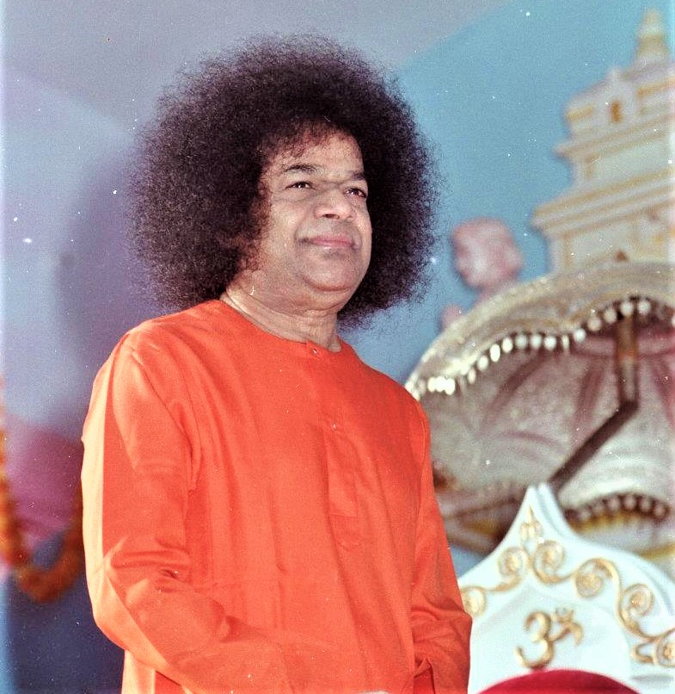
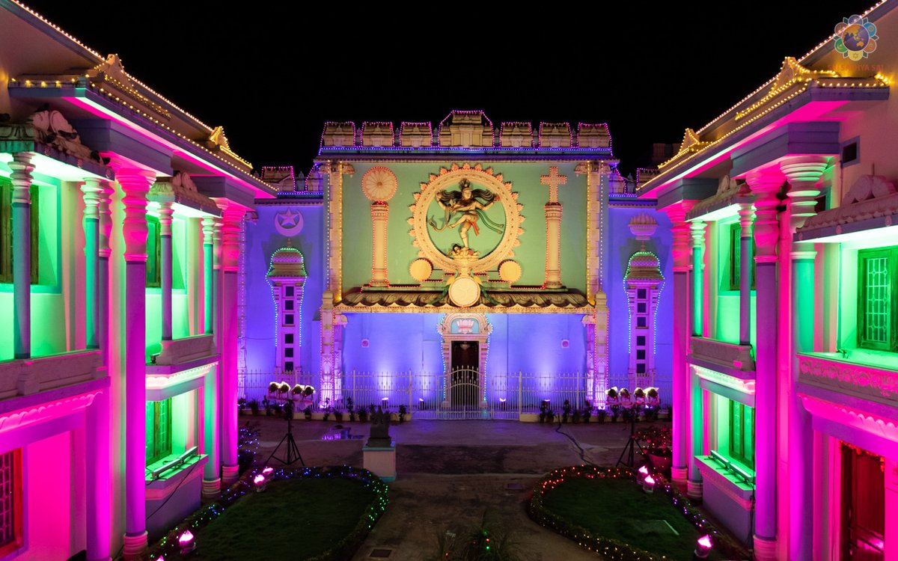
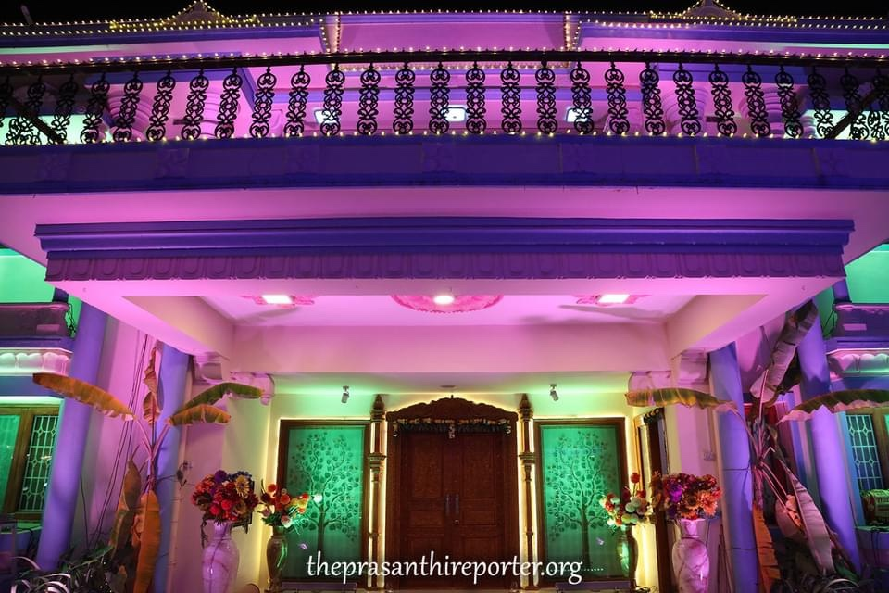
Night of Light
“During Shivarathri, the night is not dark but full of light. That light is experienced by contemplating on the g1orious form of Shiva, meditating on the Divine, reminding oneself of unity with the Divine and attaining a stare of pure holiness.”
-14th October 1994

Slide 9
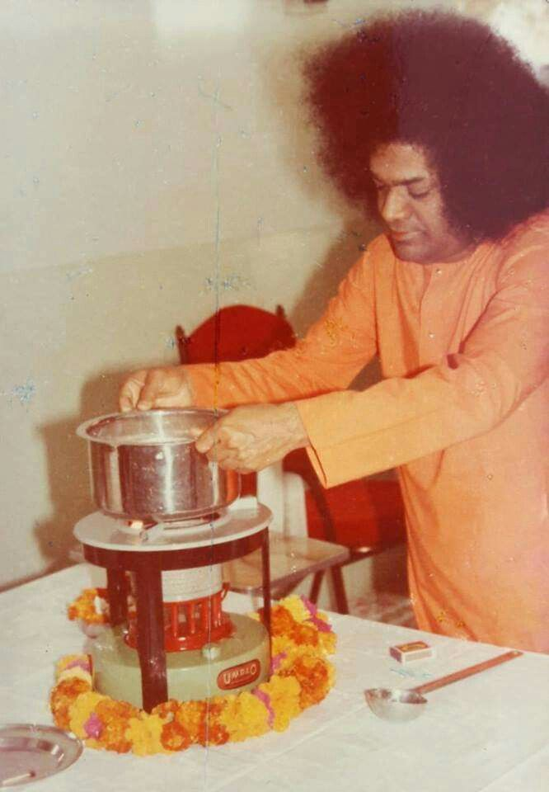
Process of Self Realisation
“The spiritual process may be compared to the conversion of milk into butter. The body is like a house. The heart is the vessel in which the milk of consciousness is boiled over the stove of devotion. The vessel is covered by the lid of Shraddha . When the fire of Viveka is lit, the cream of understanding comes up from the boiling milk. To prevent the cat of Maya from getting at the milk, the door has to be barred by the gate of Sujnana . After the milk is cooled by Shanthi and the buttermilk of the Divine Name is added to it, the curd of Divine Grace is formed. When this curd is churned with the rod of knowledge and the rope of love, the whey of ignorance is separated and the butter of the Atmic Reality emerges”
-23rd February 1990

Slide 10
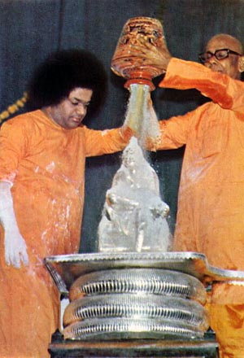
Vibhuthi Abhisheka
“The Vibhuthi Abhisheka has a potent inner meaning which Swami wants you to grasp. The Vibhuthi is the most precious object, in the truly spiritual sense
The Abhisheka with Vibhuthi is done to inspire you to give up desire and offer Shiva the ashes of its destruction as the most valuable of all the articles you have earned. Ash cannot fade as flowers do in a day or two; it does not dry and disappear or get soiled and unpotable as water does; it will not lose colour as leaves do, in a few hours; it does not rot as fruits do in a few days. Ash is ash for ever and ever. So, burn your viles, your vices, your bad habits; worship Shiva, rendering yourselves pure in thought and word and deed.”
-20th February 1974

Slide 11

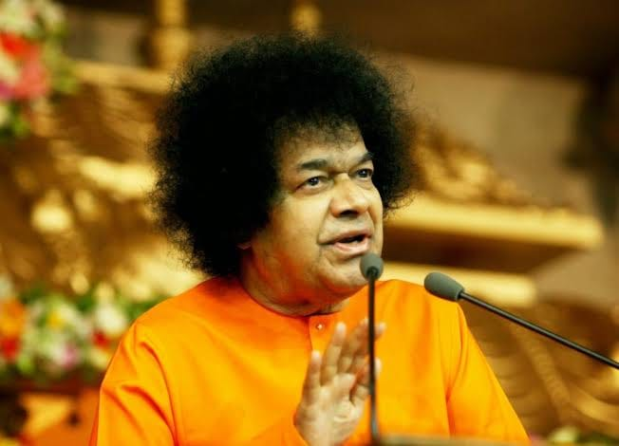
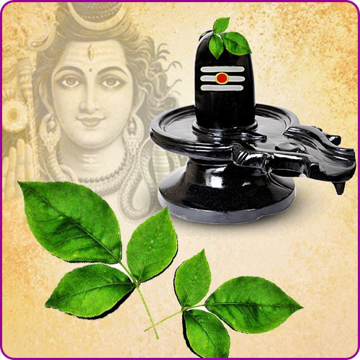
Significance of Bilva Leaf
“Shiva is worshipped with the three-leaved Bilva.. for, He is immanent in the three worlds, in the three phases of Time, in the three attributes of Nature. He removes the three types of grief; He has no basis outside Him; He is the source of Bliss; He is the embodiment of the sweetness and efficacy of Nectar. Since every being is Shiva- Swarupa - for without Shiva, it is mere ‘Shava' - man has to live up to that Divine status.”
-20th February 1974

Slide 12
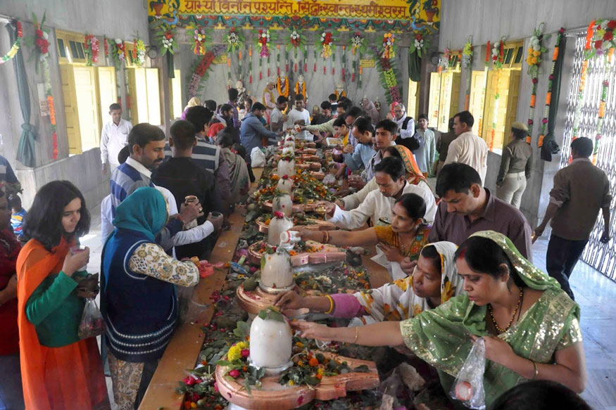
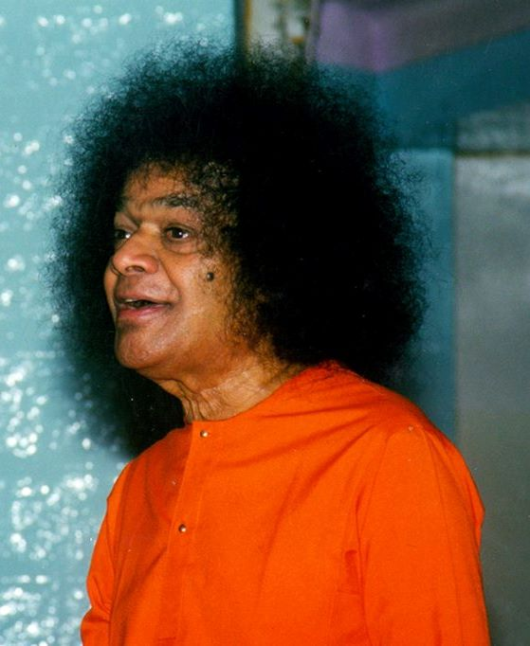
Mind Need Good thoughts
“Visiting Shiva shrines, arranging for worship through priests of Shiva Lingams, pouring sanctified waters, potful of them over consecrated idols, fasting, vigil and such other activities are resorted to on this Day. But, these are not quite relevant to the real purpose of the festival. To fulfil these rites and vows, one need not wait one full year
When man takes in food four times a day, in order that his body may keep functioning, efficiently, is it too much to ask him to feed the mind with good thoughts and godly acts, at least once every day?
The mind too needs clean and sustaining food."
-5th March 1973

Slide 13
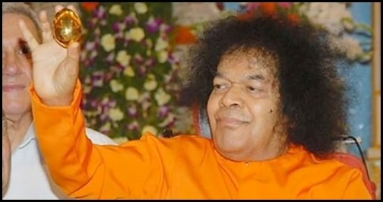
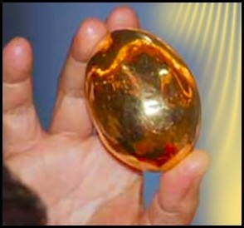
Significance of Lingodbhava
“Understand the true meaning and inner significance of Shivarathri. Hiranyagarbha Lingam is present in everybody’s Hridaya and is on the right side of the body. The principle of Hiranyagarbha permeates My whole body. It assumes a form when I will it. Whoever has seen this Lingam at the time of its emergence will not have rebirth. One should see its form as it emerges. In order to sanctify your lives, such sacred manifestations have to be shown to you every now and then. Only then can you understand the divinity in humanity. This Lingam will not break even if it is dropped from a height with force. This is Amruthatwam. It is changeless. “
- Shivarathri 15th Feb 1999

Slide 14
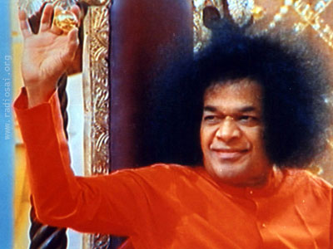
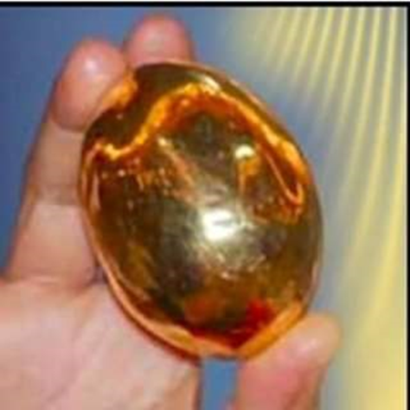
The Inner Linga
"Why does Swami produce the Lingam (Formless Form of God) from within himself on this day?“
from the Lingam arises Jangam (Universe), from the Jangam arises sangam (association, attachment, activity) and as a result of the sangam, one realises the lingam (attribute less Atma). Thus, the circle is completed - from the beginning less to the Beginning less. This is the lesson that Lingobdhavam teaches.
-Shivaratri February 1971

Slide 15
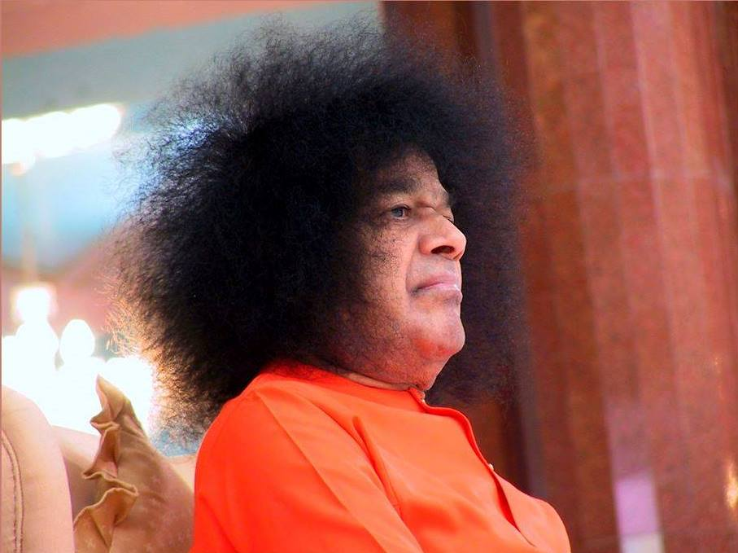
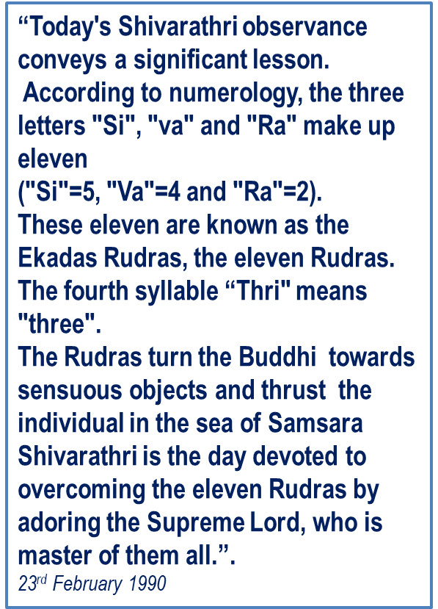
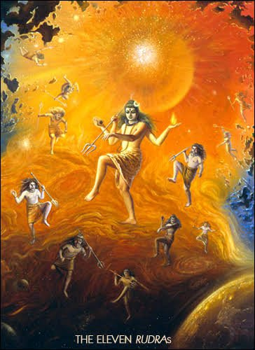
Control the Rudras

Slide 16
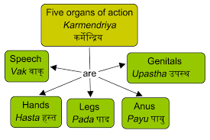
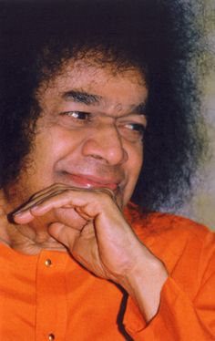
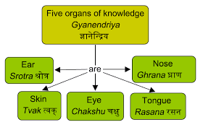
Control the Rudras…
“The Paramatma is master of all the Rudras. Only the man who has conquered the eleven Rudras can expect to realise the Supreme.
Who are the eleven Rudras?
They are' the five Karmendriyas the five Jnanedriyas and the Buddhi. Man must seek to control as much as possible these eleven organs. From ancient times, the sages have stressed the supreme importance of sense-control as the means to God-realisation.”
-23rd February 1990

Slide 17
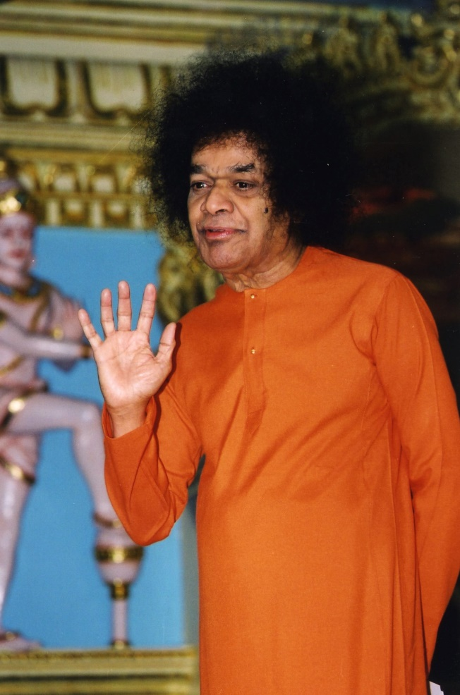
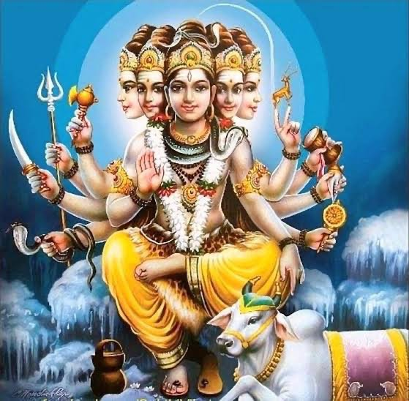
Names of Shiva
“The name is "Sambasiva". Sa means divinity. Amba refers to the cosmos. Siva means Purusha (the Supreme Person). Eshwara has yet another name Yogasikha. The sky is His blue form.
The Dik (directions) are His garments. Hence He is known as Digambara. He is also known as Panchanana - the Five headed One. The five are Earth, water, fire, air and space. His five heads represent the Panchabhutas .Siva is also described as Bhuthanatha - the Lord of all created beings. Bhutha refers to creation. Eshwara is the Lord of every creature in the universe. Hence, the entire cosmos is reflected as an image in the Lord.”
-23rd February 1990

Slide 18
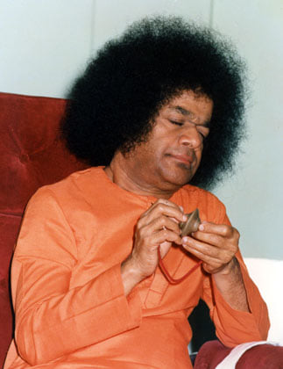
Achieve Single Centeredness
“There are three types of men-the multi-centred, the uni-centred and the non-centred. The first group, who allow their senses, mind and intelligence to wander where they will, is a very populous group. So also is the third group, which comprises people who flit from one object to another, hop around from one thing to another in listless flippancy. For earning the concentration and single-centeredness characteristic of the second group, the festival of Shivarathri is very propitious. The Bhajans and the ceaseless flow of keerthans and Namasmarana on this occasion help in the attainment of single-centeredness. “
7th March 1978

Slide 19
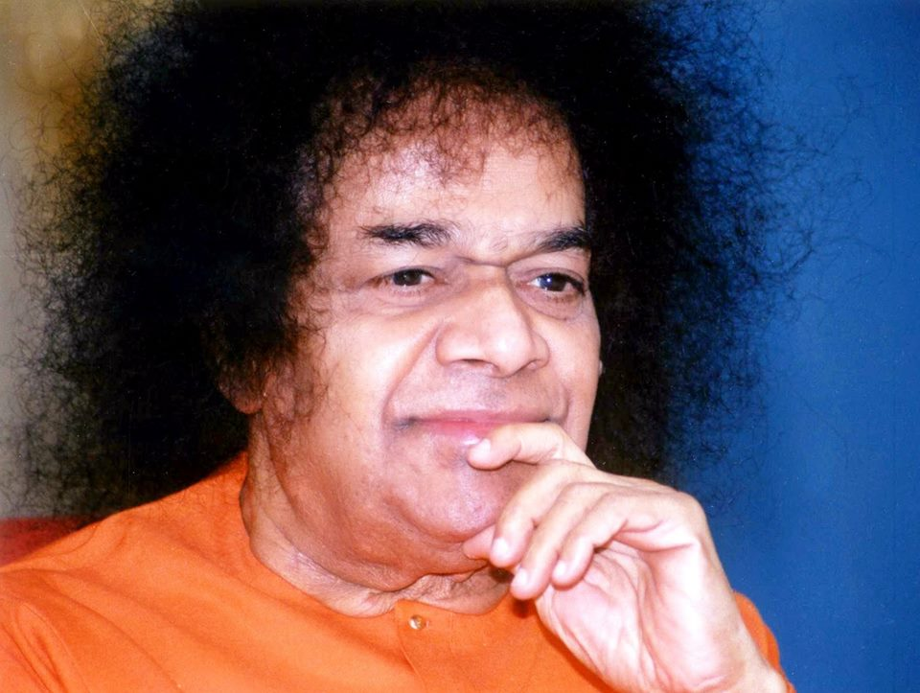
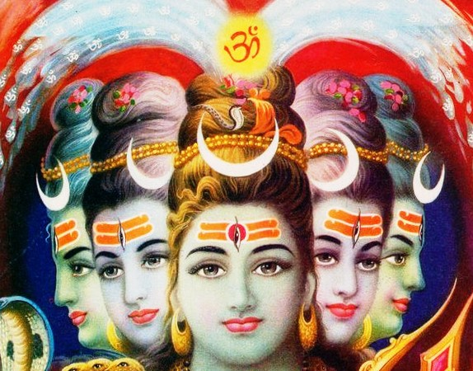
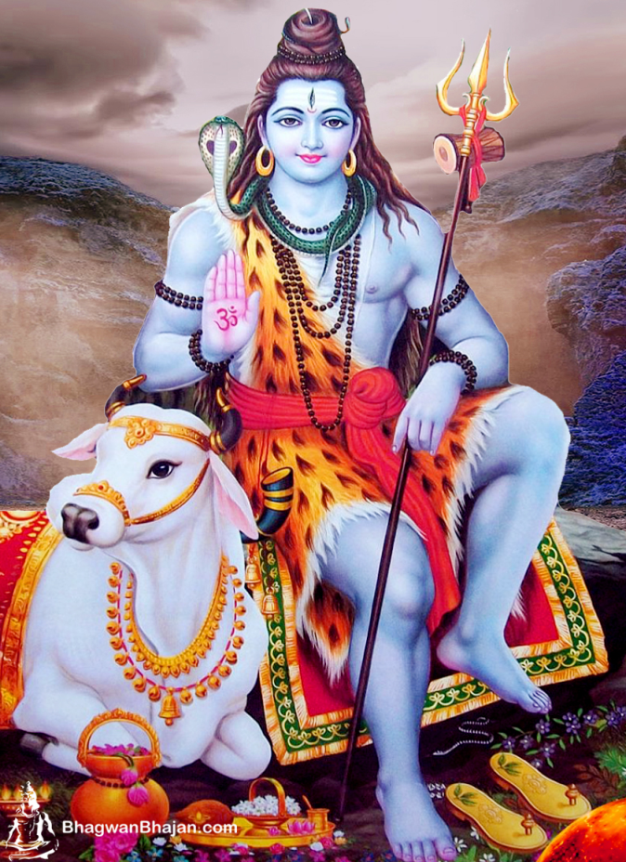
Shiva’s Form
“Every form conceived in the Sastras and scriptures has a deep significance. Shiva does not ride an animal called , a bull. The bull is the symbol of Stability standing on four legs, Sathya, Dharma, Shanthi and Prema . Shiva is described as having three eyes, eyes that see the Past, the Present and the Future. The elephant skin which forms His cloak is a symbol of the bestial primitive traits which His Grace destroys. In fact, He tears them to pieces, skin them, and they become totally ineffective. His Four Faces symbolise Shantham , Roudhram, Mangalam and Uthsaham”
February 1969

Slide 20
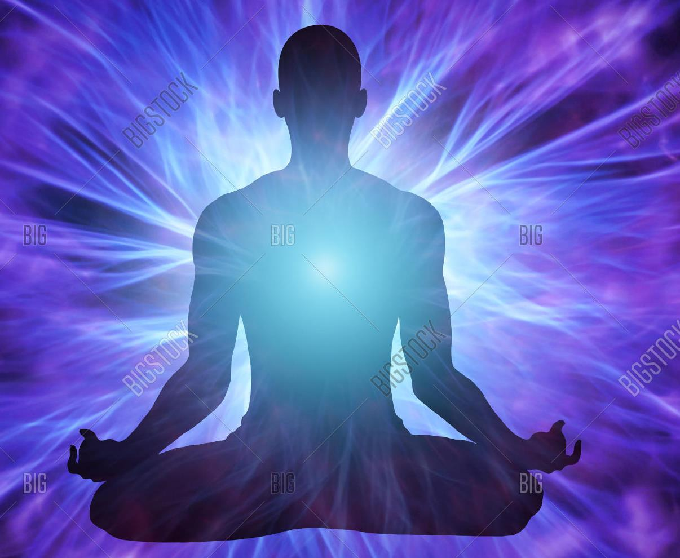
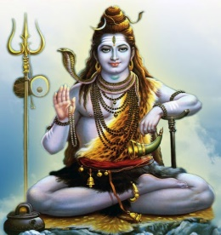
Our Heart is Kailasa…
“This Shivarathri is a day when one tries to establish friendship between mind and God. Shivarathri makes one aware of the fact that the same Divinity is all-pervasive and is to be found everywhere. It is said that Shiva lives in Kailasa. But where is Kailasa? Kailasa is our own joy, our own bliss. It means that Easwara lives in the Kailasa of delight. If we can develop that sense of joy and delight in our mind, that itself is Kailasa. How can one get this joy? It comes when we develop purity and steadiness and sacredness. Then the heart becomes filled with peace and bliss. Then your heart itself will be Kailasa and Shiva will be there in the sanctum sanctorum of your heart, within the temple which is your body”
-17th February 1985

Slide 21
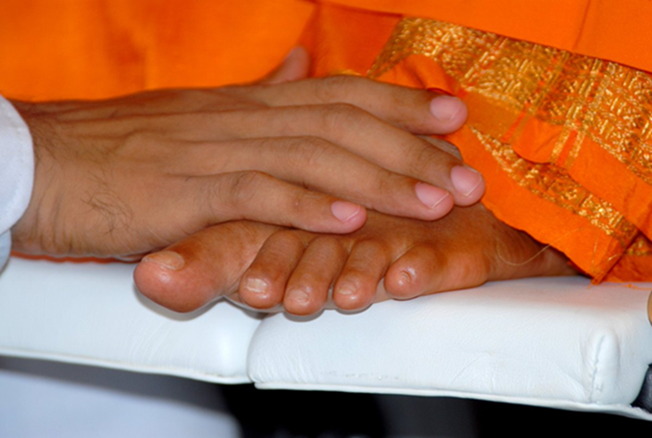
Om Sri Sai Ram
Offering this Presentation at the Divine Lotus Feet
Thank you
Jai Sai Ram

