Slide 1
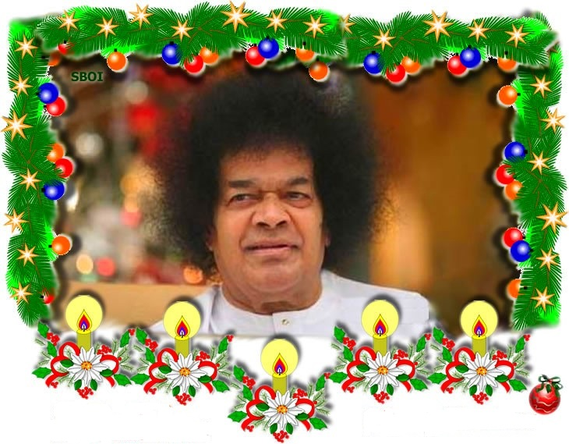


Om Sri Sai Ram
Christmas Message

Slide 2
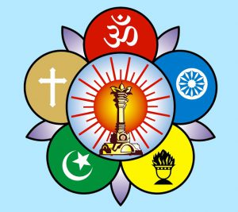
Om Sri Sai Ram
Sri Sathya Sai Seva Organisations
Karnataka South
Swami has given a lot of impactful messages on the life and teachings of Jesus Christ and the inner significance behind celebrating Christmas on 25th December every Year. Here are some of the extracts of these precious messages. Please share these with all the devotees in our state.
Sai Ram,
Yours in Sai Seva
Spiritual Wing
SSSSOKA
Karnataka South

Slide 3
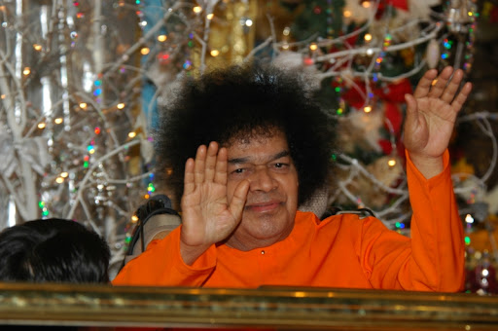
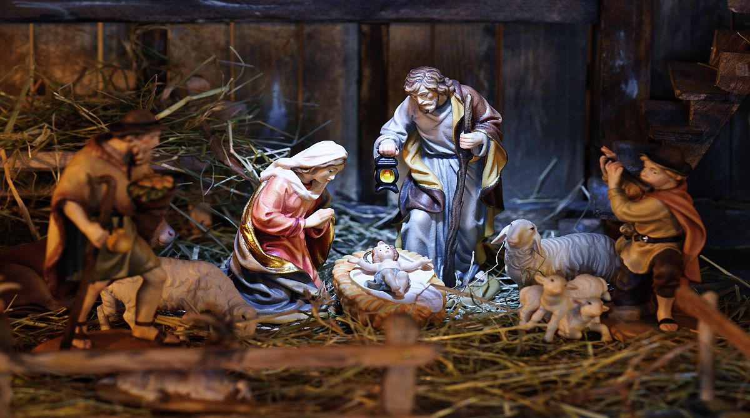
Birth of Jesus Christ
“The term Christmas was derived from the Roman language. Truly speaking, Christmas falls in the month of March, not in December. Since it is very cold in December and people are confined to their homes, they utilise this time to celebrate Christmas. Actually, Jesus was born in the month of March. With the passage of time, this fact has been distorted and misrepresented in the Bible”.
-25th December 1998

Slide 4
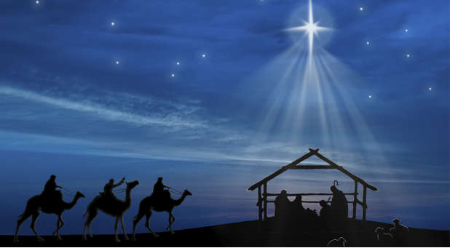

Birth of Jesus…
“When Mary was carrying, the pains started midway; they knew no one in the hamlet through which they were passing; so they took refuge in a cowshed. Joseph made ready the space between the cows, and went out into the road at midnight, to seek some woman who could help. But, soon, he heard the Baby's cry. And the story says, there was a Star in the sky, which fell with a New Light, and this led a few Tibetans and others to the place where the Saviour was born. This story is read and taken on trust by many, though stars do not fall or even slide down so suddenly. What the story signifies is this: There was a huge halo of splendour illuminating the sky over the village when Christ was born. This meant that He, who was to overcome the darkness of evil and ignorance had taken birth, that He will spread the Light of Love in the heart of man and councils of humanity.”
-24th December 1972

Slide 5
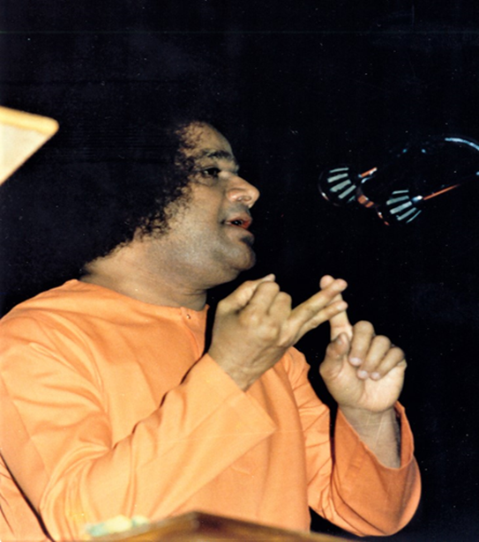
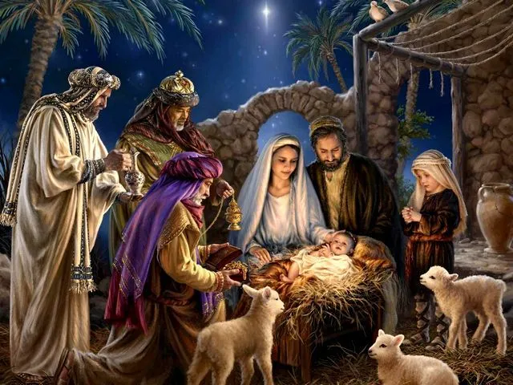
Birth of Jesus Christ
”When Jesus was born, three kings. came to his birthplace. These three gave expression to three different views about the new-born babe. One of them, looking at the infant, said: "This child looks like one who will be a lover of God." A second king said: "God will love this child." The third king declared: "Verily, this child is God Himself." The first one viewed the child from the physical point of view. The second saw the child from the mental viewpoint. The third saw from the Atmic point of view. The three declarations indicate how one can progress from the human to the divine level”
-25th December 1992

Slide 6
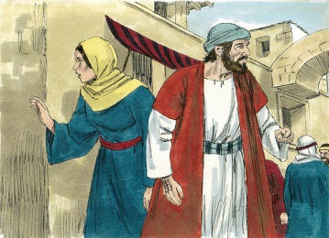
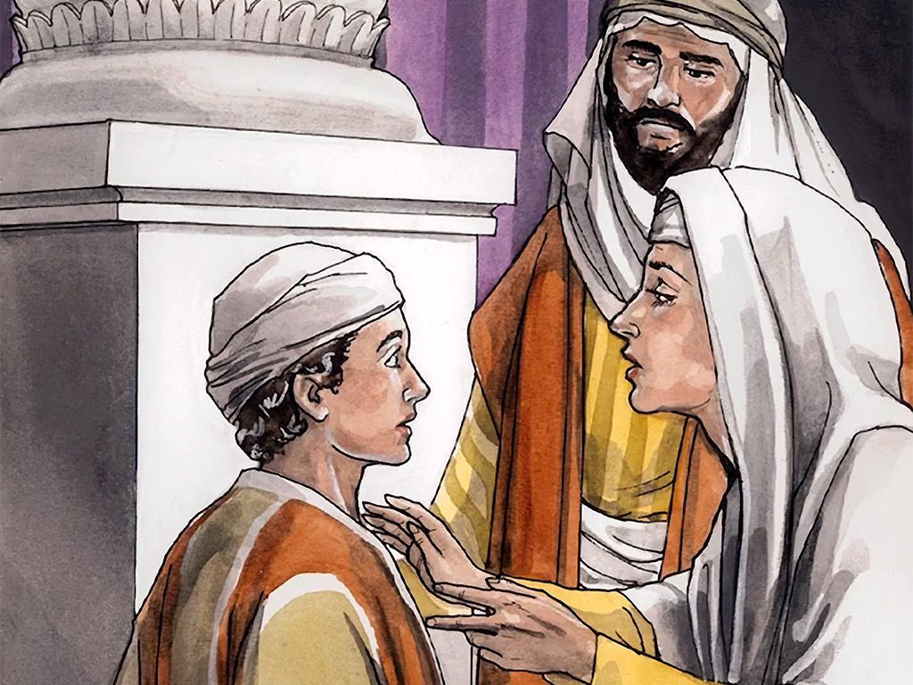
Jesus lost and Found
“When Jesus was a small boy, His parents took Him to Jerusalem to attend a fair. After some time, Mother Mary, not finding her son Jesus by her side, believed that He had lost His way in the crowd and searched for Him frantically. Ultimately, she found Him listening with rapt attention to the sermon of the priest in a temple. That scene reminded her of the prophetic words of one of the Arabian kings, who visited Jesus at the time of His birth, that He would love God. She hugged her son and shed tears of joy. Jesus said, “Mother, you can find Me in the company of God, but you have been searching for Me elsewhere. I consider divine proximity as My greatest wealth.”
-25th December 1998

Slide 7
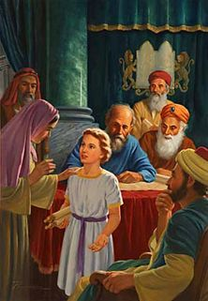
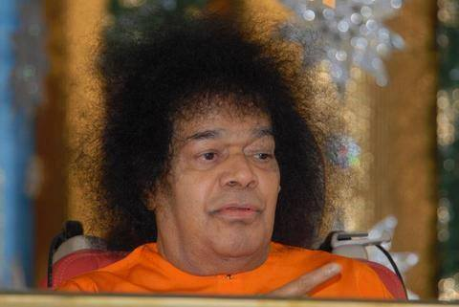
Profound Message
“But There is a profound message in this. Man is in search of God without realising that He is all-pervasive. He is the embodiment of love and can be attained only through love. When you realise that you are with God, for God, from God, you will find God everywhere. Strengthen the feeling that God is in you, with you, above you, below you and around you.”
-25th December 1998

Slide 8
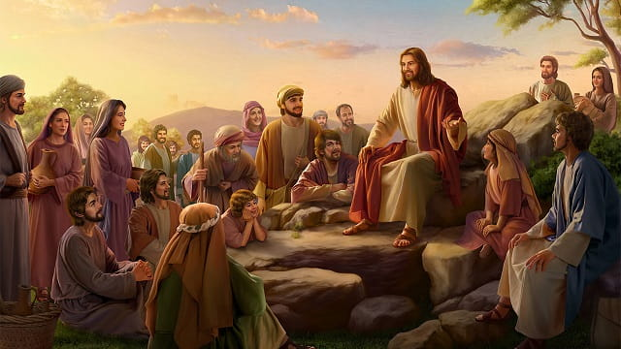
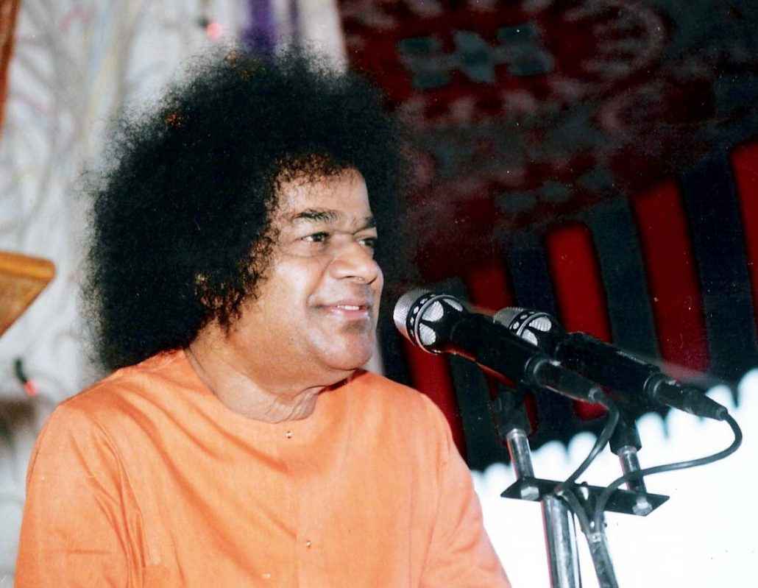
Jesus Teachings
“Jesus taught simple practical lessons in spiritual advancement for the good of mankind; He manifested Divine Powers to instil faith in the validity of his teachings; he marked out the path that can confer on men the sweet nectar of Ananda. He exhorted people by precept and example to cultivate the virtues of charity, compassion, forbearance, love and faith. These are not separate and distinct qualities, they are only the many facets of the Divine in Man, which he has to recognise and develop.”
-24th December 1972

Slide 9
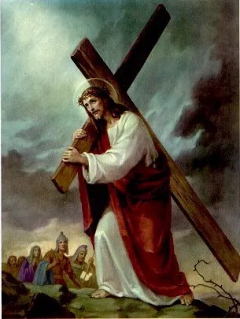
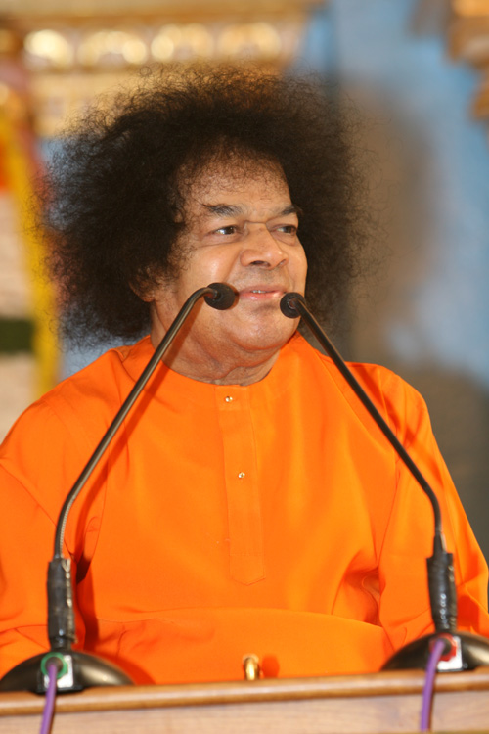
Jesus’s Sacrifice
“Let us pay attention to the sacrifice that Jesus made while free, out of his own volition.
He sacrificed his happiness, prosperity, comfort, safety and position; he braved the enmity of the powerful. He refused to yield or compromise. He renounced the 'ego', which is the toughest thing to get rid of. Honour Him for these. He willingly sacrificed the desires with which the body torments man; this is sacrifice greater than the sacrifice of the body under duress. The celebration of His birthday has to be marked by your sacrificing at least a desire or two, and conquering at least the more disastrous urges of the ego.”
-24th December 1972

Slide 10
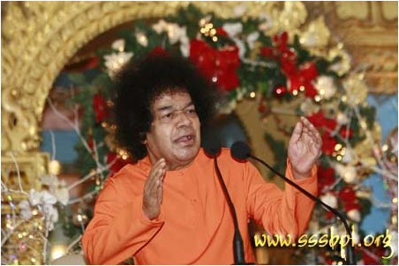
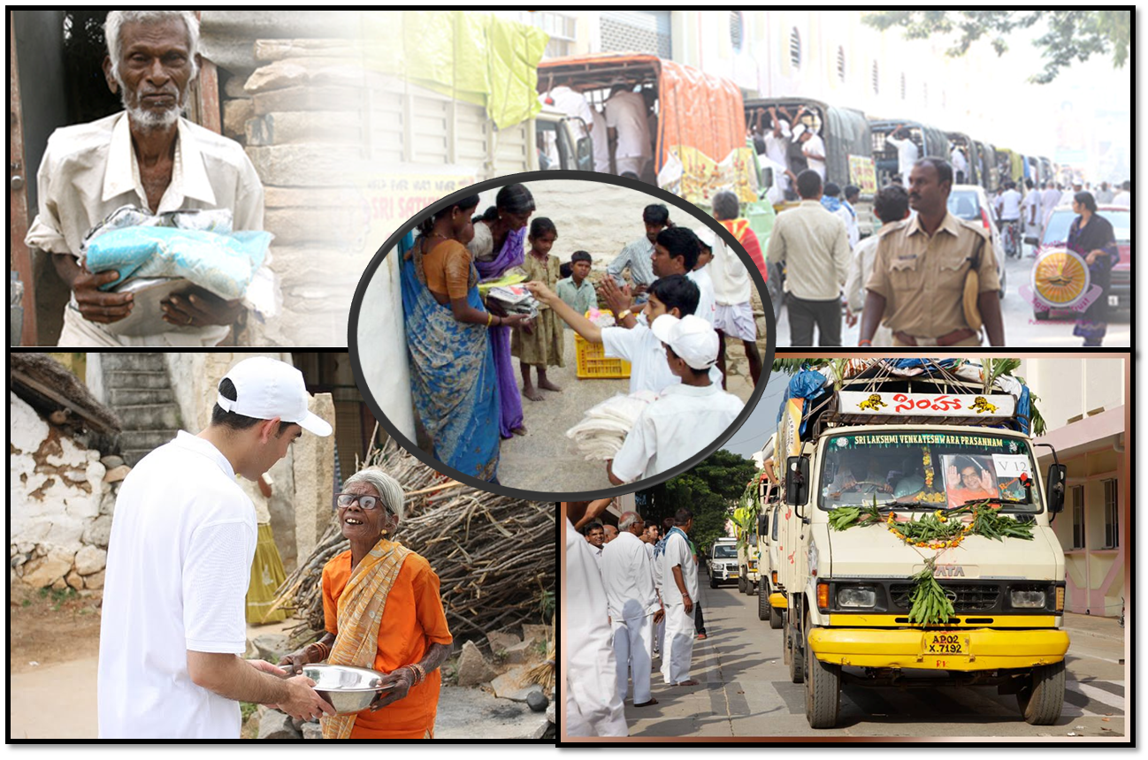
How to observe Christmas
“On this Christmas, when we celebrate the birth of Christ, resolve to lead the lives of loving service to the weak, the helpless, the distressed, the disconsolate. Cultivate tolerance and forbearance, charity and magnanimity. Hold dear the ideals He laid down and practise them, in your daily lives”
-24th December 1972

Slide 11
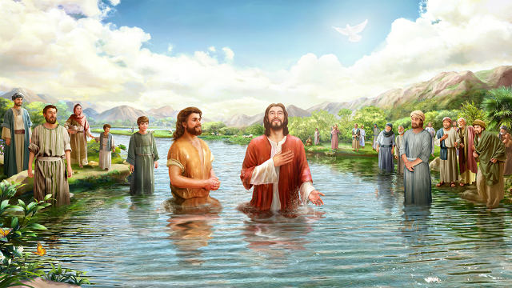
Jesus Mission Begins
“Jesus grew up at Nazareth till he reached thirty. After Joseph's passing, Jesus sought his mother's permission to embark on his Divine mission. He got baptised by John, the Baptist, and spent forty days in penance in a forest. During the penance, he prayed to God for three things: One - He should be blessed with the quality of loving equally everyone; Two He should have the strength and forbearance to suffer patiently any indignity or persecution that he might be subjected to by anyone; Three - He should be enabled to use his God-given body wholly in the service of God.”
-25th December 1988

Slide 12
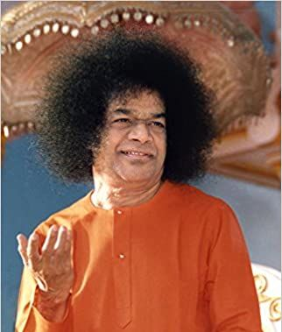
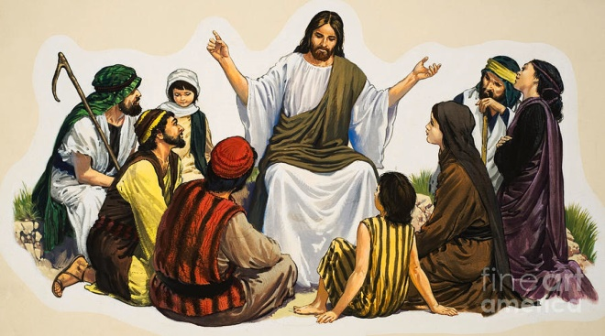
First Disciples of Jesus
“After forty days Jesus emerged from his penance with the faith that his prayers had been granted. Jesus encountered the fishermen, at Galilee, who became his first disciples. He told them that he had come to establish the reign of love on earth and that they would be his helpers in his mission. He spoke to them about the preciousness of human birth and urged them to seek the Kingdom of God within themselves.”
-25th December 1988

Slide 13
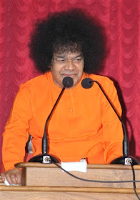
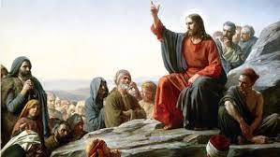
Message of Jesus
“Christ also taught that the body should be used for recognising the Indwelling Spirit and not to protect itself. It is the mark of ignorance to pamper the body and ignore the Spirit within. If a tiny sugar crystal is mixed in a heap of sand, even the most intelligent person will not be able to separate the sugar from the sand and recover it. But without any extraordinary intelligence, an ant is able to make its way to the particle of sugar in the sand heap and relish its sweetness. The ant is aware of the sweetness of sugar and is able to get at the sugar even in a heap of sand. Likewise, man: should seek to distinguish between the permanent and the transient and realise what is everlasting
-25th December 1988

Slide 14
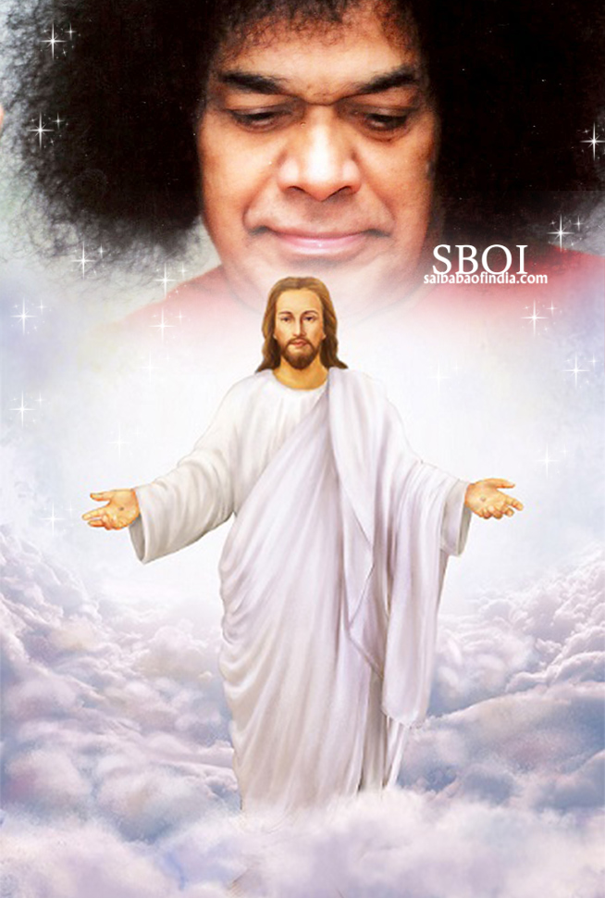
Message of Sai & Jesus
“The celebration of Christmas should not conclude with some carols, tableaux and made-up trees and Santa Claus. It must be soaked in the resolution to practise at least a few of the lessons Jesus taught us. The very first need is faith in God and in our own Divine Nature. Where there is Faith, there is Love, Where there is Love, there is Peace, Where there is Peace, there is Truth, Where there is Truth, there is Bliss, Where there is Bliss, there is God. The yearning for Bliss is the best proof of our holy nature. Man is Bliss; he seeks Bliss; Bliss is. Blessedness for him. Since God is Bliss, happiness is union with' God. Nothing else can award that joy, which is unaffected by whatever happens or does not happen”
-25th December 1982

Slide 15
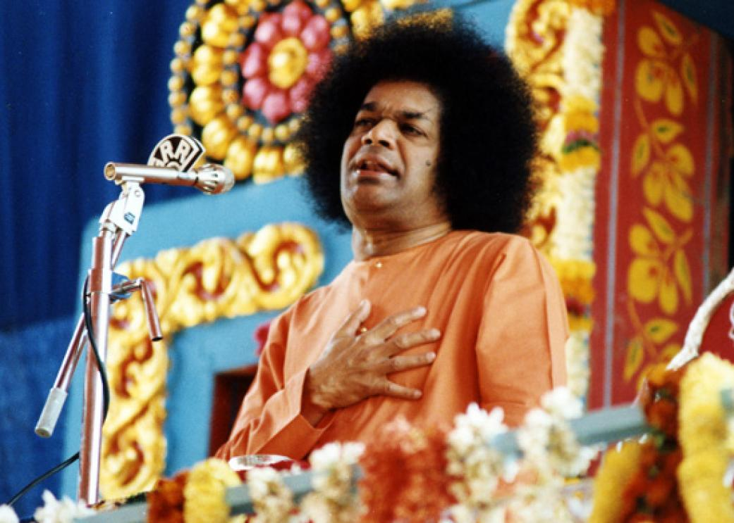
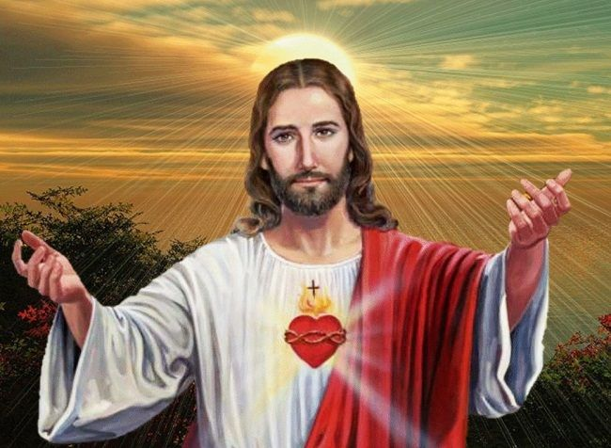
Message of Sai & Jesus
“The heart of Jesus was pure and calm. Hence, it is honoured as sacred. We must make our hearts sacred so that either we merge in Jesus or Jesus merges in. us. When we merge, it is called Bhakthi; to have Jesus awakened in us is the path of Jnana. Jesus was a messenger of God; but note this also' all of you are messengers of God. Jesus was not the only Son of God; you are all His children. Jesus and His Father are one. You and God are also one and you can be aware of it.”
- 25th December 1982

Slide 16
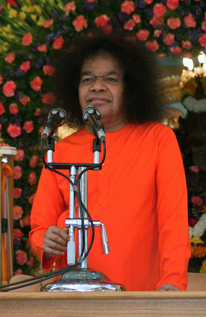
Christmas for all
“Today Christmas is mainly celebrated by Christians, but do not make the mistake that it is only for Christians. It is a holy and happy occasion to be celebrated by the entire mankind. Get rid of religious and philosophical differences and enlarge your matha (religion) and mathi (mind). There is only one God, and He is the indweller of your heart. If you realise this truth, the entire humanity becomes a single race. There is only one religion in the universe and that is divine love” .
-25th December 1982

Slide 17
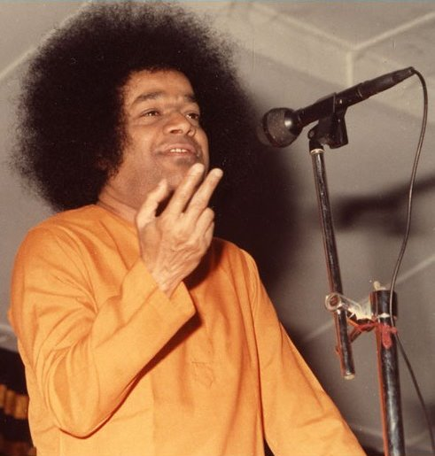
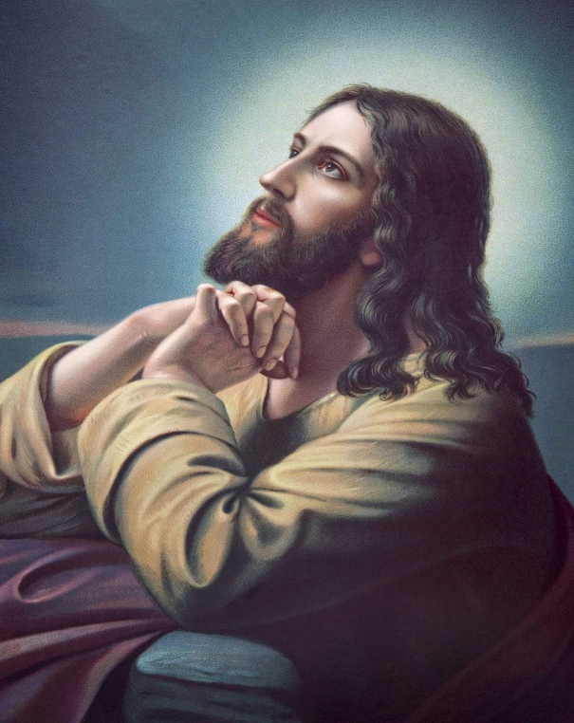
Sacrifice of Jesus
“Jesus performed many miraculous deeds, relieved the sufferings of many in distress, preached sublime truths to the people, and ultimately sacrificed his life. For over a hundred years after his martyrdom, Christ's message did not have any impact. Four centuries later, Christianity was accepted by Roman emperors. Even after many centuries, humanity is yet to realise the inherent divinity of man.”
-25th December 1992

Slide 18

Christmas Tree
“There is a custom of putting up a Christmas tree on this day and worshipping it. The genesis of this custom can be traced to Germany. A preacher by name Jensen from England once visited Germany. When he was travelling in Germany on his mission, he noticed some Germans attempting to offer a child's life as sacrifice to propitiate God who, they believed, lived in an oak tree. The priest was worried and questioned them why they were offering an innocent child as sacrifice to a tree. As they asserted that God lived in the tree, he took an axe and cut the tree. To his surprise, he was shaken by an inexplicable vibration from head to foot. He noticed the form of a child between the two portions of the tree that was cut by him.
This incident teaches the truth that God lives not only in human beings but also in plants and trees. From that time onwards people started putting up a Christmas tree and worshipping it on this Christmas day”
-25th December 1992

Slide 19
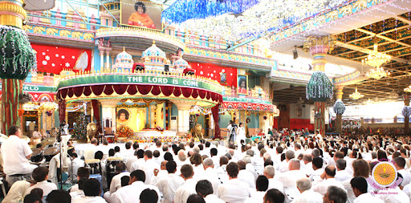
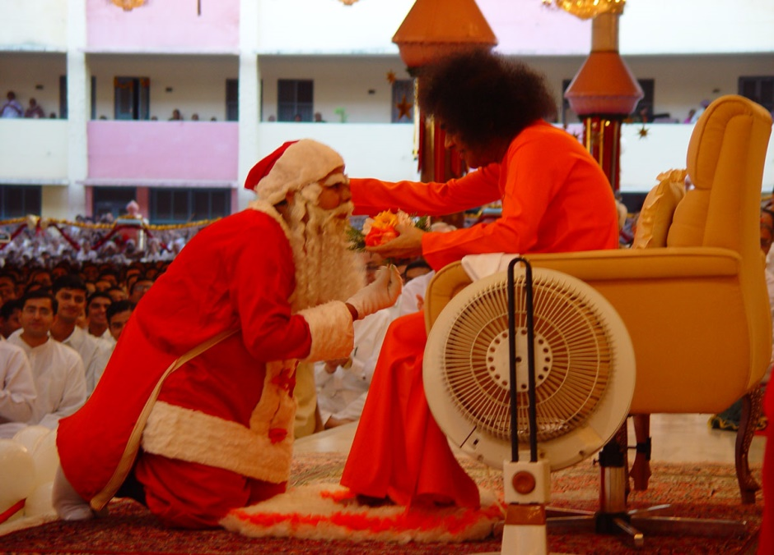
Christmas in Prashanthi Nilayam
“Christmas is celebrated in innumerable places all over the world. Nowhere in the world is it done in the way it is celebrated here in Prashanthi Nilayam. People elsewhere may attend some church service and revel in drinking and dining parties. But, here, people from many countries in the world, speaking many languages, following different faiths and cultures, assemble together unitedly, start the day with singing God's name and glory regardless of their differences, join in spending the day in carrying the message of Universal love. This is Unity in diversity and true Adwaitha in action. Every minute we are experiencing this”.
- 25th December 1992

Slide 20
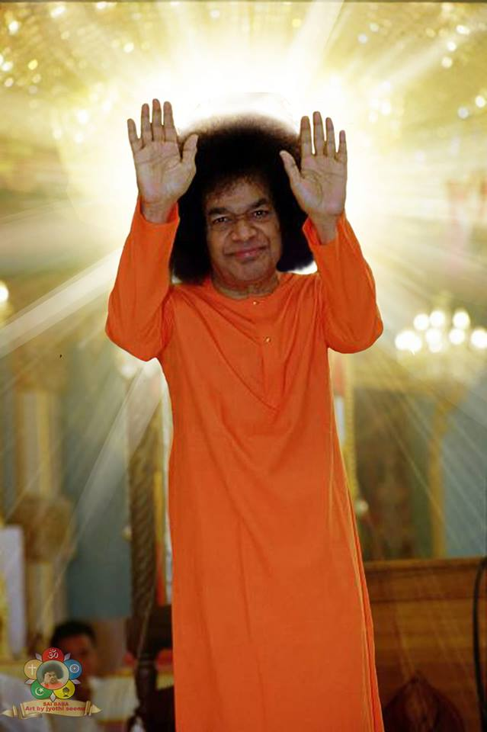
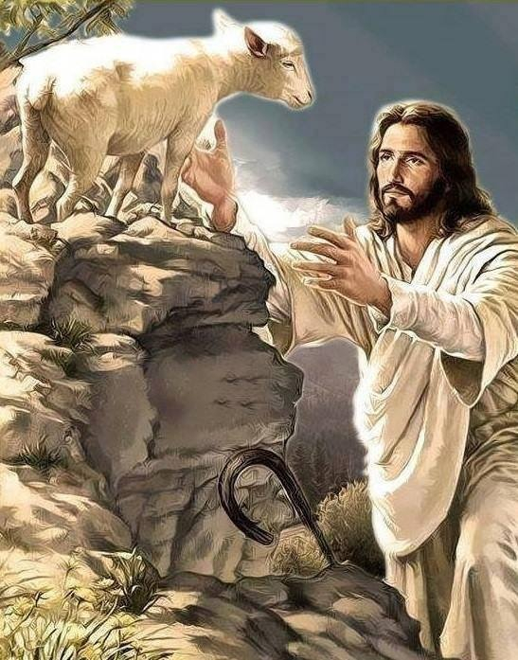
Christ's Announcement Of The Advent Of Baba
“At the moment when Jesus was merging in the Supreme Principle of Divinity, he communicated some news to his followers,. The statement of Christ is simple:
“He who sent me among you will come again!" and he pointed to a Lamb. The Lamb is merely a symbol, a sign. It stands for the Voice - Ba-Ba; the announcement was the Advent of Baba. "His Name will be Truth," Christ declared. Sathya means Truth. "He will wear a robe of red, a blood red robe. "He will be short, with a crown of hair. The Lamb is the sign and symbol of Love." Christ did not declare that he will come again. He said, "He who made me will come again." That Ba-ba is this Baba and Sai, the short, curly-hair-crowned red-robed Baba, is come. He is not only in this Form, but, he is in every one of you, as the dweller in the Heart.”
-24th December 1972

Slide 21
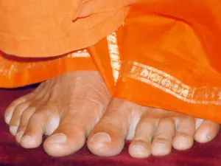
Thank you
&
JAI SAI RAM

