Slide 1
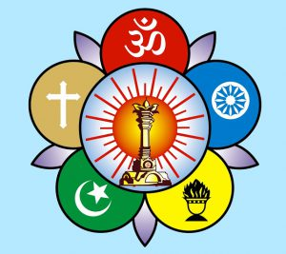
Om Sri Sai Ram
Sri Sathya Sai Seva Organisation
Karnataka South
(Spiritual Wing)
This presentation is an effort to bring out the essence
Of Bhagawan's message on the significance of
Gurupoornima.

Slide 2
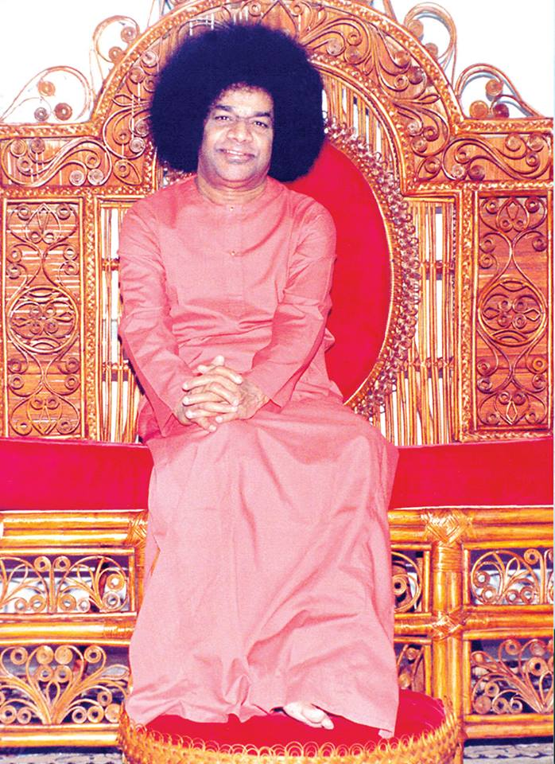
Om Sri Sai Ram
Message of
Gurupoornima

Slide 3
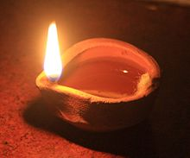
Inner Meaning of ‘Guru’
“The word “Gu” means darkness or ignorance and “Ru” stands for the removal thereof. This means that the darkness of ignorance can be dispelled by the light of wisdom. Such is the function of a guru. “Gu” also stands for one who is beyond all attributes and “Ru” is Rupa varjita or one who has no form. One who has neither attributes nor a form is only God.”
-20th June 1973- Summer Course

Slide 4
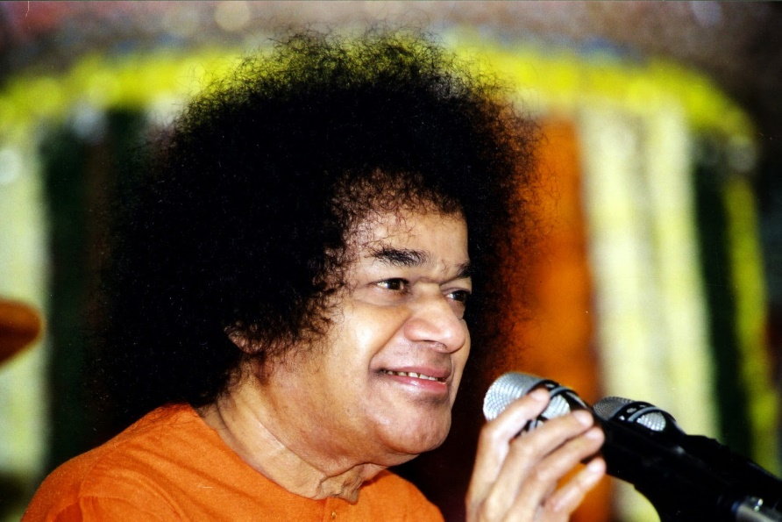
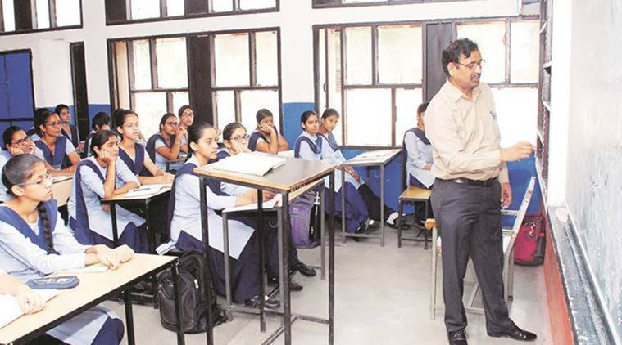
Guru vs. Teacher
“There is a lot of difference between a Teacher and a Guru.
A Teacher transmits what he has learnt in return for a reward, whereas a Guru, through his grace, enters your heart, broadens it and enables you to comprehend the aspects of divinity. Such a being, in the form of a guru, appears at an appropriate time”
-20th June 1973- summer course

Slide 5
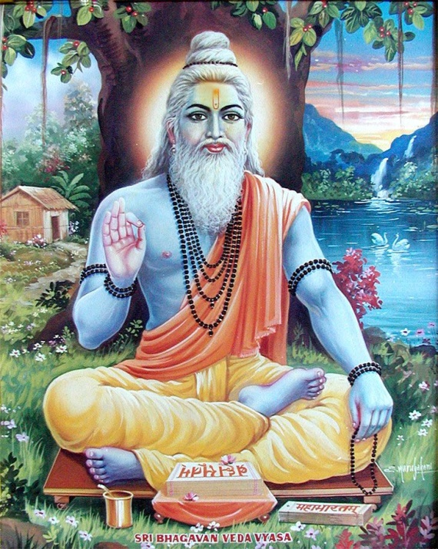
God the only Guru
“Vyasa was the great teacher who gave many profound and sacred truths to man-kind. Hence his birthday is celebrated as Gurupoornima. Guru is one who dispels the darkness of ignorance. Those who teach mundane subjects can only be called teachers or scholars, but they cannot be called gurus. Even those who profess to impart Upadesa cannot be regarded as gurus. God is the Supreme Guru - the Guru of gurus”
-18th July 1989

Slide 6
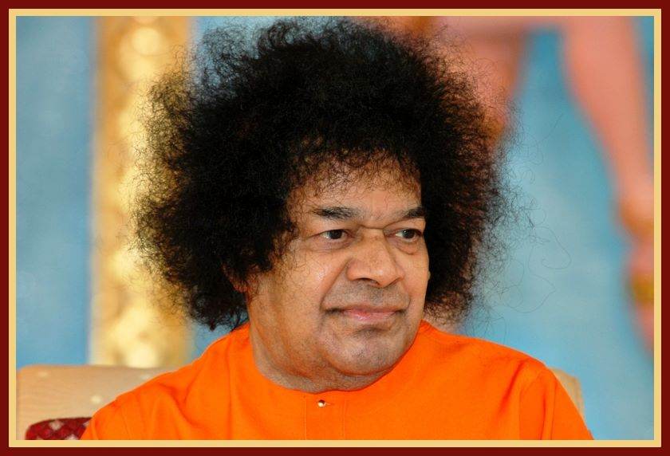
Vyasa Poornima
“The real name of this festival is Vyasa Poornima, because it is the birthday of Sage Vyasa. It is on this day that he classified the Vedas into four parts and gave them the names: Rig Veda, Yajur Veda, Sama Veda, and Atharvana Veda. He is also the composer of eighteen Puranas. However, the name Vyasa Purnima was changed into Guru Poornima with the passage of time.”
-30th July 1996

Slide 7
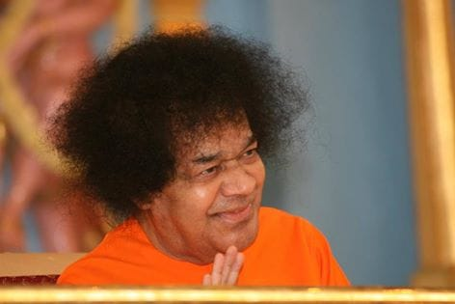
Guru Bramha…
“You repeat the sloka:
Guru Brahma Gurur Vishnuh, Gurur Dhevo Maheswarah
Gurussakshath Para brahma Thasmai Shri Gurave namah
which is usually interpreted as indicating that the Guru is Brahma, Vishnu and Maheswarah and that he is the visible Para brahma.
But, it is capable of a nobler interpretation: "Brahma is the Guru, Vishnu is the Guru, Maheswarah is the Guru, really Para brahma is the Guru”
-18th July 1970

Slide 8
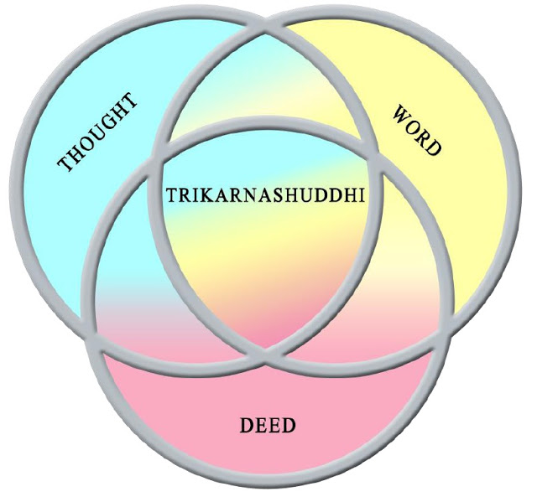
Thrikarana Suddhi
“On this Gurupoornima day, try to transform your heart making it pure and sacred. Pavitram is the true characteristic of a human being. This purity should be manifested in everything one does: in his Thoughts, in what he Sees or says and in all that he Does.
It is only when you display such purity that you can become embodiments of the Divine Atma. Then the distinction between the Divine and the mundane disappears. Everything becomes Divinised.”
-13 July 1984

Slide 9
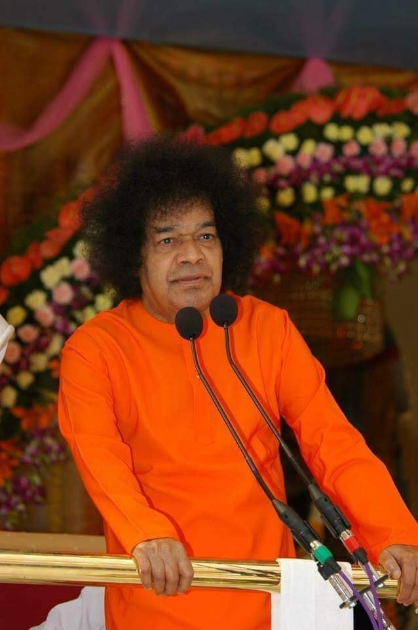
Types of Gurus
There are 8 types of Gurus in this World…Of these eight Gurus, the Karana Guru is the foremost. Through various teachings and practices, he helps the individual to progress from the human to the Divine consciousness. Only the Divine can act as such a teacher..
- 21st July 1986

Slide 10
The five letter Mantra…
“ GOD IS” – “ DEVUDUUNADU”
“On this Guru Poornima day I do not intend to give you any Ashtakshari or Panchakshari mantra based on any particular deity's name.
Nor am I enjoining you to study any Upanishad, or the Gita or the Brahma Sutras.
There is a simple five-letter pronouncement. "God is" ("Devudunnadu," in Telugu). Make this your sheet-anchor.
If you go on reciting it, thinking over it, acting up to it and conveying it to others, immersing yourself in the bliss of this experience, you will be making the greatest contribution to the welfare of the world. (Swami recited a poem on the glories of God's creation to prove "Devudunnadu").
Consider this mantra as the message for this Guru Poornima”
-21st July 1986

Slide 11
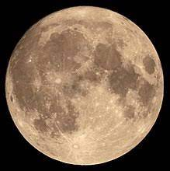
Poornima
“Today, it is Poornima . What does Poornima signify?
It means the completion of the full circle by returning to the starting point. One half of the circle is represented by worldly life. It is like the letter "C". This is equated with science, which is incomplete knowledge. The full circle represented by the moon represents the
state of the mind when it is filled with Love.”
-22nd July 1994

Slide 12
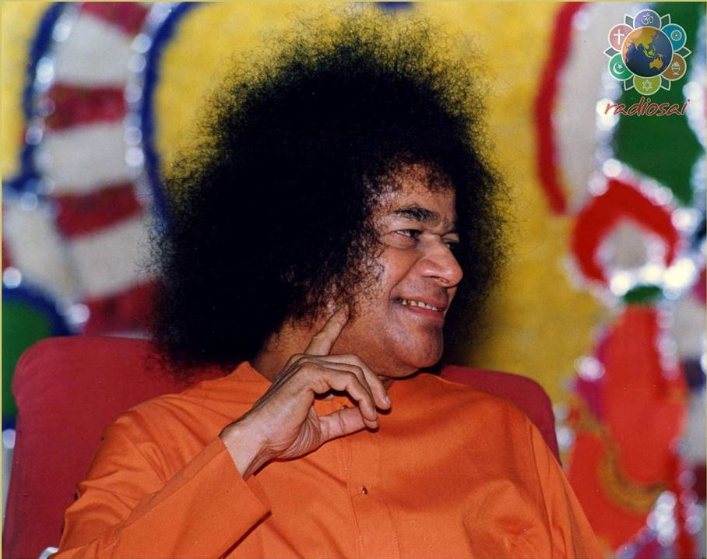
Sixteen Aspects of Mind
“Today is Gurupoornima. Poornima refers to the full moon with all his 16 aspects being illumined by the sun. In man there are 16 black spots: the 6 enemies (Lust, Anger, Greed, Infatuation, Pride and Envy),The 2 Gunas, Rajas and Tamas, and the 8 of Madha (Ego) Based on lineage and scholarship, Wealth, Youth, Beauty, Position and Penance. It is only when man gets rid of these 16 evil traits that he will be able to realise his oneness with the his poornatva (Divine). Who is the one who enables man to achieve this state of Poornatva (fullness)? It is the Guru…”
-7th July 1990

Slide 13
Mind and the Moon
“The Moon and the Mind are inter-related, as object and image. On this Day, the Moon is full, fair and cool, its light is fresh, pleasant and peaceful. So the Light of the Mind too has to be pleasing and pure. That is to say, in the firmament of the Heart, the Moon is the Mind. There are clouds there, thick and heavy - the sensual desires and worldly activities, which mar your joy at the Light of the Moon. Therefore, let the strong breeze of Love scatter the clouds and confer on you the cool glory of moon light. When devotion shines full, the sky in the heart becomes a bowl of beauty and life is transformed into a charming avenue of Anandha”.
-29th July 1969

Slide 14
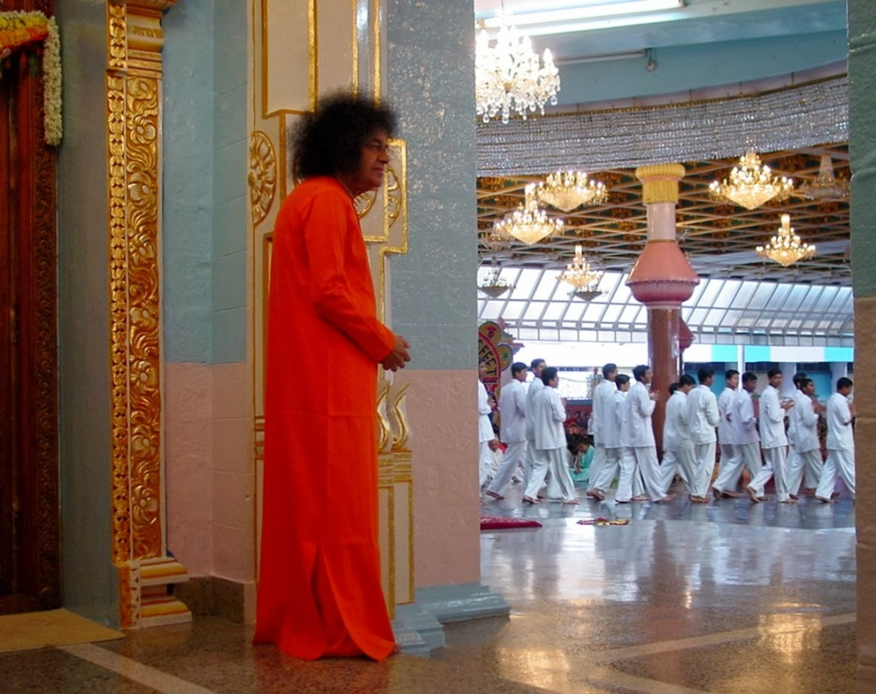
True Guru Dakshina
To offer fruits, dakshina and other things to a teacher on Gurupoornima day is not the right way of worshipping the guru. Those who accept such gifts are worldly preceptors. Real gurus are to be worshipped by Pradakshina, by revering them with heart and soul. The only true guru is God. He manifests Himself in Nature, which serves as the Cosmic teacher. Nature is the best teacher. Recognise the Divinity that is manifested in the cosmos

Slide 15
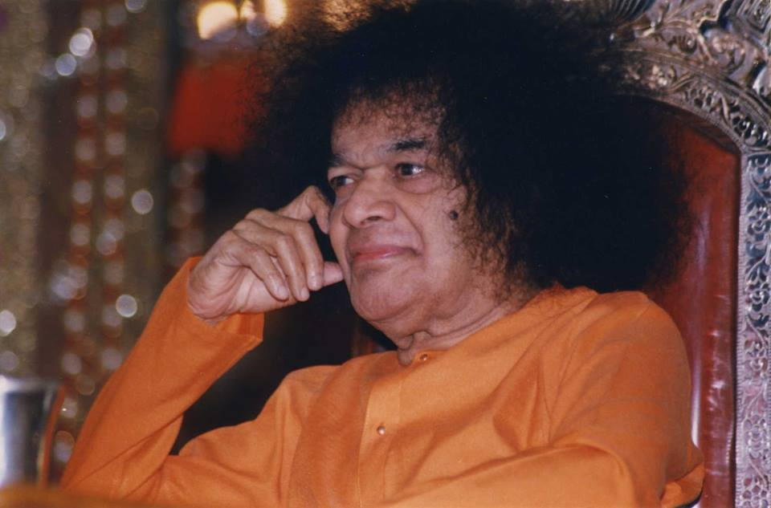
Qualities of a True Guru
“The true Guru is one, who has no ego or selfishness, and who can raise the shishya to his own level.. The signs of a true Guru are large heartedness, absolute selflessness, purity in living, freedom from acquisitiveness, absence of envy, and equal mindedness in his conduct towards everyone. Freedom from envy is an essential quality in a Guru or shishya, because envy is the root cause of many evils”.
-13th July 1984

Slide 16
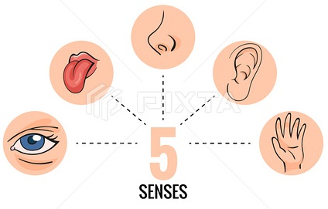
Training the Senses
“The Guru's role is to lead the shishya on the Godward path. He must teach the shishya the true purpose for which each of his sense organs is to be used - his eyes, his tongue, and his limbs. All the senses are to be used for discovering and experiencing the Divine. This was what Thyagaraja and Pothana commended in their songs. Every action in daily life should be turned into an act of devotion to God”
-13th July 1984

Slide 17
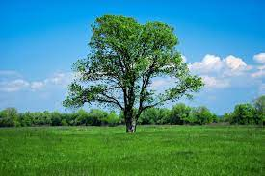
Nature is Guru
“Prakriti is the true preceptor . The trees provide cool shade and sweet fruit equally to all, whether they have fostered them or harmed them. They teach man this lesson of equal mindedness. The mountains, by bearing heat and cold, wind and rain alike, teach man not to care too much for the body. The birds take no thought for the morrow and are content to live on what they can get. They teach man the lesson of contentment and indifference to the future. Nature thus teaches man in many ways to give up ideas of "I" and "mine" and look upon God as the supreme preceptor”
-18th July 1989

Slide 18
Message of Gurupoornima
Lets understand the above messages and Practice the inner significance of celebrating Gurupoornima
Thank you
& Jai Sai Ram

