Slide 1
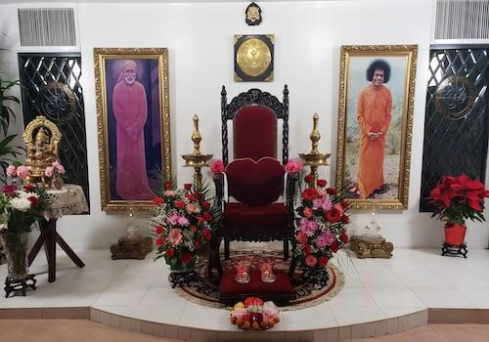
Om Sri Sai Ram
4.Attendance of at least once a month at Bhajan / Nagarsankirtan Programme conducted by the Organisation

Slide 2
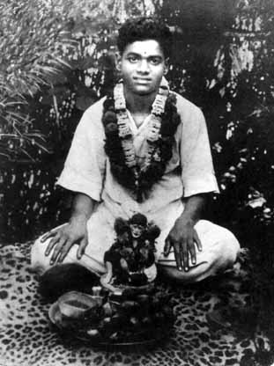
Fundamental Obligation
This point is one of the basic and fundamental obligation for the devotees and members of the organisation.
Bhajan was the activity with which our Bhagawan started HIS Avataric Mission….
“ Manasa Bhajore Gurucharanam…”

Slide 3
Basic Activity
Bhajan is the basic activity in any Bhajan Mandali or Samithi.
We assemble in a Samithi fundamentally only to participate in the Bhajan.
Bhajan and Nagarsankirtan is a part of the Namasmarana movement which our Lord has prescribed for us

Slide 4
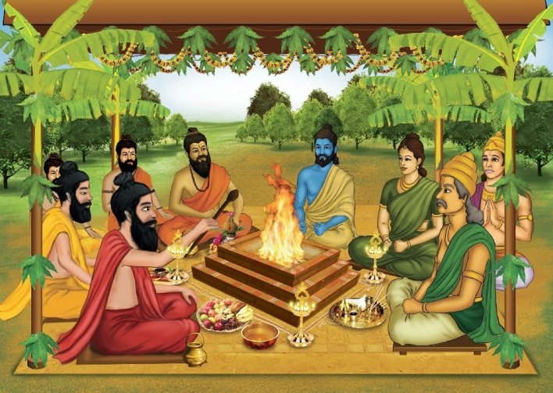
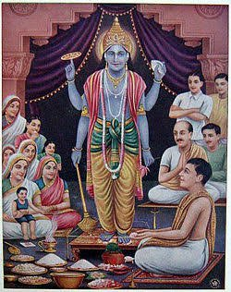
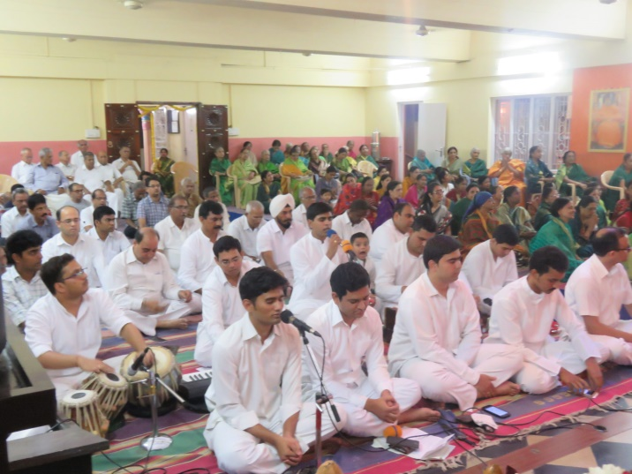
Namasmarana the only path…
Swami has said that It was
Dhyana in Krutha Yuga
Yagna in Tretha Yuga
Archana in Dwapara Yuga &
Namasmarana in Kali Yuga is the best means for our Liberation…

Slide 5
Attendance is Pre-requisite
Therefore attendance in Bhajan sessions is a mandatory for every devotee or a member or an office bearer.
Though its mentioned in the point as “at least once a month” this should not be taken as a thumb rule to follow but attend every week in our own interest.

Slide 6
Responsibility of Office bearers
It will be the responsibility of the conveners,
co-ordinators and office bearers to first lead by action by attending all the Bhajan sessions of the unit and then motivate every devotee and members to attend in their respective units.

Slide 7
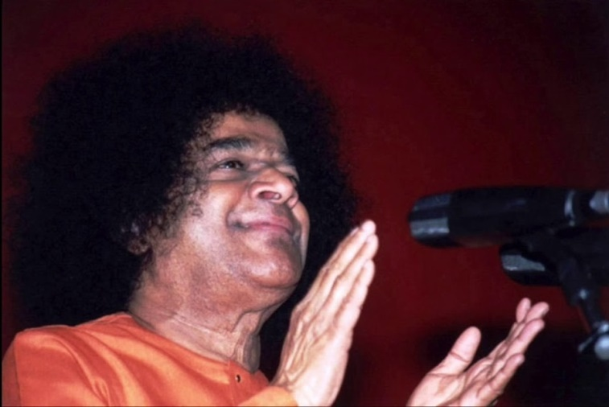
Regularity of Sadhana
We have found that we need to have regular sadhana for our chitta suddhi or cleansing of Mind.
Just as we clean our bodies and clothes by bath and wash, regularly to purify exteriors, we need more regular cleaning methodology for our polluted mind and heart.
Bhajan is the cleaning agent for our mind.

Slide 8
Unique Activity
Its only in our Sri Sathya Sai Seva Organisations that we have taken Bhajan as the major, fundamental and primary activity…Therefore its imperative that we draw energy and vibrations from Bhajans needed for other Seva activities.

Slide 9
What happens if we attend Bhajans ?
There are twin effects of participating regularly in Bhajans.
First internally, our Chitta gets purified, we develop Chitta Ekagratha
Secondly, Bhajans not only generate positive vibrations but also purify the atmosphere…This purification activity needs to be REGULAR hence the need for attending Bhajans conducted by the Samithi.

Slide 10
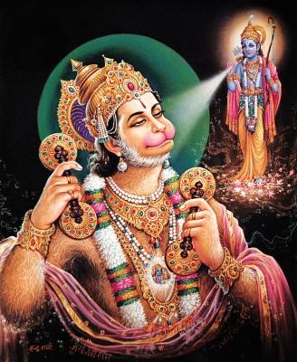
Unity of Thought Word & Deed
Thought- Divine Form- Bhava
Word- Divine Song-Raga
Deed- Clap- Tala
Unity & Purity…

Slide 11
Power of Namasmarana
SAIRAM
Uttering falsehood
Talking ill of others
Indulging in scandal
Excessive talk.

Slide 12
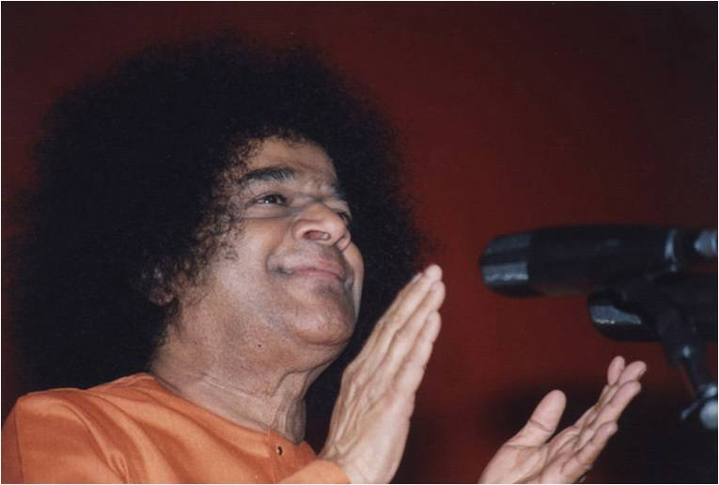
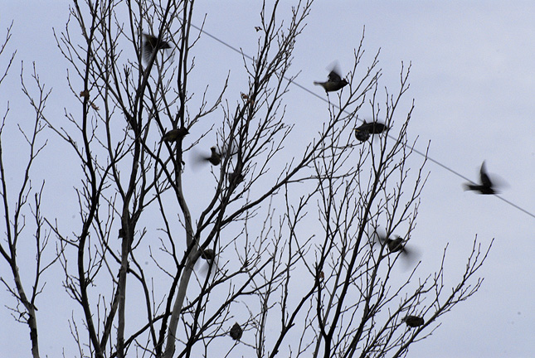
Clap and Sing…

Slide 13
Regular Bhajans
Its with the above benefits in view that Bhagawan had blessed this activity for all members, devotees and office bearers of the organisation.

Slide 14
Thank you
&
Jai Sai Ram

