Slide 1
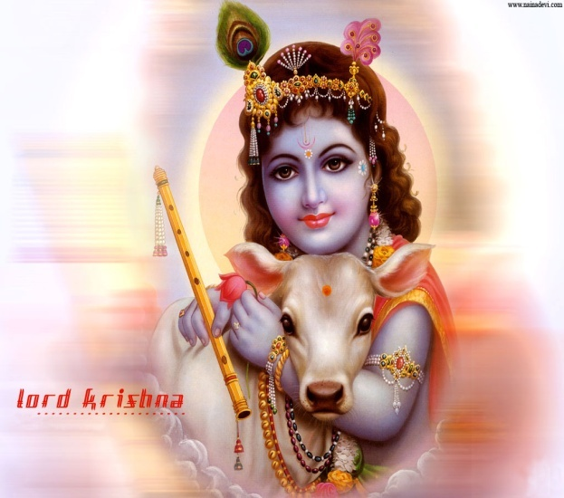
BHAGAVATHA SAPTHAHA

Slide 2
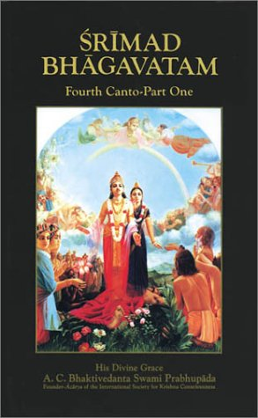
What is Bhagavatham?
Is it just a Story Book?

Slide 3
Fantasy Vs Reality
Bhagavatham is all about
of Glory of GOD and
Greatness of Devotion

Slide 4
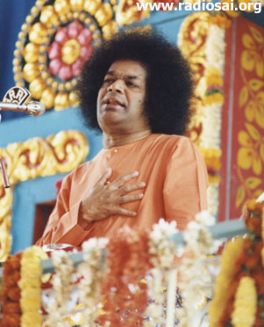
Bhagavatha
Who is a Bhagavatha?
The one whose
Thought Word
Deed are the Same…
“ Thrikarana Suddhi”

Slide 5
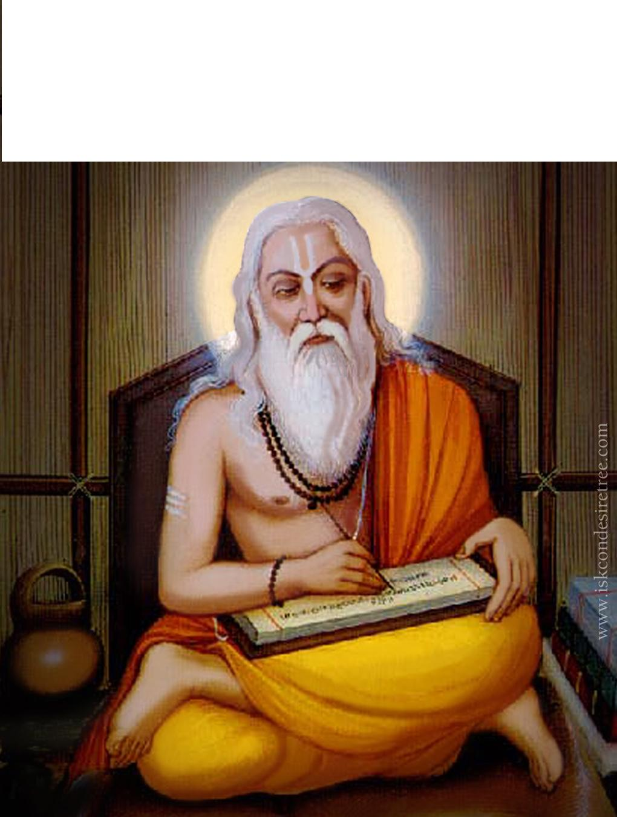
Bhagavatham
SAGE VYASA

Slide 6
Narada Advises to Sage Vyasa
Bhagavatham….

Slide 7
BHAGAVATHA VAHINI Is Written by Avatar Himself !

Slide 8
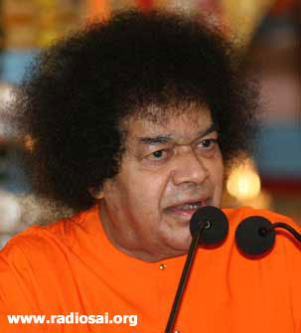
Bhagavatham
Can be compared
to a building with
12 floors. Each Floor
is called a “Skandas”
The Foundation Is
“ Vasudeva Upasana”

Slide 9
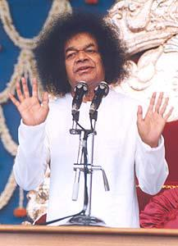
BHAGAVATHAMU
“BHAGAITHAMU”
“Studying Bhagavatham does good to us…..
POTHANA

Slide 10
BHAGAVATHAMU Travel from Devotion to Detachment
MU
MUKTHI
THA
THATHWAM
VA
VAIRAGYAM
GA
JNANAM
BHA
BHAKTHI

Slide 11
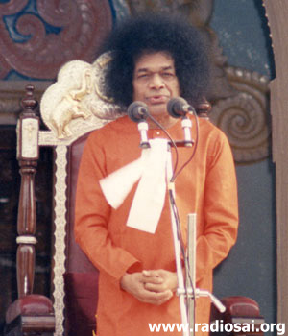
Bhagavatham
Primary need for liberation is
Bhakthi gives shakthi
Shakthi leads to Rakthi,
Rakthi leads to Virakthi.
Virakthi is the gateway for Mukthi

Slide 12
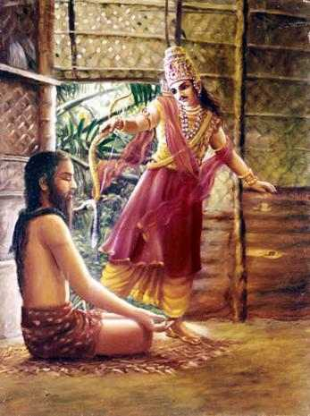
Effect of Parikshit’s Action
If a citizen commits a mistake it confines to him
But if a King commits a mistake?

Slide 13
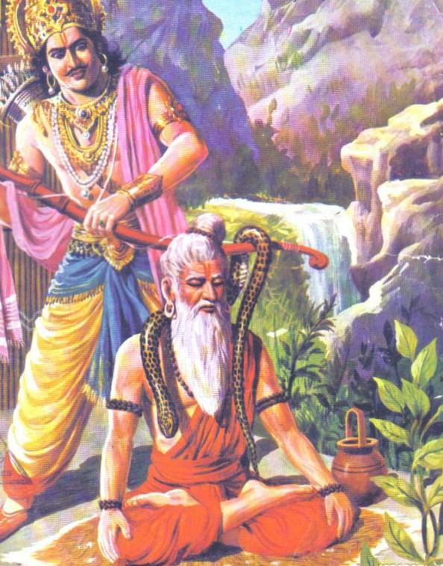
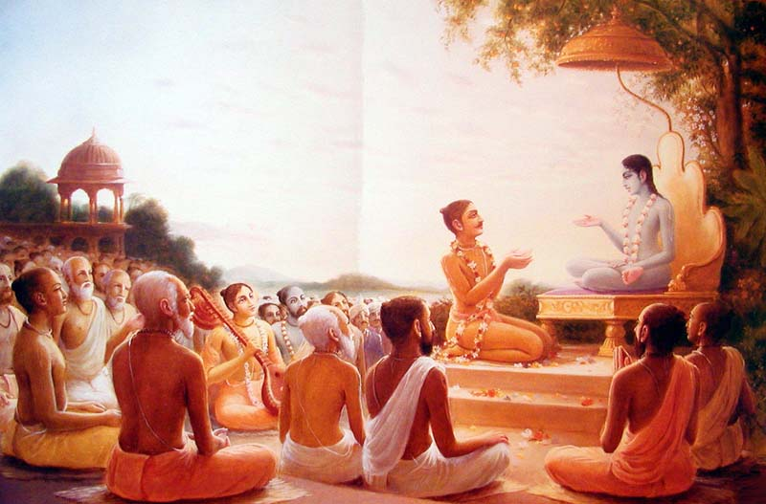
Blessing in Disguise
Because of the “Mistake” we got Bhagavatham!

Slide 14
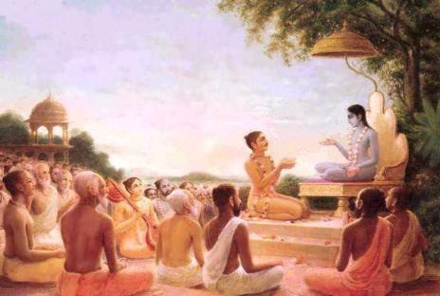
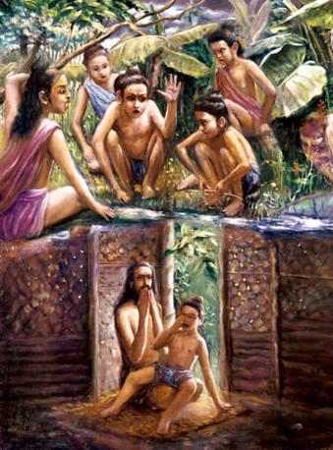
Parikshit’s Reaction to the Curse

Slide 15
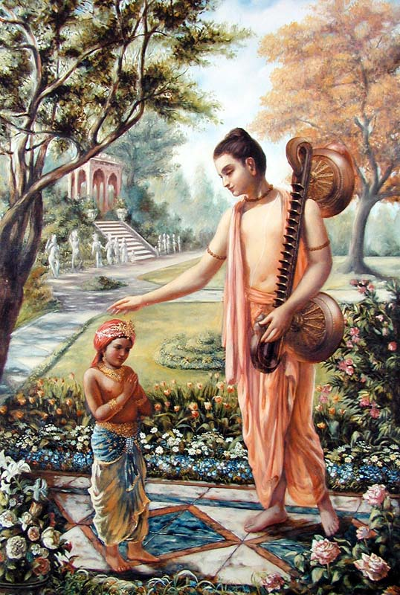
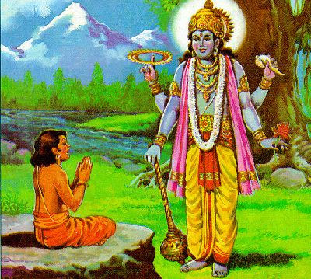
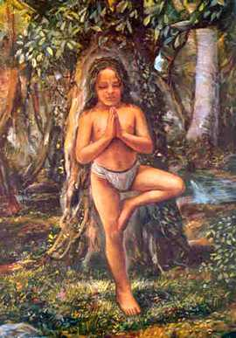
Dhruva- Strong Determination
“Om Namo Bhagavathe Vasudevaya..”

Slide 16
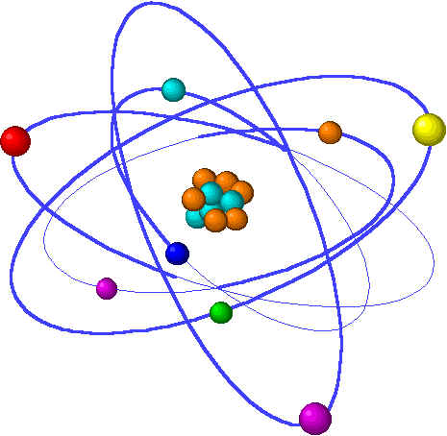
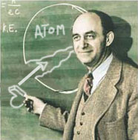
Prahlada- Faith
Faith in the Omnipresence of GOD!
Today’s scientists,
after many experiments,
Proclaim that the atom
is the basic element
in creation. The atom is the
basis for the cosmos.
It is present everywhere in the Universe.

Slide 17
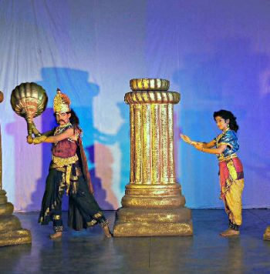
But Prahlada discovered this principle long before them. He said that God is present everywhere as scientists talk about the atom
Atom= Bramha

Slide 18
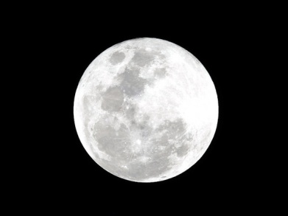
Hiranyakashapu- Great Scientist
“He had explored Nature, and the solar system. He once noticed that the Earth’s axis was tilted at 23.5 degrees. With his yogic powers, he changed the tilt out of curiosity. He returned it to
normal when large-scale destruction resulted.”

Slide 19
Spiritual Significance
B
O
D
Y

Slide 20
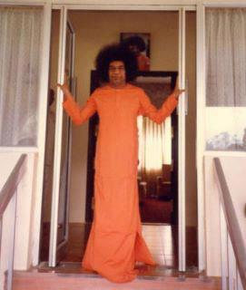
The Lord Emerges!!

Slide 21
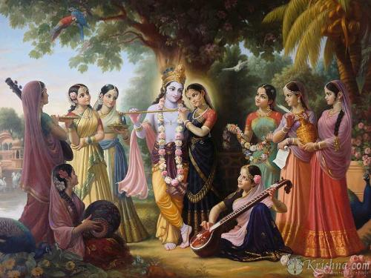
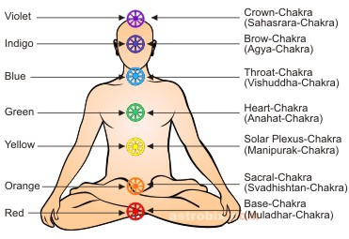
Inner Significance of Krishna Leela Eight Consorts of Krishna
There are 8 petals in the Hrudaya Chakra which represents 8 consorts of Lord Krishna

Slide 22
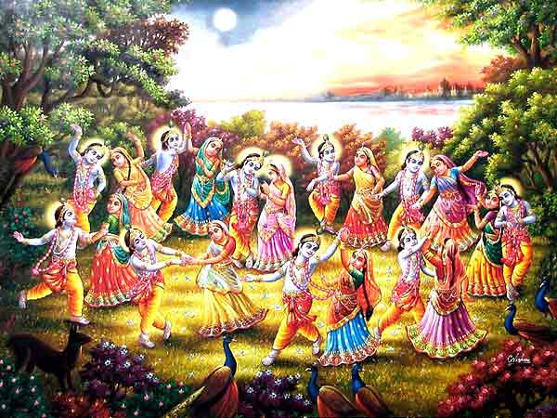
Krishna leelas
Krishna’s sport with16000 Gopikas:

Slide 23
Inner Significance
The sahasrara chakra
has a thousand
petals. Each petal
carries sixteen
phases (kalas).
Thus the sahasrara
chakra is said
to represent
16,000 cowherd
maidens (Gopikas),

Slide 24
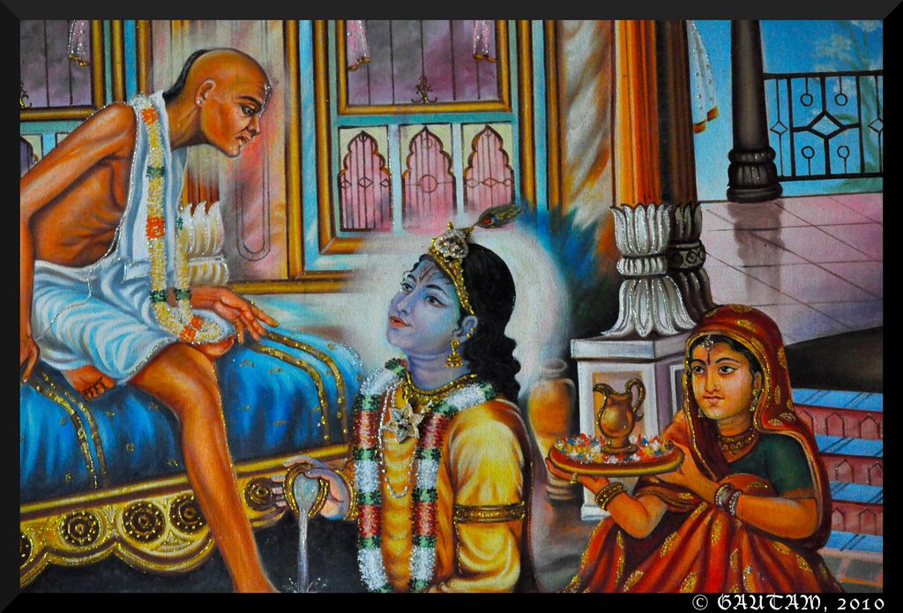
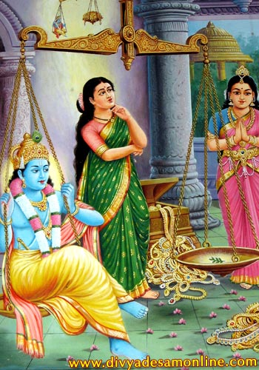
What We give to the Lord Returns Manifold!!
What did Kuchela Offer? With What did Rukmini
Weigh?

Slide 25
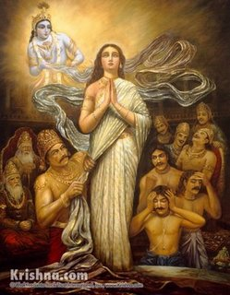
Draupadi’s Devotion What she gave & What She Got…

Slide 26
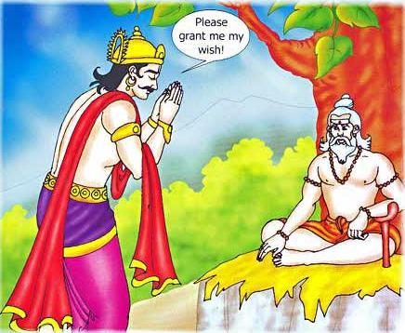
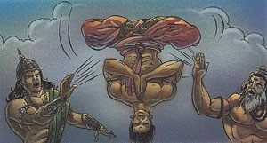
Trishanku Episode
What is the message of Trishanku Episode?
One should not go against the Laws of Nature…

Slide 27
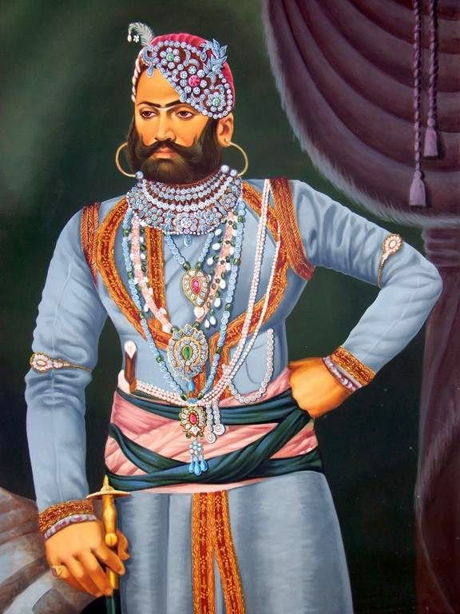
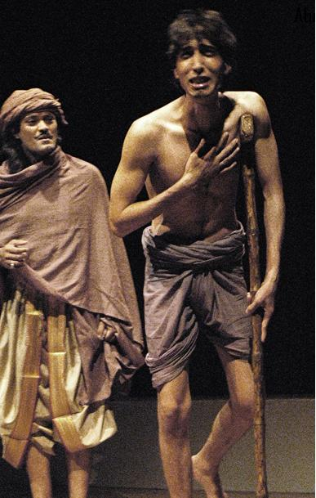
Trishanku’s Son Harishchandra
Harishchandra Failed to keep up the Promise to Varuna…was afflicted with Chronic Disease…

Slide 28
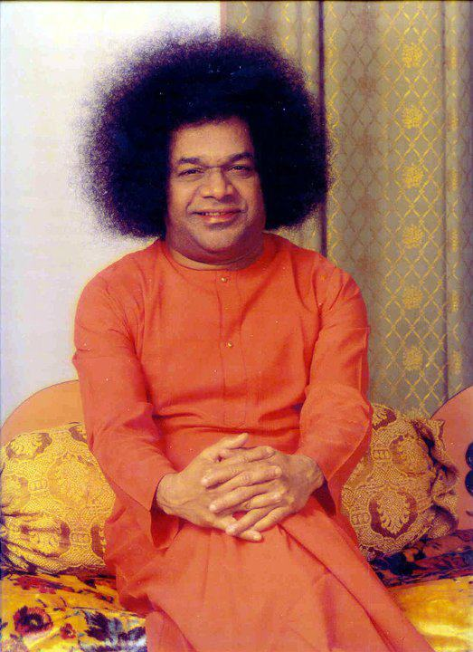
BHAGAVATHAM IS ABOUT 3 ASPECTS
BHAKTHA- BHAGAWAN-BHAGAVATHAM
Bhagavatham binds Bhaktha with Bhagawan

Slide 29
BHAGAVATHA SAPTAHA
JAI SAI RAM

