Slide 1
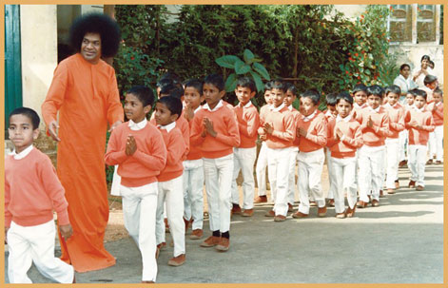
Om Sri Sai Ram
Participation in the Balvikas Programmes by the Children of the family conducted by the Organisation

Slide 2
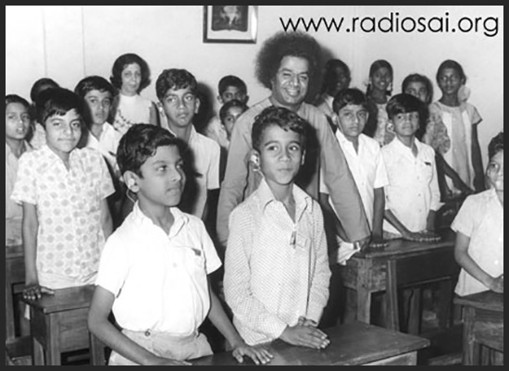
Bal Vikas Movement
Bhagawan initiated the Bal Vikas movement in 1972 with an aim of Blossoming of Human Excellence in Children and to infuse Divine feelings and Values in the young minds of the children. This is why He says :
Start Early, Drive Slowly and Reach Safely

Slide 3
Today’s Society
Most problems of today’s society can be traced back to acceptance given to academic progress without due importance on cultivation of human values.
Sri Sathya Sai Bal Vikas Program seeks to counter the effect of such unfortunate trends on the young adults of the world

Slide 4
Need for Character Building
Children are in the impressionable age.
Whatever they see, hear and experience gets recorded in their young subconscious mind which blossoms when they grow up.
Therefore its imperative that we teach character building at the young age itself.

Slide 5
Leaders of Tomorrow
Children of today are the Leaders of tomorrow.
Their character, Behaviour, Personality, are moulded in the Bal Vikas classes of today…
Therefore these children need to receive highest form of moral education…

Slide 6
Role of Parents in Bal Vikas
Absolute commitment to this structured 9 year program
Ensuring regular and punctual participation of their children in every weekend class
Total faith in the value oriented Bal Vikas Program
Enforcing / Reiterating the same values at home
Understanding the nobility of this totally free of cost Seva
Feedback at regular intervals
Participating in the Parent contact program to discuss the progress.
Participating in the Parenting program to facilitate improvement in relationships within families

Slide 7
Parents’ Duty
Therefore it’s the duty of the parents to ensure that their children are enrolled to Sathya Sai Balvikas
This is one of the essential duties prescribed by Bhagawan in the 9 point of code of conduct.

Slide 8
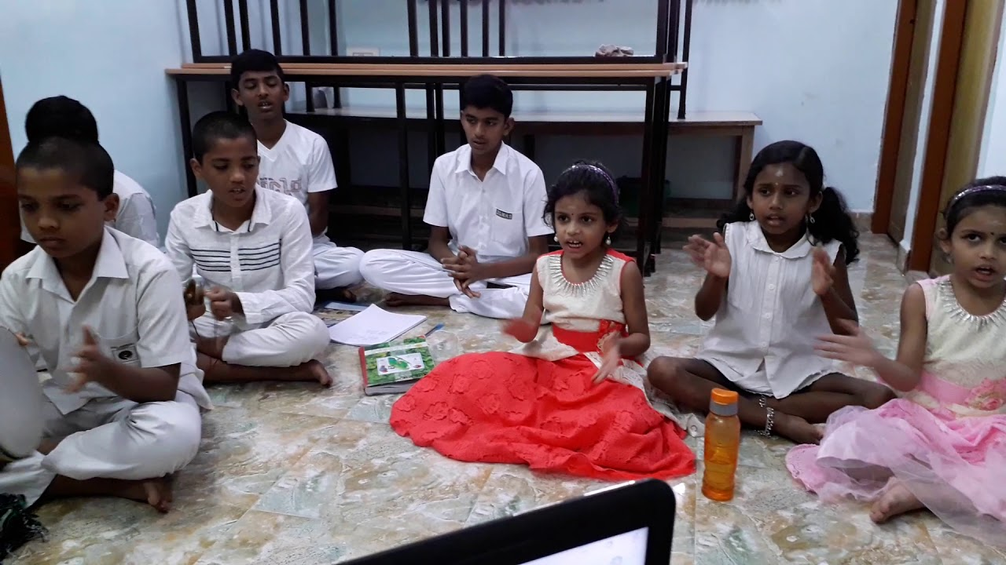
Parents duty
One question may arise. What if there are no children at home….or the children have grown up already?
Encourage other’s children to join Balvikas.
This is our sacred duty.

Slide 9
Today’s Parents…
Unfortunately today’s parents are only focussing on the aspects of living for their children..
Like classes on Karate, Swimming, Dancing, Tuitions etc…
No doubt the above are necessary along with formal education, but along with it character development is mandatory…

Slide 10
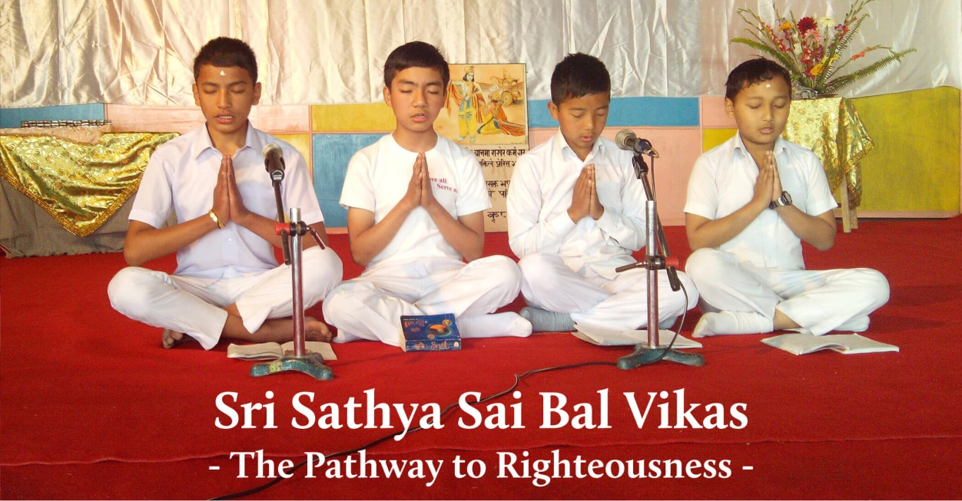
Teaching Techniques
The following five teaching techniques are taught to the Bal Vikas children:
Prayer
Group Singing
Silent Sitting
Story telling
Group Activities
This technique will mould the character of the children

Slide 11
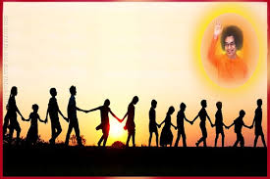
Holistic and Integrated Personality Development
Thus the Sri Sathya Sai Bal Vikas program ensures development of the children’s total integrated personality at all the five levels.
Physical
Intellectual
Emotional
Psychic and
Spiritual

Slide 12
Lets do Together…
Together, let us help our children gain self-confidence to face all challenges in life
Together, let us help our children to listen to the voice of God within and tread in the right path always
Together, let us help our children grow into dynamic, confident, expressive, creative and happy individuals
Together, let us help our children serve family, society and the country.
Together, let us make our children the ideal citizens of Bharat

Slide 13
Thank you
& JAI SAI RAM

