Slide 2
Chapter One : What is Dharma ?
Dharma : Peace
What happens when Dharma Fails ?
Why an Avatar will descend on this Planet ?
Vedas,Sastras, Puranas, Itihasas
Dharma- Karma- Janma-Brahma
“Dharayati Iti Dharma :” That which holds is Dharma
D-Devotion to Duty, H- Heart Harmony, A- Awareness, R- Respect to others, M- Morality, A- Atmic realization
Examples of Buddha and Sankara : They both adhered to Dharma
Ultimate aim of Dharma : Unison with Brahman
Symbolic meanings : Animal Sacrifices in Yajnas, The word “Pasupathi”, Nandiswara, etc

Slide 4
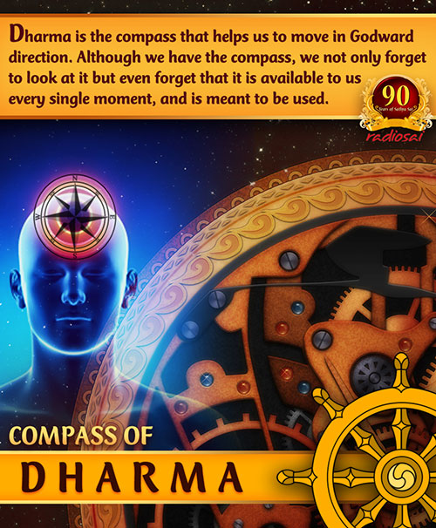

Slide 5
Chapter Two : Divine Versus Worldly Dharma
Atma Dharma : Dharma expresses in various form. Hold on to Atma Dharma
What is Atma Dharma ? : build your living on the Atmic base; then, your progress is assured.
See Stone as GOD : ? The unlimited, the ever-present, the all-pervading-immanent entity, the Absolute, is visualized in the particular, in the concrete. Similarly, dharma that is universal, equal, and free can be spotted and tested in a single concrete act !
Follow DHARMA and Be Free
How can dharma, which sets limits on thoughts and words and regulates and controls, make a person free?
Egotism based on Body is Hell : If a person, finding life with the son miserable, goes to the daughter and lives in her house, that is not winning freedom! That is only a way of feeding the ego.
Destruction of Ego is the way to Freedom
The feeling “that is a friend” or “this is an enemy” is an error. This delusion has to be given up. The Lord, the embodiment of love, is the only constant friend, relative, companion, guide, and protector. Know this and live in that knowledge !

Slide 10
Chapter Three : THE BASIC Flaw
Hoping to improve matters in a dark room by a mere readjustment of furniture. However, if a lamp is lit, passage across the room is rendered easier even without readjusting furniture. There is no need to interfere with the furniture at all. Light the lamp! Let it reveal the reality; get the light of spiritual wisdom (jnana). That will solve all the difficulties
Dharma and Gita : Mama - Dharma
Atma has NO FORM : Example : Take a palanquin. Before being transformed into that article, it was a tree, which was changed into timber and planks and finally into a palanquin. With every change in form, the name is also changed. Sitting in a palanquin, no one would claim to be on a piece of timber or on a tree. Objects undergo change; they are not eternal. They are not real.
Dharma based on caste (varna), dharma for a householder (grihastha), dharma for a forest dweller (vanaprastha), dharma for a renunciate (sanyasa), dharma for a student (brahmacharya), this dharma, that dharma —all are modifications of the basic dharma
Truth (sathya) has to be shaped into dharma for a householder, dharma for the forest dweller, dharma based on caste, dharma for women, dharma for men, etc. The stuff is the same in all; the substance is identical, in every separate form.
Dharma is yoga, union, merger; it is truth (Sathya).

Slide 12
Chapter Four : Masculine and Feminine Natures
Purusha and Prakruti
The Maya : the feminine form. This is why woman is considered the embodiment of the highest energy (Parasakthi Swarupa).
Women, who are the repositories of the embodiment of energy (sakthi swarupa), are in no way inferior. How full of fortitude, patience, and love is their nature! Their self control is seldom equalled by men. They are the exemplars and leaders for men to tread the spiritual path. Pure selfless love is inborn in women. Women who are full of knowledge, who are cultured, who are bound by love, and who are keen on discriminating whether their words and deeds are in conformity with dharma —such women are like the goddess Lakshmi, bringing joy and good fortune to the home
Chastity : Savithri, Anasuya, Nalayani, Damayanthi
Modesty
Ideal Gruhini
Swami’s Last Discourse in 2010

Slide 15
Chapter Five : Education for Women
Vidya + Viveka
Sulabha, Savithri, Anasuya, Gargi, Nalayani, and other such models of chastity, devotees of the Lord like Meera, yoginis like Chudala, all were born in this country of God (Bharatha-desa) and strengthened dharma by their adherence to it
Home is the Primary responsibility for Women !!

Slide 17
Chapter Six : Practice Dharma
Truth has to be spoken and Dharma has to be Practised !
Chatur varnas- Brahmana, Khastriya, Vaishya, Shudras
DHARMA FOR MEN :
Brahmacharya
Faithful to Wife
Should consider Wife as Lakshmi
Man is equally BOUND by rules of Dharma

Slide 19
Chapter Seven : Gayatri – MOTHER of Mantras
Gayantam Trayate Iti Gayatri
The Gayatri has four feet and six categories. The categories are speech, objects, world, body, breath, and heart (vaak, bhutha, prithvi, sarira, prana, and hridaya).
Samdhyaa heeno suchirnithyam, anarhah sarva karmasu Yadh anyath kuruthe karmano thasya phala bhaagbhaveth.
Sandhyavandanam
Upanayanam and Thread Ceremony
Mantras

Slide 21
Chapter Eight : The Householder Stage
The chief stage, because the householder fosters the other three. The householder is the most important of all
All four stages will lead you to liberation (moksha) if you follow strictly the dharma as laid down for each and devote yourself steadfastly to your uplift
Castes like brahmin, colours like white and black, stages of life like student, etc. —these are physical conditions and not the characteristics of the Atma. They are conditioned by time and place. They belong to this world of bondage and are governed by reasons related to this world
The great sages who grasped the divine dharma (Atma-dharma) declared that being, awareness, and bliss (sat, chit, and ananda) are the basic characteristics of the Self.
Kingly sages like King Janaka, Aswapathi, and Dilipa reached the goal while continuing in the householder stage; while in that stage, they struggled and succeeded in removing all obstacles that hindered the winning of the grace of the Lord; they had as the goal the Godhead they wanted to reach
The scriptures (sastras) therefore require that a person has to be in the householder stage till the age of 48

Slide 23
Chapter Nine : All May Seek Spiritual Wisdom
along with the drug, the regulations regarding the mode of living have also to be strictly adhered to. The drug, Brahma-consciousness, has to be supplemented and strengthened by the appropriate dharma as well as by cultivation of devotion, wisdom (jnana), and discrimination (vairagya).
Women may Seek knowledge of Brahman : Gargi, Maitreyi, Sulabha, Yogini
Classification of Yugas – Kruta, Treta, Dwapara, Kali

Slide 25
Chapter Ten : The House of God
Functions of Temple : schools for the training of the spirit, academies for the promotion of scriptural studies, institutes of super-science, laboratories for the testing of the values of life
Devotion is the Queen
Arousing feelings during Worship : you must cultivate the attitude of seeing your chosen deity, Rama or Krishna, in the cradle when you swing your own child in it
Rani Rasmani – Ramakrishna Paramahamsa

Slide 26
Chapter Twelve : Temples
Believe that God walks about in the temple; it is His residence. All have a responsibility to preserve the holiness of that atmosphere, which confers the joy of serving the Lord.
Idlers gather in the precincts and play cards or dice or such other games. The evil spirit of Kali (Kali-purusha) sports in glee when such groups gather in the temples.
Gopuras : Some ultra-modern critics condemn the decorated gate of the temple (gopuras), etc. as so much waste of money. This reveals a total absence of farsightedness; no one with a high ideal or an upward vision would make such a remark. If you dwell upon the significance of the entrance gate to the temple, you can realize how holy, how mysterious, how revealing its purpose is !
Deho Devalaya Prokto Jivo Devah Sanathana

Slide 27
Chapter Eleven : The Three Eras
Vedic Era : hymns (samhithas), Brahmanas, forest texts (Aranyakas), and Upanishads.
Upanshidic era : spiritual wisdom (jnana) and are therefore called wisdom texts (Jnana-kanda).
Puranic Era
Only pure, tender, tolerant, calm and loving souls, the very cream of spiritual aspirants (sadhus), the swans (hamsas) sporting ever in the company of kindred devotees, can understand Bhakti, It’s purity and depth
BHAKTA VATSALA “I follow the devotee as the calf follows the cow, for the devotee gives up for Me all that is considered desirable by the worldly-minded”
Spiritual aspirants have to practise the spiritual discipline related to the with-qualities aspect of God; this will endow them with concentration and, later, according to the law of procedure from the gross to the subtle, they can merge their minds in the quality-less Brahman itself.

Slide 29
Chapter Thirteen : The Dharmic Person
The knowledge of dharma is reached in three stages: (1) You must receive training under wise people (vidwans), who are also imbued with dharma. (2) You must aspire to attain self-purification (Atmasuddhi) and truth (sathya). (3) You must realize the value of knowledge of the Vedas (Veda-vidya), the voice of God (Parameswara)
Purusharathas
IDEAL Nature

Slide 30
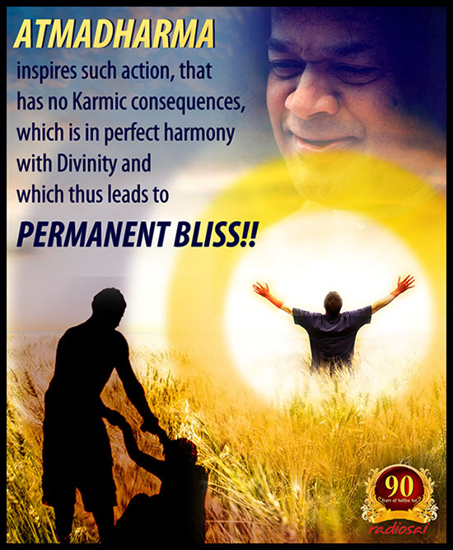

Slide 31
We can take references to Dharma Vahini also from :
References from Ramakatha Rasa Vahini
Prashnottara Vahini
Sandeha Nivarini
Swami’s Discourses during various festival ocassions.
Swami’s Avataric mission
Bhagavad Geeta
Musings on Dharma Vahini

