Slide 1
Om Sri Sai Ram
Core Message of

Slide 2
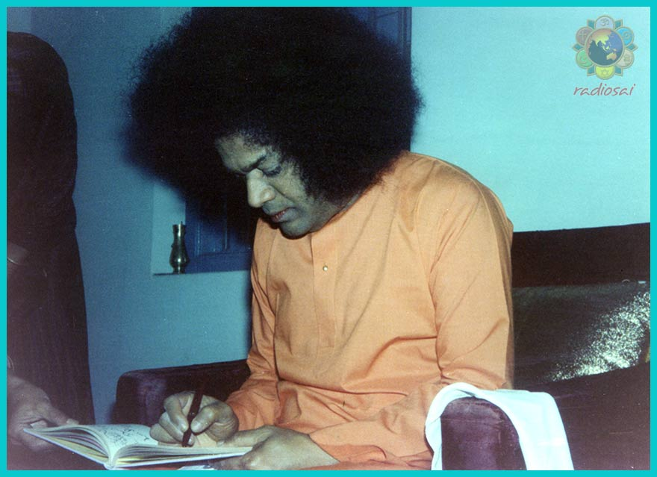
Unique aspects
Bhagawan wrote this Vahini in 1964.
This was earlier published as an Appendix to Gita Vahini but now is a exclusive Vahini.

Slide 3
Yoga Vashista and Bhagawat Gita
What is the difference between Yoga Vashista
and Bhagawat Gita?
In one God asks questions and devotee answers but in the next devotee asks and God answers….
But in Prasnothara Vahini and Sandeha Nivarini its GOD who asks and answers!
This Vahini is to clarify fundamental concepts of Spirituality so that we do our Sadhana with Complete Awareness

Slide 4
Prasnothara Vahini
There are 15 chapters in this Vahini
Three on the aspects of Yoga
Two on the aspects of four stages in Human life
Two touching the aspects of Spiritual wisdom and also the obstacles in the path
And also on Body & Senses, Scriptures, Mantras etc.

Slide 5
Prasnothara Vahini
Gives a basic information / clarification
- facts about our body
-the way we need to lead our spiritual life…
But this know-how need to be applied to get the full benefit -Which is Nidhidhyasanam……

Slide 6
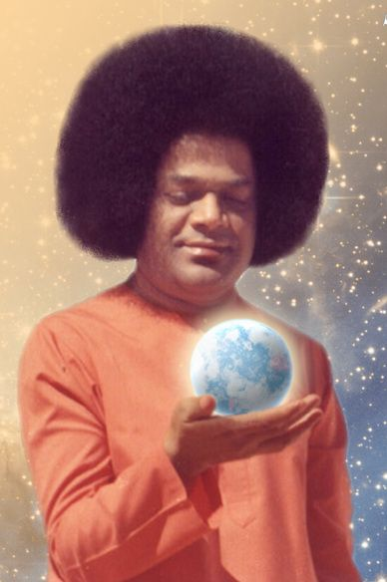
Body & Senses
Only the Creator knows
the Secret of Creation.
No one can understand fully
the Mystery of creation.
Creation keeps changing
Not the Creator.
Creation is Temporary
but the Creator is Permanent.

Slide 7
Creation
Atma / GOD/ Bramha
Five Subtle Elements- Akasa / Vayu / Agni / Jala / Prithvi
Panchekrutams with Gunas
Five Gross Elements
World / Manifested Universe

Slide 8
Akasa
Akasa is the first among the five elements.
From Akasa emerged what is known as Suddha Sathwa.
This is the basis for the human form.
Sathwa

Slide 9
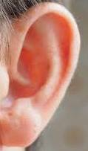
Sathwa Guna
From the Sathwik aspect of Akasa…came our Ears..
From the Sathwik aspect of Vayu came our Skin..

Slide 10
Sathwa Guna
From the Sathwik aspect of Agni came our Eyes
From the Sathwik aspect of Water came our Tongue
From the Sathwik Aspect of Earth came our Nose

Slide 11
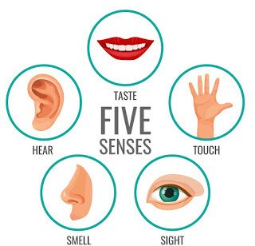
Sathwik Guna
The aspects of Sabda, Sparsha, Rupa, Rasa Gandham Should be essentially Pure Sathwik in Nature
Akasa- Sabda
Vayu- Sparsha
Agni- Rupa
Water- Rasa
Earth- Gandham

Slide 12
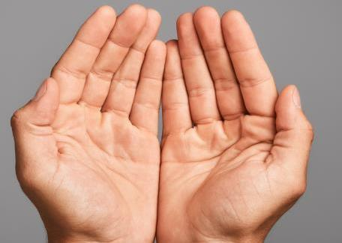
Rajo Guna
From the Rajo Guna Aspect of Akasa came the Eyes
From the Rajo Guna aspect of Vayu came the Hands
From the Rajo Guna aspect of Agni came the Legs
From the Rajo Guna aspect of water and earth is the Excretory organs

Slide 13
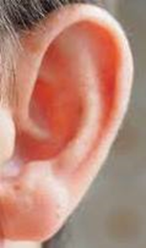
Sathwik and Rajas
Akasa
Sathwik Rajo
Ear Eye
Vayu
Sathwik Rajo
Skin Hand

Slide 14
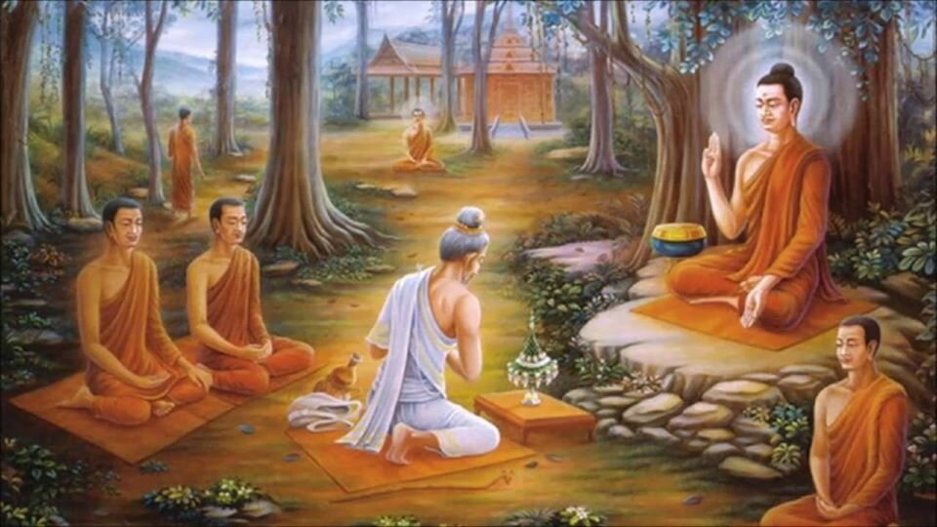
Sathwik / Rajo Guna
“In the law of creation, the Sathwik aspects have to be received and Rajasic aspects need to be rejected….But in today’s world it has become the opposite !”

Slide 15
Vedic injunctions
Om Bhadram Karnnebhih Shrnnuyaama Devaah |
Bhadram Pashyema-Akssabhir-Yajatraah |
Sthirair-Anggais-Tussttuvaamsas-Tanuubhih | Vyashema Devahitam Yad-Aayuh |
Svasti Na Indro Vrddha-Shravaah | Svasti Nah Puussaa Vishva-Vedaah |
Svasti Nas-Taakssaryo Arisstta-Nemih | Svasti No Vrhaspatir-Dadhaatu ||
Om Shaantih Shaantih Shaantih ||
Om yash chanda sam risha bo vishwaru pa ha
Chando biyo diya mritat samba bu va
Sa mendro medaya-a spri no tu
Amritasiya deva dara no bu ya sam
Shari ram me vi char shanam
Jiva me madu mata ma
Karna-a biyam buri vi shru vam
Bramana kosho asi medaya pihi ta ha
Shrutam me gopa ya

Slide 16
Eyes -A Gift of God
There are 13 Crores of
Light sensors in our eyes!

Slide 17
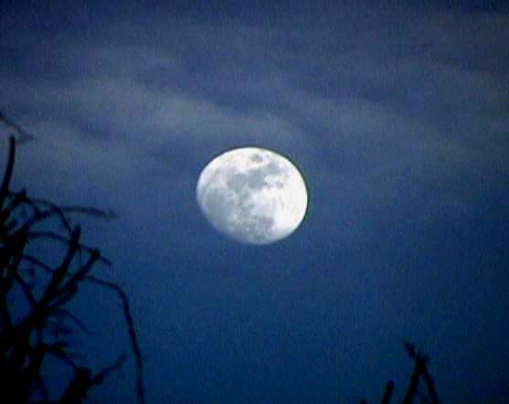
Eyes -A Gift of God
Moon
2,45,000 Miles
Sun
9,80,00,000 Miles

Slide 18
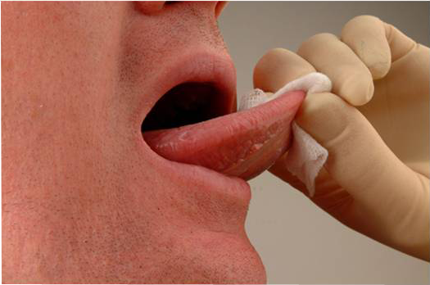
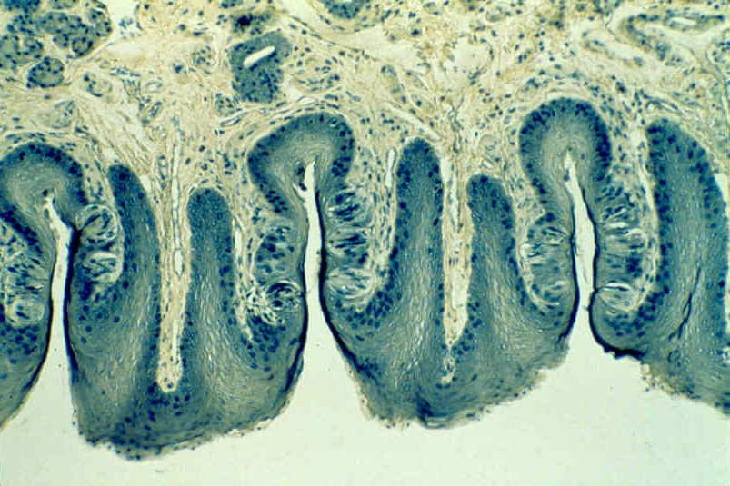
Tongue -A Gift of God
There are 50 Lakh
of Taste Buds
Present in our
Tongue!

Slide 19
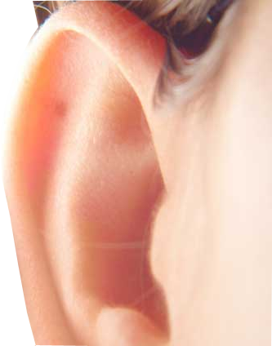
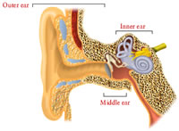
Ears-A Gift of God
There are 30 Lakhs
Of cells in our Ears!!
Which makes us
Hear a Sound

Slide 20
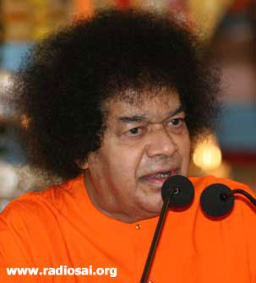
Body- A Great Teacher!
GOOD
OXYGEN
CarbonDioxide
BAD

Slide 21
Welcome Good and Give up Bad
Swami says ancient Rishis Prayed this way:
“ Agamaanam Devathah :
Gamanaam Rakshasah:
Sath Chintana
Sadha charamu
Sath Pravarthana

Slide 22
Ksheerasagara not Ksharasagara

Slide 23
YOGA
What is Yoga? Is it just a physical exercise?
No…..the purpose of Yoga is
“Union of the self with its source”
Yoga means union

Slide 24
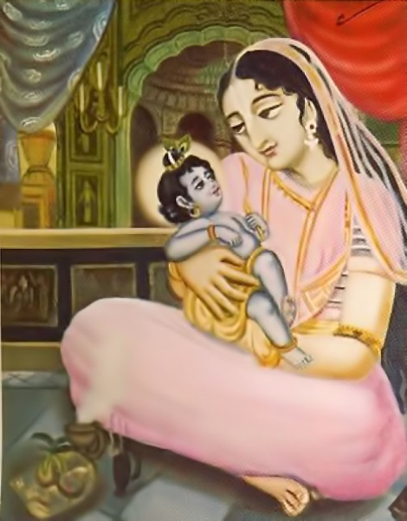
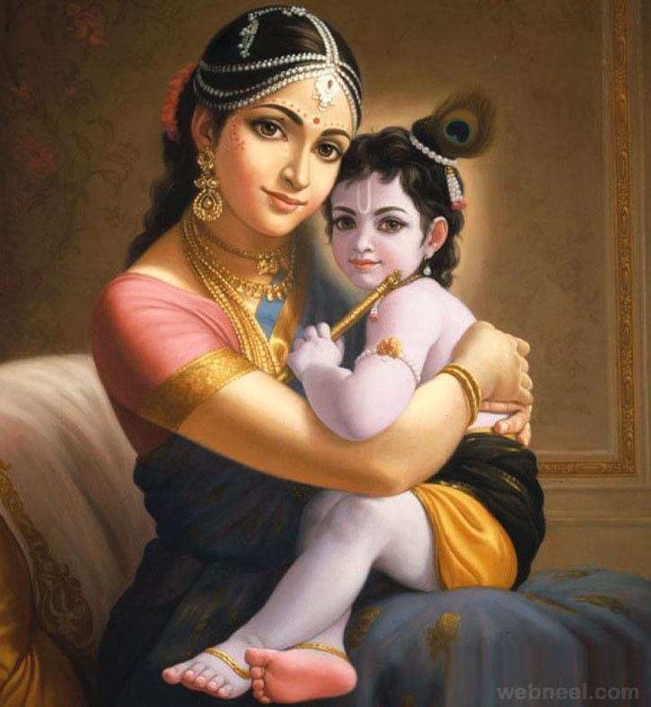
Bharatha homeland of Yoga
“Though India is the homeland of Yoga, the people ignore the efficacy of Yoga and thereby fail to benefit from it. Though Devaki was the mother who nurtured Krishna in her womb, it was Yashoda who enjoyed the pleasure of Krishna’s company as a foster mother. Sitting under a tree Devaki lamented. The plight of the Indians today is similar to that of Devaki.”

Slide 25
YOGA
It is said:
“ Yogah: Chitta Vruthi Nirodakah:”
“Yogah: Karmasu Kaushalam”
“Samthvam Yoga muchathe”
But how can we achieve all this?

Slide 26
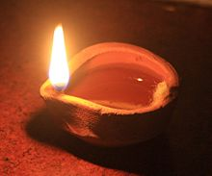
Aspects of Yoga
Swami says Jnana and Yoga are complementary
Its like oil and flame
Jnana
Yoga

Slide 27
YOGA

Slide 28
Research on Yoga
“Prof. Carlton, Elliot, Shuton and Johnson are scientists Professors in Hawaii University who did research on Yoga. The professors determined that the joy that one derives from two hours of undisturbed deep sleep can be obtained by twelve minutes of Yogic practise.”

Slide 29
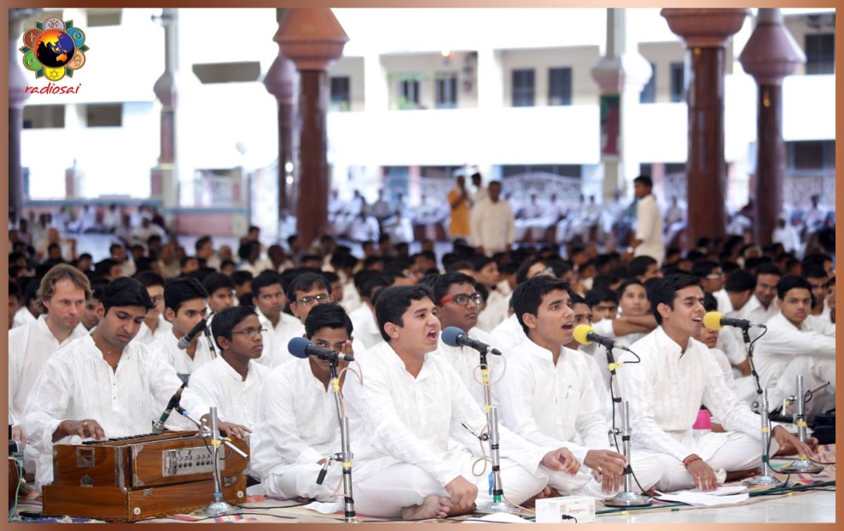
Yoga and Bhajans
If we take up Bhajan singing in the true sense then Swami says we are actually practicing Astanga yoga!
Coming clean and neat with external & Internal cleanliness..
Asana is sitting straight for the full length of Bhajan
Singing with breath control itself is Pranayama
Dwell on the meaning is Pratyahara
Then Dharana, Dhyana and Samadhi are automatic ..then you will yourself become a Yogi!

Slide 30
Present Obstacles to Spiritual Growth
We are all affected with these obstacles in a way or other….
Vishaya Ashakthi / Vasana Shakthi
Pragnya Mandyam
Vitarkam / Kutarkam
Vipraya / Vivarya Duragraham

Slide 31
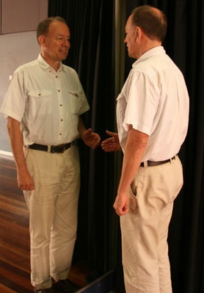
Obstacles to Divinity….
1.Vasana Shakthi / Vishaya Asakthi
Forgetting our true nature and
behaving opposite Like the mirror showing
opposite image!
Taking Truth as Untruth and
Untruth as Truth….
Solution: Sama, Dama, Uparathi and Thithiksha

Slide 32
Obstacles to Divinity
2. Pragnya Mandyam:
Good things does not reach our ears!
Like the mosquitos it disturbs our concentration!
But for bad things both ears are in full concentration…
Solution: Listen Again and Again till it registers

Slide 33
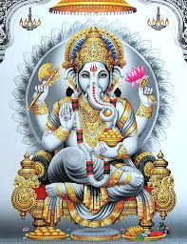
Obstacles to Divinity
3. Vitarkam / Kutarkam
Taking opposite meaning instead of the correct one!
Taking Good as Bad and Bad as Good!
Solution: Constant Meditation on things heard…

Slide 34
Obstacles to Divinity
4. Vipraya / Vivarya Duragraham
This is the EGO we have even in Spiritual Field!
EGO in Spiritual field is more risky compared to worldly ego…
Solution: Practicing /Imbibing the Teachings…

Slide 35
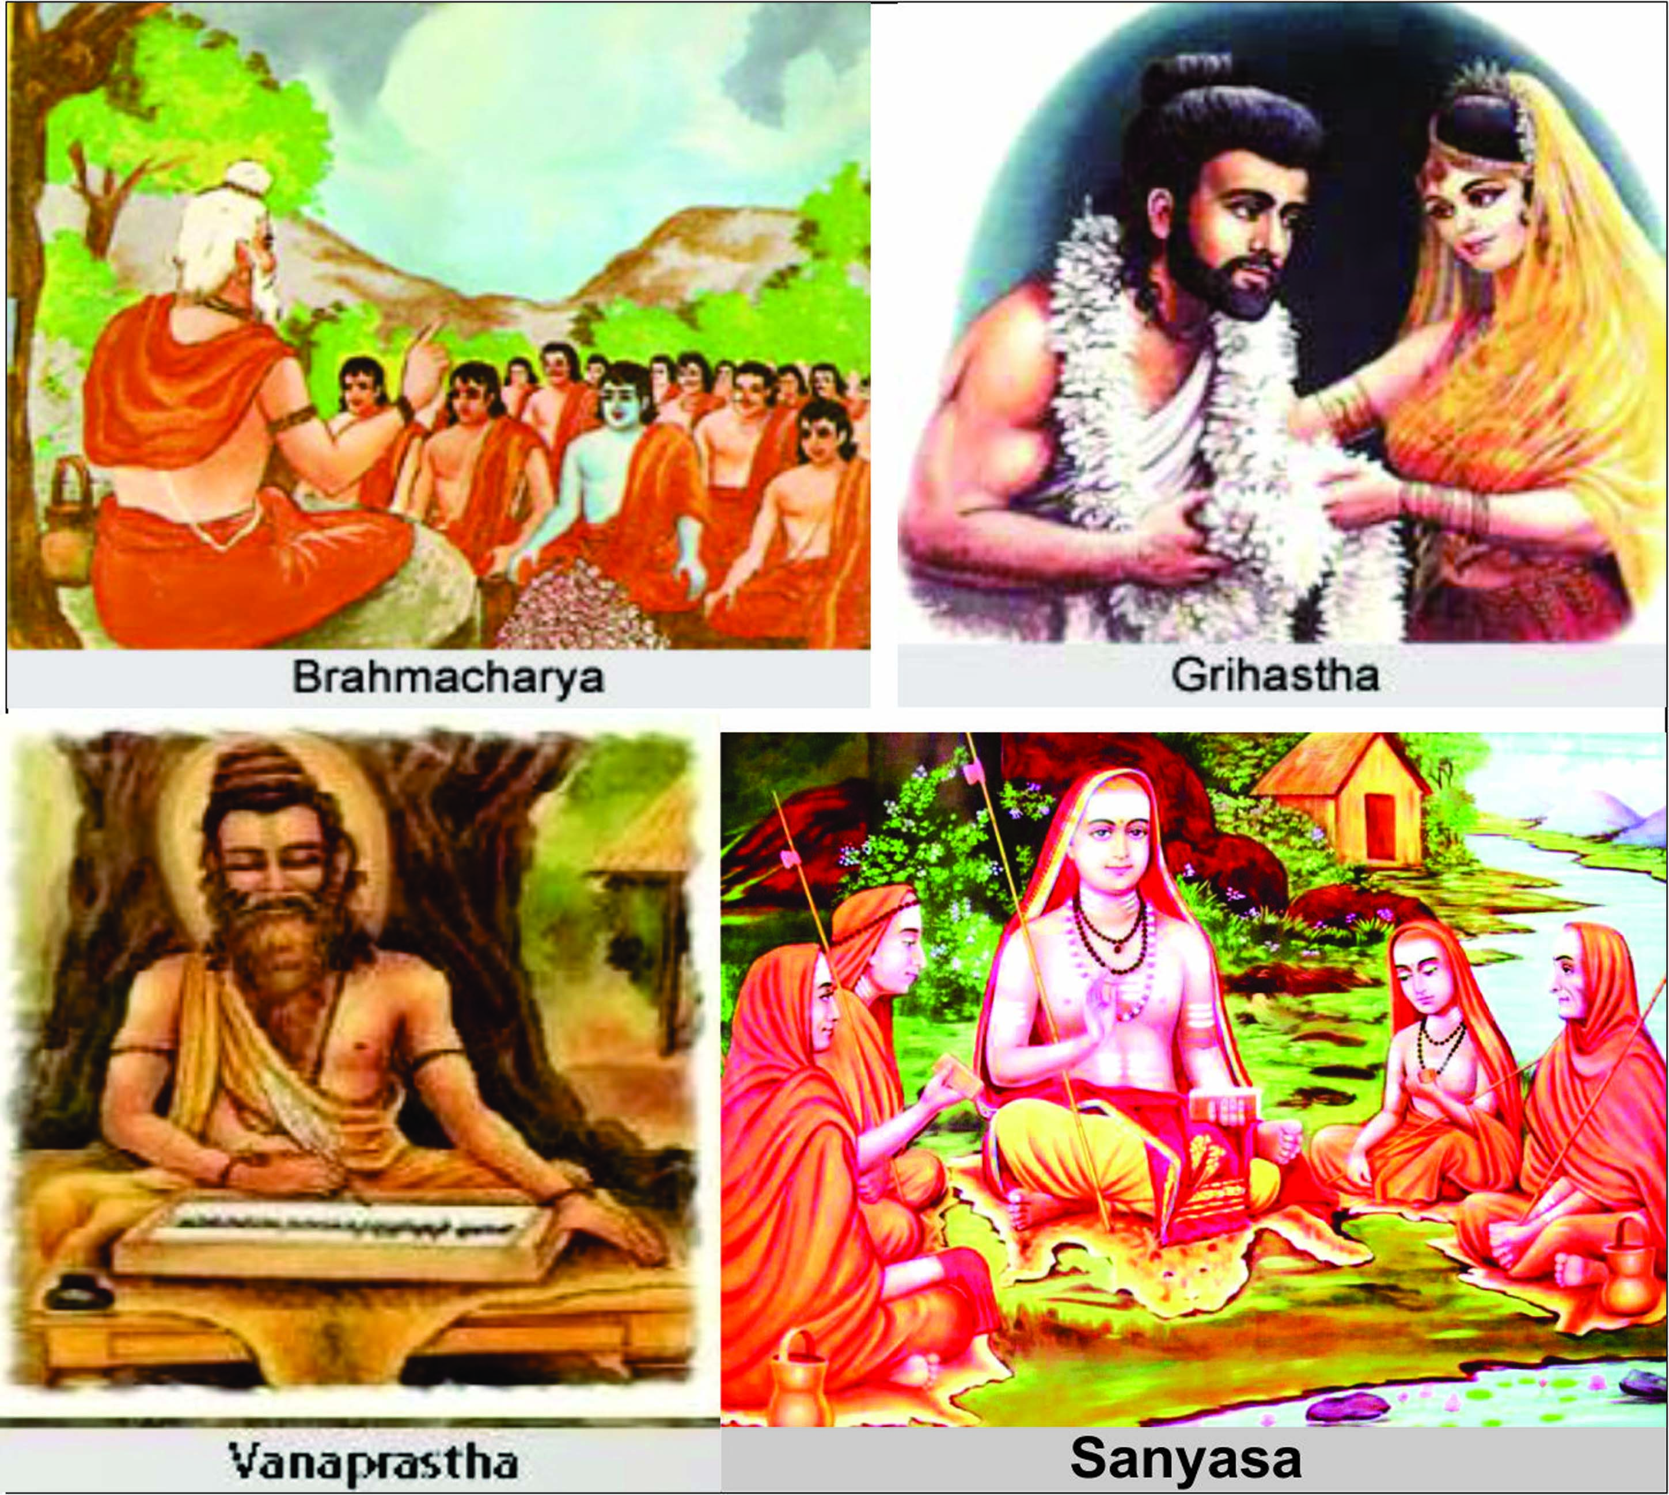
Four stages of Life
Bramhacharya
Grihastha
Vanaprastha
Sanyasa
Swami has
mentioned this in 4 vahinis:
Prasnothara Vahini,
Dharma Vahini,
Sandeha Nivarini &
Prema Vahini.

Slide 36
Four Stages of Life
Brahmacharya -just does not mean remaining unmarried but the one who walks on the path of God
Brahmacharya is the foundation to the other three stages.
Purity of Mind
purity of Chitha
purity of the Heart
and purity in Action
this fourfold purity constitutes
Brahmacharya.

Slide 37
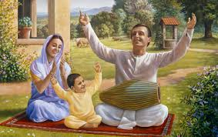
Four Stages of Life….contd.
Grihasta Ashrama : Has a number of injunctions apart from raising a family. The householder is the most important of all.
Just as all living beings depend upon air for their existence, the other three stages are dependent on the householder. Householders not only feed and clothe the others, they also provide facilities for the study of the Vedas.

Slide 38
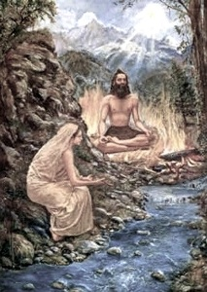
Four Stages…contd.
Vanaprastha :
Is essentially to gain Gnana and also to remove all the Vasanas from our Chitta
The scriptures (sastras) therefore require that a person has to be in the householder stage till the age of 48.
Leave Home Travel North wards by foot
should not stay with a roof top
Should eat only tubers, Fruits etc.
Can eat only in a leaf
Should bear the Sun and Rain

Slide 39
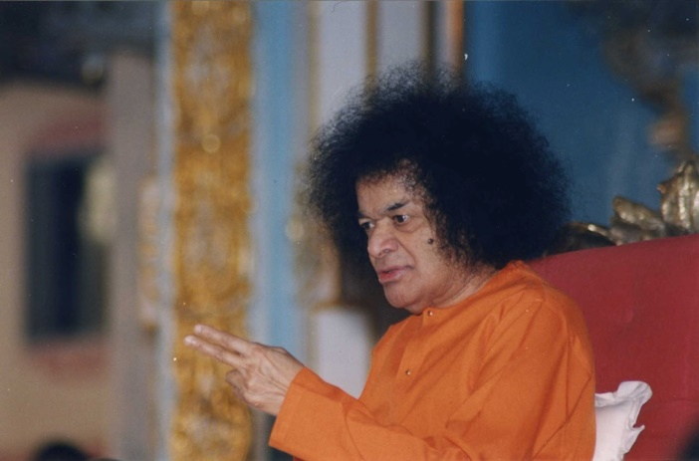
Is Vanaprastha possible now?
Swami Says:
“Hands in the Society and Head in the Forest”
We can continue to stay in the society but our thoughts must be Adwaithick and Spiritual ..
Detachment in Practice…
“ Paramarthika Drishito Prakruthini Anubavinchale”

Slide 40
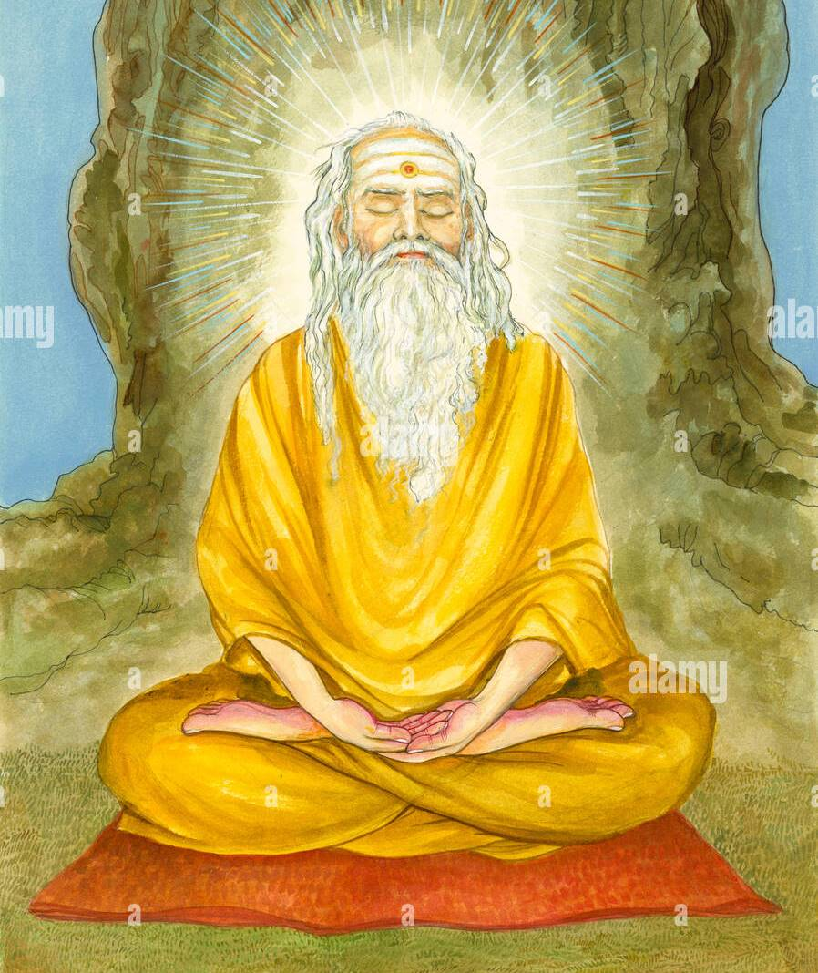
Four Stages Contd…
Sanyasa : Is the very important phase where not only detachment but also equanimity develops
True Sanyasa consists in the transformation of one's qualities and not in a change of garb. The mind must change, not the apparel. A true sanyasi is one who has mastery over all his senses and has given up all desires.
Sanyasa at 3 Levels:
Deha Sanyasa
Mano Sanyasa
Atma Sanyasa

Slide 41
In Conclusion….
Prasnothara Vahini is a treatise written by the GOD Himself and will be a written Veda for generations to come.
Basics are elaborated here but we need to apply this to various life situations and pursue our Spiritual Journey

Slide 42
Om Sri Sai Ram
Offering this at the Divine Lotus Feet of Bhagawan:
THANK YOU
&
JAI SAI RAM

