Slide 1
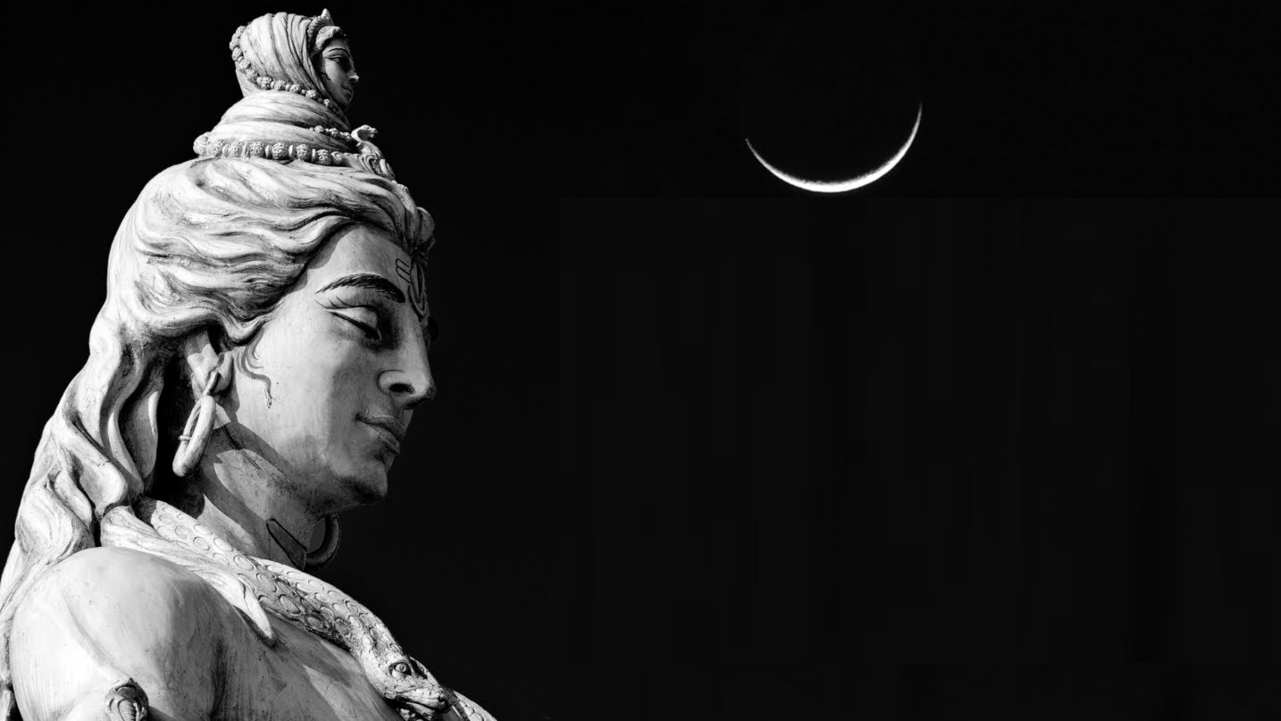
Quiz on Sri Rudram

Slide 2
Basics

Slide 3
What are the three names of Rudram?
Sri Rudraprasna, Satarudriya, Rudradhyaya, Namakam

Slide 4
Where does Sri Rudram occur in Vedic Texts?
Taittiriya Samhita- Krishna Yajurveda- 4th kanda (Chapter)- 5th Prasna (topic)

Slide 5
What exact word is used to describe ‘Cucumber’ in Rudram and what is special about this simile?
Urvarukam

Slide 6
Name the Rishi, Devata and Meter of Sri Rudram?
Aghora Rishi, Rudra Devata, Anushhthup Chandaha

Slide 7
Bhagawan on Sri Rudram

Slide 8
Rudram is derived from ‘rudana’-crying. How Bhagawan has connected crying (tears) with blessings of Lord Rudra?
Kalla neellu tapistadu-kalla neellu tepistadu
Wipes your tears and makes you cry happy tears

Slide 9
What is Bhagawan’s one sentence summary of the benefits of chanting Sri Rudram?
Rudram cheppite Bhadramuga Untaru
If you chant Rudram you will be happy and peaceful

Slide 10
Name the five faces of Lord Shiva?
Vamadeva, Sadyojaata, Aghora, Ishaana, Tatpurusha

Slide 11
What according to Bhagawan is the relationship of Sri Rudram and four Vedas?
Sri Rudram is the essence of all the four Vedas.
9-Aug-2006

Slide 12
What Swami has spoken about the relationship between Namakam and Chamakam?
Namakam emphasizes detachment, Chamakam stresses on desire and the oneness of both is Rudram. Evil to be discarded and good to be desired.
9-Aug-2006

Slide 13
How Bhagawan explained Rudra and Shiva tatwam using food?
Shiva-Food taken within limits (Aghora)
Rudra- Food taken without limits (Ghora)

Slide 14
How Bhagawan explains the Shiva and Rudra Tatwa using a storm?
Rudra-Storm created in the ocean
Shiva- Rain on the land

Slide 15
According to Bhagawan what is the symbolism of lingam?
Lingam signifies the universe without beginning and end
Lingam is the simplest sign of Emergence & Mergence

Slide 16
Shiva and Other Deities

Slide 17
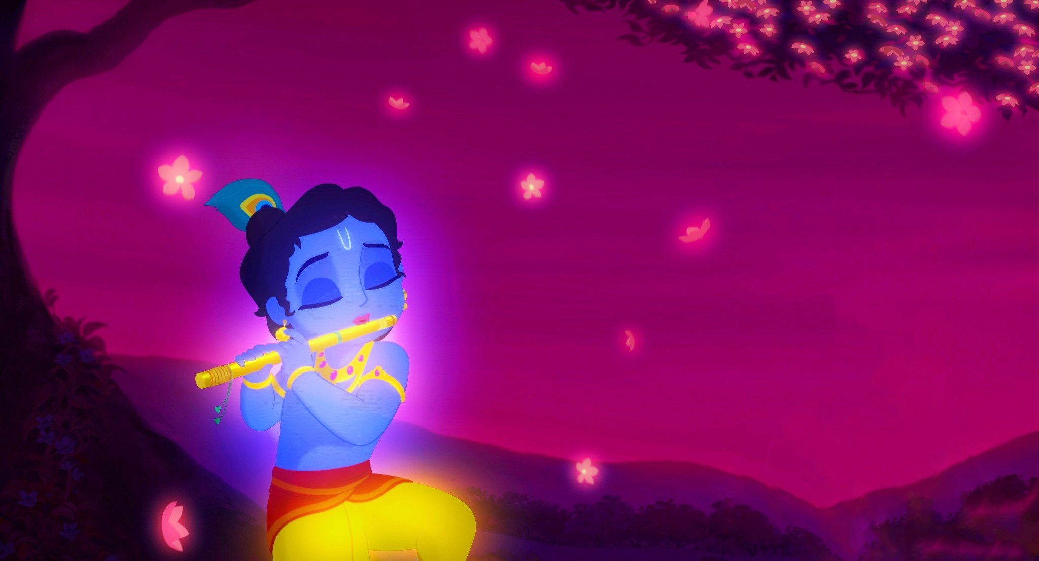
When did Lord Krishna Chant Sri Rudram according to Mahabharata?

Slide 18
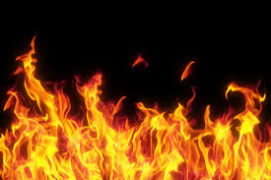
Where in Sri Rudram mention of Agni comes?
Trikagnikalaya, Kalagnirudraya,
Viranmano…..vadhir havishmanto,
Yo Rudro agnau yo apsu ya oshadishu

Slide 19
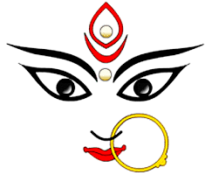
In Dasara Yagnam, in addition to, Sri Rudra Homa what Devi worship done?
Lalitha kumkum archana
Parayana of Devi Bhagavatam & Durga Saptashati

Slide 20
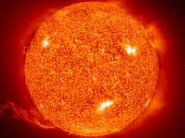
Which verses in Sri Rudram use the colour of sun to describe siva?
Asou yastamro aruna uta bhabru sumangalaha
Tamraya cha arunaya cha

Slide 21
Shiva as Professional

Slide 22
Which verses in Sri Rudram describe Shiva as a Divine Doctor?
Daivyo bhishak,
Ya te rudrashiva tanuhu shiva vishwaha bheshaji
Shiva rudrasya bheshaji taya no mruda jevase
…rudra ririshaha

Slide 23
Which verses in Sri Rudram describe Shiva in a negative role?
Kakubhaya- stenanaam- mushnataam- prakruntanaam (thieves), taskranaam (smugglers), vanchate-parevanchate (cheat), paricharaya- kulunchanaam(robbers)

Slide 24
Which verses in Sri Rudram describe Shiva as animal rearer?
ashwapatibhyscha, shwanibhyscha, shwapatibhyscha,
shamasad dwipade chatushpade

Slide 25
Which verses in Sri Rudram describe Shiva as skilled artisan?
Takshabhyo(carpenters), rathakarebhyscha (builder of chariots), kulalebhya(potters), karmarebhya (blacksmiths),
ishukrutbhyo dhanvakrutbhyo (fabricators of bows and arrows)

Slide 26
Different facets of Shiva

Slide 27
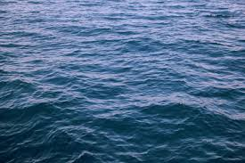
Which verses in Sri Rudram describe different forms of water?
Sheeghreyaya cha sheebhyaya cha, urmyaya cha vasvanyaya cha
Srotasyaya cha dweepyaya cha, katyaya cha neepyaya cha
Naadyaya cha vyshantaya cha, kupyaya cha avatyaya cha, varshyaya cha

Slide 28
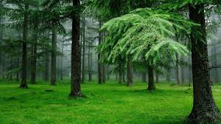
Which verses in Sri Rudram mentions about vegetation?
Vananaam pataye namaha,
Vrukshanaam pataye namaha
Aushadhinaam pataye namaha
Vanyaya cha kakshaya cha

Slide 29
Which verses in Sri Rudram describe Shiva in contradictory attributes?
Bhavaya cha rudraya cha,
Neelagrivaya cha shitikanthaya cha
Kapardine cha vyuptakeshaya cha
Jyesthaya cha kanisthaya cha
Mahadbhyaha kshullake bhyascha

Slide 30
Which prayer in Sri Rudram is chanted for the wellbeing of the community?
10th anuvaka
Dwipade chatuspade.. (two legged, four legged)
Mano mahanta muta mano…(young ones, aged ones, loved ones etc.)

Slide 31
Swasti Chanting Round

Slide 32
Namo rudrebhyo ye pruthivyam

Slide 33
Namah irinyaya cha prapathyaya cha

Slide 34
Namah somaya cha rudraya cha

Slide 35
Namaste astu bhagawan visweshwaraya

Slide 36
Sai Ram

