Slide 1
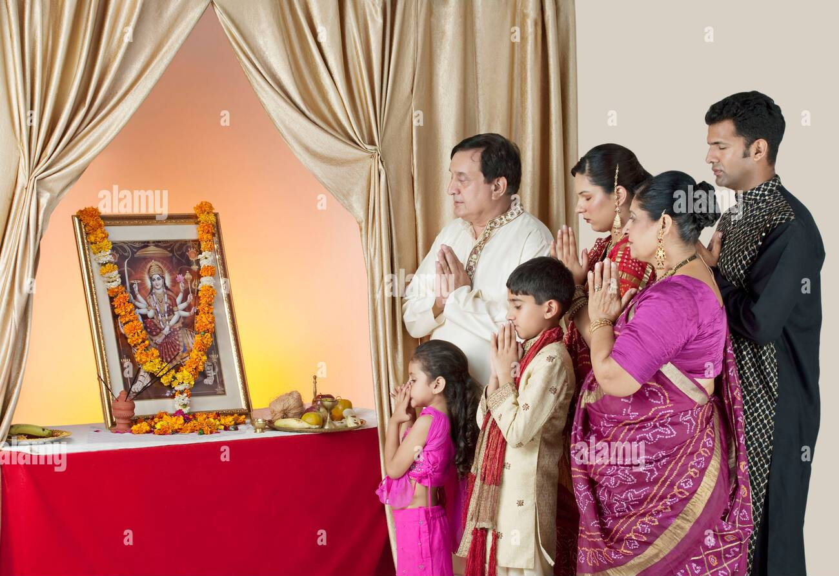
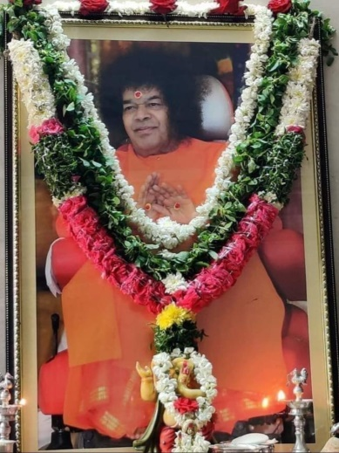
Om Sri Sai Ram
Devotional Singing / Prayer with members of the Family once a week

Slide 2
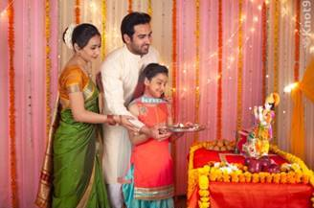
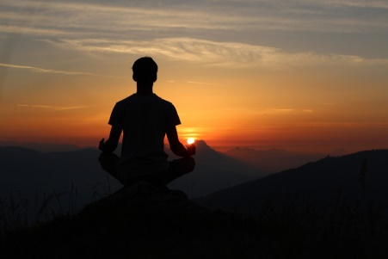
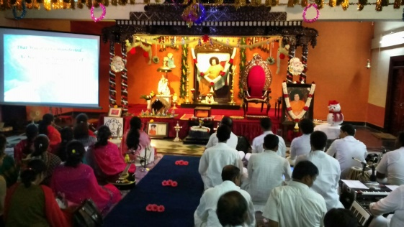
Sadhana for Self Transformation
SADHANA
Personal Sadhana
Family Sadhana
Society Sadhana

Slide 3
Family Sadhana…
Family is a very important component
Members of the family influence our thoughts and Actions. We spend major portion of our life with the members of the family.
Therefore it is very important to involve the family in the Sadhana Path.

Slide 4
Need for Family Prayer
Family that Prays together Stays Together…
Therefore its important that we involve our families in our Sadhana Path Devotional Singing and Prayer..

Slide 5
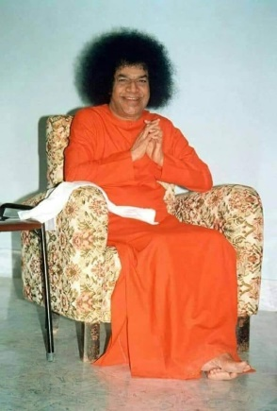
Weekly Prayer / Bhajans

Slide 6
Spiritual Benefit of Weekly Prayer
SAIRAM
Uttering falsehood
Talking ill of others
Indulging in scandal
Excessive talk.

Slide 7
A Question may arise….
That only one or two members in a family only are devotees. How can we meet every week for Bhajans/ Prayer
Bhagawan has never said to pray to him…but
HE responds to any prayer to any deity / God of our faith…But the practice of joint family prayer is most important

Slide 8
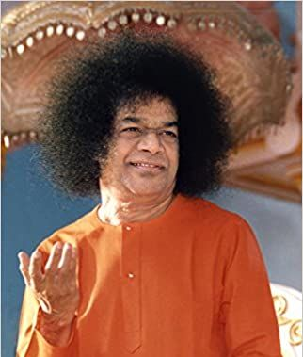
Regularity is important
What happens if all family members are not available at a particular time?
Start the family prayer with whoever is willing and available.
Fix a particular day and time By doing it regularly with devotion other family members too will join…..Allow Swami to work…

Slide 9
Be Patient
We need to remember is to be patient with the members of the family…whether they participate on time etc.,
Our family members should see visible Positive transformation in us as a result of our Sadhana…

Slide 10
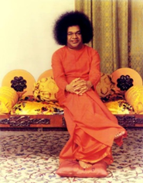
Start Early….
When children participate in weekly prayer along with elders, we are sowing seeds of Bhakthi and Culture in their tender minds which will come in good stead when they grow up into adults.

Slide 11
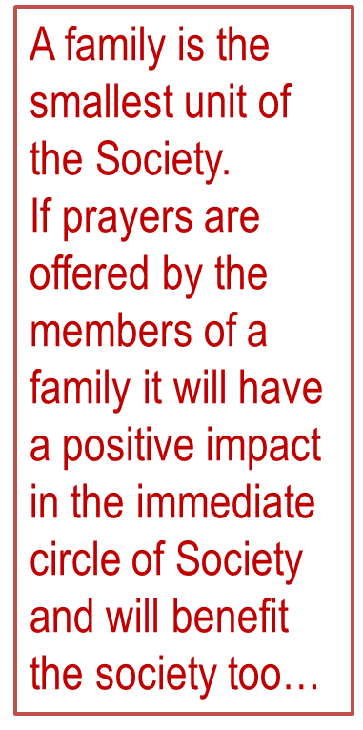
Family is a unit of the Society

Slide 12
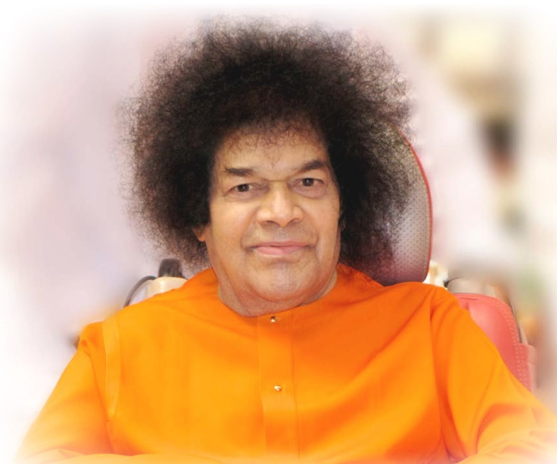
Om Sri Sai Ram
Lets involve all our family members in our prayers every week and maintain Unity, Purity and Divinity.
Thank You
JAI SAI RAM

