Slide 1
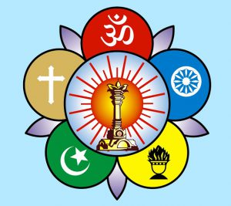
Sri Sathya Sai Seva Organisations Karnataka South
Deepavali is a very important festival with inner significance…Here is a narrative based of the Spiritual dimension of celebrating Deepavali as told by Bhagawan….
JAI SAI RAM

Slide 2
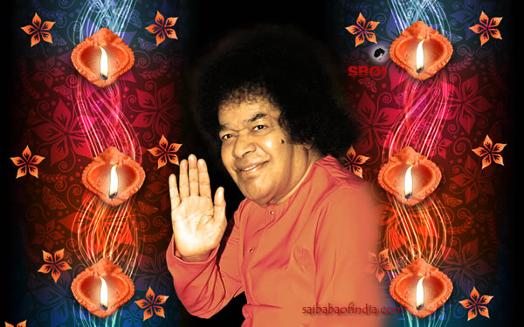
Om Sri Sai Ram
Inner Significance of Deepavali festival

Slide 3
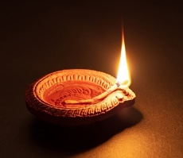
Lamp of Name…
“On this Deepavali Day, resolve to light the lamp of Namasmarana and place it at your doorstep, the lips. Feed it with the oil of devotion; have steadiness as the wick. Let the lamp illumine every minute of your life. The splendour of the Name will drive away darkness from outside you as well as from inside you. You will spread joy and peace among all who come near you.”- 24th October 1965

Slide 4
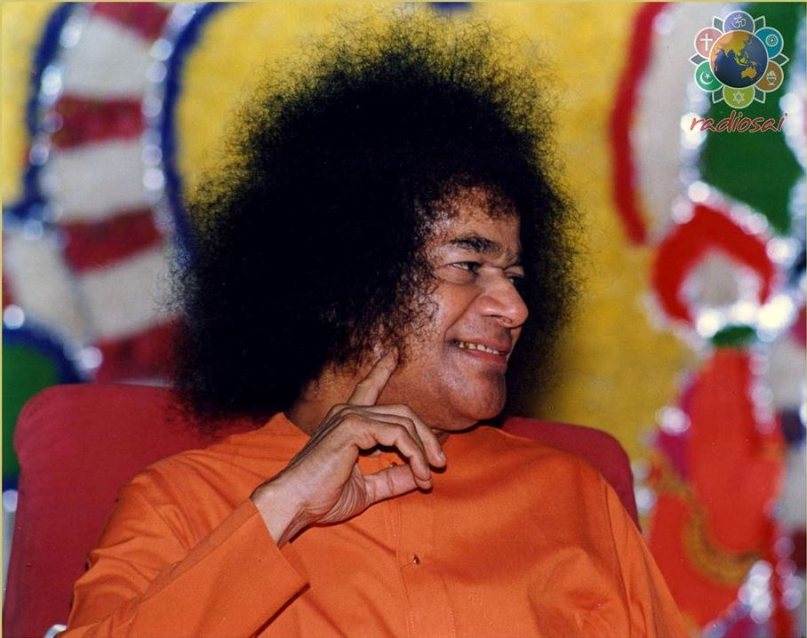
Jivana Jyothi…
“There is significance in lighting lamps. The flame of one lamp can light the whole array of lamps. That one lamp symbolizes the paramjyothi . The others symbolize the jivanjyothis . Deepavali is celebrated in order to teach this truth to the world”.
-19th October 1998

Slide 5
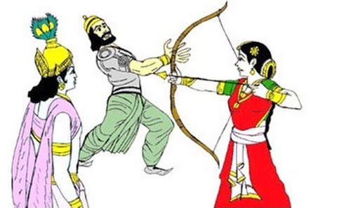
Inner significance of Deepavali
“What is the inner significance of Deepavali? The capital of the kingdom ruled by Narakasura was known as Pragjyotishapuram. The name consists of four syllables: prag, jyothi, sha, and puram. Prag means before, jyothi means light, and sha refers to forgetting. The inner meaning of this name is that the inhabitants of this city have forgotten the ancient and eternal light (Atma Jyothi). Narakasura, the king of Pragjyotishapuram had totally forgotten the Atmic principle and was identifying himself with the body and leading a life in darkness of ignorance.”
-19th October 1998

Slide 6
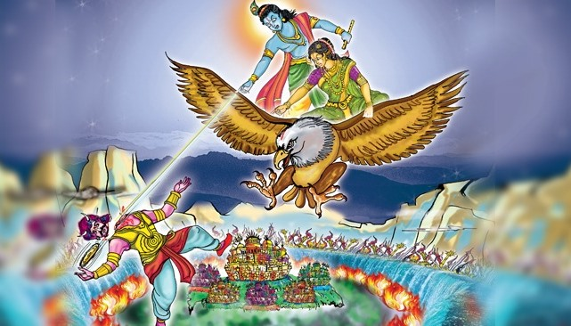
Principle of Truth…
“The bad qualities in man, in the form of Narakasura, have to be destroyed. Krishna came to destroy these bad qualities. He enlisted the aid of Sathyabhama, who represents the bearer of Truth. This means that with the help of truth, Krishna destroyed the bad qualities. On this Deepavali day, people should pledge
themselves to get rid of their bad qualities. There is no greater virtue than Truth."
-23rd October 1995

Slide 7
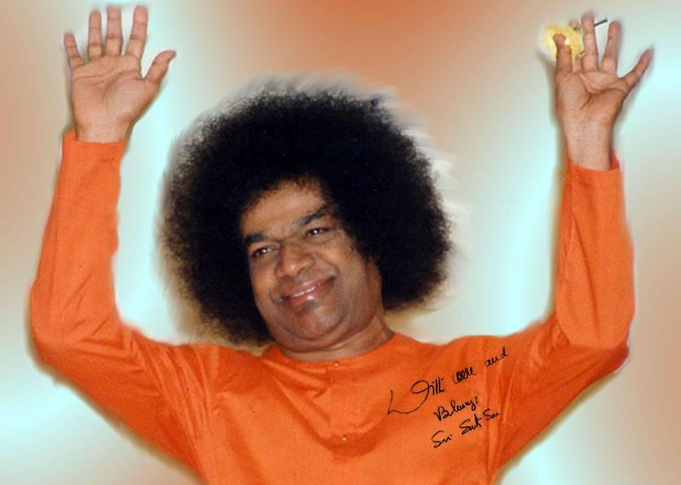
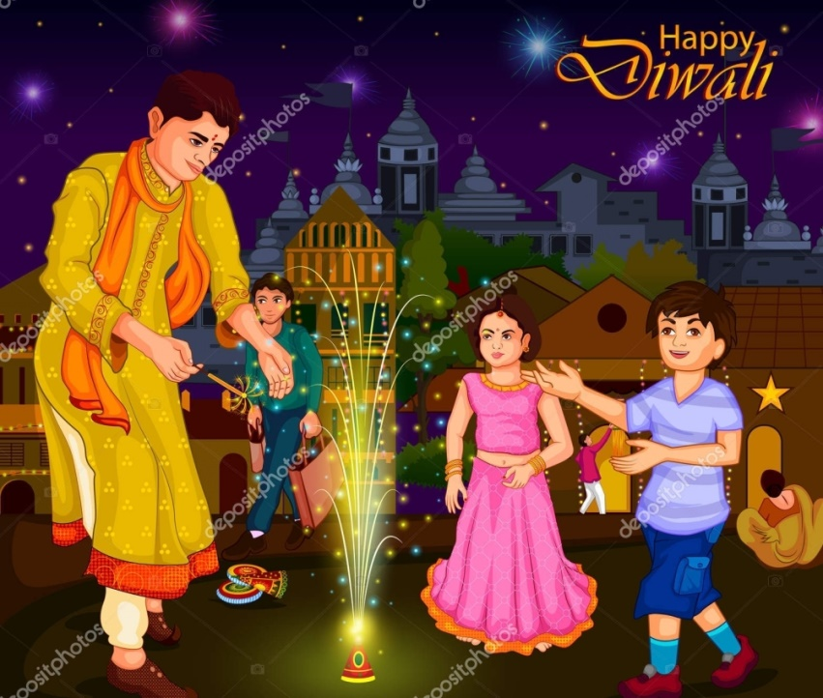
Bhumatha’s Prayer….
“Naraka was the son of Mother Earth- Bhoomatha.
She asked for a boon from the Lord, that the Day should be observed, in his memory, as a day of light or joy and the sharing of joy by one and all.”
-25th October 1973

Slide 8
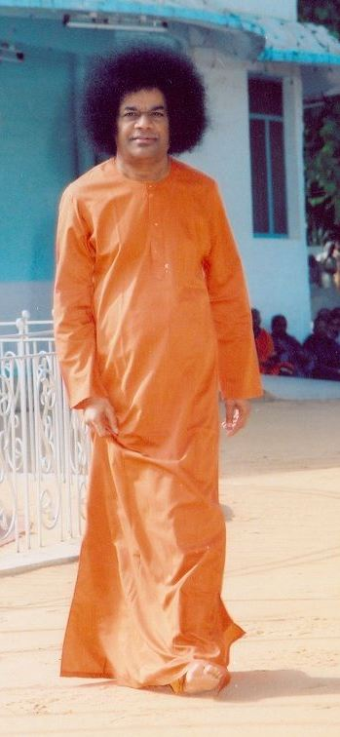
Cosmic Significance
“Apart from this Puranic version, there is a cosmic explanation for the observance of Deepavali. Naraka was a planet moving in orbit with the moon around the earth. Once it appeared to be heading towards the earth. People prayed to Lord Krishna to avert the impending catastrophe. The Lord had to take action to destroy this planet and save the world from disaster. From that day, Deepavali was being observed as a joyous day of deliverance from evil.”
-24th October 1992

Slide 9
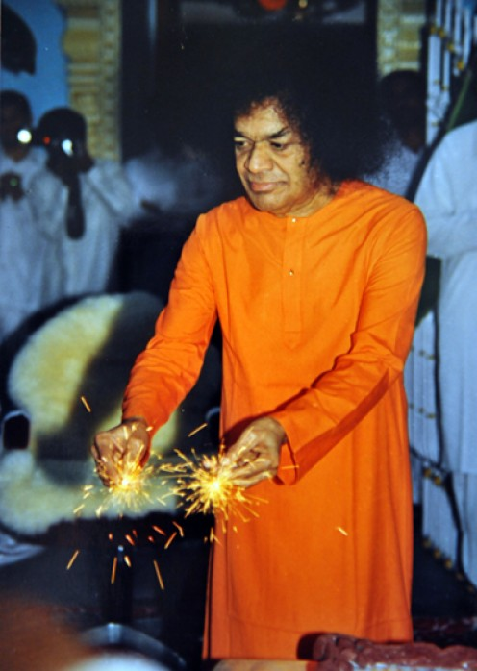
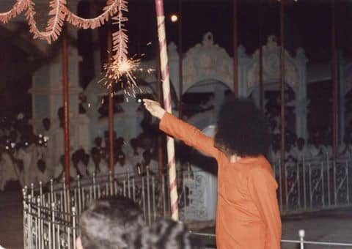
Significance of Crackers…
There is a meaning in the burning of crackers on Deepavali day. This is the rainy season. All kinds of germs fill the atmosphere. The smoke from the crackers destroys these germs. The joy derived from the burning of crackers should really come from the elimination of bad qualities within one. For this, it is essential to meditate on God. Listen to Divine discourses. Participate in Bhajans.”
-23rd October 1995

Slide 10
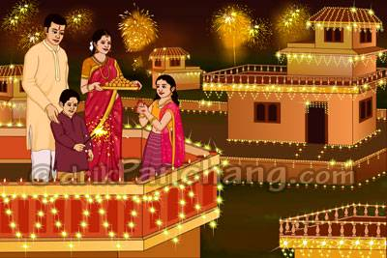
Significance of New Clothes
“Deepavali is the day when old clothes are discarded and new ones worn; when the home and its precincts are swept clean, given a new look, and made to appear fresh and fine. Flowers are arranged in lovely designs in each room and in the courtyard; festoons of green add charm to every door. But, even while doing all this, attention has to be paid to the discarding of worn-out prejudices, the adoption of new habits of love and mutual respect, the freshening of one's attitude towards one's kith and kin, brothers and sisters of all creeds and castes, the hanging of festoons of friendship and fraternity over the door sill of the heart. This will make the Festival really meaningful and fruitful”- 25th October 1973

Slide 11
Antar Bahischa Suddhi:
“The Vedas declare:
“Anthar Bahischa Tat Sarvam Vyapya Narayana Stithaha.” God is present within and around. So one has to be pure both internally and externally. It is the water that helps to keep your body clean.
But it is love that keeps your heart clean. You should celebrate the festivals in full realisation of their inner significance.”
-19th October 1998

Slide 12
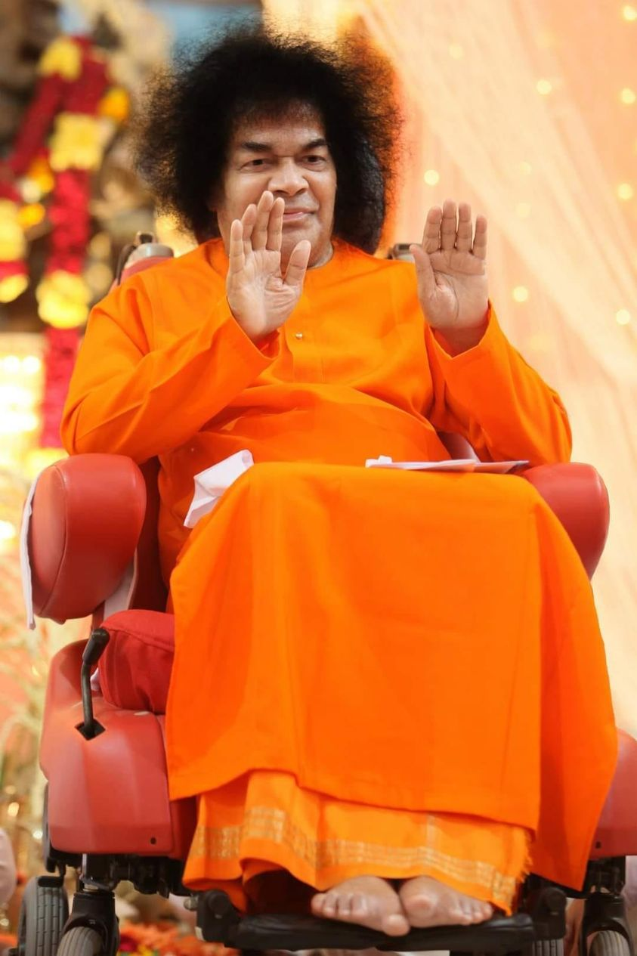
Thank you &
JAI SAI RAM

