Slide 1
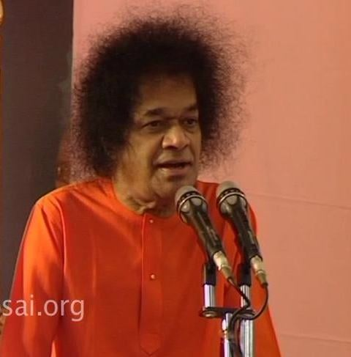
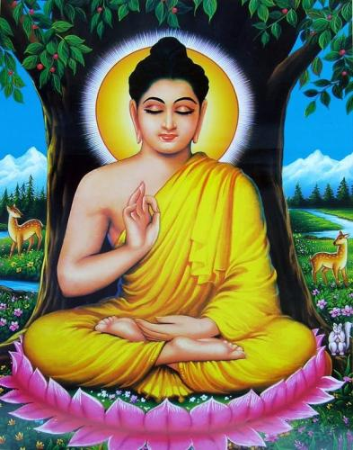
Om Sri Sai Ram
Message of
Buddha
Purnima

Slide 2
Message of Buddha Purnima
Sri Sathya Sai Seva Organisations
Karnataka South
This presentation aims to bring out the inner message of
Buddha Purnima as told by Bhagawan

Slide 3
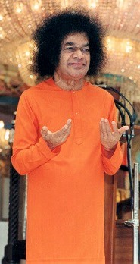
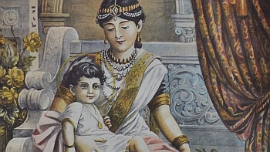
Birth of Gautam Buddha
Unfortunately, Mayadevi died soon after giving birth to her son who was named Siddhartha. Gautami, the second wife of Suddhodhana, brought up the child with loving care like her own sonThat is why he was also called Gautam.
King Suddhodhana and his wife Mayadevi performed many spiritual austerities such as Japa,Tapa,Vratas , and Yajnas for years together with an aspiration to have a son.
-13th May 2006

Slide 4
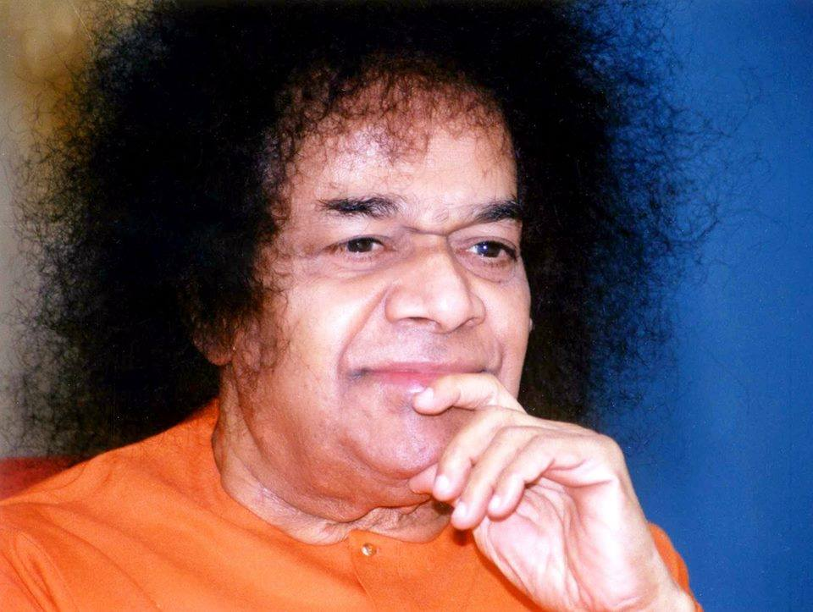
Siddhartha
“The astrologers predicted that Siddhartha would not rule the kingdom; he would leave the kingdom and become a renunciant. The prediction of astrologers was always ringing in Suddhodhana's ears and caused him anxiety as he watched his son grow. He took all precautions to see that his son did not step out of the palace and get into the company of others, lest he should be influenced by them. Thus, he protected his son from the influence of others for twenty long years.” -13th May 2006

Slide 5
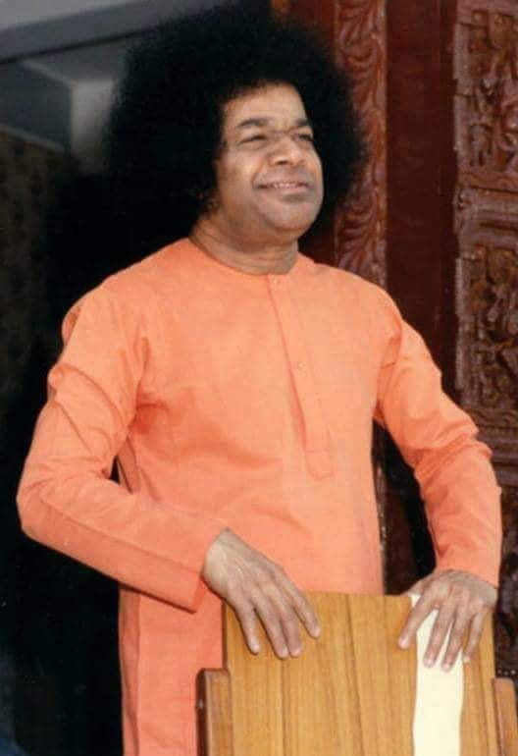
Siddhartha’s Marriage
“One day, the parents of a girl came to Suddhodhana and expressed their wish to give their daughter in marriage to his son Siddhartha. The name of the girl was Yashodhara. Suddhodhana accepted their proposal and performed the marriage of Siddhartha with Yashodhara. Owing to their loving insistence, Siddhartha continued to stay with his parents in the palace even after the marriage. One year after the marriage, he begot a son, who was named Rahul. Both the husband and wife spent their time happily with their son.”

Slide 6
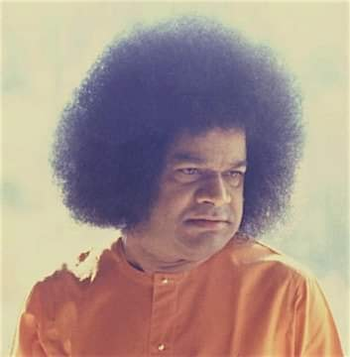
Siddhartha to Buddha
“In spite of all the comforts of the palace and happy married life, Gautama's mind became restless when he saw people afflicted with old age, disease, and death after he ventured out of the palace one day. One night, there was a sudden transformation in his mind. While his wife was fast asleep, he got up at midnight, caressed his son, and left for the forest”
-13th May 2006

Slide 7
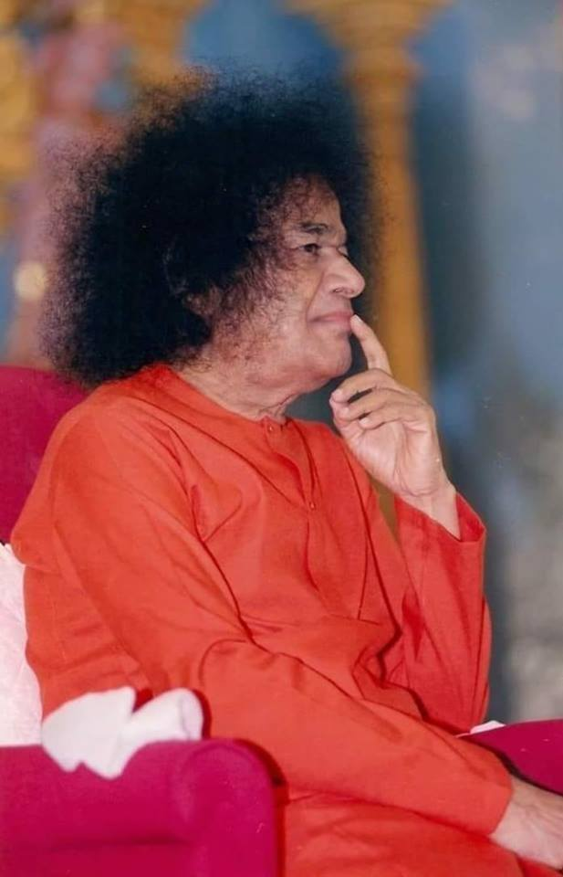
Buddha Purnima
“Today is Buddha Purnima. Purnima means full moon. The underlying message of Buddha Purnima is that the mind should shine with total purity like the full moon. It should unite with its source, i.e. the Atma, which is pure and effulgent. There is no darkness on the full moon night. On this auspicious day of Buddha Purnima, we should attain full purity of the mind”
-13th May 2006 Brindavan

Slide 8
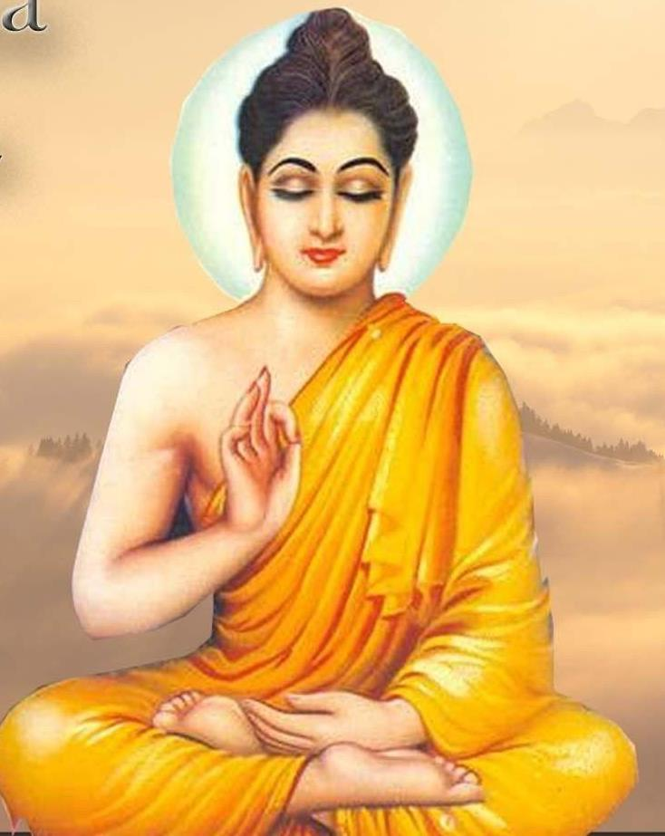
Buddhist Prayer
“The Buddhist prayer must be properly understood.
"Buddham Sharanam Gachchami,
Dharmam Sharanam Gachchami, Sangham Sharanam Gachchami,“
the real meaning of the prayer is: You must divert your Buddhi towards Dharma. And the Dharma should aim at serving society. When this is done, society gets purified.”
-15th May 1997

Slide 9
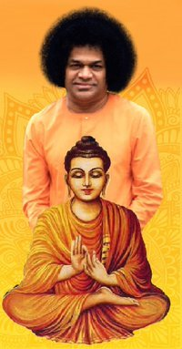
Five Teachings of Buddha
We need to put into practice the five important teachings of Buddha.
They are
Samyak Drishti (Right Vision),
Samyak Bhavam (Right Feeling),
Samyak Sravanam (Right Listening),
Samyak Vaak (Right Speech), and
Samyak Karma (Right Action).
A true human being is one who follows the path of truth. Truth, righteousness and sacrifice should be the way of life.

Slide 10
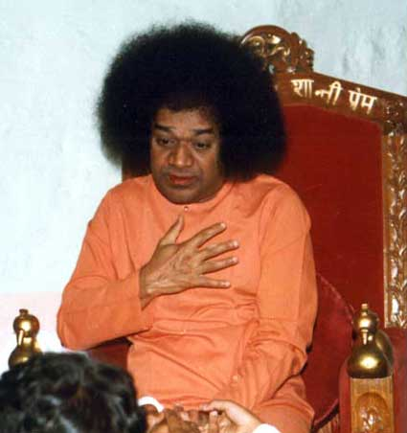
True Meditation- I am I
“Buddha advocated the practice of meditation. What is that you have to meditate upon?
To contemplate upon the principle of "I am I" is true meditation. No other Sadhana can match this.”
-13th May 2006

Slide 11
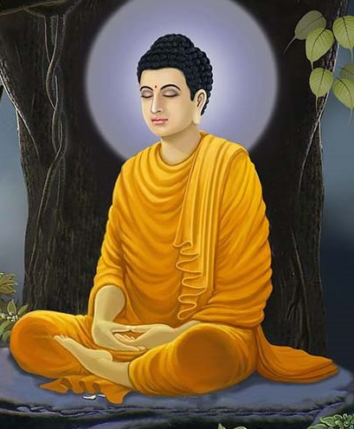
Curly Hairs…
“The principles taught by Buddha have profound significance, but people are not trying to understand them. You might have observed that Buddha had curly hair on his head. One lock of hair was entwined with the other. There is an underlying message of unity in this. He had only one feeling in his heart, the feeling of love. “ -13th May 2006

Slide 12
Three Principles…
“There are three things required to be done in life. 1.You should try to do good to those that have done harm to you.
2.You must forget the harm done by others and 3.Also the good you have done to others. “
-11th May 1998

Slide 13
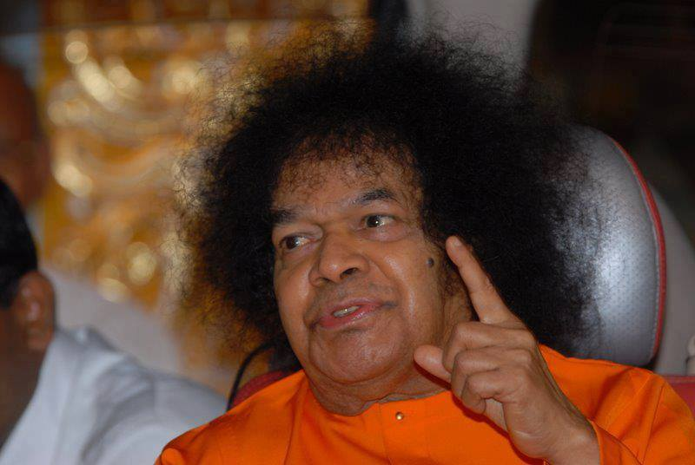
Essence of Buddha’s Teachings
“This is the essence of Buddha's teachings
See no evil; See what is good.
Hear no evil; Hear what is good.
Speak no evil; Speak what is good.
Think no evil; Think what is good.
Do no evil; Do what is good.
This is the way to God.”
.
-11th May 1998

Slide 14
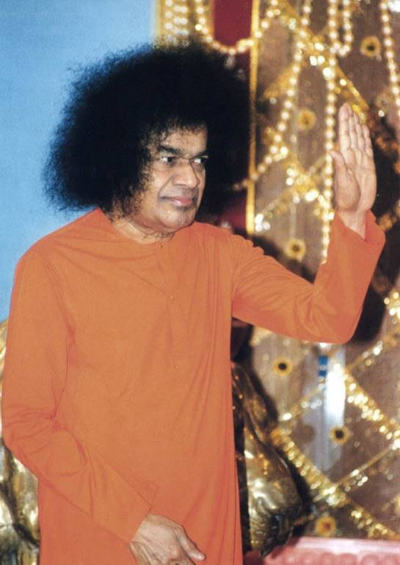
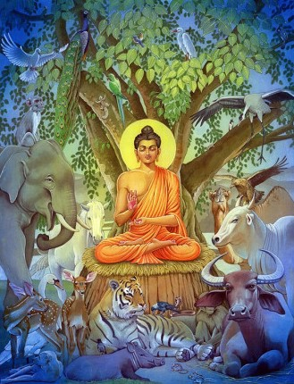
Principle of Non- Violence
“One day in his wanderings, Buddha came to a village. The residents of the village were performing a Yajna and, as a part of the rituals, were preparing to sacrifice an animal. Buddha saw this and advised the villagers not to do so. He said, "No harm must be done in any manner whatsoever to any living being, because God dwells in all. therefore the individual is God and God is the individual. Hence, it is wrong to kill this animal.“
-21st May 2000- Brindavan

Slide 15
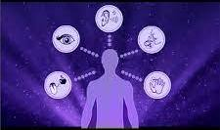
Mastery of Senses
“After many years of inquiry he came to the conclusion that the secret of spiritual wisdom was not to be got from scholars or by study. He realized that spiritual understanding could only come from mastery of the senses”.
-5th February 1998 Chinese New Year

Slide 16
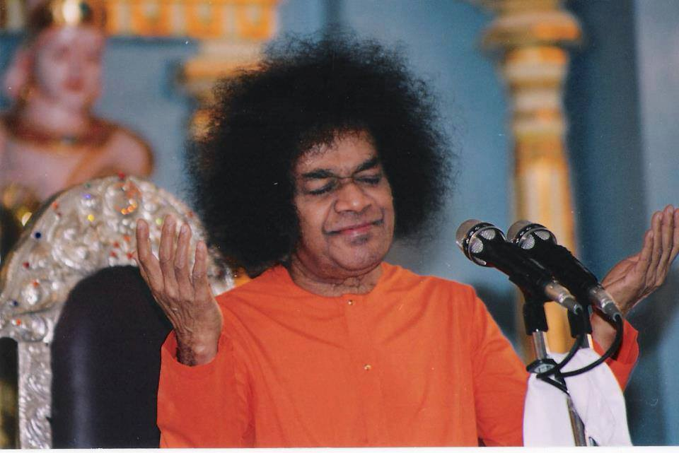
Buddha’s Last Message
“In his last moments, Buddha summoned his stepbrother Ananda to impart to him his final message. Ananda was the son of Gautami (Buddha's stepmother). Placing his palm on the head of his younger brother, Buddha said: “My dear child! I came to the world to teach (the Truth). If anyone asks, ‘Where is God?’ the answer is: ‘He is everywhere’. Truth is God. Speak the Truth. Do not harm anyone. Recognize that the highest dharma is Ahimsa.”

Slide 17
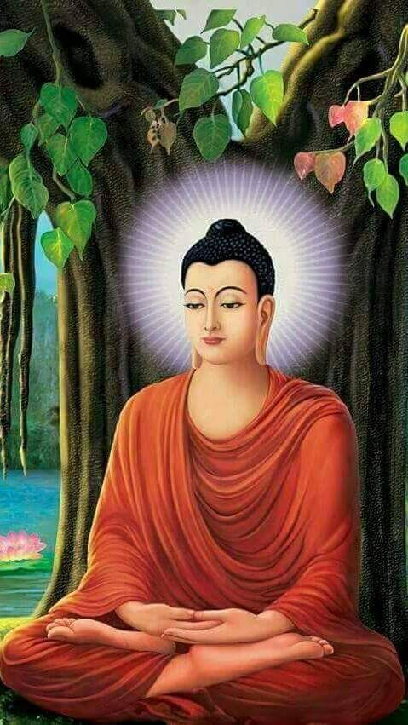
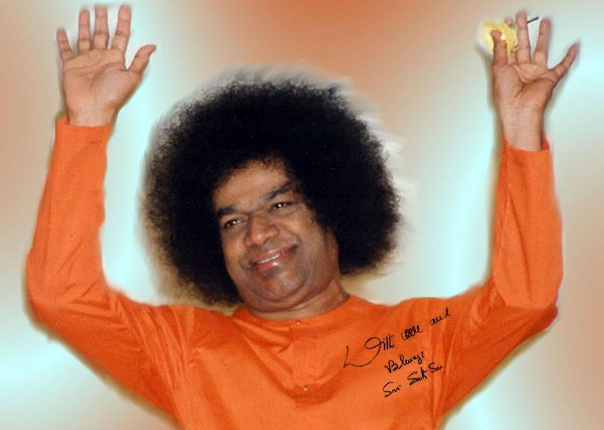
Buddha Purnima
Thank you
&
Jai Sai Ram

