Slide 1
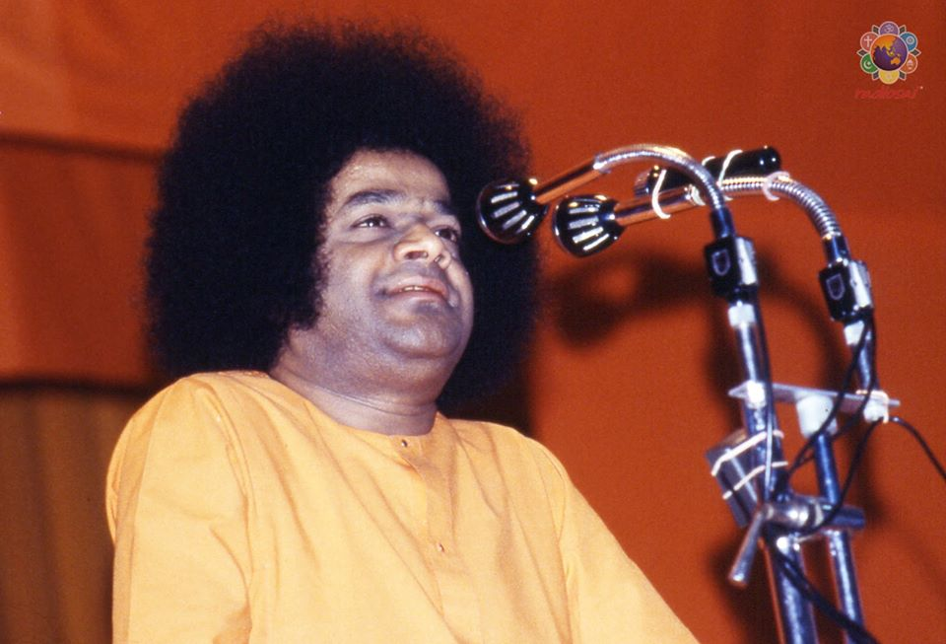
Bhagawan Uvacha….
Message from Bhagawan on
Inner Significance of
Ugadi Festival

Slide 2
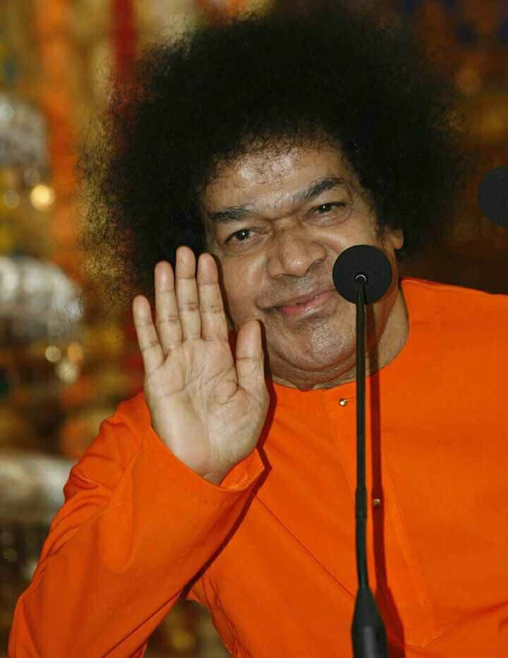
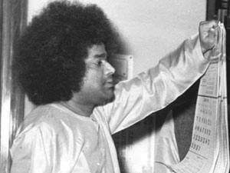
Bhagawan Uvacha…
“Ugadi, the first day of the
first month of Indian calendar
(Chaitra Masa).
It denotes the commencement
of New Year for all in
Karnataka and
Andhra Pradesh…”
-16th March 2010

Slide 3
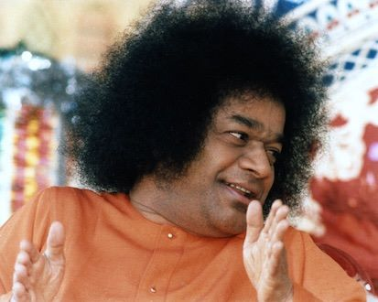
Bhagawan Uvacha…
“Do not limit the celebration
of Ugadi to merely putting
on new clothes & partaking
of delicious items.
True Ugadi is the day
when man gives up
bad qualities, fills his heart
with love, and takes
to the path of sacrifice”
-13th April 2002

Slide 4
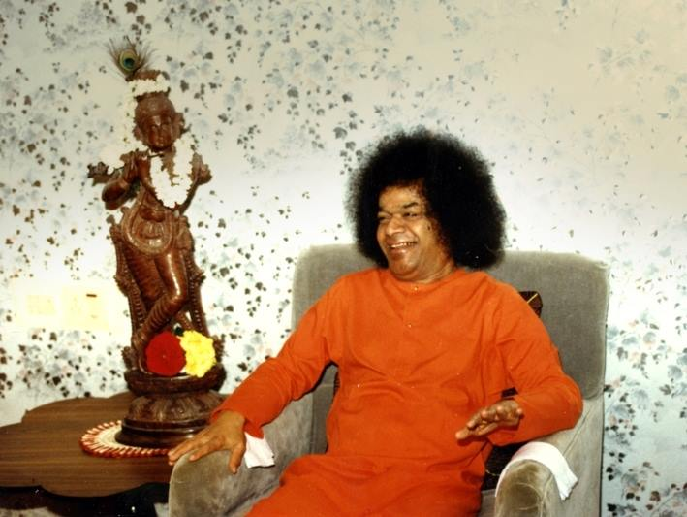
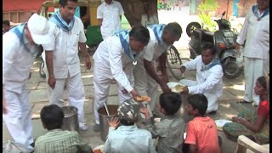
Bhagawan Uvacha…
“Since you claim to be Sai devotees, you should strictly adhere to the Sai path and make everyone happy. When you follow in My footsteps, you will certainly achieve sacred results and attain good reputation. Being Sai devotees, you should give up selfishness and dedicate your lives for the welfare of society.. “
-13th April 2002

Slide 5
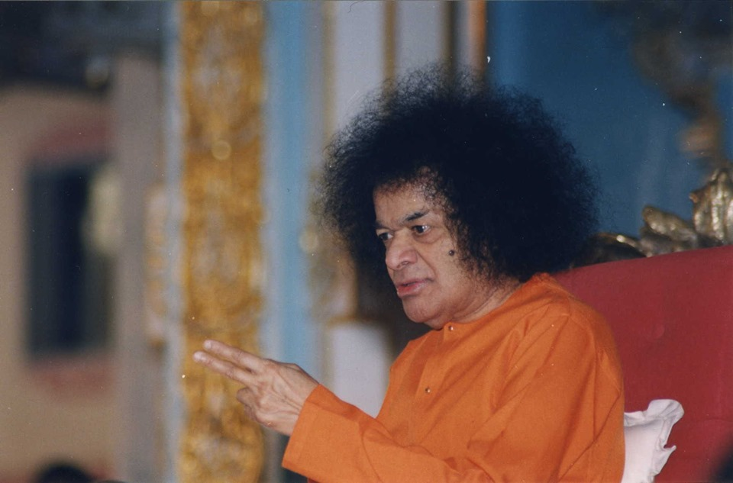
Bhagawan Uvacha…
“Fill your lives with love. Stop criticising others. Offer your respects to even those who hate you. Hatred is a mean quality. It will ruin you. Hence, do not give room for hatred. Cultivate love. Help the poor and needy to the extent possible.
Help ever, Hurt never”
-13th April 2002.

Slide 6
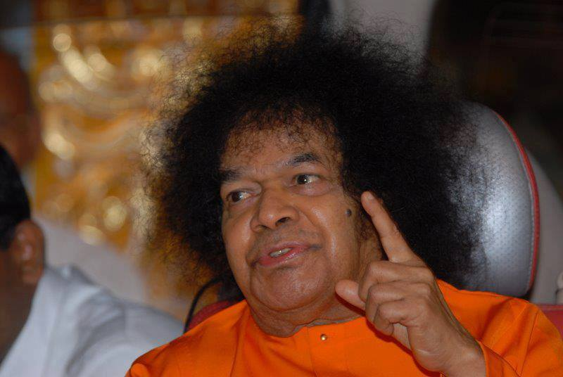
Bhagawan Uvacha
“Today is Yugadi day. It is really a beginning of a Yuga.
The Lord is the beginning and the end of every Yuga.
Hence, He is called “Yugadikrit”.
He is also called "Yugadhara" -Sustainer of Yuga
He is also known as “Yugandhara” as Divinity is the power behind the creation, sustenance and dissolution of every Yuga”
-07 April 1989

Slide 7
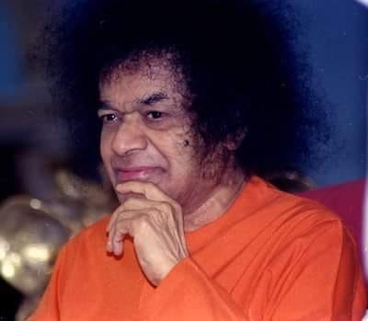
Bhagawan Uvacha…
“You may be thinking about the events that are going to take place in the forthcoming New Year (Ugadi). You think that the New Year would bring you happiness or sorrow. The year may be new, but what does it matter if you do not give up your old and mean habits? You aspire for good results, but are you performing good deeds?”
-16th March 2003

Slide 8
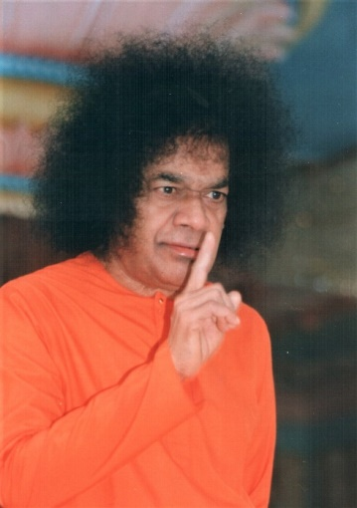
Bhagawan Uvacha…
“You expect others to be good toward you, but are you good toward them? If you act against the dictates of your conscience, how can you expect to be happy?”
-16th March 2003

Slide 9
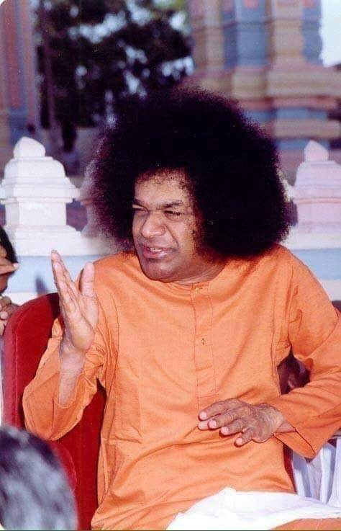
Bhagawan Uvacha…
“Your deeds should be in accordance with your aspirations. Good deeds will certainly yield good results. Today people are immersed in Adambara (pomposity). How can such people attain Ananda (bliss)?”
16th March 2003

Slide 10
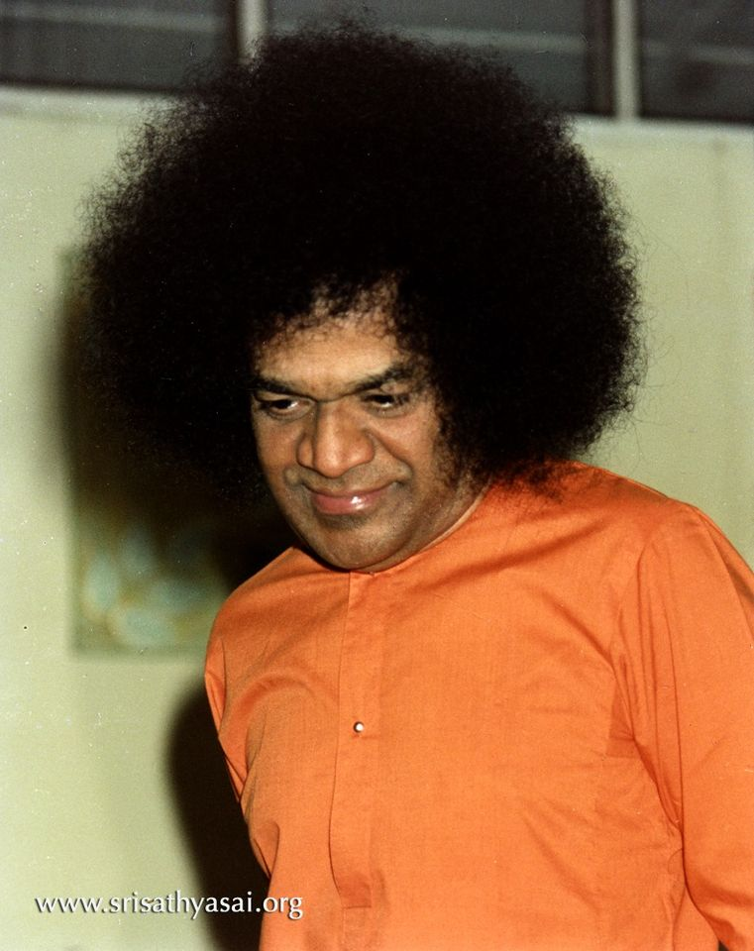
Bhagawan Uvacha…
“Embodiments of Love! Do not lead a pompous life. Adambara is the root cause of Asanthi (restlessness). Give up Adambara and strive to attain Ananda”
-16th March 2003

Slide 11
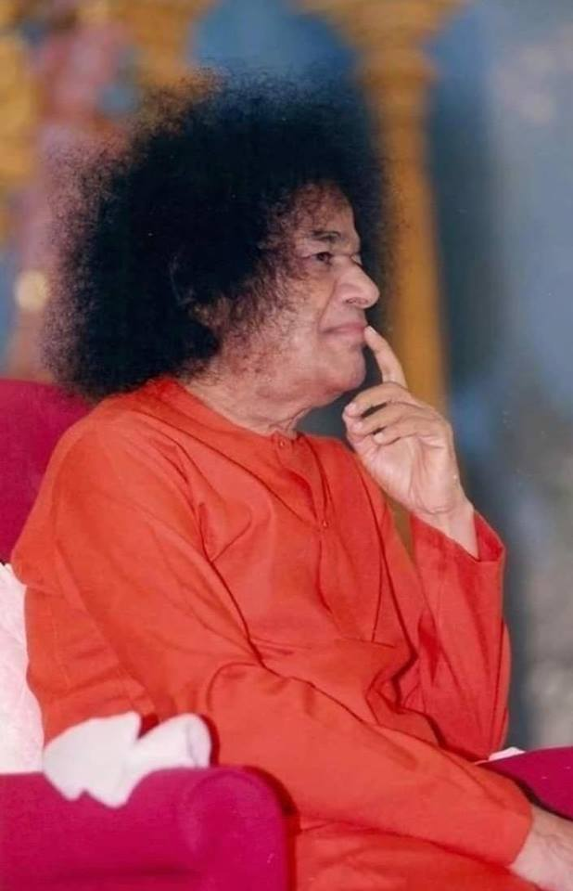
Bhagawan Uvacha…
“How do we celebrate the Ugadi? We sweep, we clean, we remove the cobwebs, we whitewash the walls, we hang up festoons and greens, floral garlands and croton leaves; we wear new dresses, we feast on new types of dishes. For one day, we feel fresh and renovated”. -27th March 1971

Slide 12
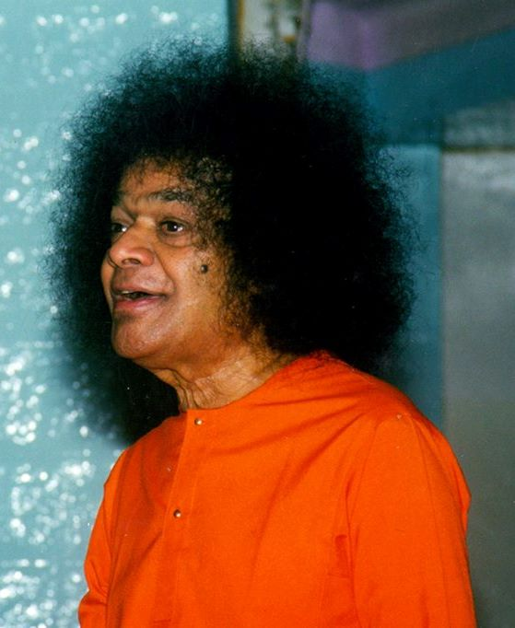
Bhagawan Uvacha…
But…Should not we too brush the cobwebs from our mind? Should we not get rid of opinions and motives which tarnish and demean?
- 27th March 1971

Slide 13
Bhagawan Uvacha…
“On Yugadi day, it is the practice among the rural folk to eat what is called "Yugadi pachchadi" . This chutney is made from neem flowers, mango juice, honey, sugar and other ingredients with different tastes. The inner significance of this preparation is to indicate that life is a mix-rare of good and bad, joy and sorrow and all of them have to be treated alike.”
7th April 1989

Slide 14
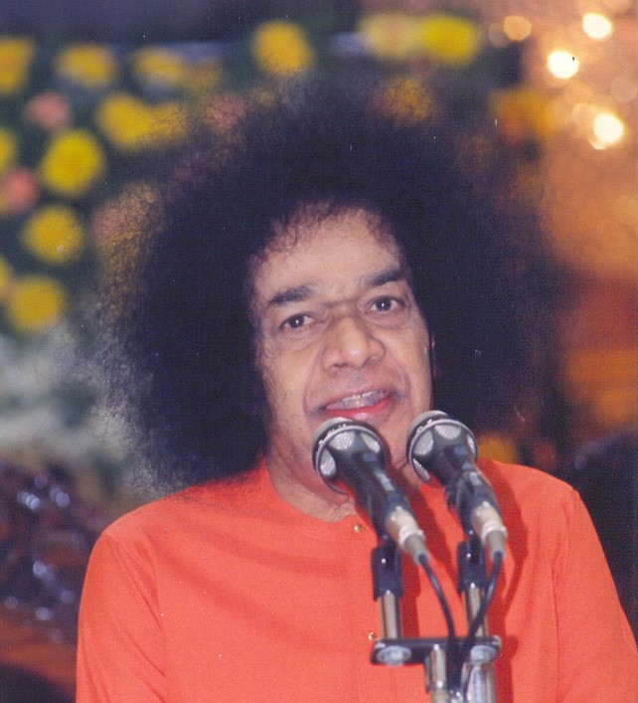
Bhagawan Uvacha…
“All experiences have to be treated with equanimity. Everyone should make a resolve that he will face calmly whatever happens in this year, accepting it with good grace. Welcome everything. Consider everything as for your own good. Men should rise above sorrow and happiness, success and failure. This is the primary message of the Yugadi festival.”
7th April 1989

Slide 15
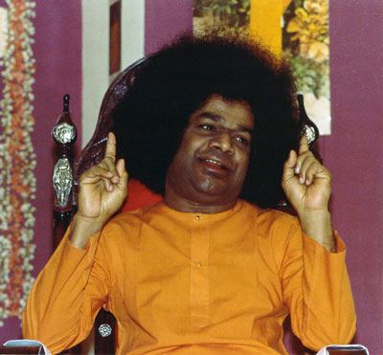
Bhagawan Uvacha…
“Everything that occurs should be treated as a gift from God. This world is a mixture of pleasure and pain, which are inseparable. Pleasure is the outcome of pain. By developing equal-mindedness, you must cherish faith in God.”
-7th April 1989.

Slide 16
Bhagawan Uvacha…
Happy Ugadi
Thank you
& JAI SAI RAM

