Slide 1
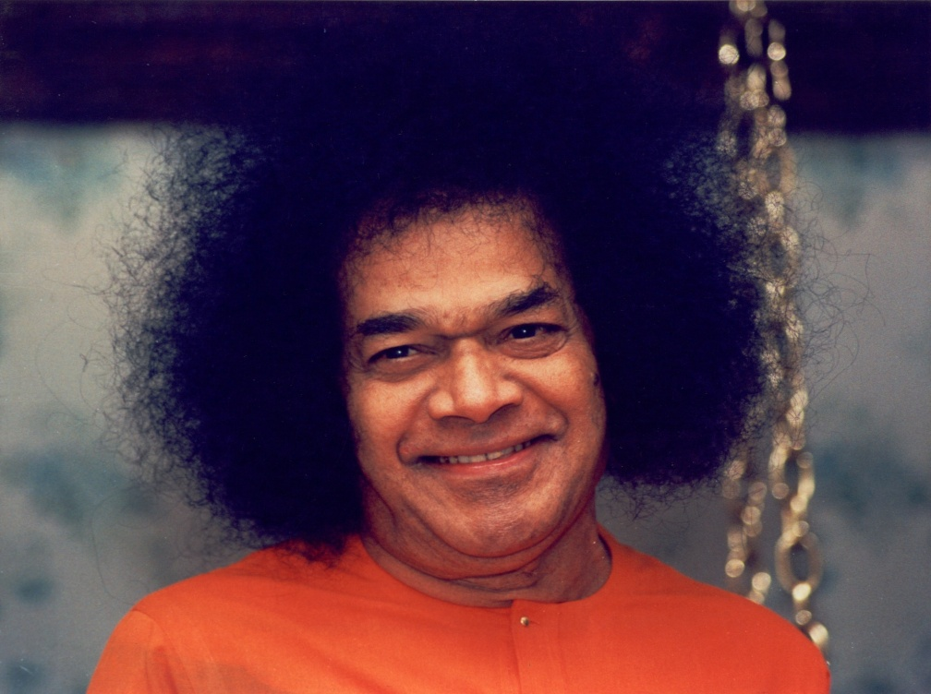
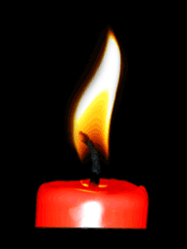
Multi Significance
of
Nine Point Code of Conduct

Slide 2
Significance of Number 9
9 forms of Devotion ( Nava vidha Bhakthi)
9 Nights ( Navaratri)
9 planets ( Navagrahas )
9 Point Code of Conduct…

Slide 3
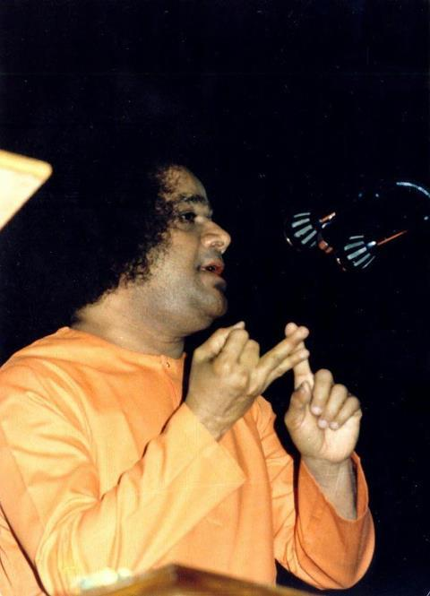
First All India Conference- 1967- Madras
1.We should be interested in
our Liberation
2.We should have unshakable
faith in Name, Form and
Teachings of Swami.
3. We should be recognized
as a Good Person in Society

Slide 4
1980- Nine Point Code of Conduct
Avatar’s Gift to Humanity For Sadhana & Evolution
Prescription for Complete
Human Experience
Must for all “Sai Devotees”
especially Office bearers
Helps in Spiritual Growth
of Individual, Family and
Society.

Slide 5
9 point code of Conduct
Daily Meditation & Prayer
Devotional Singing / Prayer with members of one’s own family once a week
Participation of children of family in Bal Vikas of the organization
Attendance at least once a month at Bhajan and Nagarsankirtan of the organisation
Participation in community service of the organisation
Regular Study of Sai Literature
Speaking Softly & Lovingly with everyone with whom one comes into contact
Not to indulge in talking ill of others especially in their absence
Putting into practice principle of “ Ceiling on Desires” and utilise any savings thereby generated for the Service of Mankind

Slide 6
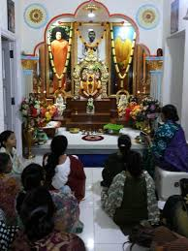
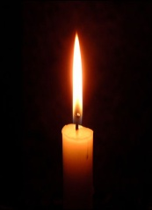
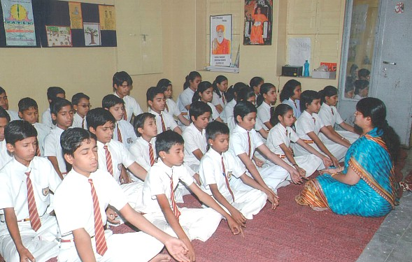
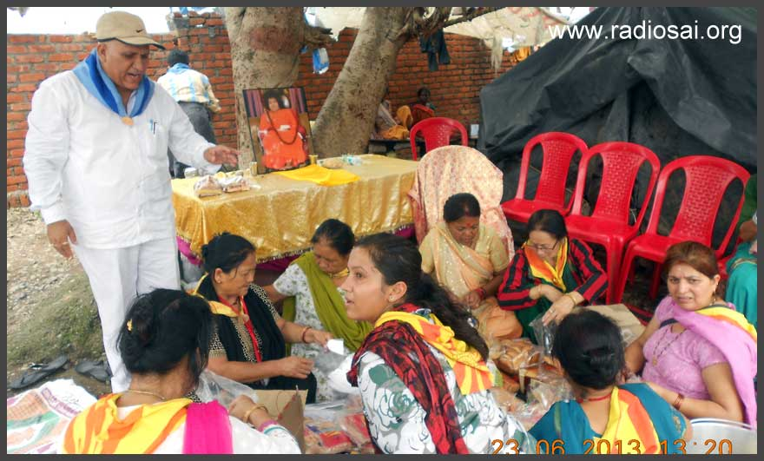
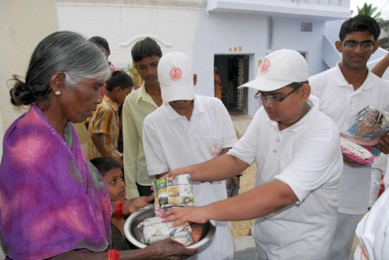
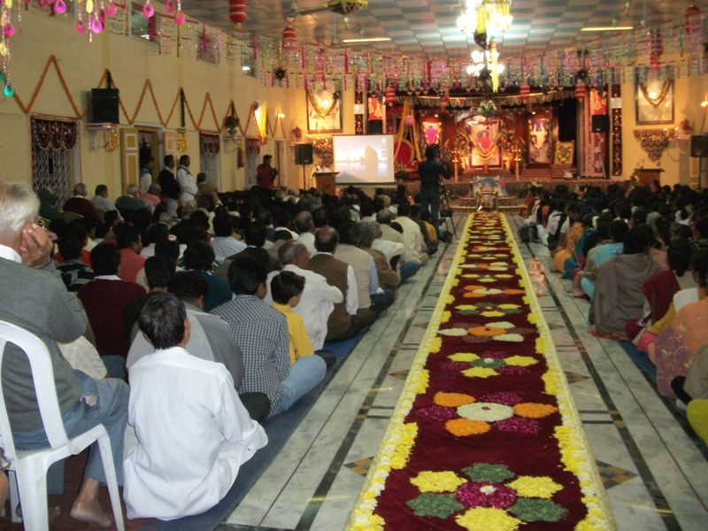
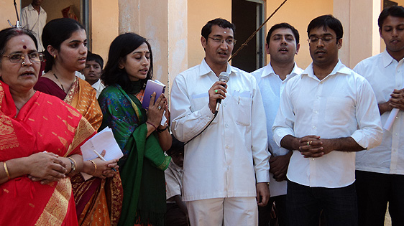
9 point code of Conduct

Slide 7
Ideal Sadhana at 3 Levels
INDIVIDUAL
SOCIETY
ORGANISATION

Slide 8
9 Point Code of Conduct
Daily Meditation & Prayer
Devotional Singing / Prayer with members of one’s own family once a week
Participation of children of family in Bal Vikas of the organization
Attendance at least once a month at Bhajan and Nagarsankirtan of the organisation
Participation in community service of the organisation
Regular Study of Sai Literature
Speaking Softly & Lovingly with everyone with whom one comes into contact
Not to indulge in talking ill of others especially in their absence
Putting into practice principle of “ Ceiling on Desires” and utilise any savings thereby generated for the Service of Mankind.

Slide 9
5 Runas / Obligations
Daiva Runa
Rushi Runa
Pithru Runa
Samja Runa
Bhuta Runa

Slide 10
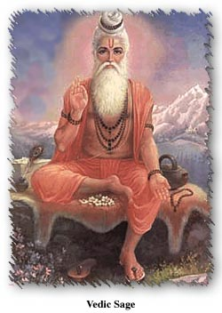
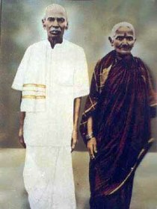
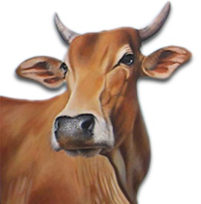
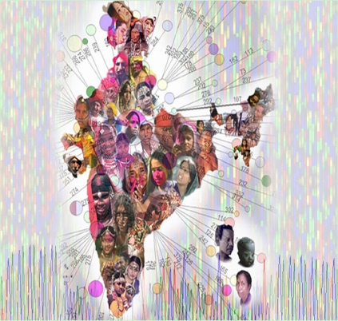
RUSHI
RUNA
Rushi Runa
DAIVA
RUNA
Daiva Runa
PITRU
RUNA
Pithru Runa
Bhuta Runa
BHUTA
RUNA
SAMAJA RUNA

Slide 11
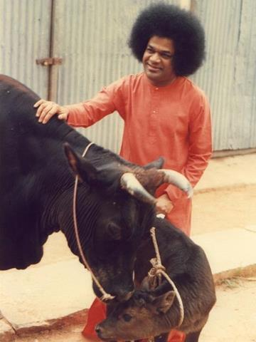
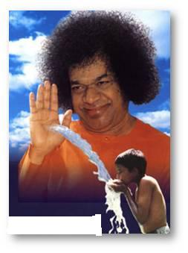
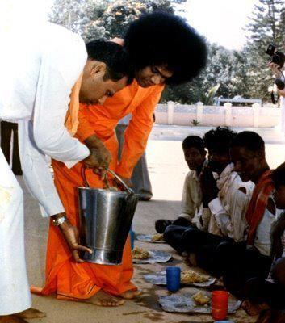
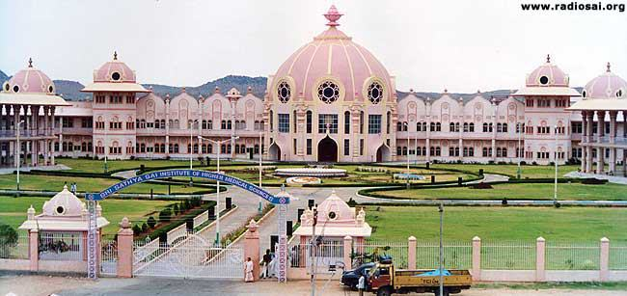
Swami Demonstrates!!

Slide 13
Daily Meditation & Prayer
Devotional Singing / Prayer with members of one’s own family once a week
Participation of children of family in Bal Vikas of the organization
Attendance at least once a month at Bhajan and Nagarsankirtan of the organisation
Participation in community service of the organisation
Regular Study of Sai Literature
Speaking Softly & Lovingly with everyone with whom one comes into contact
Not to indulge in talking ill of others especially in their absence
Putting into practice principle of “ Ceiling on Desires” and utilise any savings thereby generated for the Service of Mankind

Slide 14
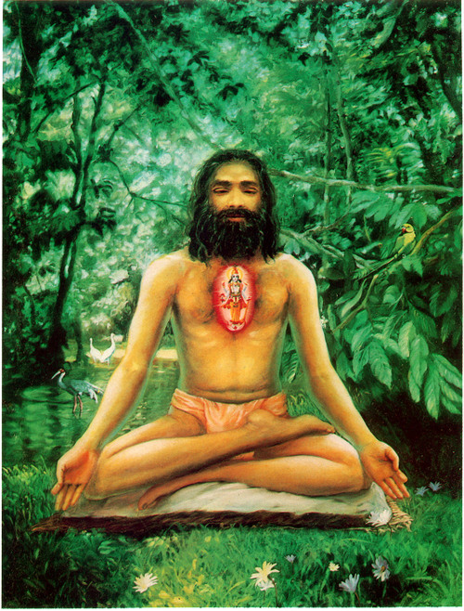
9 point code of conduct
We do 3 Tapas when we follow 9 points as mentioned in the 17th chapter Of Bhagwat Gita
KAYAKA
(With Body)
1 to 8
MANASIKA
( With Mind)
VACHIKA
( With Words)
All 9 pts
6 & 7

Slide 15
Daily Meditation & Prayer
Devotional Singing / Prayer with members of one’s own family once a week
Participation of children of family in Bal Vikas of the organization
Attendance at least once a month at Bhajan and Nagarsankirtan of the organisation
Participation in community service of the organisation
Regular Study of Sai Literature
Speaking Softly & Lovingly with everyone with whom one comes into contact
Not to indulge in talking ill of others especially in their absence
Putting into practice principle of “ Ceiling on Desires” and utilise any savings thereby generated for the Service of Mankind

Slide 16
9 point code of Conduct
A sincere practice of 9 points will benefit the member in many ways:
We Live as Per Indian Culture
Practice the 3 Eligibility of Bhagwan
True Progress in Spiritual Sadhana
Discharge the 5 debts of Human Being
Practice the 3 Tapas of Body Mind and Word as mentioned in Bhagwat Gita

Slide 17
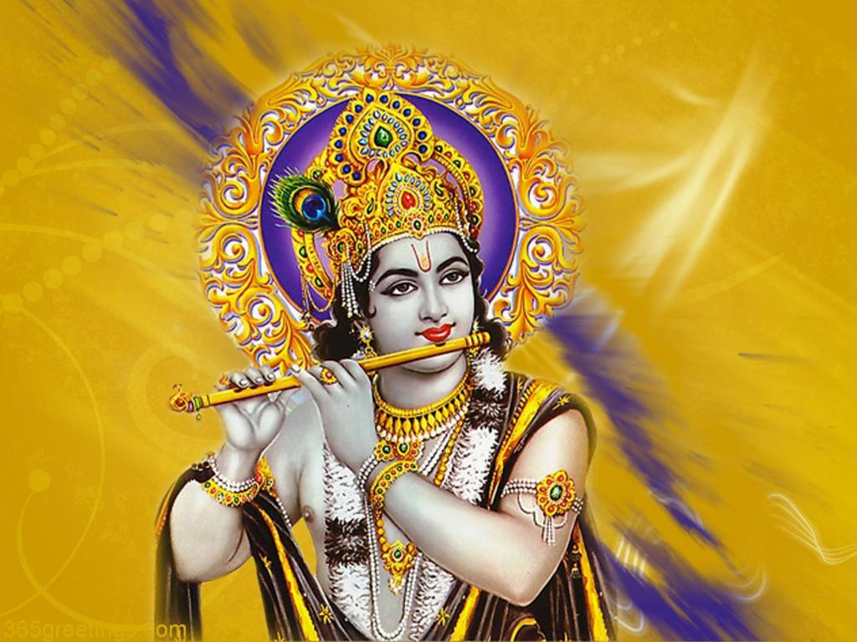
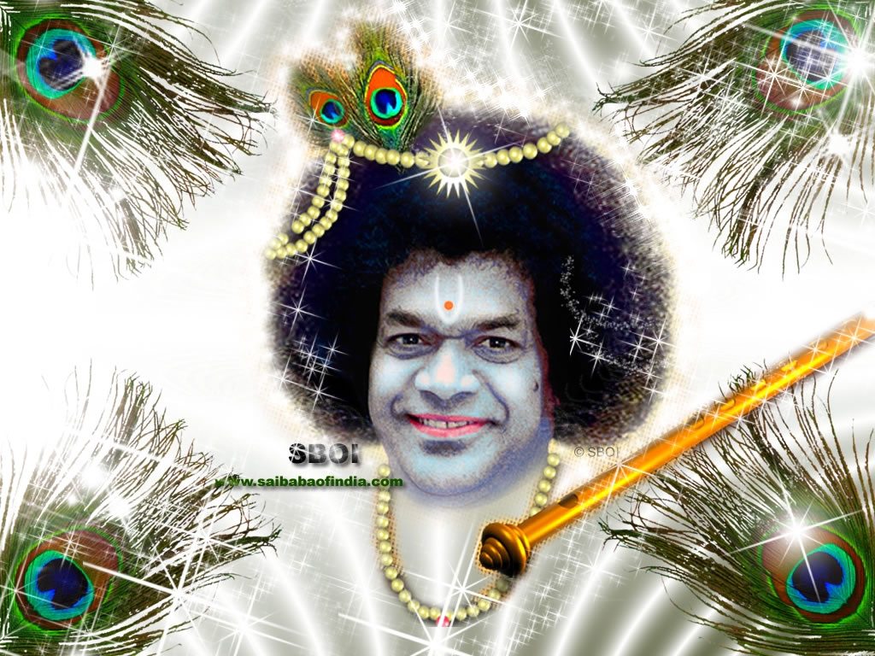
When we practice the 9 code of Conduct…
We become Hollow like the FLUTE…

Slide 18
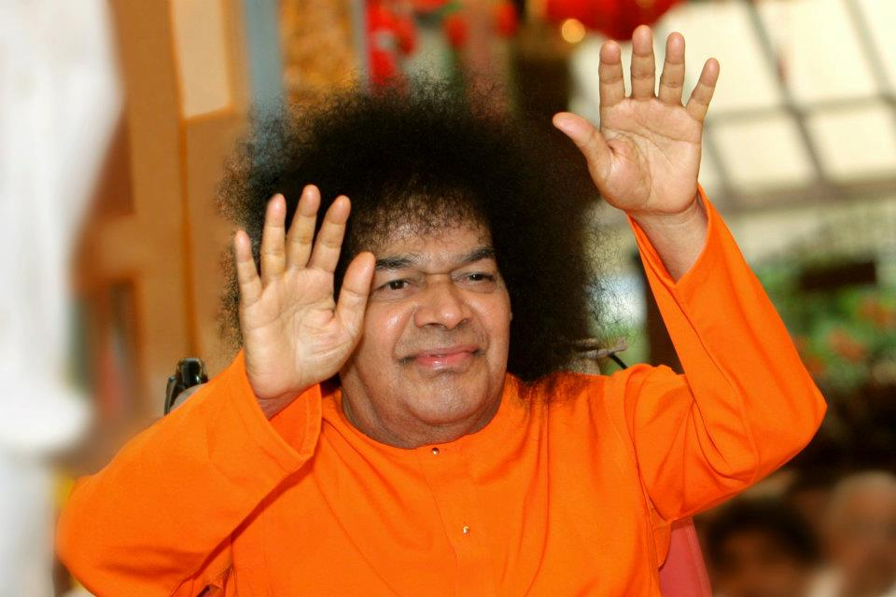
Jai Sai Ram

