Slide 1
Ramakatha Rasavahini

Slide 2
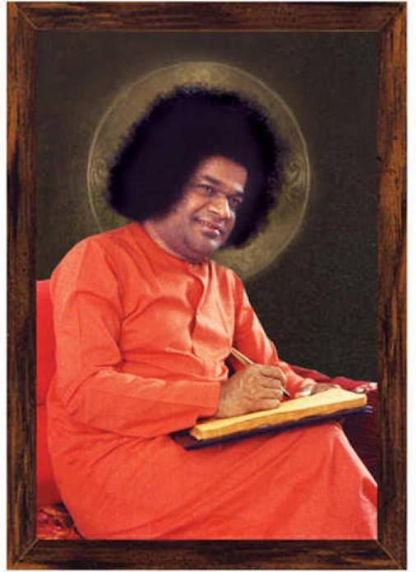
Ramayana
There are many Ramayanas available
But Ramakatha Rasavahini is an Autobiography written by Sai Rama…

Slide 3
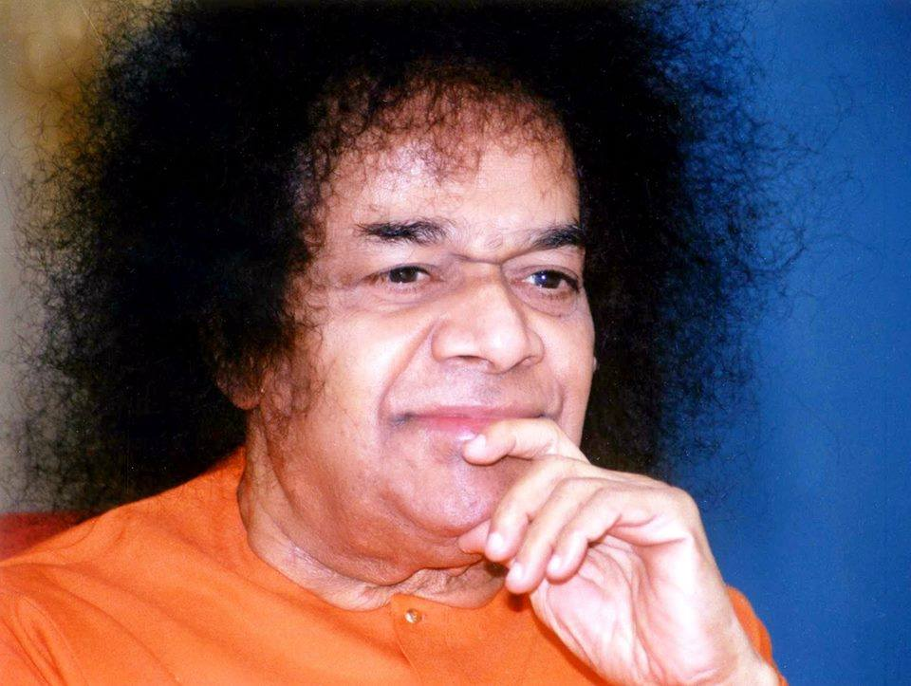
Rama katha Rasavahini
We all know the story of Ramayana but Swami wants us to understand the inner values of Ramayana ….

Slide 5
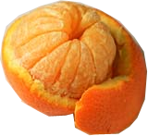
Only juice…..
Do We consume
The Orange peel
Along with the fruit?
No….

Slide 6
Inner Essence
Rama = Atma Rama
Dasaratha= 10 senses
Sita = Bramha Gnana
3 Queens = 3 Gunas
Sathwa/ Rajo/ Tamo
4 Sons = 4 Purushartas
Dharma/Artha/Kama/Moksha
3 Rakshasas are also 3 Gunas
Ravana= Rajasic
Kumbakarna = Tamas
Vibhishana = Sathwik

Slide 7
Ikshvaku Dynasty
Khatvanga
Dileepa
Raghu
Aja
Dasaratha
All kings were followed Dharma
Kings beyond Age gave the authority to their sons.
Followed scriptures and Vedas
Consulted Sages and Seers before taking a decision.

Slide 8
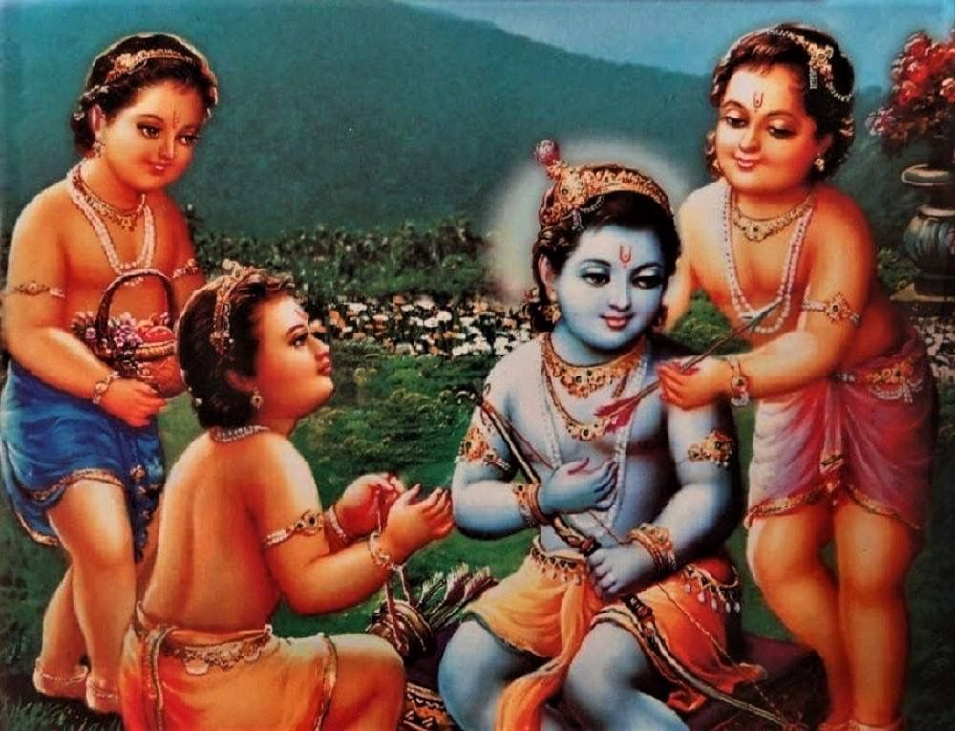
Vedas in Human Form
Swami has said that Sakshath Vedas have taken a human form as follows:
Rama- Rig Veda
Lakshmana- Yajur Veda
Bharatha- Sama Veda
Satrughna- Atharvana Veda

Slide 9
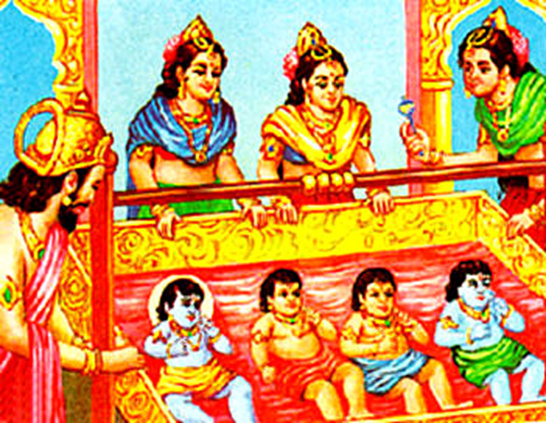
Four Sons of Dasaratha…
Lakshmana was
Amsha of Rama
Sathrughna was
The Amsha of
Bharatha

Slide 10
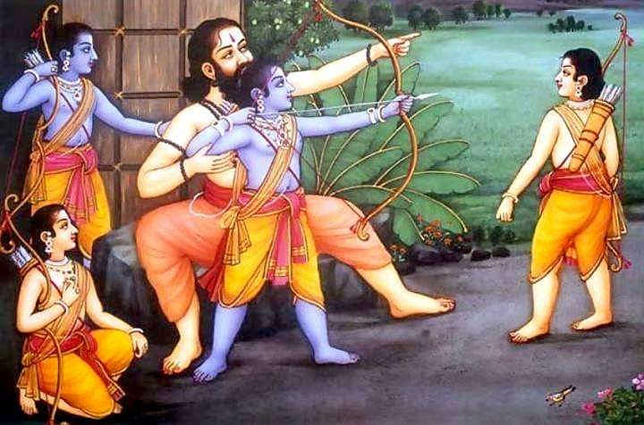
Eha and Para Education
They travelled from Kashmir to Kanyakumari in three months visited all temples
And improved the infrastructure of the temples etc…

Slide 11
Avataric Mission begins…..

Slide 12
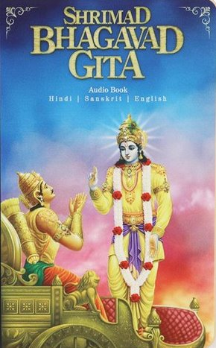
There are 29000 verses in Yoga Vasistha

Slide 13
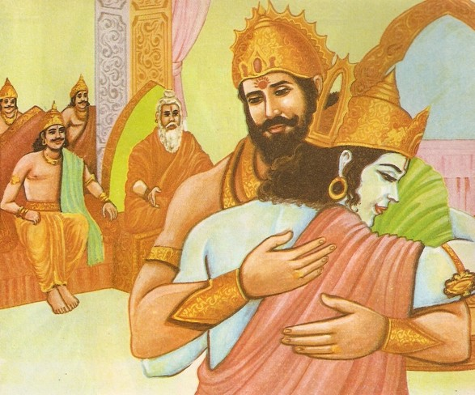
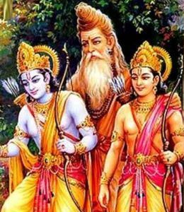
Rama had Maya Upadhi…..
Dasaratha and even Vishwamitra were affected by
Rama’s Maya!
Bala Athi Bala...

Slide 14
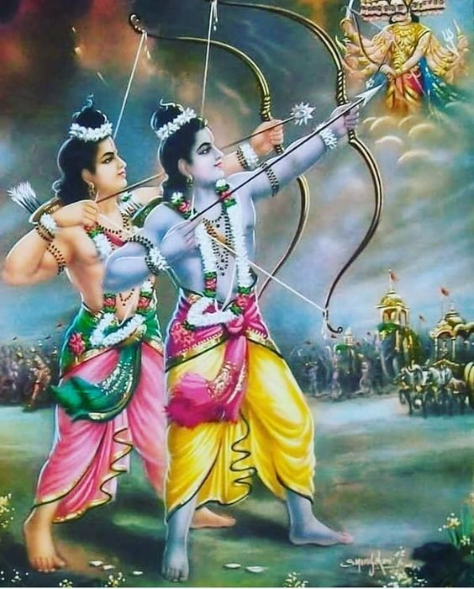
Rama Lakshmana Seva…
Rama and Lakshmana had sacrificed Food and Sleep…and did Seva to protect Yagna….

Slide 15
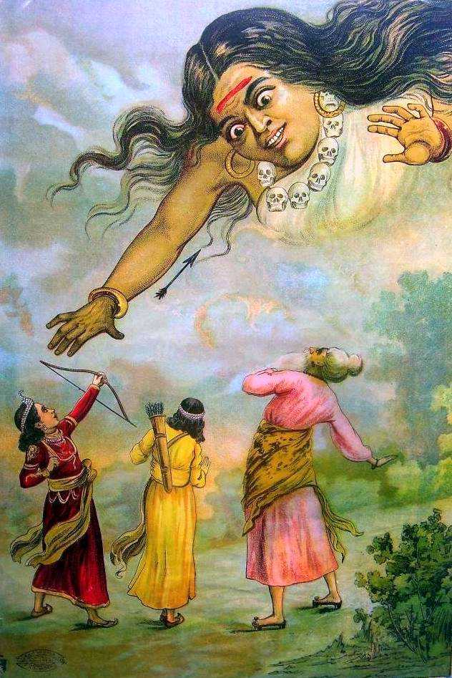
Tataki Killed by Rama
Lesson on Dharma from Rama….

Slide 16
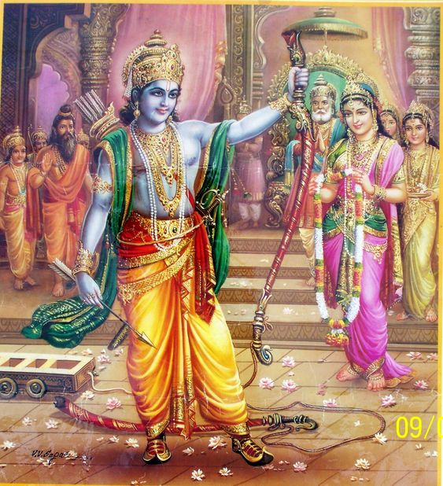
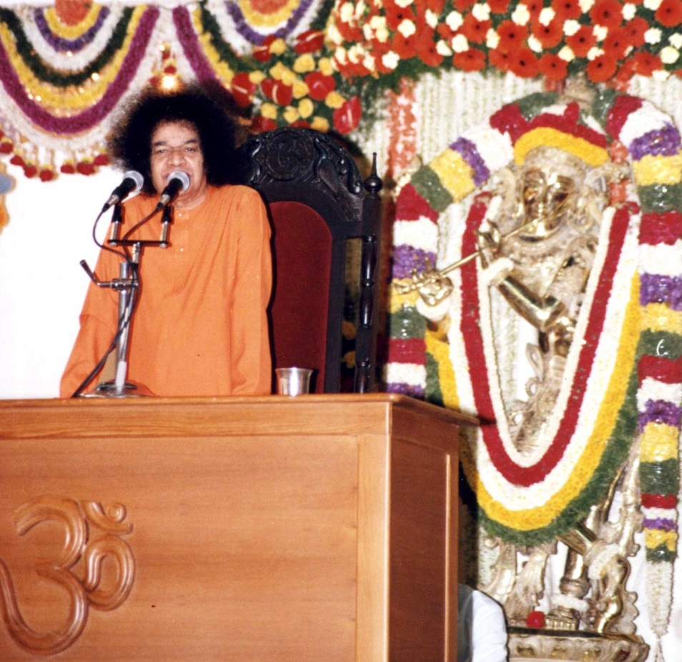
Sita Rama Kalyana…
Rama’s is full of Magnetism…So was Sita…..
Both used their left hand to lift the Shiva Dhanus !

Slide 17
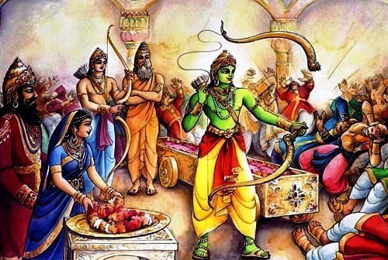
Inner Significance….
To attain Sita who is Bramha Gnana, the Shiva Dhanus of Body attachment will have to be broken is the inner Significance….

Slide 18
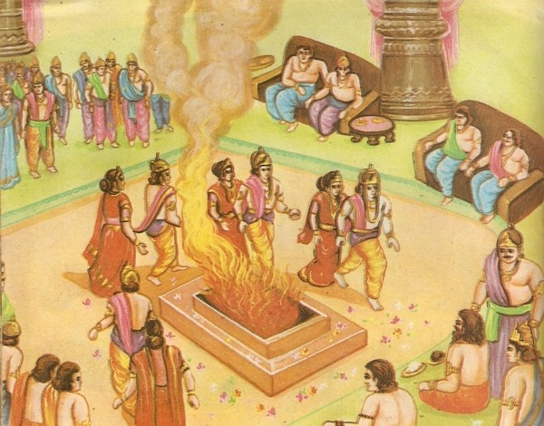
Four Sons get Married ….
The four Sons were married in one Muhurtha..
Rama to Sita
Lakshmana to Urmila
Bharatha to Mandavi
Sathrugna to Sruthakeerthi

Slide 19
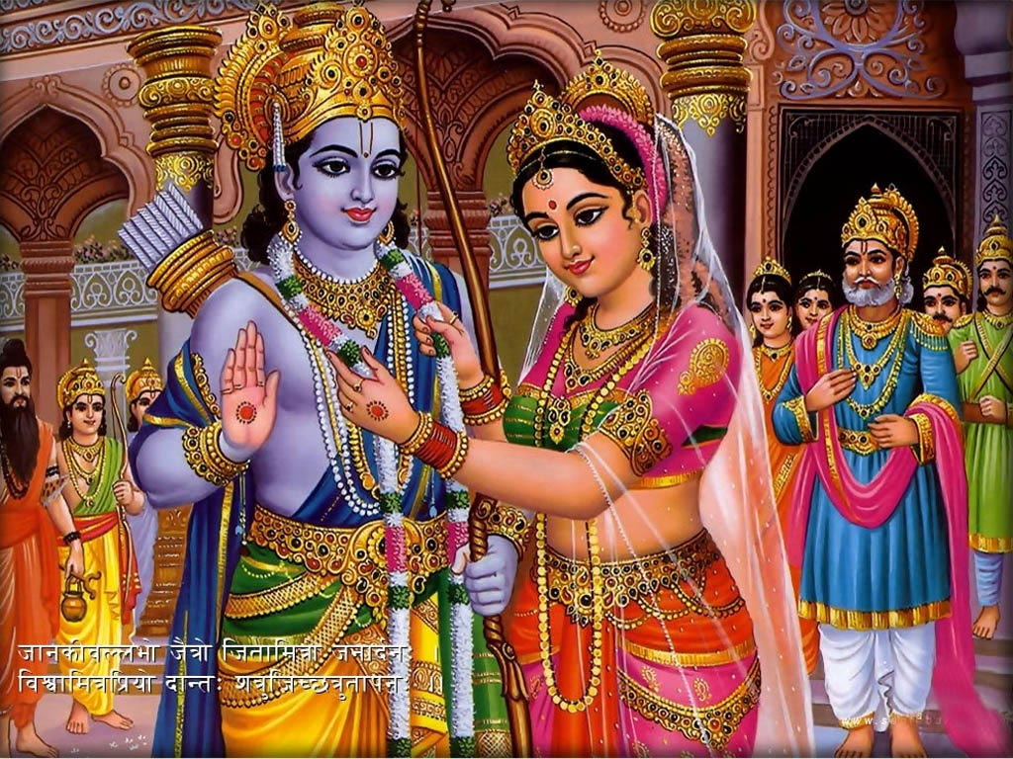
Sita Rama Kalyana
Lakshmana’s Presence of mind and Sita’s Smartness !!
Marriage of
Purusha and Prakruthi

Slide 20
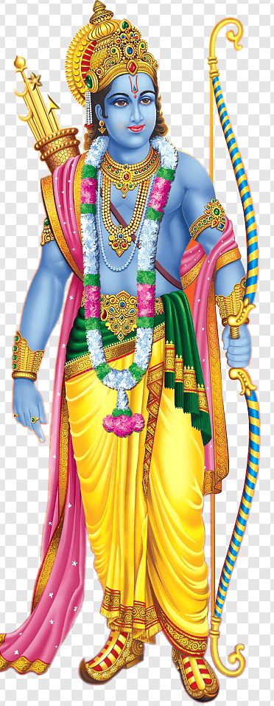
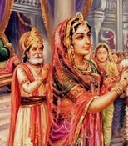
Lesson on Dharma by Rama…
Not to look at woman till
Marriage is Completed !

Slide 21
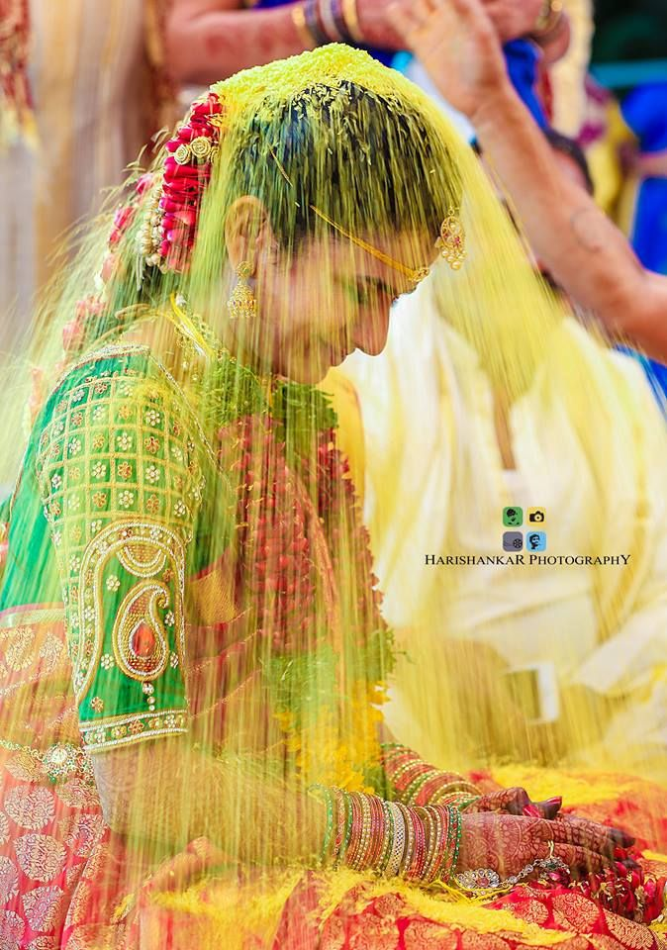
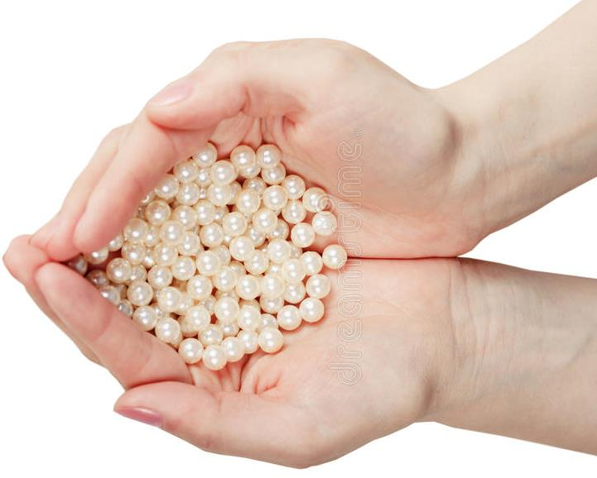
Sita Rama Kalyana

Slide 22
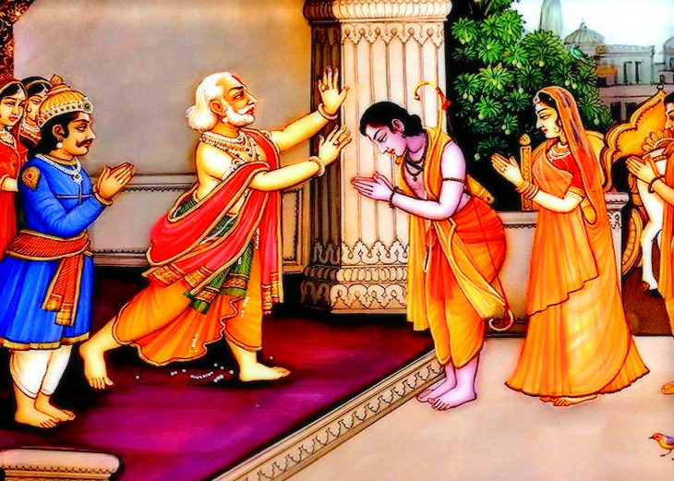
Rama refused Pattabhishekam…
Sri Rama believed in Equality among brothers..
He said
Brothers born together
Education together
Marriage to gether
Why not Coronation also together?

Slide 23
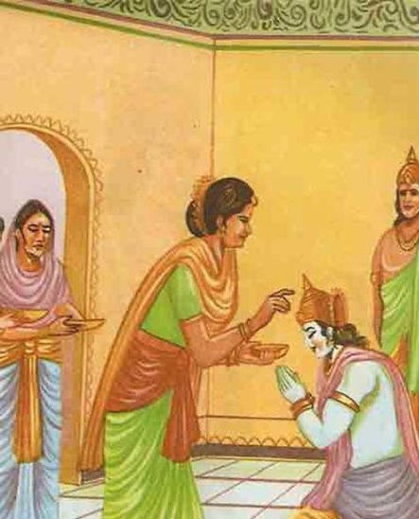
Kaikeyi’s Sacrifice
Swami says it was Rama
Who pleaded with Kaikeyi
to ask for boons
To help in HIS Avataric mission

Slide 24
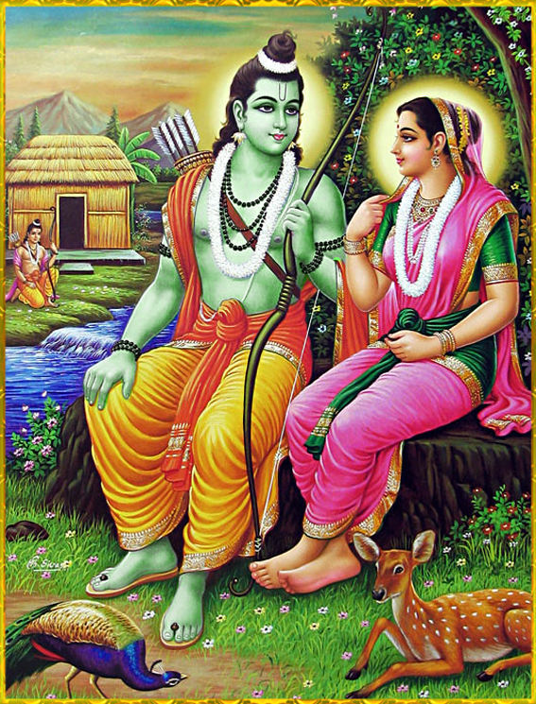
Sita Wins Argument…
Ramachandra…..
Moon & Shadow cannot
Be in different places!
How can we have two
Dharma for Dharmapatni?

Slide 25
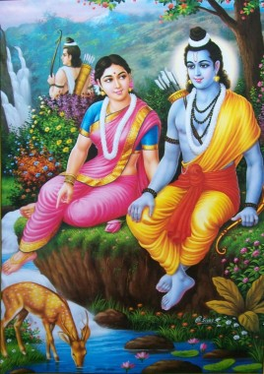
Sita and Urmila
Fundamental
Discrimination

Slide 26
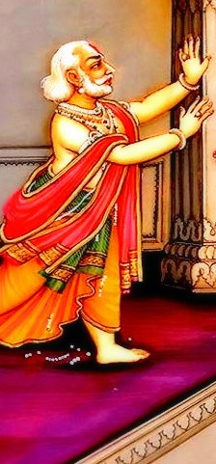
Ramo Vigrahavan Dharma:
Stop !
Sumantra…

Slide 27
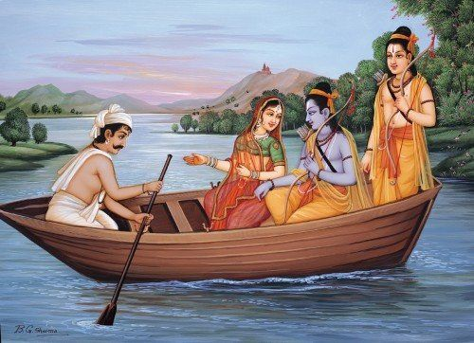
Guha’s Wisdom…
Guha to Sri Rama: Both of us do the Same Work !

Slide 28
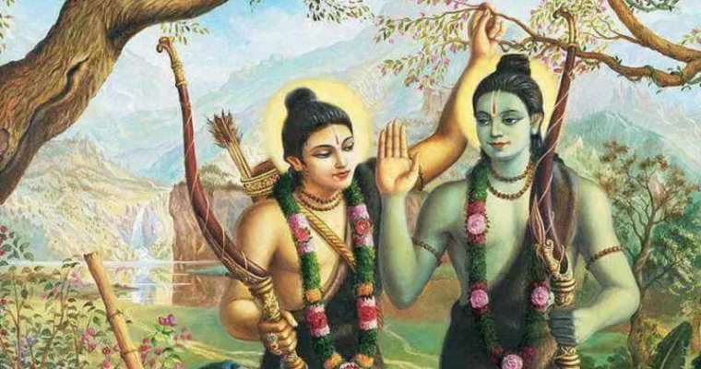
Lakshmana’s Surrender to Rama
At the Chitrakoota Mountain…

Slide 29
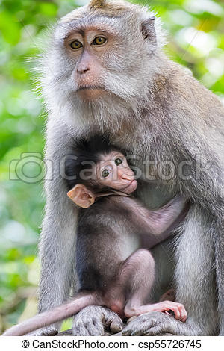
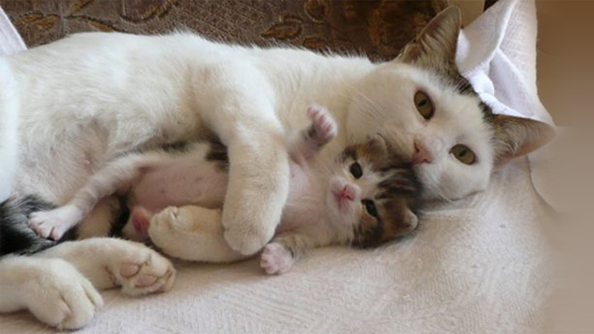
BHAKTI
PRAPATTI
Markata Kishora
Love of GOD
Love
Devotee should face Tests
Prahlada
Marjala kishora
Complete Surrender
Love
Sarva Bhara Samarpita…
Lakshmana

Slide 30
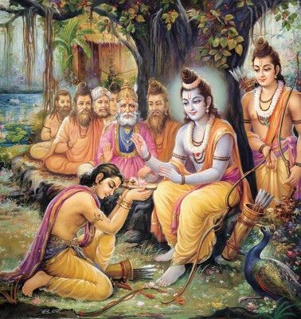
Bharatha to Forest…
Bharatha’s efforts
To get back Rama to
Ayodhya was in Vain..
Discussion between
Prema and Dharma

Slide 31
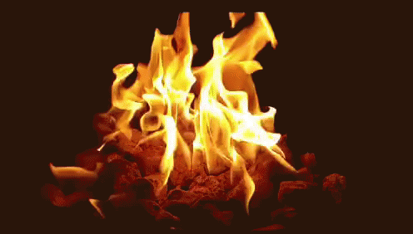
Rama & Sita are Fire Principles…

Slide 32
Dear Vs. Deer

Slide 33
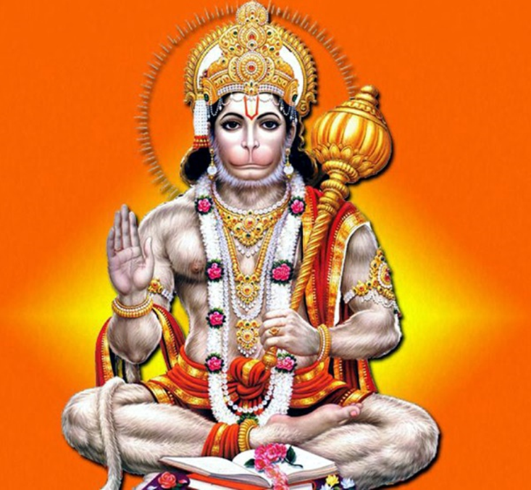
Enter Hanuman…..
Perfect Devotee
Perfect Sevadal
Intelligent
Courageous
Presence of Mind
Devoted
Singer
Poet

Slide 34
Hanuman Meets His Master

Slide 35
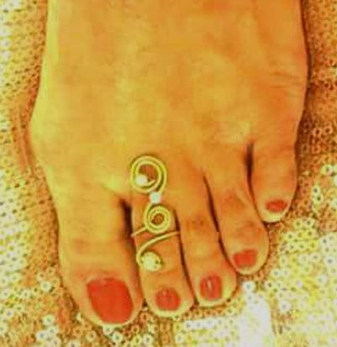
Lakshmana’s Modesty

Slide 36
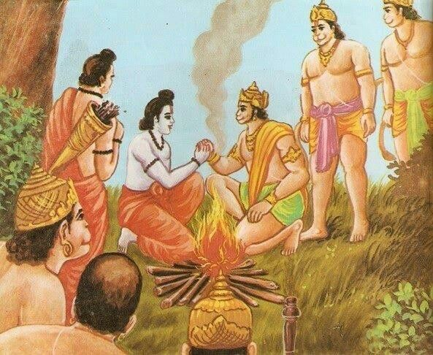
Friendship with Sugriva
Swami talks of 4 Purushartas:
Maitree
Karuna
Muditha
Upeksha

Slide 37
Vali is Killed by Rama

Slide 38
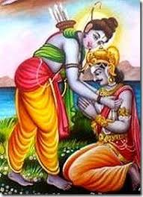
Vibhishana
Though born as Rakshasa
Younger brother of Ravana
Had deep devotion to Rama
Who ever sincerely surrenders to
Lord, HE will accept…

Slide 39
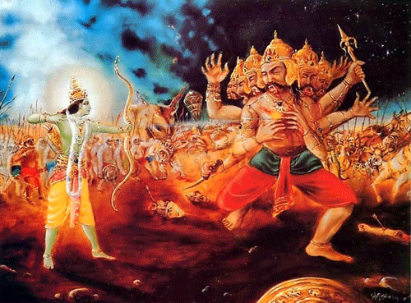
Ravana is Killed
After 75 days of war, Ravana was killed by Rama

Slide 40
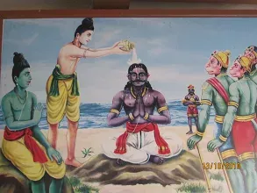
Vibhishana was made the King
Rama asked Lakshmana to coronate Vibhishana as the king of Lanka…

Slide 41
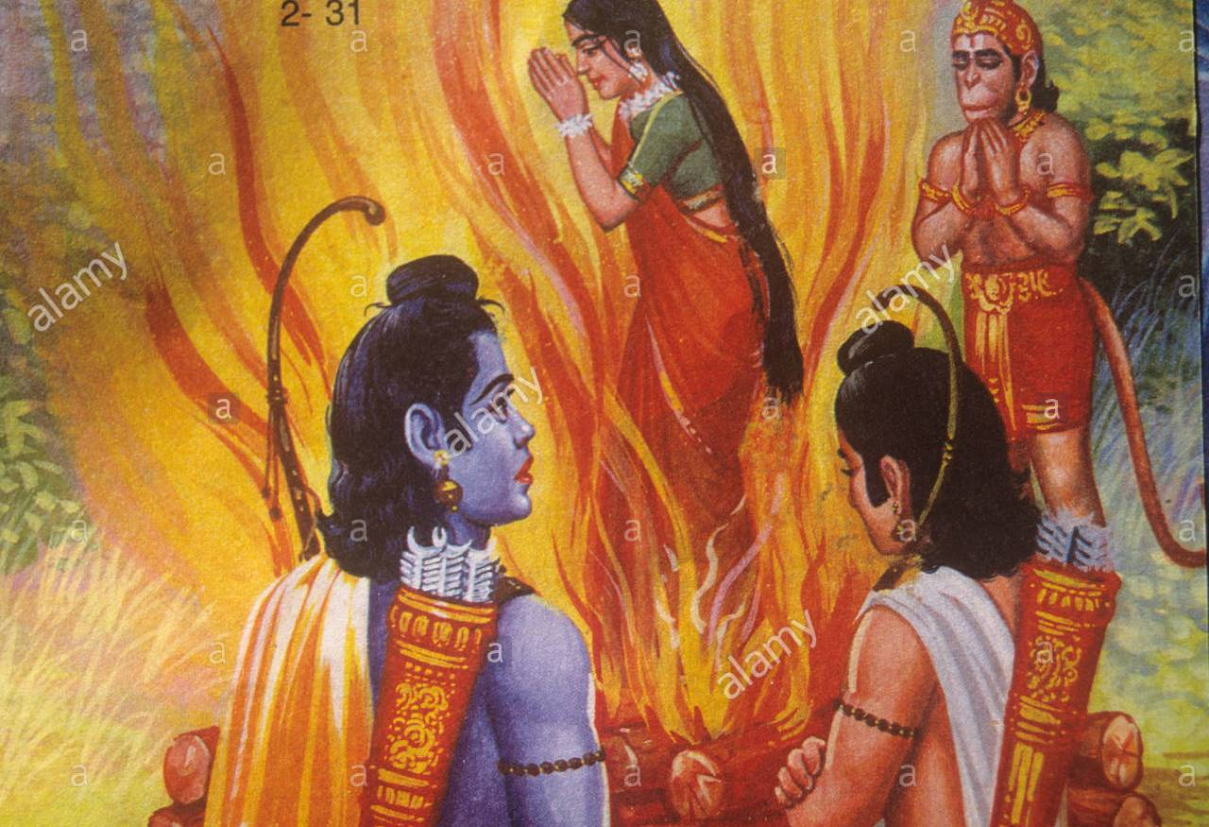
Shakthi Sita Returns
The shakthi of Sita was deposited in Fire
Sita had to go back to Fire and emerge as Sita embodied Shakthi…

Slide 42
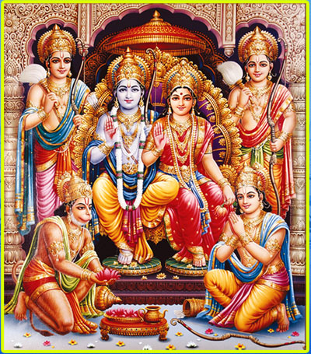
Pattabhishekam
Rama, Sita and Lakshmana return to Ayodhya
After 14 years . Rama was Crowned the King…

