Slide 1
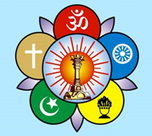
Bhagawan Uvacha….
Sri Sathya Sai Seva Organisations
Karnataka South
Presents precious gems extracted from Bhagawan's Discourses and Vahini on Ramayana…worth contemplating when we observe the auspicious Ramanavami.

Slide 2
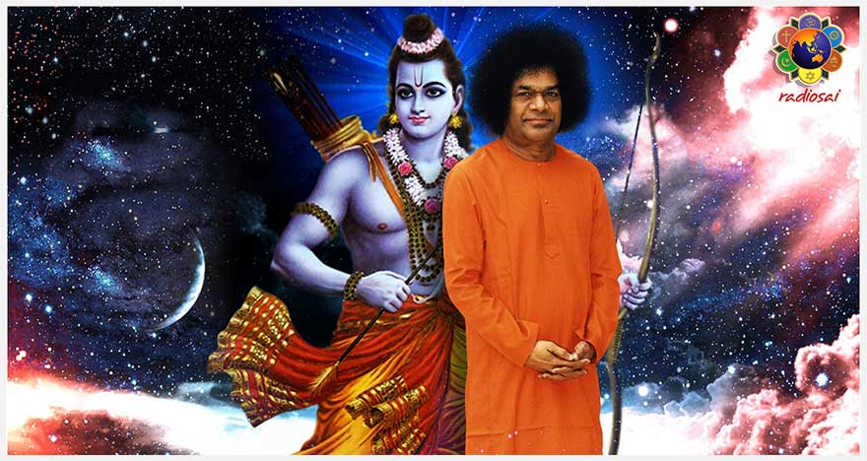
Ramanavami Messages ….
Message of Sri Rama from Sai Rama

Slide 3
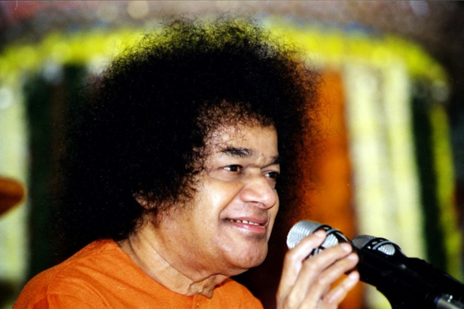
Power of Rama’s Name
The term “Rama” consists of three syllables: Ra +Aa +Ma.
Ra- signifies Agni – Burns all Sins
Aa- signifies Surya- Dispels Ignorance
Ma- signifies Chandra – cools one’s temper

Slide 4
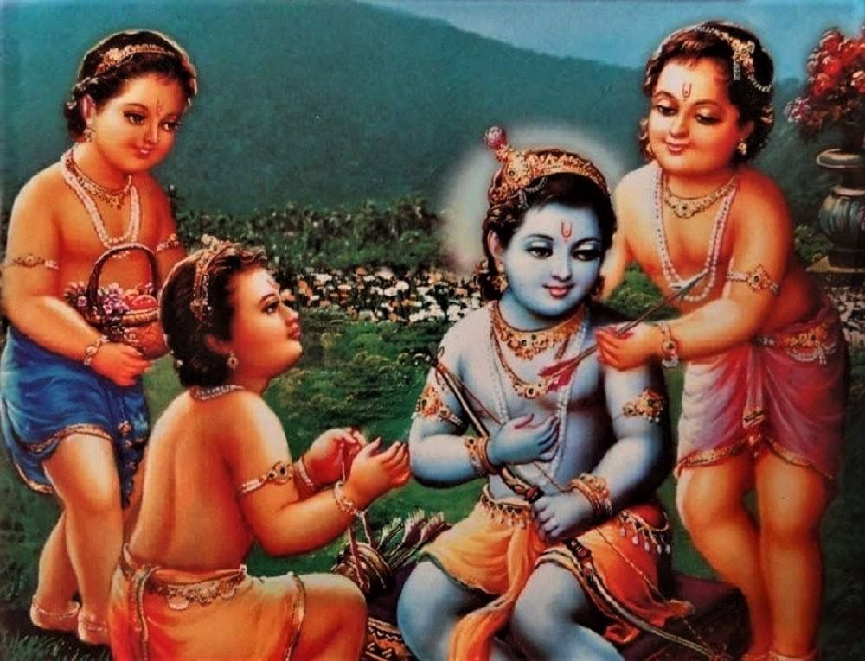
Vedas in Human Form
Swami has said that
“Sakshath Vedas have taken a human form as follows:-
Rama- Rig Veda
Lakshmana- Yajur Veda
Bharatha- Sama Veda
Satrughna- Atharvana Veda”
Ramanavami 11th April 2000

Slide 5
Inner Essence of Characters
Rama = Atma Rama
Dasaratha = 10 senses
Sita = Bramha Gnana
3 Queens = 3 Gunas
4 Sons = 4 Purushartas
Dharma/Artha/Kama/Moksha
Ravana= Rajasic Guna
Kumbakarna = Tamo Guna
Vibhishana = Sathwik Guna
Source: Rama Katha Rasa Vahini

Slide 6
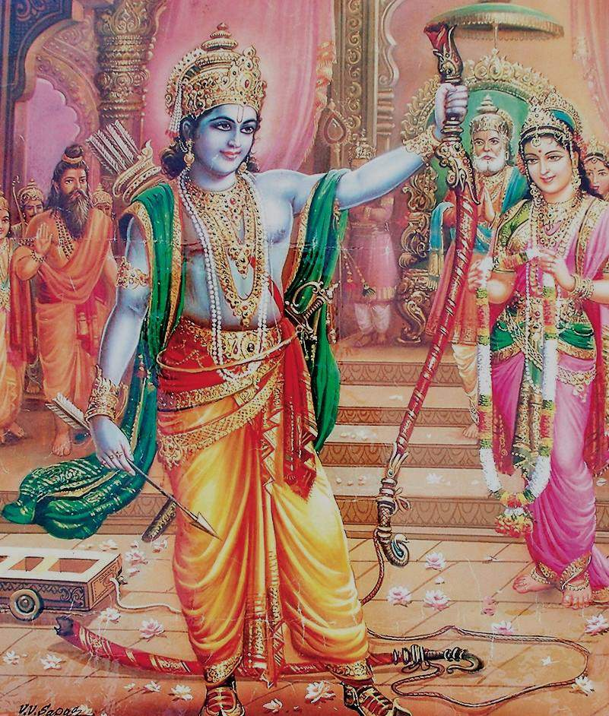
Shiva Dhanus…
In order to obtain “Bramha Gnana”
namely Sita, Rama had to
break the Body Attachment
of Shiva Dhanus….
Source: Rama Katha Rasa Vahini

Slide 7
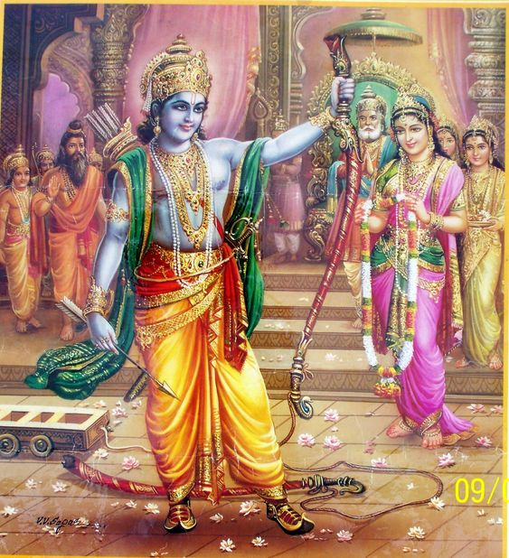
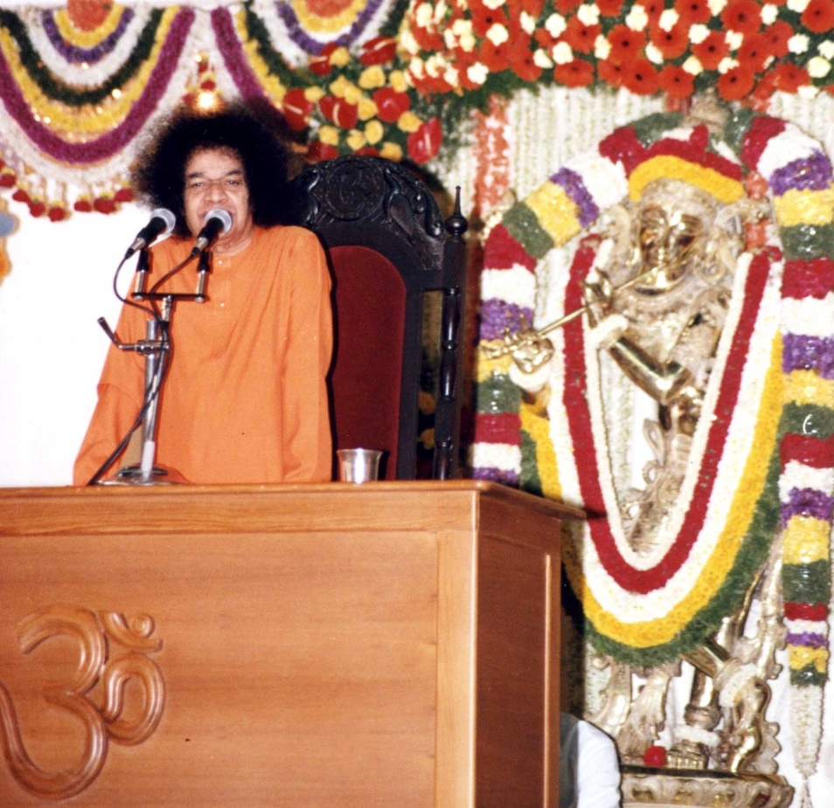
Sita Rama Kalyana…
Rama’s was full of Divine Magnetism…So was Sita…..
Both used their left hand to lift the Shiva Dhanus !
Source : Summer Showers 1996

Slide 8
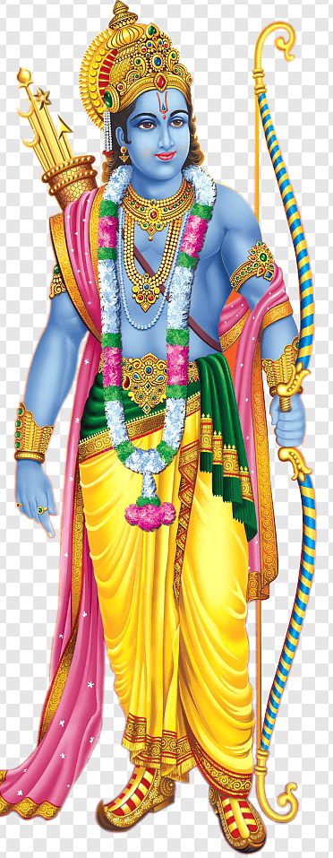
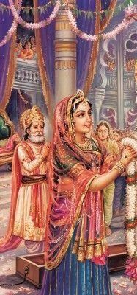
Lesson on Dharma…
“During the marriage,
Rama refused to look at
Sita. He said:
“I have not tried the
Mangala Sutra yet..
So its sinful to see a
Lady before marriage!
Rama demonstrated
IDEALISM here…”
Source: Summer Showers 1996

Slide 9
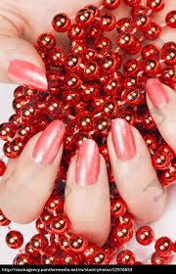
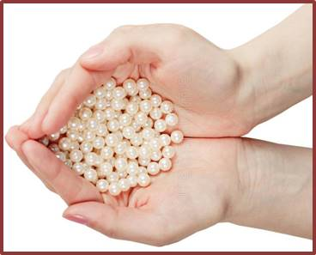
Manifestation Of three Gunas In Sita's Wedding
Spiritual Significance of “Talamralu” ..
In a princely marriage,
pearls were used instead of rice…
Sita was prakruthi, and with her red hands the pearls were Red in colour representing Rajo Guna.
When the pearls were poured on the white turban of Sri Rama, it turned white representing Sathwik Guna
And when it fell down turned dark
representing Tamo guna
Source: 25th May 1992- Summer Course- Brindavan

Slide 10
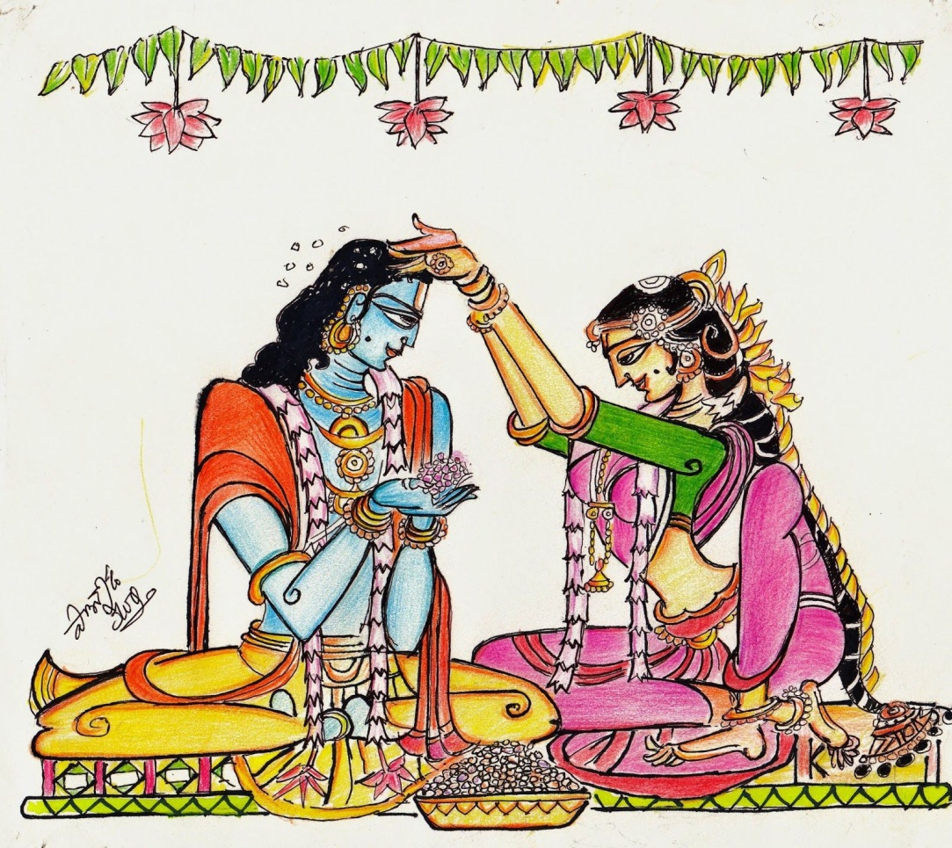
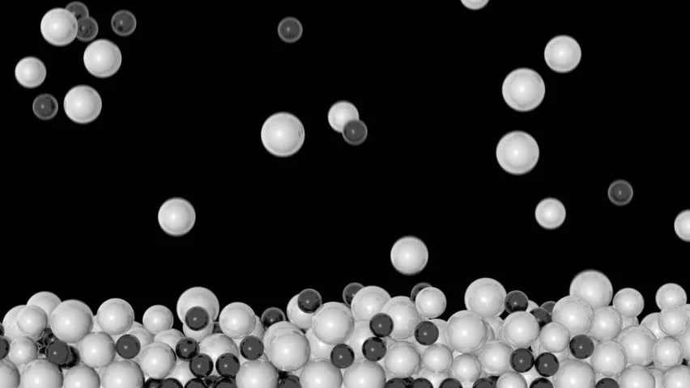
Talamralu
“When with Nature, its Rajasic Red..When near God, it turns white and away from God it turns black….”
Source: 25th May 1992 Summer Course Brindavan

Slide 11
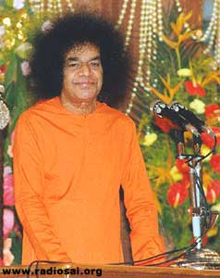
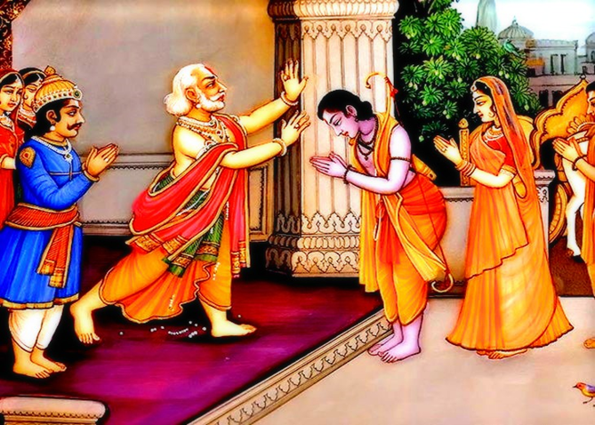
Rama’s Selflessness
“When father Dasaratha proposed…
Rama refused to be coronated..
He said: "Four of us
were born on the same day, same star.
We were born from the same Yajna
Payasam. Our Namakaranam,
Aksharabhyasam, Upanayanam, and
Marriages were performed
simultaneously.. Then why only am
I chosen to become the
crown prince?
Let all four of us be
crowned simultaneously.”
-21st April 2002 , Ramanavami

Slide 12
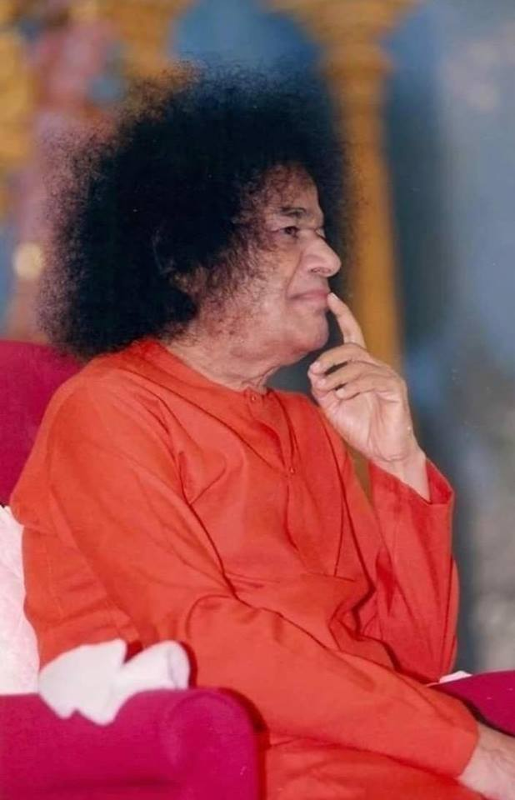
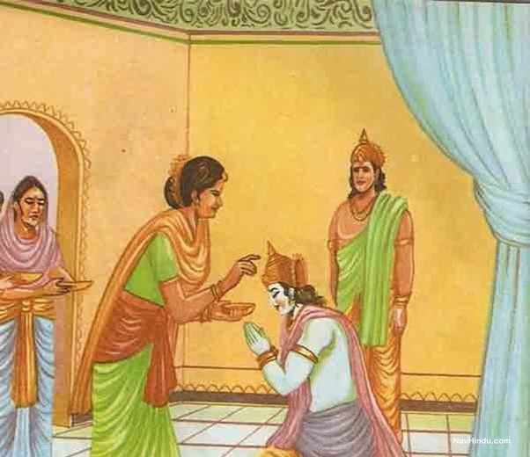
Kaikeyi’s Sacrifice
“Rama had prayed to Kaikeyi thus:
Mother! I have incarnated to put an end to the demons. You must chalk out a plan to fulfil this mission.” This is the reason that Kaikeyi went on to ask the boons from Dasaratha”.
-22nd May 2002 Summer Course

Slide 13
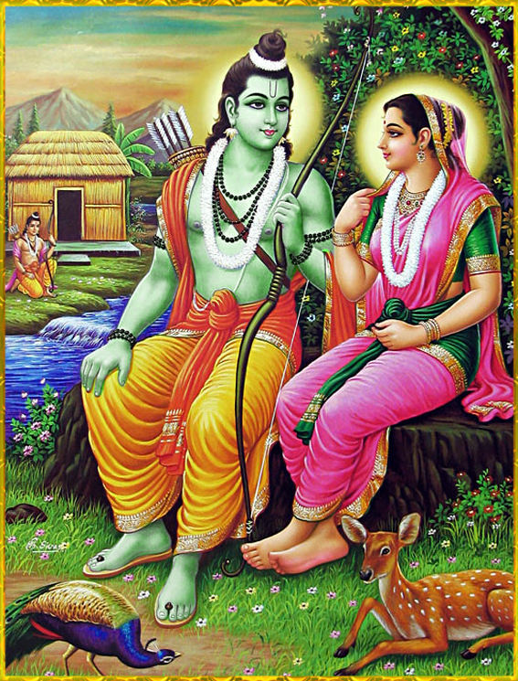
Sita convinces Rama…
When Sri Rama refused to take Sita along to the forest,
“Sita said: You are Ramachandra,
Rama the moon! I am Sita,
which means cool,
-the cool moonlight!
How can the moon be in
the forest and its cool light
be in Ayodhya?
Where the moon is,
there must be its light!
So this separation can
never be. The two shall
ever be together, never apart!”
Source: Ramakatha rasavahini

Slide 14
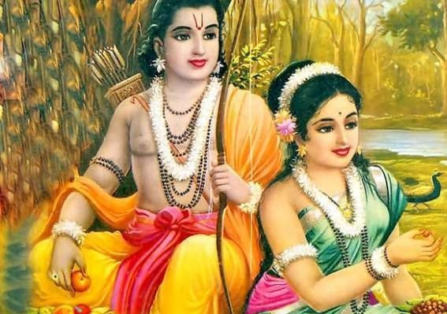
Greatness of Urmila…
“Will any lady keep quiet when she comes to know that her husband is going to the forest for 14 years?
But Urmila did not raise any objection.
In fact, she was very happy that
her husband got an opportunity
to serve Rama…
She said, "You are going to live
in the forest without me for 14 years.
It is possible that you would think of me and mention my name at some time or other. So, I want you to promise that you will not think of me at any point of time. If I accompany you to the forest, you may not be able to devote your entire time to their service. I will stay back so as not to become an impediment in your way."
-Ramanavami 14th April 2002

Slide 15
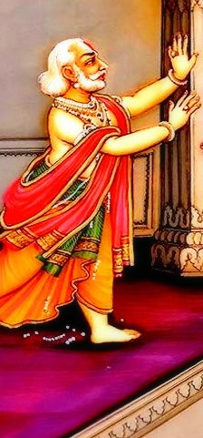
Ramo Vigrahavan Dharma:
Stop !
Sumantra…
O Sumantra! Stop! Stay a moment!
Said Dasaratha when Rama was leaving to the Forest. Sumantra was the charioteer
Rama told Sumantra to discharge his duty as per the command of Emperor Dasaratha and not to accede to the wailing pleas of his father Dasaratha.

Slide 16
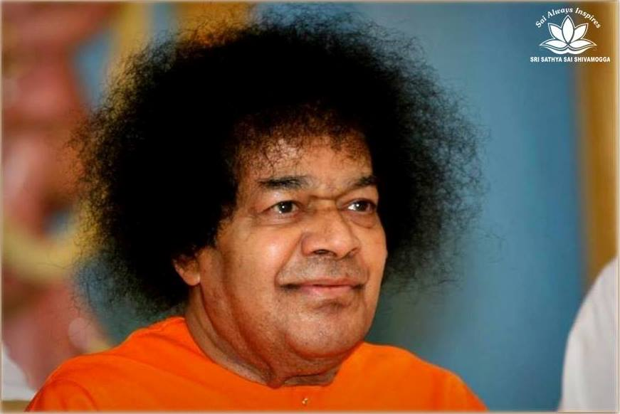
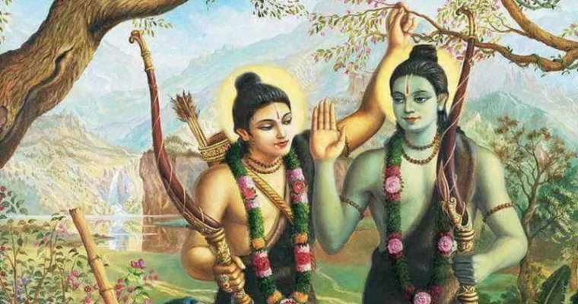
Lakshmana’s Complete Surrender to Rama
On reaching Chitrakoota mountain, Rama instructed Lakshmana to make a hut. When Lakshmana asked Him to show the location, Rama replied, “Erect it at a place of your choice.” Hearing this Lakshmana was overcome with grief. He said, “What sin have I committed to hear such harsh words from You? Have I not surrendered to Your Will?
Do I have likes and dislikes of my own?” Seeing Lakshmana’s plight. Sita remarked, “Lakshmana, why are you so agitated? Rama neither beat you nor did he admonish you.” Lakshmana replied, “Mother, I would have been happy if scolded by Him, but I cannot bear to hear that my likes and dislikes are separate from His. There is no greater sorrow than hearing such words from Lord Rama.” This incident reveals the intensity of devotion and total surrender of Lakshmana.

Slide 17
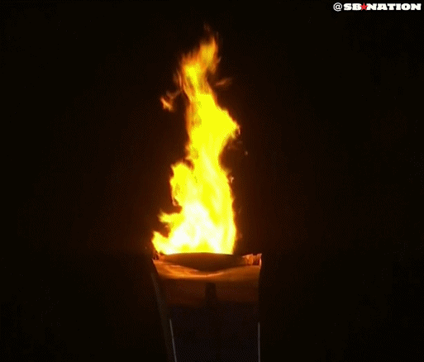
Rama & Sita are Fire Principles…
“While in Panchavati, Sita and Rama felt that the moment of fulfilment of their task had come.
Both of us assumed these human bodies through rites associated with the fire principle. My body arose from the offering brought out of the flames of the sacrificial fire by the god Agni himself. You rose from earth that was furrowed by the sacred plough in order to consecrate it for a fire-altar, where a Yagna had to be performed.
Our bodies are born in fire and are being sustained by the warmth of fire.”
“Therefore, Sita, deposit all your divine attributes and splendour in fire and act as an ordinary human being
hereafter. I will also move and act as an ordinary human being and exhibit sorrow and anxiety on your account —the pangs of separation and the pain of loneliness
Source: Ramakatha rasavahini

Slide 18
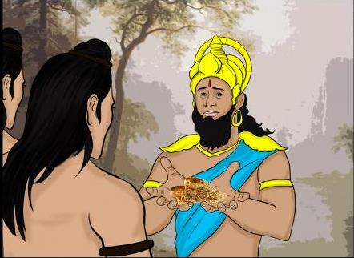
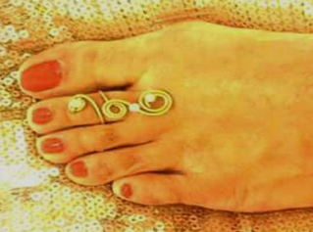
Lakshmana’s Modesty
“When Rama and Lakshmana became friendly with Sugriva, he brought the jewels, which his followers had gathered and showed them to Rama. At that time Rama asked Lakshmana if he could recognise the jewels. Lakshmana said that while he cannot recognise the other jewels, he can certainly recognise those which Sita wore on her feet”
“When Rama asked how he could recognise these, he said that every morning he used to go and touch her feet; hence he was quite familiar with them”.
-Summer Course 1997

Slide 19
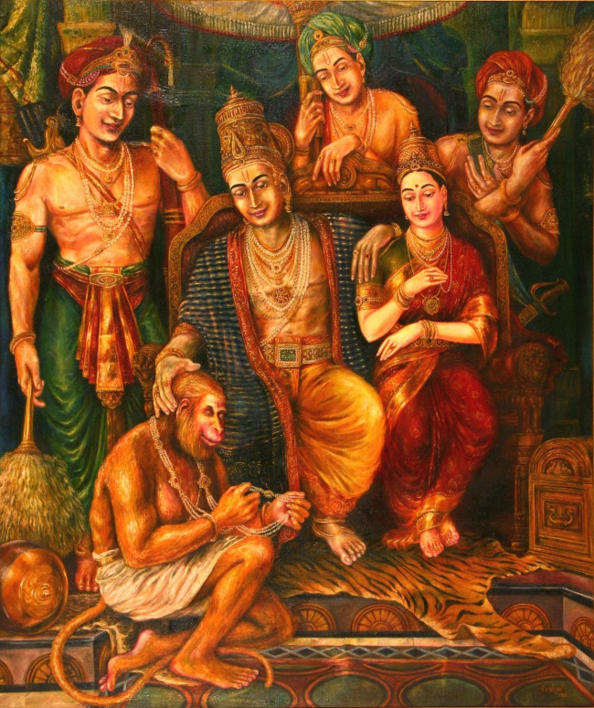
Hanuman- A Perfect Devotee
“During the Pattabhishekam,
Sita gifted a necklace to Hanuman. He gave it a suspicious look. He then placed the necklace near one of his ears as if to check whether the individual pearls were emitting some sound. He appeared to examine every pearl in the necklace, and once in a while, he would bite a pearl.”
Sita was shocked by this behaviour. With great humility Hanuman replied, "Mother, for me the Name of Rama is supreme. An object is worthless if it does not resound with the Name of Rama.
Ramanavami- 12th April 2000

Slide 20
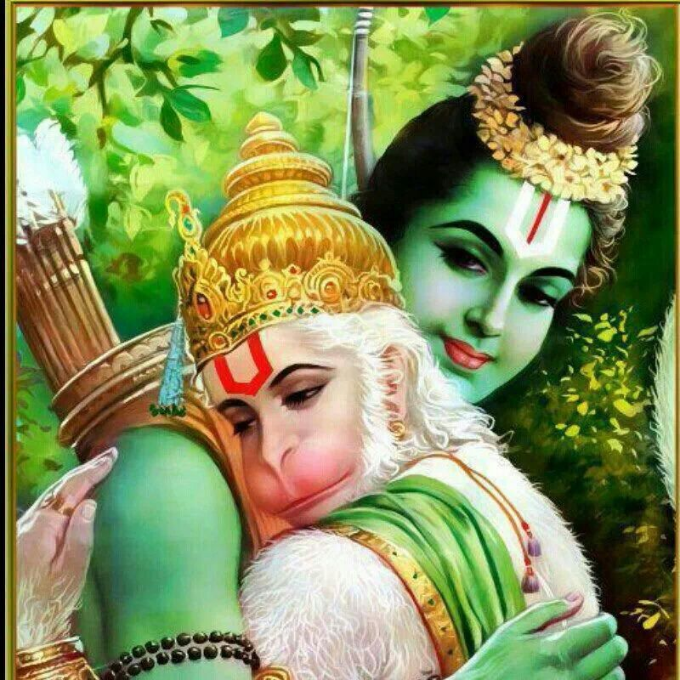
Rama’s Real Gift to Hanuman…
Praising Hanuman's
unexcelled services,
Rama said that the
only fitting reward
for such a devotee
was to give himself
to Hanuman.
He embraced Hanuman most lovingly
18th December 1994- Paduka Puja Discourse

Slide 21
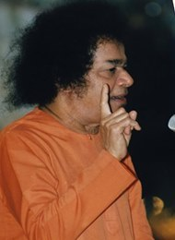
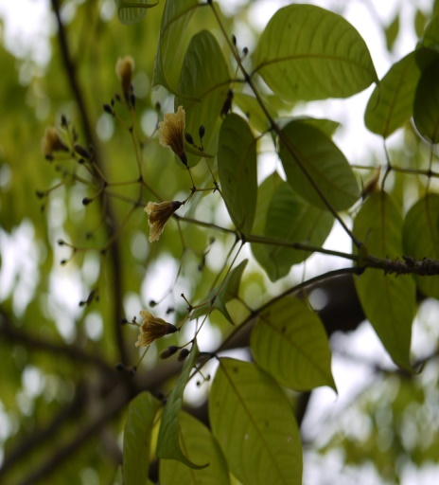
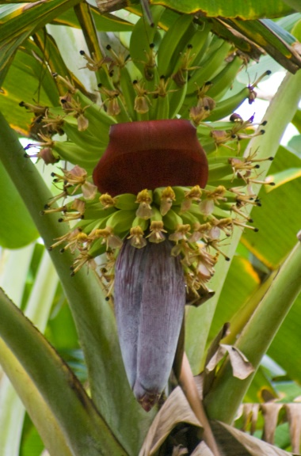
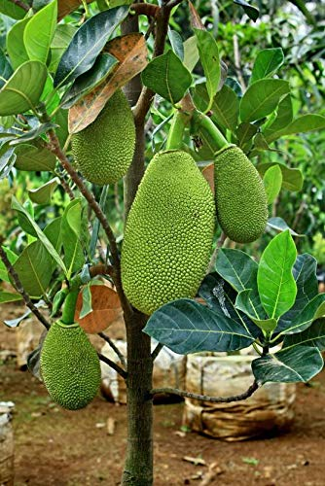
Rama’s Moral Counsel to Ravana
1st Type of Men
Pitali Tree
Only Flowers No Fruits
Men who only talk with no Action.
Ravana was this type.
2nd Type of Men
Plantain Tree
Both Flowers and Fruits
Equal measure of Talk and Action
3rd Type of Men
Jack Tree
Only Fruit and no flowers.
Only Action and No talk.
BEST TYPE
Source: Ramakatha Rasavahini

Slide 22
Ten Heads of Ravana
“The ten heads of Ravana signify the four Vedas and six Sastras. Though Ravana had mastered all these texts, he could not benefit from them. Practice is more important than mere mastery of the texts.”
4 Vedas
6 Sastras
“Since Ravana misused the knowledge of 6 Sastras and 4 Vedas, Sri Rama the Lord removed these Heads….”
-27th May 1996- Summer Course, Brindavan

Slide 23
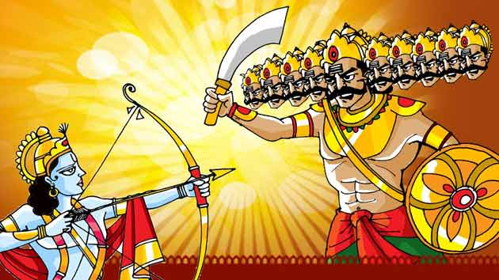
Wickedness Annihilated…
Sri Rama Shot 31 Arrows on Ravana:
30 for the Heads and Hands and one for the Nectar jar (Amruta Kalasam)

Slide 24
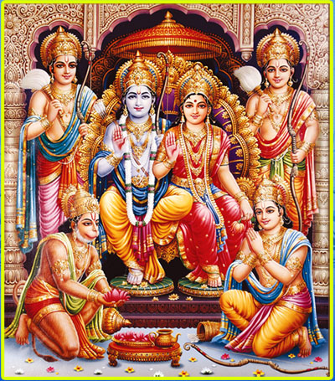
Rama Rajya
Rama, Sita and Lakshmana return to Ayodhya
After 14 years . Rama was Crowned the King…
“In Rama’s time, no one tried to utter falsehood under any circumstance.
children honoured the directions of parents and preceptors. Everyone was as happy as the lord of gods in heaven, Indra. Grain and riches were as plentiful in every home as in the place of the God of Wealth.”
Source: Ramakatha rasavahini

Slide 25
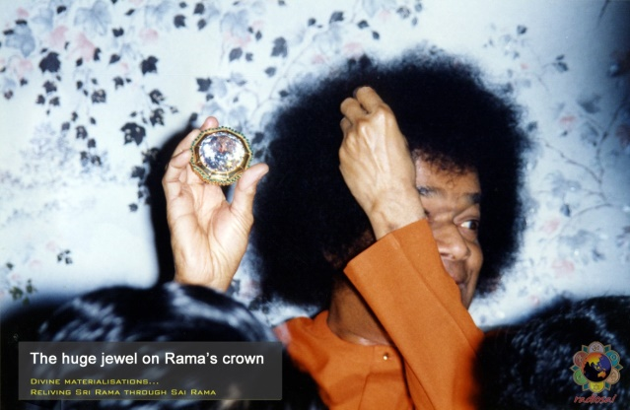
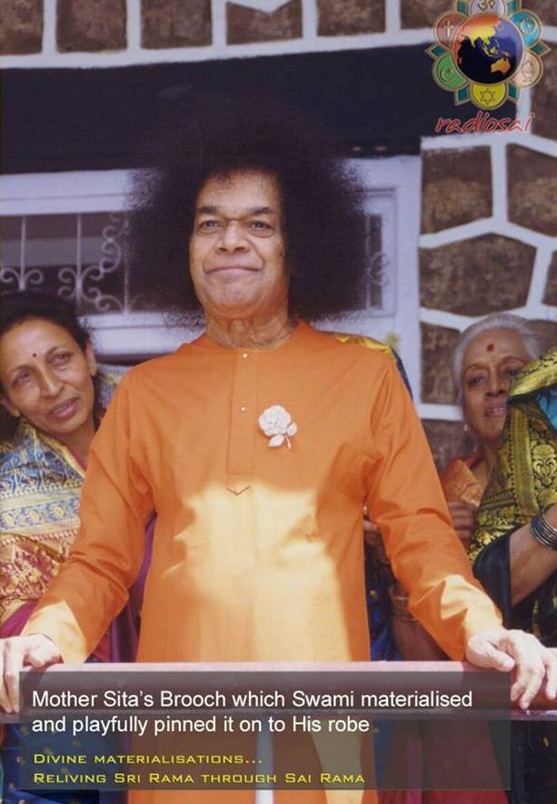
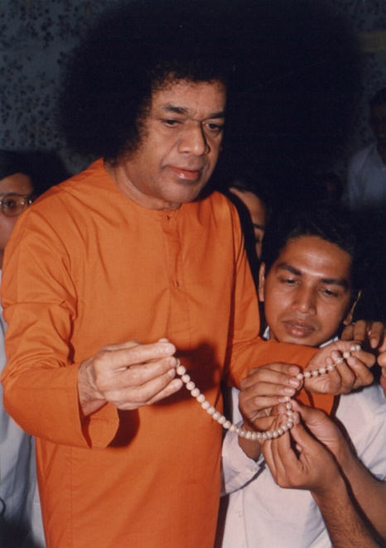
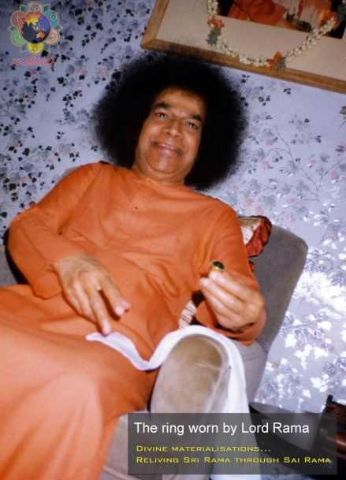
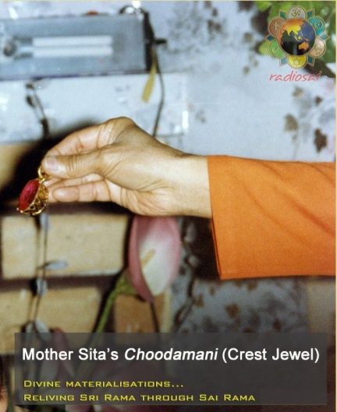
Re-Living Sri Rama thro Sai Rama…
Our Lord Sai Rama had created these to the devotees:

Slide 26
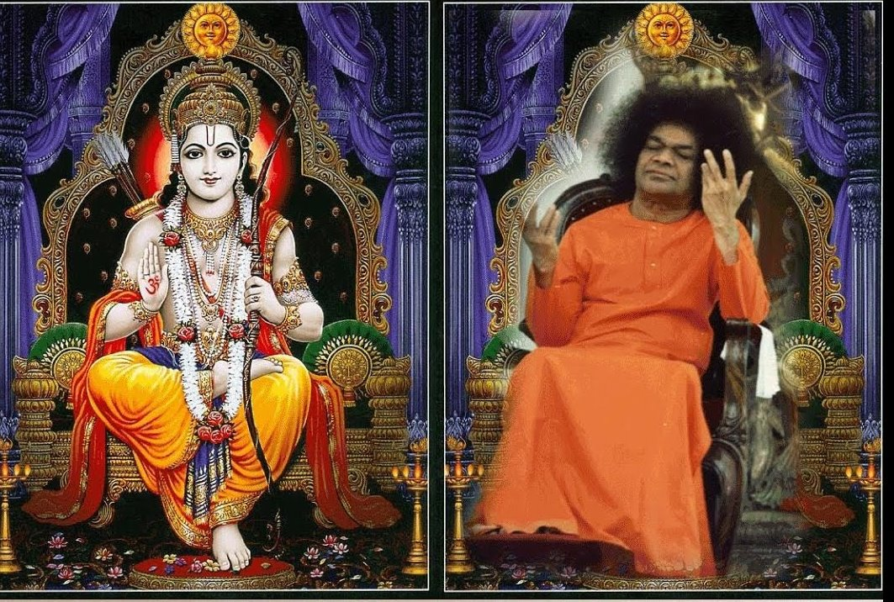
Bhagawan Uvacha…
Thank you
JAI SAI RAM

