Slide 1
Om Sri Sai Ram
Inner Significance of observing
Sri Krishna Janmastami

Slide 2
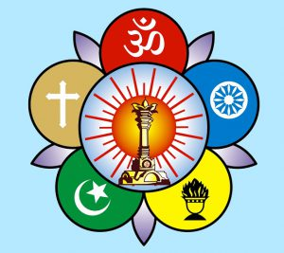
Om Sri Sai Ram
Sri Sathya Sai Seva Organisation
Karnataka South
Swami has given a lot of insights to the divine incarnation of
Lord Krishna in HIS discourses during Krishna Janmastami and similar occasions…Here is an extract of such precious messages of Bhagawan covered in this PPT.
Request all to share this content widely in all Samithis and Bhajan Mandalis for the awareness of all the devotees.
JAI SAI RAM

Slide 3
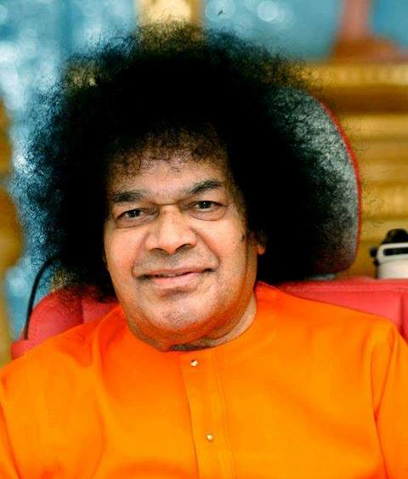
Different meanings for ‘Krishna’
The Avatar of Krishna is the most attractive incarnation. The very word "Krishna" means one who attracts - "Karshatiti Krishna" (Krishna is one who attracts). "Krishyatiti Krishna" (Krishna is one who cultivates) is another derivation for the name. In the case of the Avatar, this means that Krishna is the Lord who cultivates the heart of the devotee by removing the weeds, sowing the seed of good qualities and growing the crop of love. "Kushyatiti Krishna" (Krishna is one who gives delight). Krishna thus means the one who cultivates our hearts and raises in them the crop of bliss.
-24th August 1989

Slide 4
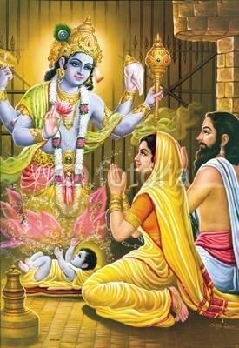
Avatar Manifested
“The Avatar manifested. The Divine effulgence of the child illuminated the surroundings. Vasudeva and Devaki bowed to the child. How did they know? They were told earlier that God would incarnate as their son. The Lord had appeared to them in a dream the previous night and said, "I will take birth from your womb at dawn." They knew He was God” -May 1995 Summer Course

Slide 5
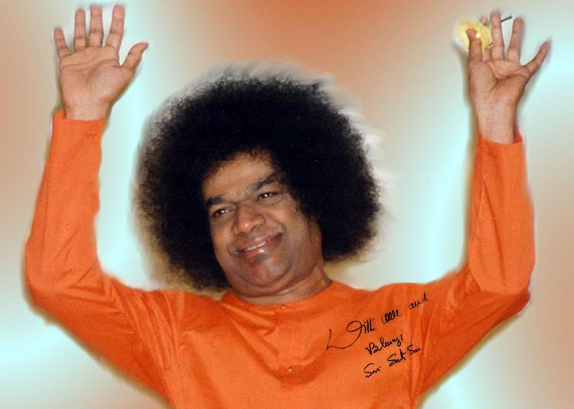
Miracles after the Birth
“The Lord had instructed Vasudeva to take Him out. How was this to be done? Vasudeva placed the Lord in a small basket and wondered how to fulfill the command. In a trice, the chains came loose. The doors flew open. It was three o’clock in the morning. The gatekeepers were fast asleep. No one else was around. Vasudeva quietly walked out of the dungeon. As he proceeded, there was a tremendous downpour of rain - a sign of the intense joy and purity of the occasion. Even the clouds were ecstatic at the Divine Advent.”
-May 1995 Summer Course

Slide 6
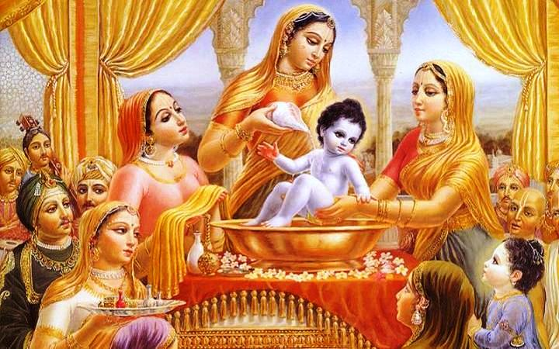
Significance Of Krishna Being Born As Eighth Child
“Sri Krishna was born as the eighth child of Devaki. This is significant.. for, Samadhi is the eighth stage of spiritual effort, coming after Yama, Niyama, Asana, Pranayama, Prathyahara, dharana and dhyana . These are known as Ashtanga-yoga , the eight-fold discipline (The Lord can be visualised only after the seven steps are successfully negotiated and the mind purified in the process”
-24th August 1989

Slide 7
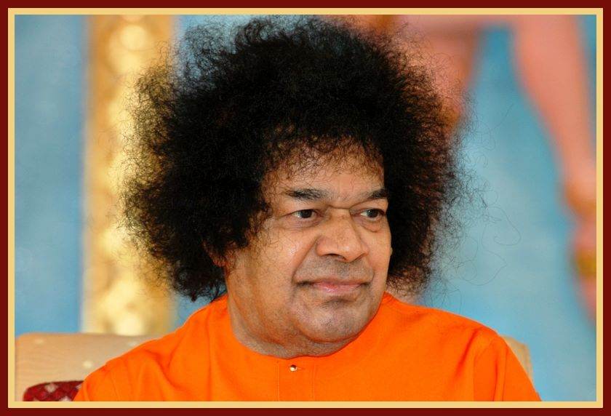
Fruits turned to Gems!
“When Krishna was three years old he saw an old lady carrying a basket of fruits from the jungle. Krishna wanted to have it.. The old woman said he could get them only if he paid the price. Krishna innocently asked the meaning of the word ‘price.’ The woman said that something should be given in return for the fruit. Krishna went in and brought a palmful of rice. The woman placed the rice in her basket and gave Krishna some fruits. She was charmed by the beauty of the child. As she was returning to her cottage, she felt that the basket was getting heavier. When she placed it down in her hut, she was amazed to find that all the rice grains had turned into precious gems! “
-28th August 1994

Slide 8
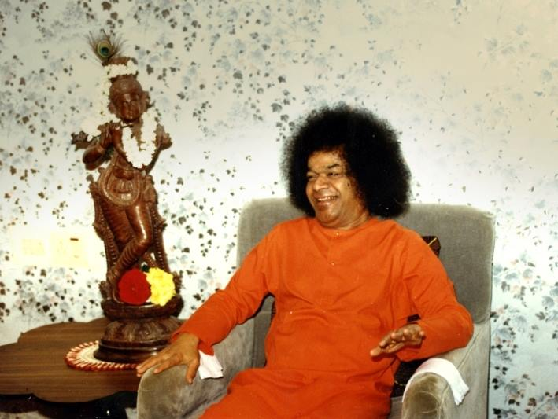
Meaning of Krishna’s Pranks…
“Krishna used to visit the houses of the cowherds and drink curds and milk. The symbolic meaning of this action is Krishna's preference for Sathva, represented by the pure white curds and milk.
Krishna explained to Yashoda the reason why he preferred the butter in their homes to the butter offered by Yashoda. The hearts of the gopikas were pure and filled with selfless devotion to Krishna. Their devotion was superior to the maternal affection of Yashoda, which bore a taint of selfishness. Krishna told Yashoda:
"I am attracted to the hearts of those who are pure and selfless.“
-4th September 1996

Slide 9
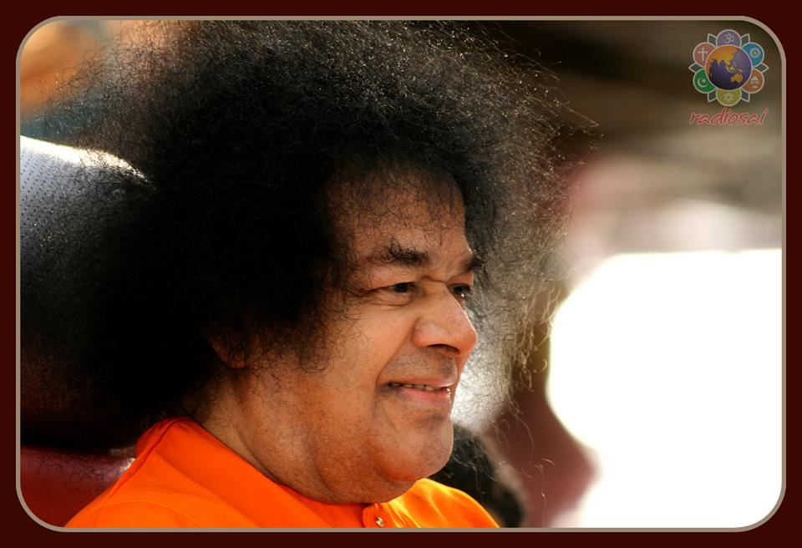
Follow the Lord’s Foot steps!
“Krishna had always eluded the gopikas after playing his mischief. But once, out of compassion for them, he wanted to provide a clue by which they could trace him. One day they all lay in wait round their houses to catch Krishna. Krishna went into a house stealthily, broke a pot of milk and quietly hid himself. The gopikas found that he had broken the pot and tried to trace him. The milk white steps which he had left revealed to them his hide-out. Then, Krishna revealed to them the spiritual truth that if they cling to the feet of the Lord they realise Him. "Follow my footsteps and you shall find me," Krishna told the gopikas.”
-4th September 1996

Slide 10
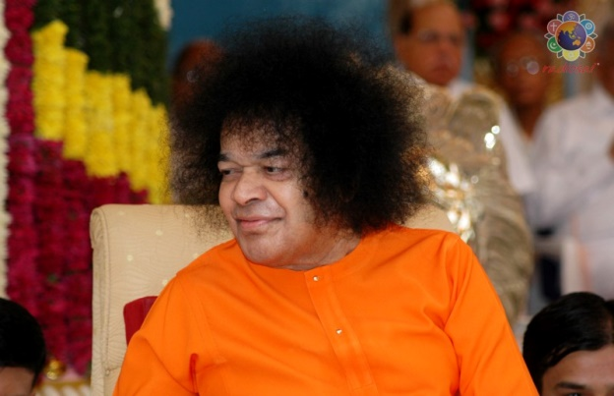
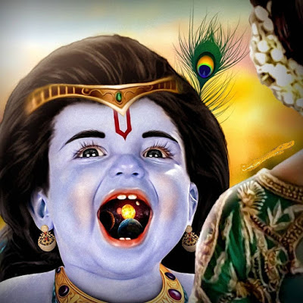
Krishna’s Divinity revealed
“Once Krishna played a game and acted as if he ate mud….Yashoda could not
recognize Krishna’s Divinity. She said sternly, “Open your mouth! I want to look inside.” Krishna complied. Yashoda saw the entire universe inside His mouth!
“Is it a dream, an illusion... what is happening?
Am I Yashoda?”
she wondered.
She was totally confused. In this way Krishna gave glimpses of His Divinity to His Mother.”
- 21st May 1995- Summer Course

Slide 11
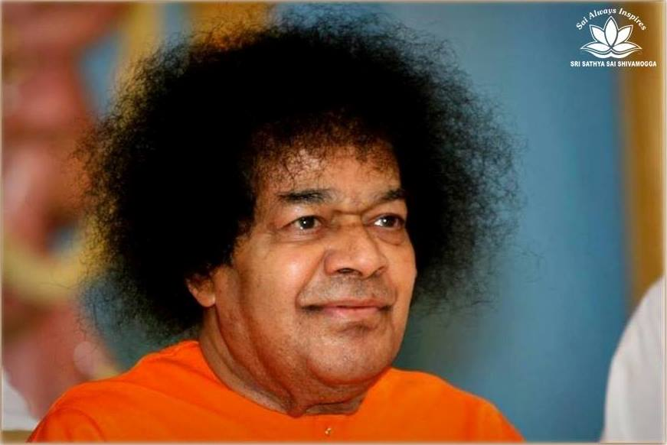
Love and Attachment
“Once Yasoda caught Krishna and scolded, “You don’t eat what I serve. You go to other houses and steal. You are ruining our reputation. Why don’t you eat the butter I give?
Is the butter in our house not tasty?”
What is the inner significance of this incident? The mother serves with motherly affection. But the gopikas served the same food with pure love, divine feelings! It was not the butter that attracted Krishna but the purity of their hearts.
Butter symbolizes the hearts of the gopikas, which were filled with purity, one-pointedness, and selflessness. Yashoda’s butter was attachment, while the gopikas’ was prema. This is the difference between love and attachment”. -21st May 1995.

Slide 12
The complexion of Sri Krishna
“Krishna's complexion was neither fair nor dark; it was three parts dark and one-part fair, an amalgam of both. Since they were of the Vaishnava caste, the parents placed a line of musk on the centre of his brow. He wore silver kankans (bangles) on His wrists, such as cow-herd boys wore in those days in that part of the country”
-6th September 1977

Slide 13
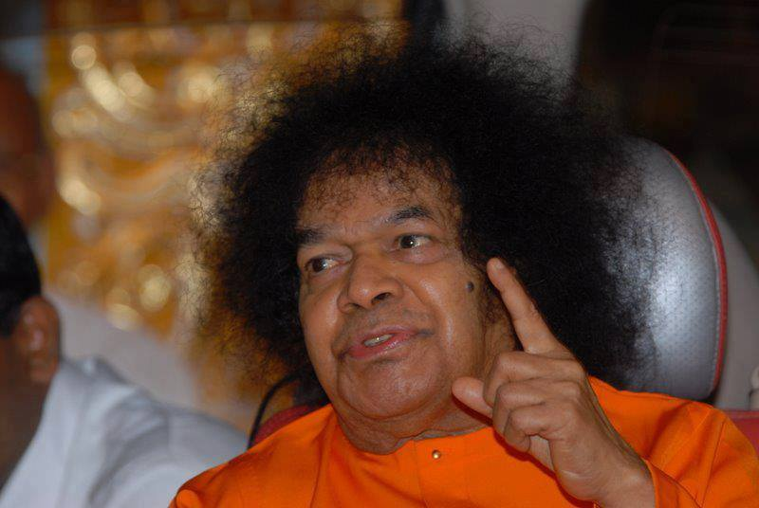
The Three vows that Krishna took
But the kankans that Krishna wore were not mere kankans. They had profound implications.. Krishna had taken three vows and the kankans were symbolic of his determination to fulfill them. They were, as mentioned by Him in the Gita:
Dharma samsthapanarthaya sambhavami yuge yuge
2. Yogakshemam vahamyham.
Mokshayishyami ma sucha.
-6th September 1977

Slide 14
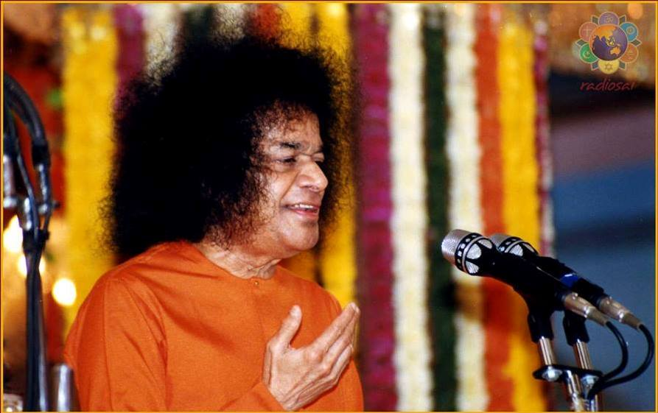
Radha and Gopikas- Prajnanam Bramha…..
“The Gopikas have been misunderstood and misrepresented by commentators. Gopikas symbolise thoughts. Radha symbolises the combination of all thoughts in the mind. So, thoughts and the mind should merge in Krishna, represented by Prajna (in a human being). That is the significance of the Vedantic declaration, "Prajnanam Brahma." This Prajnanam pervades every part of the human body, the mind and the intellect. It is constant integrated awareness. All our thoughts, desires and aspirations should be merged in this Prajna.” - 21st August 1992

Slide 15
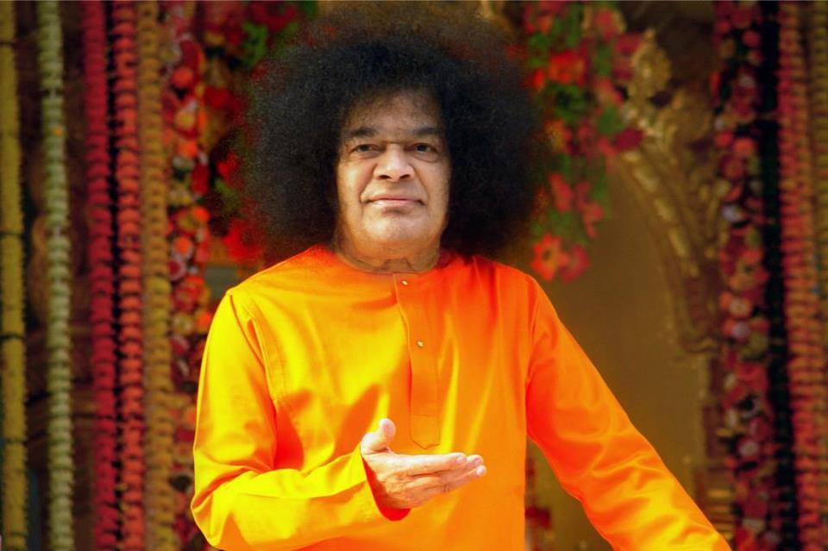
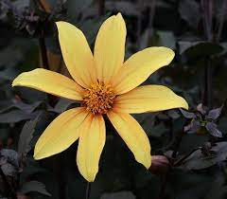
Inner meaning of 8 consorts
“In the life of Krishna, there are many incidents which have an esoteric meaning, but which have been misunderstood and misinterpreted by scholars and commentators Such misunderstandings have been caused by stories that Krishna had eight wives
Hridayachakra in the middle of the spinal column. The Hridayachakra is a flower-like chakra with eight petals. The eight petals are symbols of the eight parts of the earth, whose master is the Lord Himself”.
The esoteric meaning of this is that God is the Lord of the eight-petalled lotus of the heart in man. The Lord of the heart is described as Madhava. "Ma" means Lakshmi or Maya or Prakruthi. "Dhava" means husband. God is the Lord of Lakshmi, or Maya or Prakruthi. Krishna is thus the Lord of the eight-petalled lotus of the heart
-2nd September 1991.

Slide 16
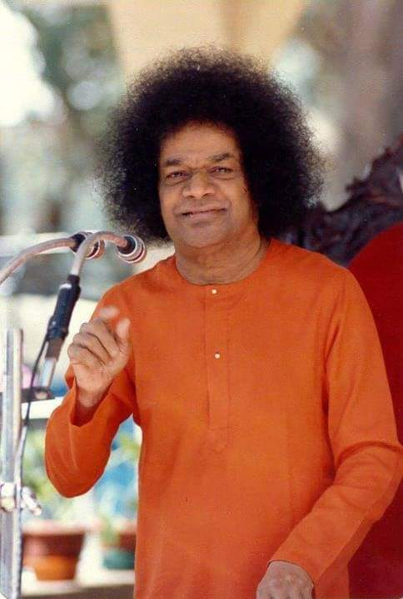
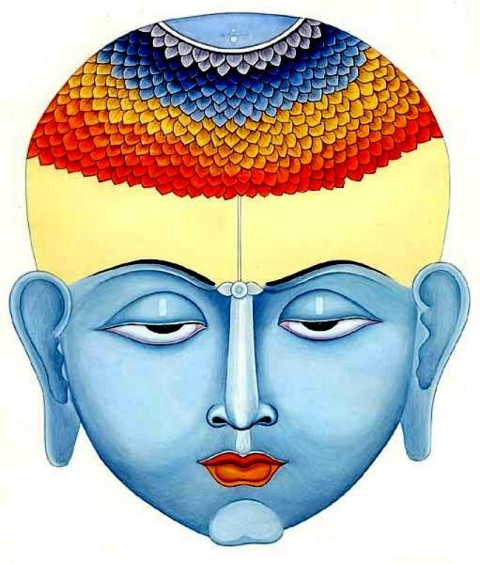
Sixteen thousand Gopikas
“Sahasrara is the topmost chakra of the spinal column. It is pictured as a thousand-petalled flower. In each petal, God dwells with all his sixteen kalas (potencies). Altogether, there are 16,000 potencies, which represent the gopikas. "Go" means sound, speech, and life breath. God is the Lord of this thousand-petalled Sahasrara.”
The inner significance of the reference to 16,000 gopikas should be understood in this manner.. Few attempt to understand the spiritual significance of many episodes in the Bhagavatham”-2nd Sept 1991

Slide 17
Inner significance of Krishna’s Actions
“To understand the glories of the Lord as related in the Bhagawatha, you have to enjoy the Leela of Krishna and realise their inner meaning. For instance, the real meaning of the story about Krishna taking away the clothes of the gopikas while they were bathing is that to realise the Lord they have to abandon the attachment to the body, which is the vesture of the Spirit. These stories should not be treated in a spirit of levity or profanity.”
-4th September 1996

Slide 18
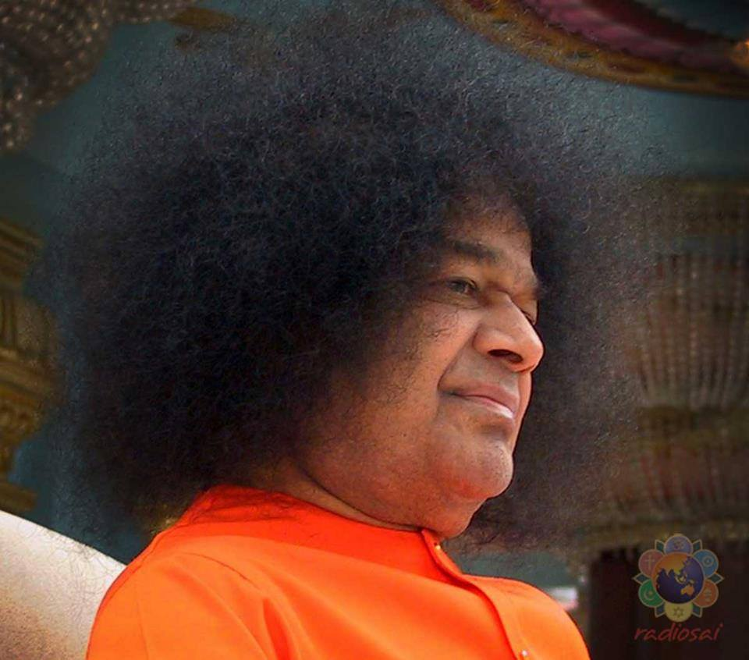
Radha & Krishna
“Radha was living in Vrishabhapura and knew from the very beginning her being an embodiment of Prakruthi and her connection with Paramatma. Since the entire creation was only a projection of Paramatma., The relationship between Radha and Krishna was one like the relationship between an object and its image. Radha, in the bodily aspect, was nine years older than Krishna. She was also a cousin sister of Nanda and thus was closely connected with Nanda. Ever since Krishna reached the home of Nanda and Yasoda, Radha’s ideas began to take shape in the direction of wanting to move closer and closer to Krishna. At all times, Radha was thinking of Krishna and uttering the name of Krishna. Her daily routine was filled with work connected with Krishna. Krishna was a seven-year-old boy at that time”
-Summer Course 1978

Slide 19
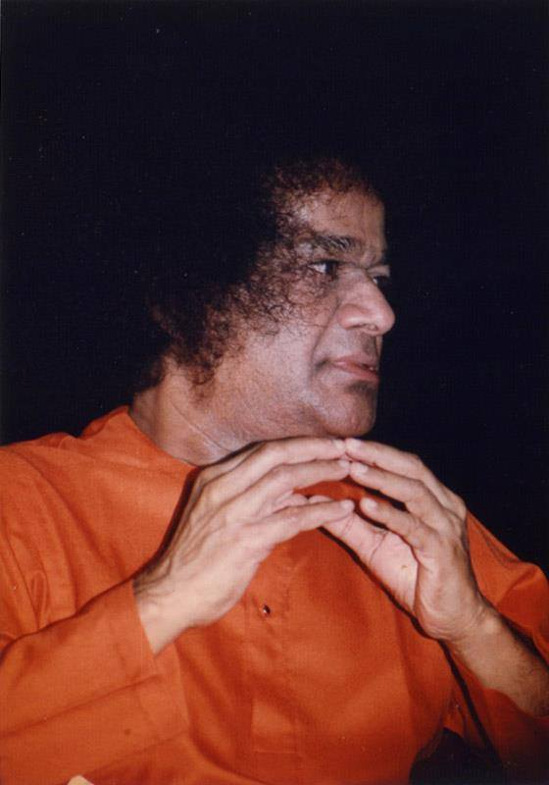
Radha and Krishna…
“This relationship is the sacred relationship that exists between God and His creation. It is as inseparable as the white colour of milk is inseparable from the milk itself. The colour of the milk is white. It is not possible for us to remove the white colour from milk. If we turn milk into curds, the curd is also white. If we churn the curd and get buttermilk out of it, the buttermilk is also white. If from that buttermilk, we separate the butter, it is also white. Thus, do what you may, it is not possible to separate the white colour of milk from the milk itself. Radha is part and parcel of Krishna even as much as white colour is part and parcel of milk. The kind of association between Radha and Krishna has no parallel in the world and cannot occur in any other instance. The Creator is Krishna. The creation is the Prakruthi”
-Summer Course 1978

Slide 20
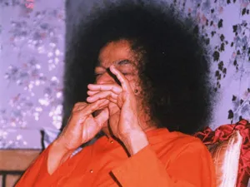
Radha & the Flute…
In the case of Radha, Krishna churned her heart and gave here the nectar of Divine bliss. Radha had no attachment to any of her kith and kin. Krishna appeared before Radha before she gave up her life and blessed her. God will give anything for the devotee including Himself. No one can equal Him in the sacrifice He will make for the sake of the devotees. Krishna asked Radha what she wanted at the last moment of her life. Radha said:. "Distil the essence of the Vedas and make it flow into the eternal music of your flute, Oh Krishna." Krishna took out His flute and played on it and when Radha closed her eyes, He threw it away. He never touched it again. He dedicated the flute to give delight to Radha.
-4th September 1996.

Slide 21
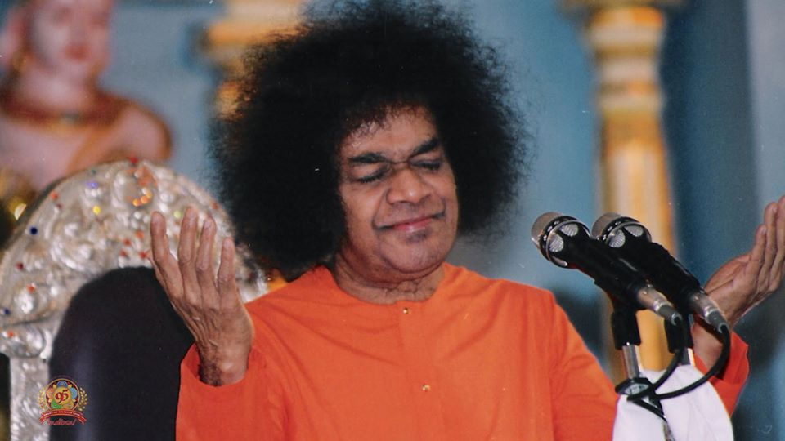
Inner Significance of Mantra…
“Krishna is the embodiment of the Five Elements -ether, air, fire, water and earth.
He is also the embodiment of five life breaths –
Prana, Apana, Samana, Udana and Vyana.
"Kleem-Krishnaya-Govindaya-Gopijanavallabhaya-Swah:"
This mantra contains the essence of the Bhagawatha.
The five names represent the Five Pranas Kleem refers to the earth.
Krishnaya refers to water. Govindaya refers to Agni (the Fire-God). Gopijanavallabhaya refers to Vayu ..Swah: refers to ether.
When we recognise that the Divine is immanent in the five elements, we will realise that there is no place in the cosmos where these five are not present”
4th September 2007

Slide 22
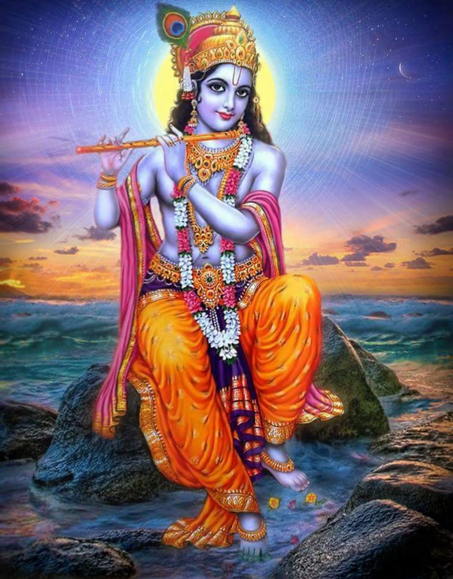
Krishna- Thrishna
“When you say that Krishna was born in Gokula, then. He grew up in Brindavan, that He ruled over Mathura and that He later reigned at Dwaraka, what do those statements signify? The Mind is the Gokula! where He was born. The heart is Brindavan where He grows, where Prema for Him develops; the Chith is the Mathura which He rules over and the Nirvikalpa stage is Dwaraka where He installs Himself, as the reigning monarch. Make the Krishna-Thrishna (thirst for Krishna) grow through these stages and you will be saving yourself! “
-SSS Vol.6 - 1966

Slide 23
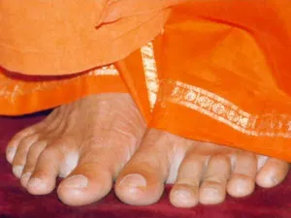
Om Sri Sai Ram
Thank you
Jai Sai Ram

