Slide 1
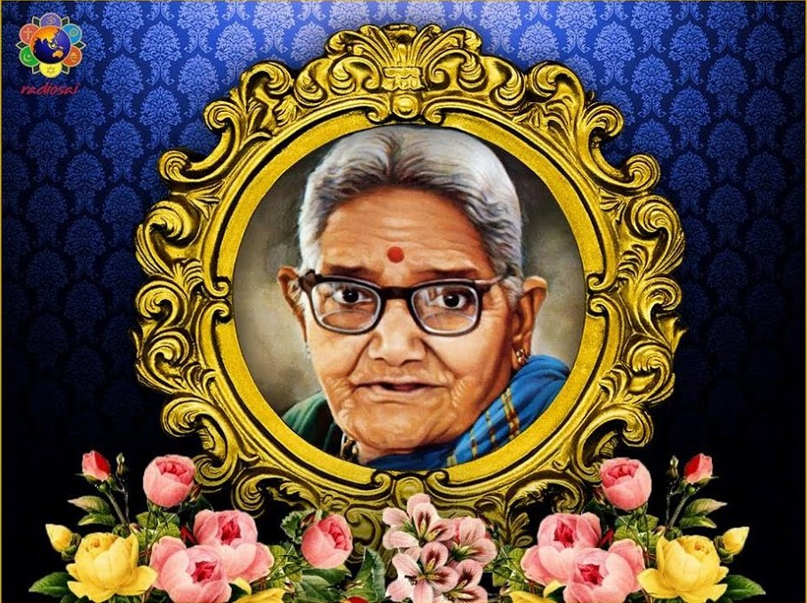
Om Sri Sai Ram
Inner Significance of
Eshwaramma Day

Slide 2
Sri Sathya Sai Seva Organisations
Karnataka South
Sai Ram,
This Presentation is a collection of gems culled out of Bhagawan’s Discourses given on
Mother Eshwaramma, for us to understand the inner significance of observing 6th of May every year as Eshwaramma Day…

Slide 3
Eshwaramma Day is Childrens’ Day
“This day is Eshwaramma Day. The significance of the Day is that it is celebrated as Children's Day, a day when little children are to be reminded of the ideal- a day when Eshwaramma presented an ideal.”
-6th May 1983 Prashanthi Nilayam

Slide 4
Eshwaramma- the Chosen Mother…
Unlike mortals, an Avatar selects HIS parents..
Our Bhagawan, chose
the humble couple of
Eshwaramma and
Pedda Venkappa Raju
as HIS parents!

Slide 5
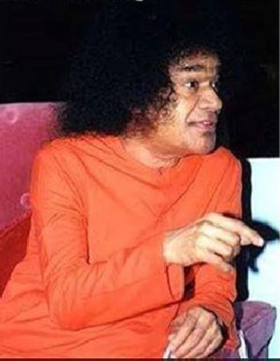
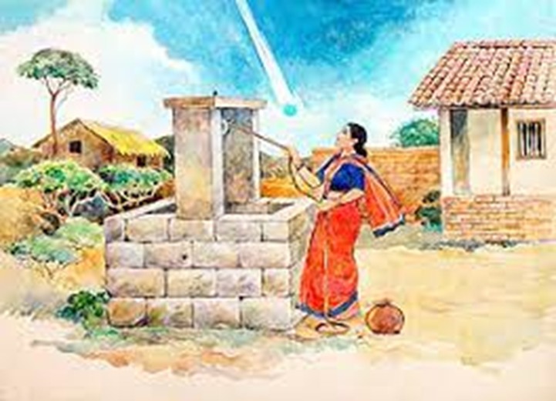
Birth of the Avatar…..
“Once the mother of this body Eshwaramma went to the well to fetch water. Suddenly she felt giddy and also heard an Ethereal Voice “ I am entering your Body” She was fear stricken and was at a loss to know what was entering her body. Whether it was a ghost, a spirit or an Angel. She heard the voice again “ I am entering your body for the Welfare of the World”
-23rd November 2006

Slide 6
Mother of Eshwara-Eshwaramma
“Namagiriamma was the actual name of Eshwaramma, given by her parents. Since Kondama Raju recognised My Divinity, he told his son, Pedda Venkappa Raju, to change her name to Eshwaramma because he was very well aware that she was the mother of Eshwara Himself ! ”
-23rd November 2003

Slide 7
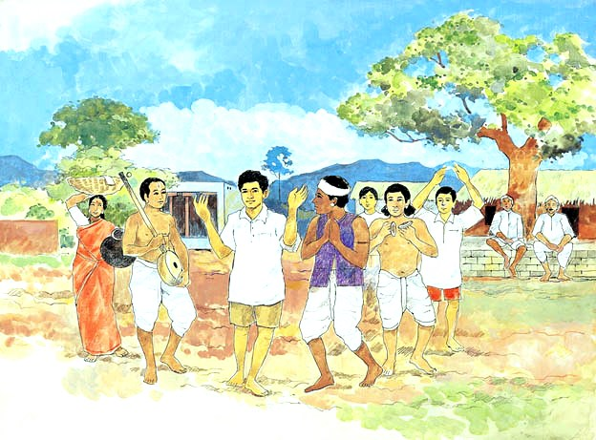
Pandari Bhajans
“When I was seven and half years old, I used to teach Pandari Bhajans to small children in our village. Eshwaramma and Subbamma used to feel ecstatic watching Me sing & dance the Pandari Bhajans to their rhythm.”
-6th May 2000- Brindavan

Slide 8
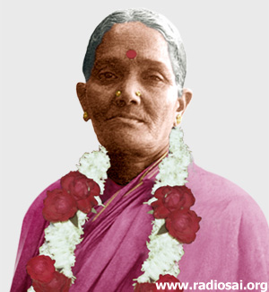
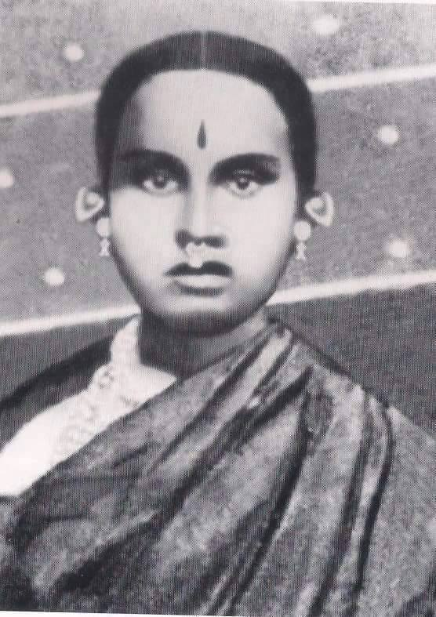
Sathya Narayana Vratha
“In olden days, it was a common practice among the women of Bharat to perform the sacred ritual of Sathyanarayana Vratam, on every poornima day.
Likewise, mother Eshwaramma used to perform Sathyanarayana Vratam every full moon day in the company of Karanam Subbamma, who was her neighbour. Karanam Subbamma would often tell Eshwaramma, "You are performing Sathyanarayana Vratam. With His blessings, you will bear a son.
I want you to name him Sathyanarayana."
-23rd November 2003

Slide 9
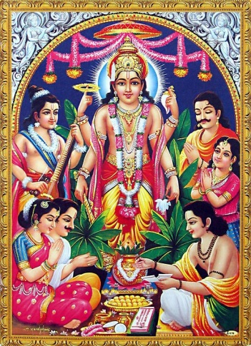
Sathyanarayana Vratha
“On a particular full moon day, Eshwaramma did not have food until late in the afternoon, since she was participating in the Sathyanarayana Vratam being performed in Subbamma's house.
After the ritual was completed, Subbamma brought prasadam to Eshwaramma. Only after partaking of prasadam could Eshwaramma conceive.”
23rd November 2003

Slide 10
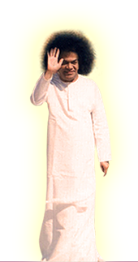
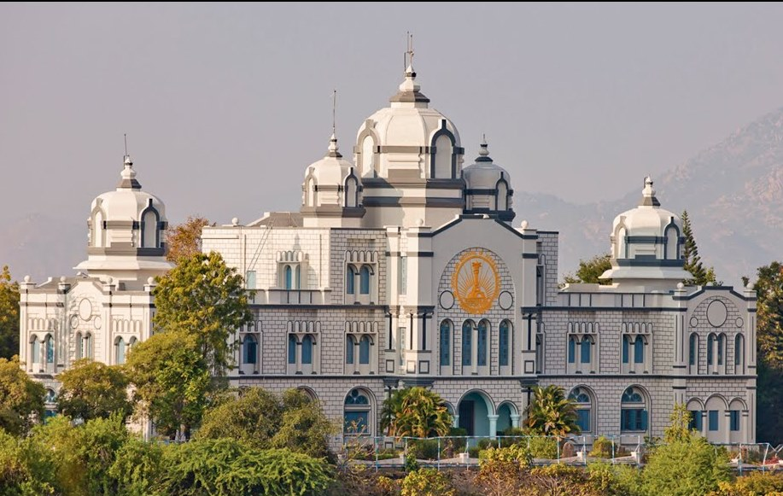
Eshwaramma’s Wishes
Once Eshwaramma told me "Swami, our Puttaparthi is a small village. Since there is no school in this village, the children are forced to walk long distances to attend schools in the neighbouring villages. I know that You are the ocean of compassion. Please construct a small school in this village.” As desired by her, I got the school constructed. Though it was a small school, the inaugural function was a grand affair, attended by many devotees. - 6th May 1999- Brindavan

Slide 11
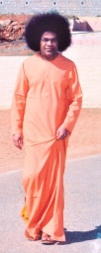
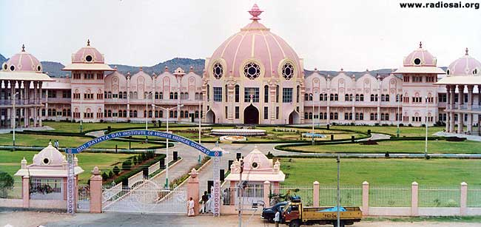
Eshwaramma’s Wishes
“The next day, Eshwaramma expressed her happiness and said that she had one more desire. She wanted a hospital also to be built in the village. She said, “Swami, I don't want to put You to trouble. If You are troubled, the whole world will be in trouble, and if You are happy, the whole world will be happy. So, if it gives You happiness, please construct a small hospital.” As per her wish, I got the hospital constructed- - 6th May 1999- Brindavan

Slide 12
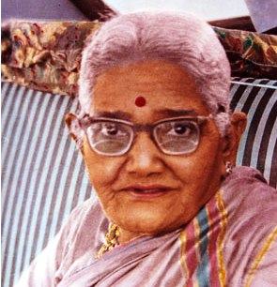
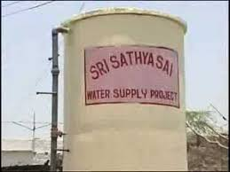
Eshwaramma’s Wishes
“Once Eshwaramma said “You know that the river Chithravathi is in spate during the rainy season. But in summer it dries to a trickle and people do not have drinking water. So, please see that some wells are dug in this village.” I told her that I would not stop with these small wells and that I would provide drinking water to the entire Rayalaseema region. “ - 6th May 1999- Brindavan

Slide 13
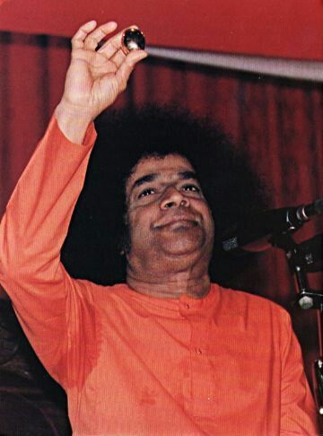
Mother’s Love…
“Once, on a Shivaratri day, after My discourse, the Linga was ready to emerge from My mouth. I sat on the chair and was in severe pain. Seeing Me suffering, Eshwaramma got up from the gathering, came up to Me and said, “Swami, why do You suffer like this? Come inside, come inside and went inside. But I did not go….”
“As soon as she left, Hiranyagarbha Linga emerged. All the devotees burst into thunderous applause. Listening to this, she came back…but by then the Linga had already emerged and I was showing it to the devotees. “- she does not like Swami Suffering…..
-6th May 1999

Slide 14
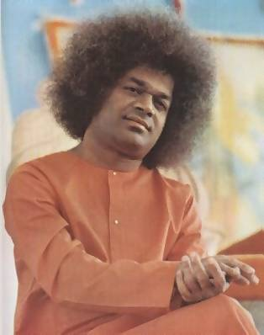
God’s Promise to Mother
“One night, mother Eshwaramma came to Me with tears in her eyes and said, "Swami, people want to take You here and there for their selfish purposes. If you leave Puttaparthi, I will give up My life. Please promise me that You will remain in Puttaparthi for ever." I gave her My word that I would never leave Puttaparthi. It is for this reason that I have constructed many buildings in the ashram for the comfort and convenience of devotees.”-20th October 2002

Slide 15
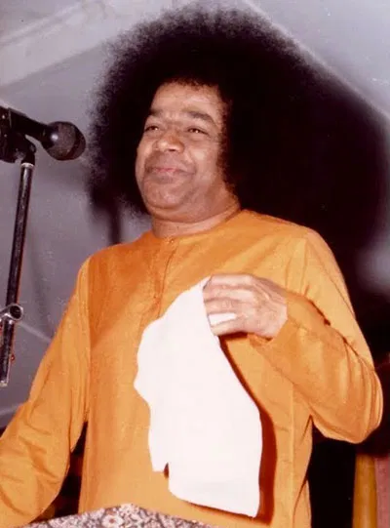
Eshwaramma’s Advice to Swami !
“Even after 30 years of her passing away, Mother Eshwaramma comes even to this day…she moves around in her physical body. At times, she comes to Me and expresses her motherly concern for My well being. Once she cautioned Me not to accept handkerchief from everybody
I told her that I had to accept when people offered it with devotion. She said, “Swami, no doubt there are crores of such noble persons. But there are also a few evil-minded persons who may smear poison on the handkerchief and offer it to You. This can prove dangerous when You use it to wipe your lips.” I promised her that I would follow her advice. “
-6th May 2001

Slide 16
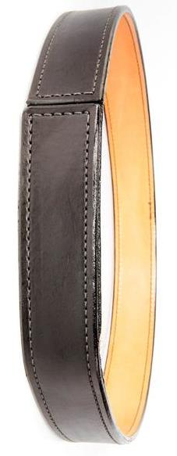
Eshwaramma’s Gift to Her Swami !
“One day Eshwaramma came to My room early in the morning and started talking to Me. Then the boys woke up and wanted to know with whom I was conversing. They wondered how anyone could enter My room since the lift was locked and the key was with them. Then I told that “Griham Ammayi”-Eshwaramma had come. I showed them the belt that she gave me. It had no buckle. There are many such noble mothers in this world. But Eshwaramma was the chosen one. I chose her to be My mother . That is the intimate relationship between Mother Eshwaramma and Myself.” - 6th May 2001- Brindavan

Slide 17
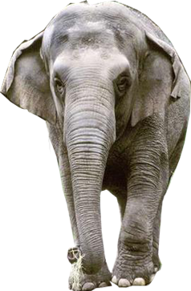
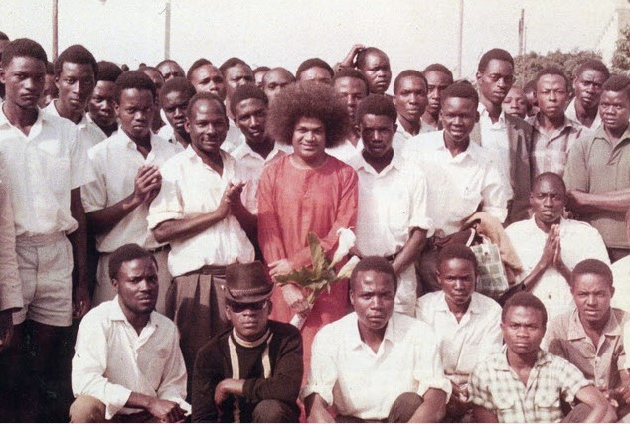
On East Africa Visit
“At the time of My departure for East Africa, Eshwaramma tried to dissuade Me from going, saying, “Swami ! I hear there are many fierce animals in those forests and the place is full of all kinds of dangers. Therefore, You should not go there. Whatever You will, all that will come here. Then, why do You want to go there?” I told her, “I am not going to see the wild animals there. I am going in response to the loving prayers of My devotees.” - 6th May 2007 at Kodaikanal

Slide 18
Privilege of the mother
Bhagawan granted the rare privilege of Anointing HIM with oil on HIS Birthday..23rd November every Year to Eshwaramma till she was Physically present…

Slide 19
6th May 1972
“Eshwaramma had finished her bath; she drank her coffee as usual quite happily, and took her seat on the inner veranda.
All of a sudden proceeding to the bathroom, she cried out. "Swami ,Swami, Swami,'" thrice. At this, I responded: "Coming, Coming." Within that period she breathed her last.”
“It was like the elephant Gajendra‘s calling and the Lord proceeding to bless it - the two wires achieving connection, the release happening instantaneously.”
-6th May 1983

Slide 20
My Life is My Message
To Demonstrate Idealism…Bhagawan Himself visited the Samadhi of the mother every Year to Show Gratitude…

Slide 21
Eshwaramma Day
Thank You
&
Jai Sai Ram

