Slide 1
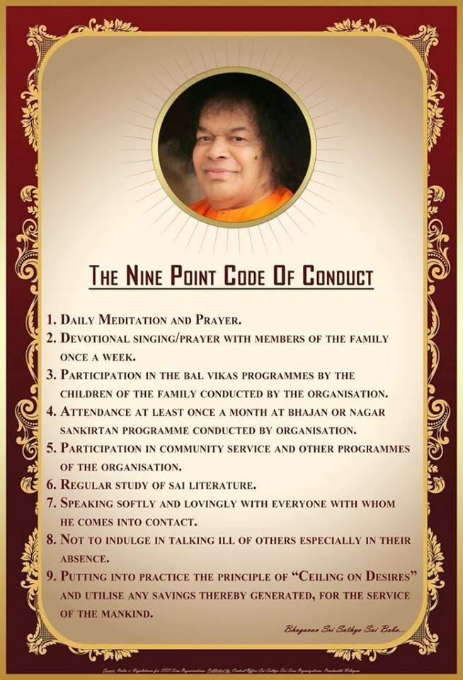
Nine Point Code of Conduct

Slide 2
Astanga Yoga and Nine Points
Yama
Niyama
Asana
Pranayama
Pratyahara
Dharana
Dhyana
Samadhi
Daily Meditation & Prayer
Devotional Singing with family
Balvikas Participation
Attendance in Samithi
Community Service
Study of Sai Literature
Speaking softly and
not to talk ill about others
Ceiling on Desires

Slide 3
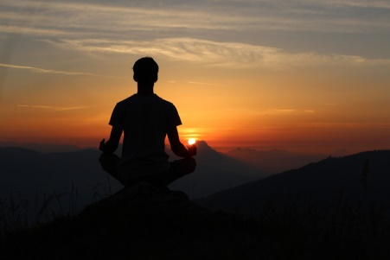
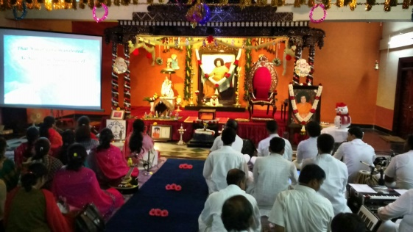
Sadhana is at three Levels
SADHANA
Personal Sadhana
Family Sadhana
Society Sadhana

Slide 4
DAILY MEDITATION & PRAYER

Slide 5
Why Daily Sadhana
As Swami Said. We Clean our hands and take bath daily for the Body…Similarly Daily Prayer and Meditation for Cleaning our Mind

Slide 6
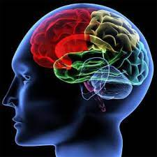
Daily Meditation & Prayer
Prayer and Meditation are spiritual practices which is done for Chitta Suddhi
In order to clean our mind of Impulses and Vasanas

Slide 7
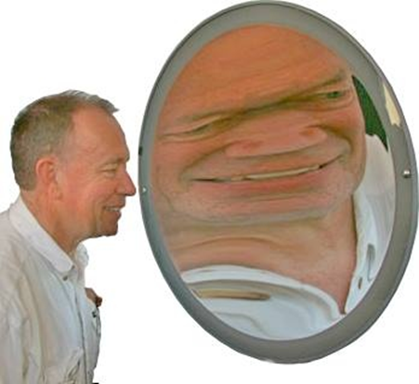
Three defects of Mind
Mala
Vikshepa
Avarna
Of these defects the 2nd aspect Vikshepa is the unsteadiness of the Mind which can be stilled with Meditation, Prayer and Namasmarana .

Slide 8
What is to be done daily
21 Times Omkaram
Suprabhatam
Jyothi Meditation
Daily Rituals like Sandhyavandanam etc.
Daily Puja / Prayer even while cooking / Cleaning
Namasmarana / Bhajans
Gayatri chanting while travelling / Driving
Bramharpanam during Breakfast / Lunch / Dinner
Night Prayer before sleep

Slide 9
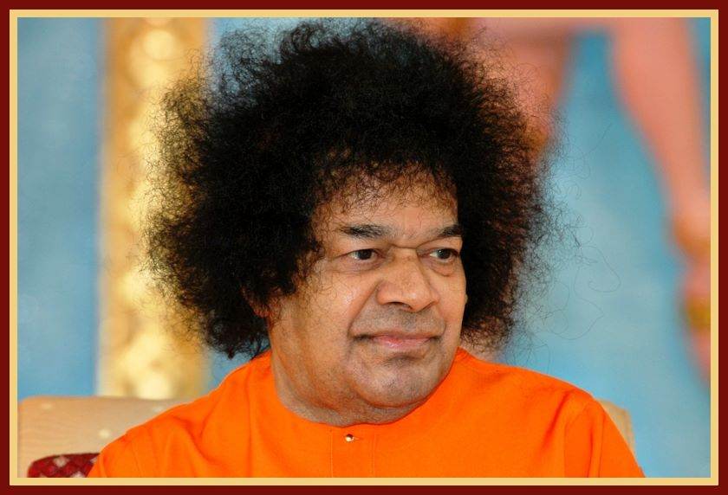
Why Prayer & Meditation
“Repetition of God’s name and meditation are for acquiring one-pointed attention on the Lord, for casting off Sensory attachments, and for attaining the joy derived from the basis of all sensory objects”-Dhyana Vahini

Slide 10
Lets not be like a Fly…
“The fly dwells in the sweetmeat shop and runs after the rubbish carts; the fly that has such a mind has to be taught to understand the sweetness of the first place and
the impurity of the second place, so that it may not desert the sweetmeat shop and pursue the rubbish cart. When such teaching is imparted to the mind, it is called meditation!”
-Dhyana Vahini

Slide 11
We should be like Bee
Look at the other type, the bee! It has contact only with sweetness; it approaches only flowers that possess nectar; it is not attracted to other places; it does not proceed there at all. Similarly, one has to give up all inclinations toward sensory attraction, toward the rubbish cart of the untrue and the impermanent.
-Dhyana Vahini

Slide 12
Power of Prayer / Namasmarana
SAIRAM
Uttering falsehood
Talking ill of others
Indulging in scandal
Excessive talk.

Slide 13
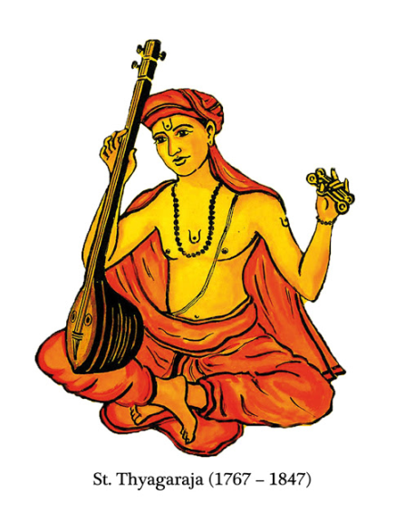
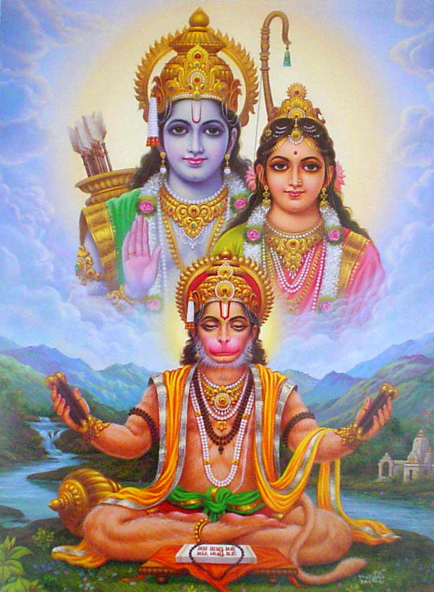
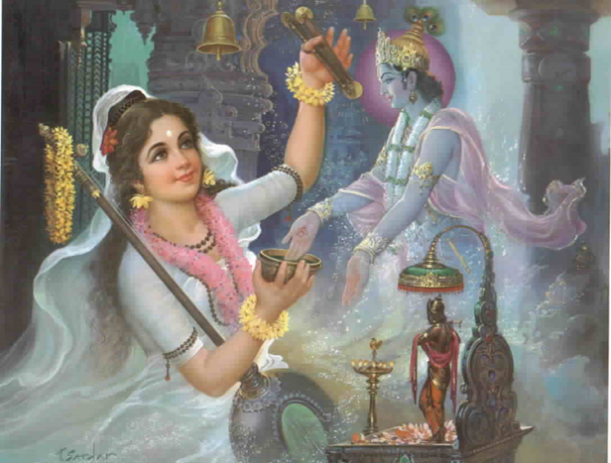
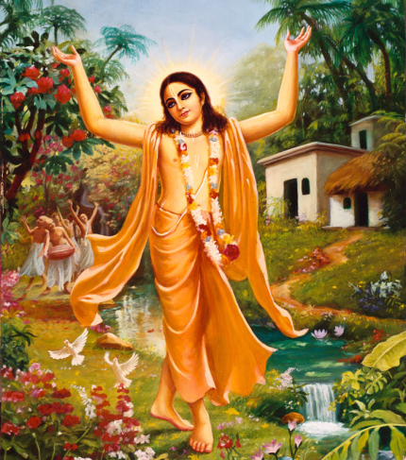
Great Sages /Devotees
Indian History and culture is replete with ardent devotees who achieved liberation and Chitta Suddhi with constant prayer and meditation..

Slide 14
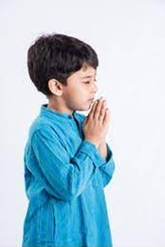
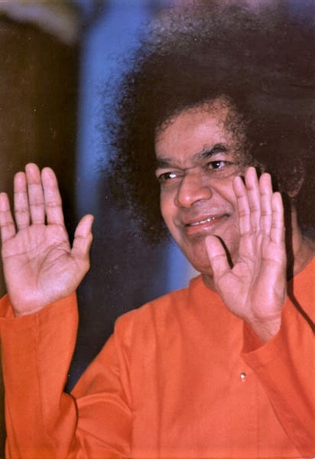
Prayer
Swami has said that we should Pray for what we do not have and only GOD has / or can give..
HE says do pray for worldly things which we can get by effort..
But for everlasting values like Love, Shanthi, Courage and Equanimity

Slide 15
Om Sri Sai Ram
Thank you
Jai Sai Ram

