Slide 1
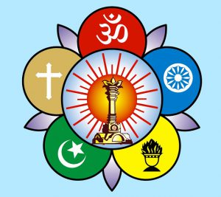
Om Sri Sai Ram
Sri Sathya Sai Seva Organisation
Karnataka South
Navarathri is a very important festival in the spiritual diary of our country- Bharatha.
Bhagawan has given us a lot of insights into the significance of observing this nine day festival.
Here are some of the highlights from those precious discourses.
Lets spread these messages to all devotees of our state and observe Navarathri with full awareness.
JAI SAI RAM

Slide 2
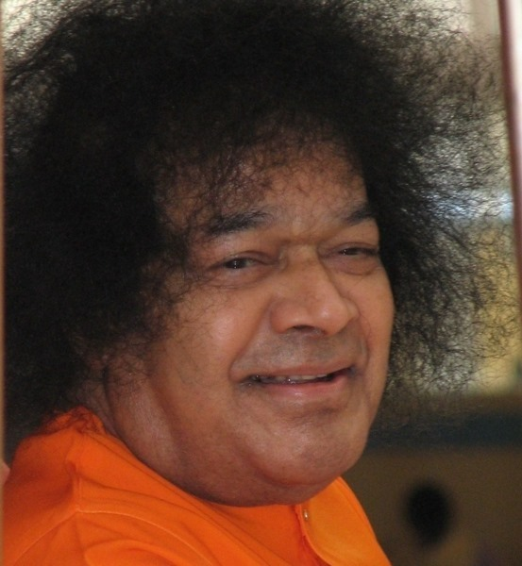
Om Sri Sai Ram
“Navarathri means nine nights. Darkness is associated with night. What is this darkness? It is the darkness of ignorance. The purpose of the Navarathri celebration is to enable man to get rid of nine types of darkness which have taken hold of him”-27th September 1992

Slide 3
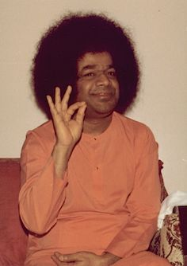
Each Deity for three Days
“The Navarathri has been divided into three parts the first three days being dedicated to the worship of Durga, the next three days to the worship of Lakshmi and the last three days to the worship of Saraswathi”
-27th September 1992

Slide 4
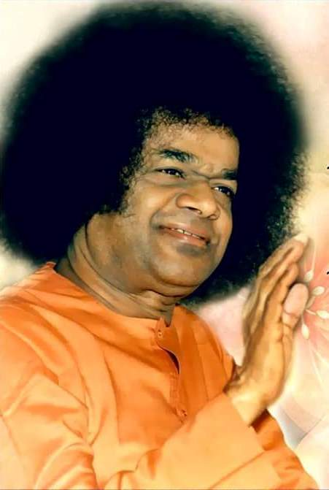
Devi and Three Gunas
“Shakthi is the energy that accounts for all the phenomena of Prakruthi. Prakruthi is energy and the controller of that energy is the Lord. Prakruthi is made up of the three qualities, Sathwa, Rajas and Thamas. Saraswathi represents the Sathva Guna. Lakshmi represents the Rajo Guna and Parvathi represents the Thamo Guna. As Prakruthi (Nature) is made up of these three qualities (Sathwa, Rajas and Thamas), to get control over Nature, man has been offering worship to Dhurga, Lakshmi and Saraswathi.” - 27th September 1992

Slide 5
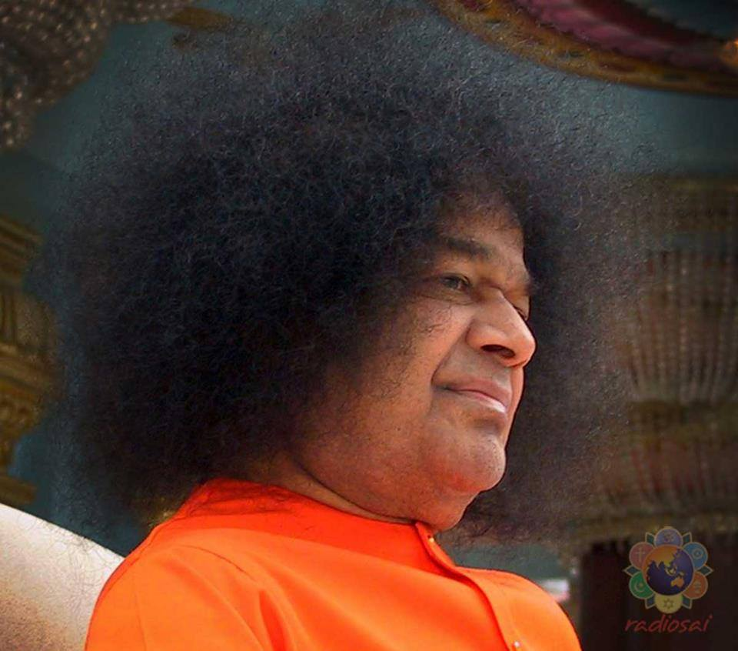
Significance of Kumkum
“During the Navarathri festival, for the purpose of eradicating one's demonic tendencies, the deities were worshipped with Kumkum .The red powder is symbol of blood. The meaning of this worship is offering one's blood to the Lord and receiving in return the gift of peace from the Lord.”-14th October 1994

Slide 6
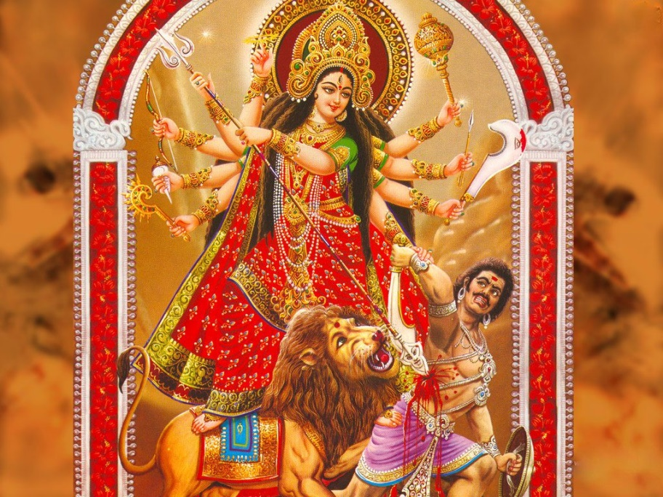
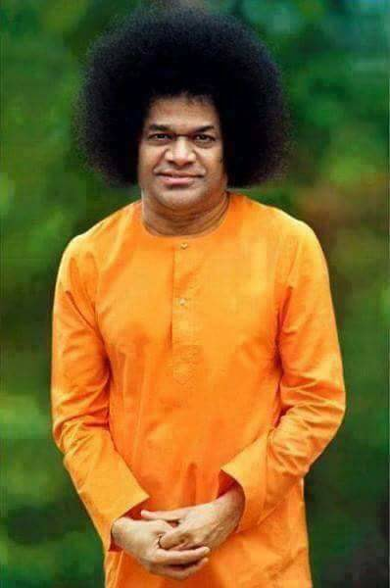
Kumkuma Archana
“When the Divine Goddess is in dreadful rage to destroy the wicked elements, She assumes a fearful form. To pacify the dreaded Goddess, Her feminine children offer worship to Her with red kumkum (sacred red powder). The Goddess, seeing the blood-red kumkum at her feet, feels assured that the wicked have been vanquished and assumes Her benign fom. The inner meaning of the worship of Devi with red kumkum is that thereby the Goddess is appeased. “ – 18th October 1991

Slide 7
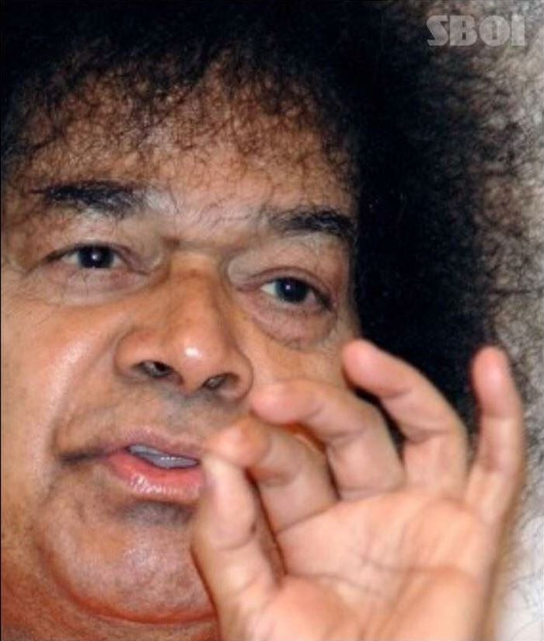
Purifying Thought Word and Deed
“Durga represents Mother Nature. To overcome the demonic qualities arising out of the influence of Nature, the power of Nature has to be invoked. This is the meaning of the worship of Durga. Nature is the protector as well as the chastiser. Lakshmi represents the protecting aspect of Nature. When Durga has destroyed the demonic qualities, Lakshmi purifies the mind. Then there is purity in speech, represented by Saraswathi. The worship of Durga, Lakshmi and Saraswathi is thus undertaken to get rid of the impurities in the mind and purify one's thoughts, words and deeds.”
-5th October 1992

Slide 8
Durga, Lakshmi & Saraswathi
“The presiding deity or the driving force behind the actions is Durga, who is the personification of energy.. Goddess Lakshmi bestows various kinds of wealth like money, food grains, gold, different kinds of objects, vehicles for movement, etc., The third facet of the divine female principle is Saraswathi, the goddess of learning and intellect. Thus, the Trinity of Durga , Lakshmi and Saraswathi are worshipped during this festival of Dasara. This is the underlying principle of worshipping this Trinity of Durga, Lakshmi, and Saraswathi during this Navarathri festival. It is essential that people worship all these three facets of the divine Principle.
-9th October 2008.

Slide 9
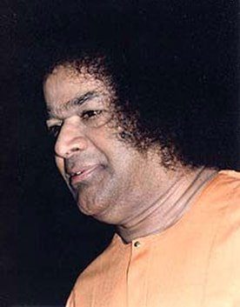
Mathru Devo Bhava:
“The life of a man who cannot respect and love such a venerable mother, is utterly useless. Recognising one's mother as the very embodiment of all divine forces, one must show reverence to her and treat her with love. This is the true message that the Navarathri, the nine-night festival gives us.
There is no need to propitiate Durga, Lakshmi and Saraswathi for energy, material prosperity and worldly knowledge. If we love and adore the mother, we shall be showing our love and devotion to all goddesses.” -14th October 1988.

Slide 10
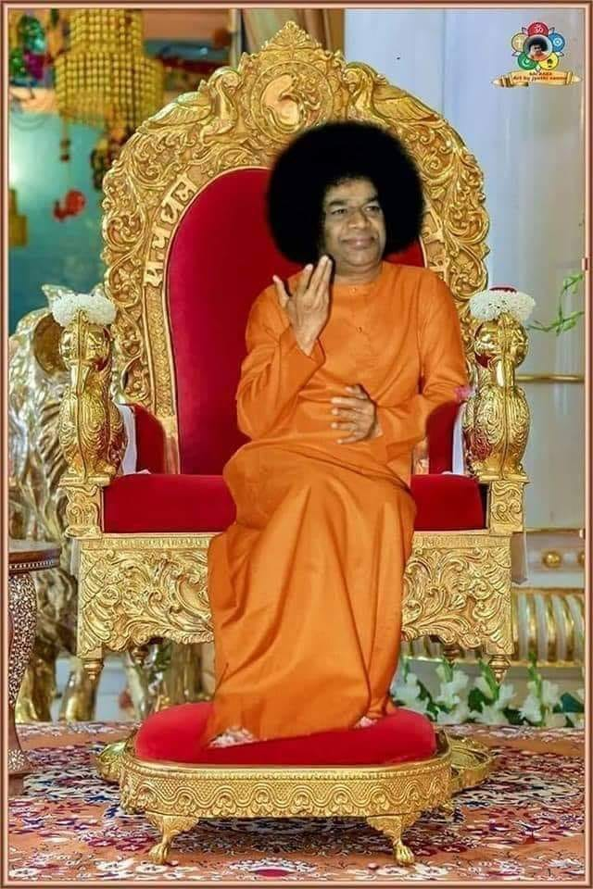
Iccha, Kriya and Jnana Shakthi
“The significance of Durga, Lakshmi and Sarasvathi has to be rightly understood. The three represent three kinds of potencies in man. Ichcha Shakthi , Kriya Shakthi , and Jnana Shakthi . Saraswathi is manifest in man as the power of Vak or speech. Durga is present in the form of dynamism, the power of action. Lakshmi is manifest in the form of Will power. The body indicates Kriya Shakthi. The mind is the repository of Ichcha Shakthi. The Atma is Jnana Shakthi. Kriya Shakthi comes from the body, which is material. The power that activates the body that is inert and makes it vibrant is Ichcha Shakthi. The power that induces the vibrations of Ichcha Shakthi is Jnana Shakthi, which causes radiation” . -14th October 1988

Slide 11
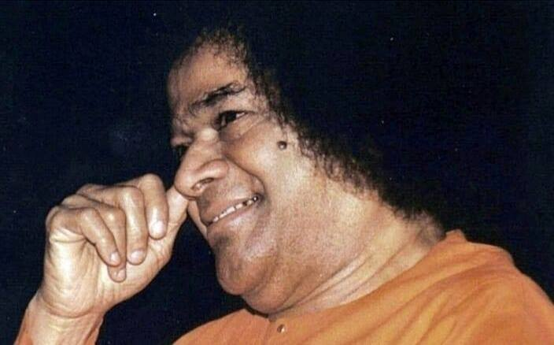
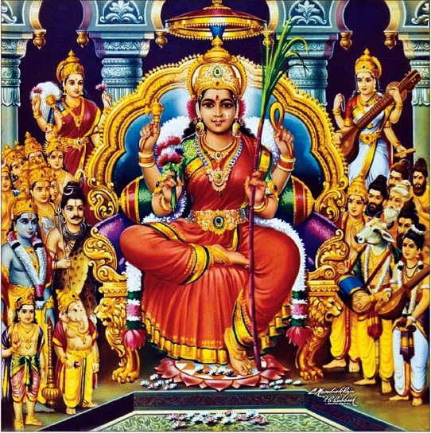
Rasaswaroopini
“In the human body the Divine flows through all the limbs as Rasa (The Divine essence) and sustains them. This Divine principle is called Rasaswaroopini (Embodiment of Divine sweetness). Another name for the same is Angirasa. These Divine principles that permeate and sustain the physical body should also be worshipped as mother goddesses”
-14th November 1988

Slide 12
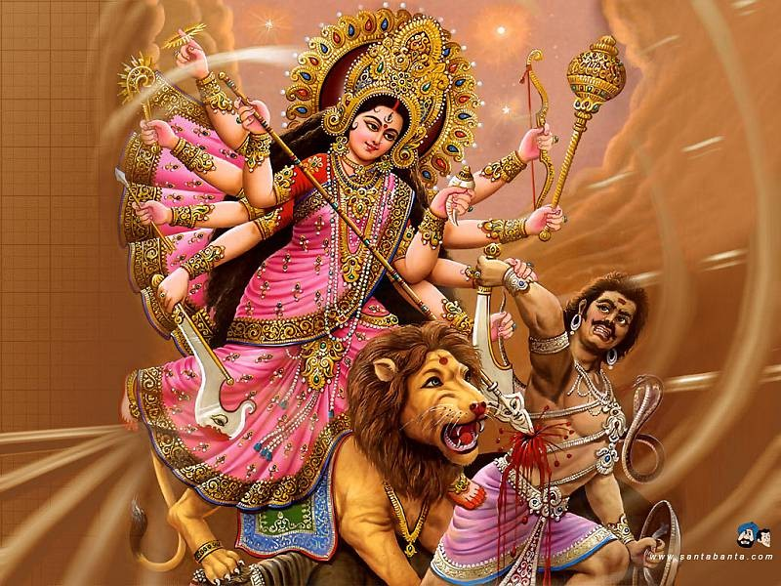
The Devi Principle
“The term "Devi" represents the Divine power which has taken the Rajasic form to suppress the forces of evil and protect the Satwic qualities. When the forces of injustice, immorality and untruth have grown to monstrous proportions and are indulging in a death-dance, when selfishness and self-interest are rampant, when men have lost all sense of kindness and compassion, the Atmic principle, assuming the form of Sakti, taking on the Rajasic quality, seeks to destroy the evil elements. This is the inner meaning of the Dasara festival”
-18th October 1991

Slide 13
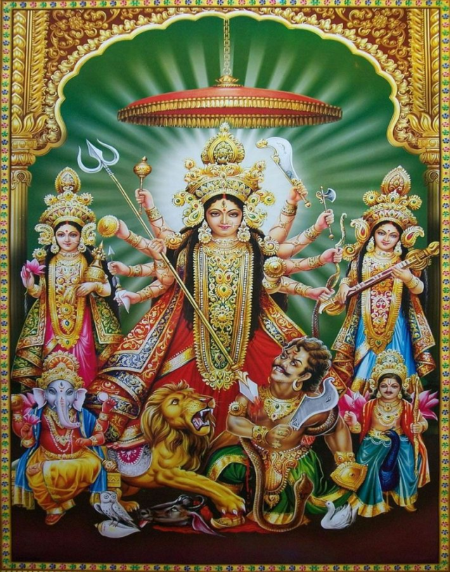
Victory of Good over Evil…
“To commemorate the Victory of God over Evil. The Embodiment of Divine Power
(Para-shakthi), in its various manifestations, as Maha-Saraswathi (Sathwik), as
Maha-Lakshmi (Rajasik), as Maha-Kali (Thamasik) was able to overcome the forces of vice, wickedness and egoism, during the Nine Days' struggle and finally, on Vijaya Dasami day, the Valedictory Worship is done. It is a Festival of Thanksgiving.” -12th October 1969

Slide 14
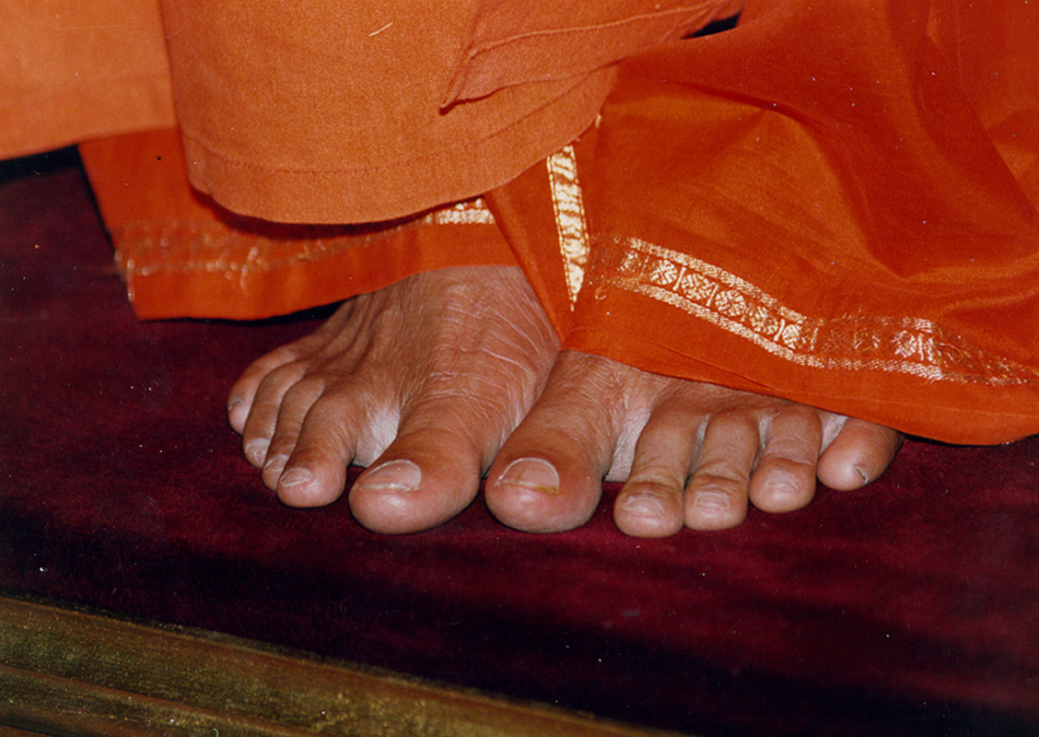
Thank You
JAI SAI RAM

