Slide 1
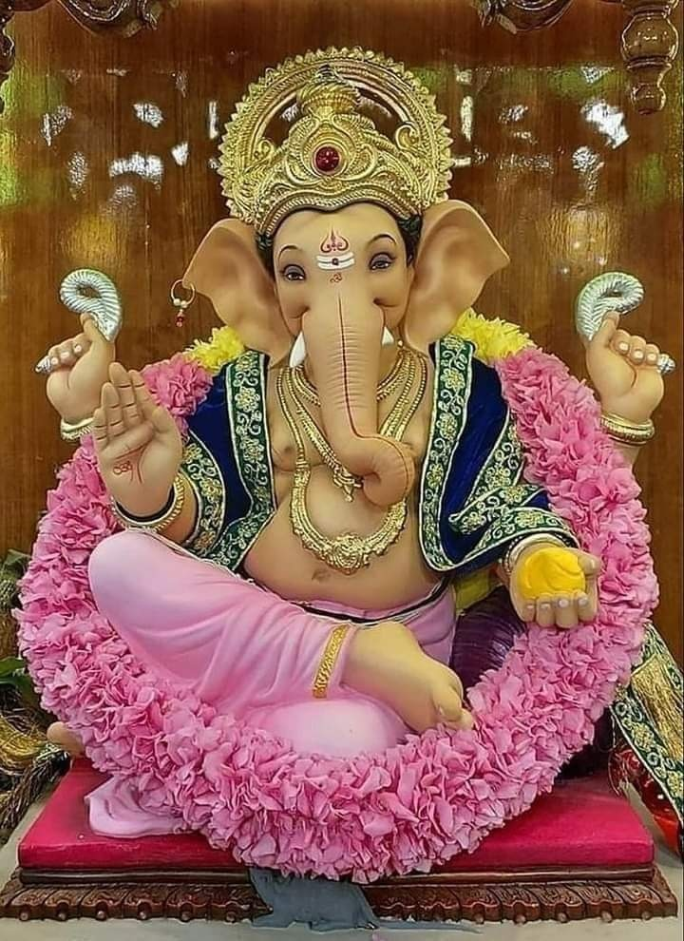
Significance of Ganesha Festival

Slide 2
Om Sri Sai Ram
Sri Sathya Sai Seva Organisations
Karnataka South
During each of the Ganesha Festival Bhagawan has given a lot of insights into the significance and Uniqueness of Ganesha Worship.
On the occasion of Ganesha Festival, here are some pearls of wisdom from the Avatar Himself….
Sai Ram
Spiritual Wing
SSSSO- Karnataka South

Slide 3
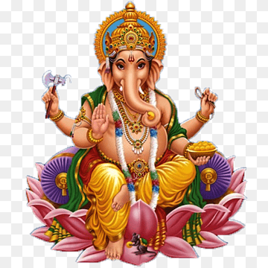
Ganapathi
“In the name Ganapathi, "Ga" stands for Guna (virtue) and "Na" for Vijnana (wisdom). When Ga and Na are joined we have the combination of Vijnana (worldly wisdom) and Prajnana (Spiritual wisdom). It is out of the combination of Vijnana and Prajnana that Sujnana (Supreme knowledge) emerges. Sujnana is the distinguishing mark of a true man. Ajnana is the sign of ignorance. Ganapathi is the Lord of Vijnana and Prajnana (worldly knowledge and spiritual wisdom). Therefore, when a devotee prays to Ganesha, he asks for the conferment of Vijnana, Prajnana and Sujnana” -31st August 1992

Slide 4
Vinayaka
“Vinayaka has no master above him. He is the master unto himself. Vinayaka will never put you to suffering in anyway. Vinayaka blesses all your endeavours, efforts and confers success. He will never allow anything evil to reside in you.. Vinayaka helps you to dispel this darkness and spread light. Divinity is not limited to mankind alone. We find divinity present in birds and beasts too. To demonstrate this latent, immanent divinity, we have Vinayaka having an elephant’s head, with a mouse as his vehicle”- 22nd August 2001

Slide 5
Vigneshwara
“Another name for Vinayaka is "Vighneswara." Easwara is one who is endowed with every conceivable form of wealth: riches, knowledge, health, bliss, beauty, etc. Vighneswara is the promoter of all these forms of wealth and removes all obstacles to their enjoyment. He confers all these forms of wealth on those who worship him. Vinayaka is described as "Prathama Vandana" (the first deity who should be worshipped). As everyone in the world desires wealth and prosperity, everyone offers the first place for worship to Vigneswara. It is only when the inner meanings of various aspects relating to the Divine are understood that worship can be offered to the Divine meaningfully”
-12th September 1991

Slide 6
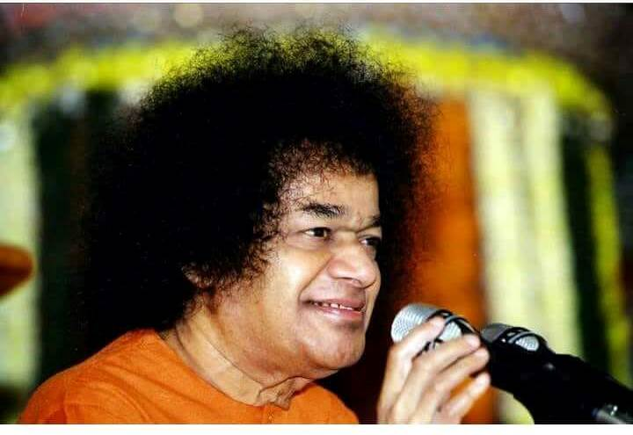
“Shuklam Bharadaram”…
“In the sloka beginning with the words, "Suklambaradharam Vishnum," only the form of the deity is described. But there is another inner meaning for the name Vinayaka. "Suklambaradharam " means one who is clad in white. "Vishnum" means, He is all-pervading. "Sasivarnam" means His complexion is grey like that of ash. "Chathurbhujam" means He has four arms. "Prasannavadanam" means, He has always a pleasing mien. "Sarvavighnopasanthaye" means, for the removal of all obstacles, "Dhyayeth," meditate (on Him). Vinayaka is the deity who removes all bad qualities, instils good qualities and confers peace on the devotee who meditates on Him” -12th September 1991

Slide 7
Gaja Mukha
“Vinayaka has the head of an elephant. What is its significance? No human being has an elephant's head. It is against the order of nature. How then did Vinayaka acquire an elephant's head? This has an inner significance. Vinayaka is known for His supreme intelligence. The elephant is also known for its high intelligence (Gajathelivi). The elephant will not trust anybody except its master. Because Vinayaka is endowed with exceptional intelligence, His elephant face is symbolic of supreme intelligence.”
-31st August 1992

Slide 8
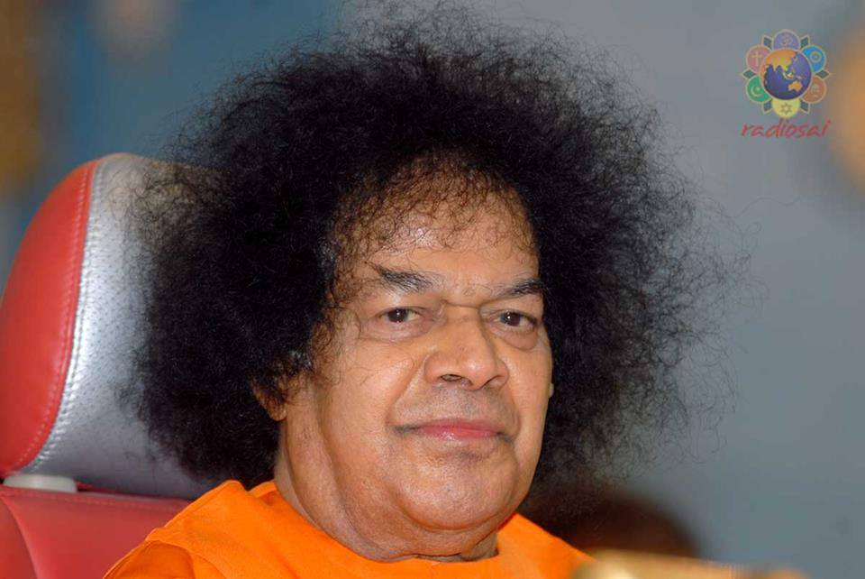
Ganesha Festival
“There is astronomical support also for the Ganesha festival, celebrated on the fourth day of the bright half of Bhadrapada month. A constellation with the appearance of the elephant-head becomes brightly visible on this very night”
-18th September 1985

Slide 9
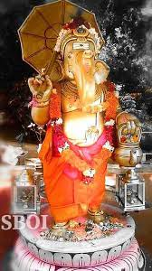
Vinayaka the Leader
“The nature of Vinayaka is found everywhere. Vinayaka is the master of Siddhi and Buddhi. We have to pray to such a Lord. If the leader is good, you will certainly reach the goal. Today, we do not have good leaders. Who is a good leader? Our conscience is the leader, but you have polluted that conscience. It is full of bad traits and wickedness. Vinayaka is the one who annihilates all such bad traits in our conscience”
-22nd August 2001

Slide 10
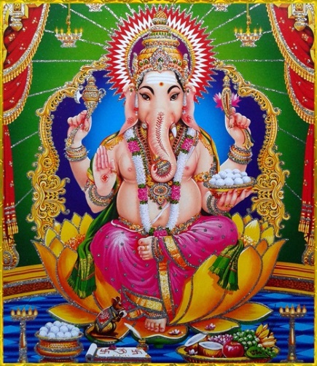
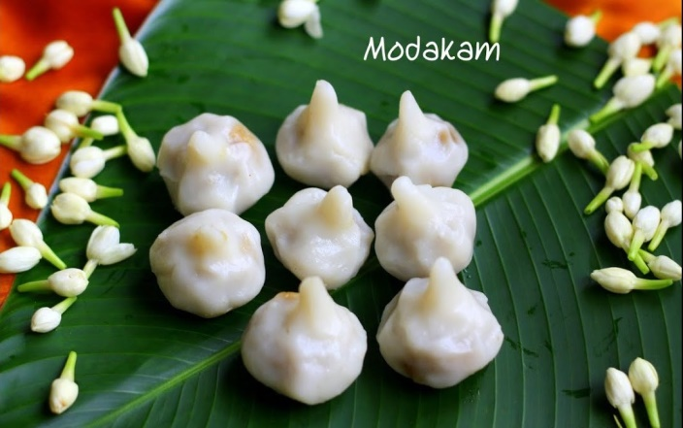
Steam-Cooked Offering
“Bharatheeyas make some special offerings to Ganesha as food offerings. These preparations are made entitely by using steam instead of heat from a burning stove. Combining rice flour with jaggery and thil (sesame) seeds, balls are prepared which are cooked in steam. In Ayurveda this edible is accorded a high place for its curative properties. The jaggery in the edible is a remedy for various ailments. The til seeds serve to purify the arteries. It also helps to improve the vision. The inner meaning of all this is that the food offerings to Ganesha have health giving properties. It should be noted that edibles cooked in steam are easy to digest”
-7th September 1997.

Slide 11
Significance of Mouse
“What does the Mushika-mouse represent? It represents darkness, which is the symbol of ignorance. The mouse moves about in the dark. Ganapathi is regarded as controlling the darkness of ignorance. The mouse is also known for its strong sense of Vasana (smell). Based on the smell emanating from an object, the mouse finds its way to it. The inner significance of Vasana in relation to humanity is the heritage of Vasanas which they bring from their previous lives. These Vasanas (inherited tendencies) account for the actions of human beings in their present lives. They also signify desires. “
-7th September 1997

Slide 12
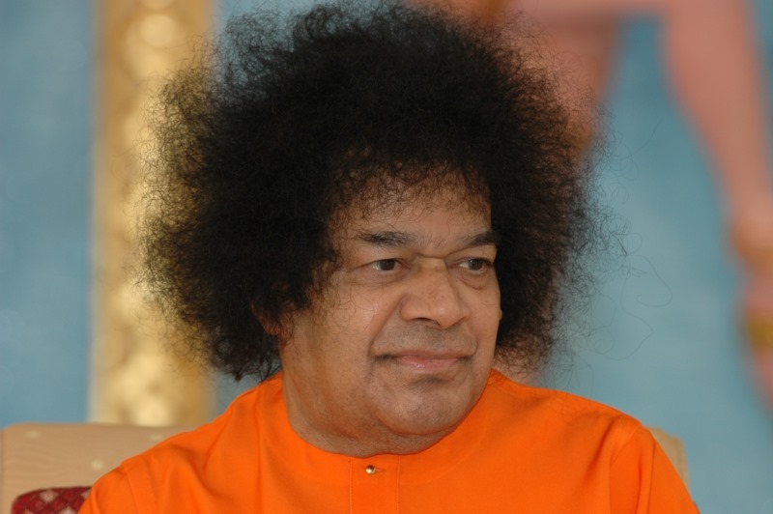
Ekadantha
“When Vinayaka was writing the Mahabharata to the dictation of Sage Vyasa, the latter laid down the condition that Vinayaka should go on writing non-stop whatever Vyasa said. But Vinayaka also stipulated a condition that Vyasa should never stop his dictation but should go on without a break. While he was writing, Vinayaka's pen broke and he did not hesitate to break one of his tusks to use it as a pen. That is why he is called Ekadhantha or one with a single tusk.”
-9th September 1994

Slide 13
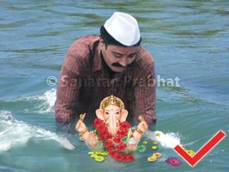
Significance of Ganesha Immersion
“What is the significance of immersion of idols in water? When the idol of Vinayaka is immersed in water, it loses its form, and the Vinayaka Principle becomes all-pervasive. If you put sugar in water, it will mix with water, permeating its every molecule. Likewise, the merger of the idol of Vinayaka with water signifies His all-pervasiveness”
-26th August 2009

Slide 14
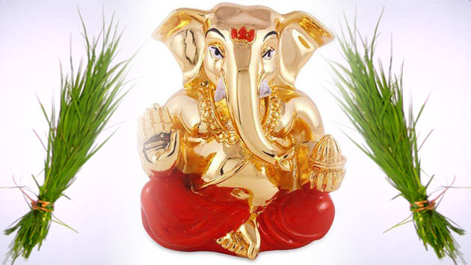
Significance of Grass Worship
“People worship Vinayaka by offering garika (a kind of white grass). What is the origin of this worship? Once, Parvati and Parameswara were engaged in a game of dice. Nandi was asked to be the adjudicator. Nandi declared Easwara to be the winner each time. Mother Parvati thought that Nandi was biased in Easwara’s favour. She became furious and pronounced a curse on Nandi that he should suffer from indigestion. At once Nandi fell at her feet and prayed, “Mother, I have not cheated you, I have been highly impartial in my judgement. It is because of the power of His will that Easwara emerged victorious each time. Hence, I seek your pardon that I may be freed from the curse.” Parvati at once took pity on him and said, “Nandi! on the fourth day of the month of Bhadrapada, you worship Vinayaka with garika (white grass).” -10th Sept.2002

Slide 15
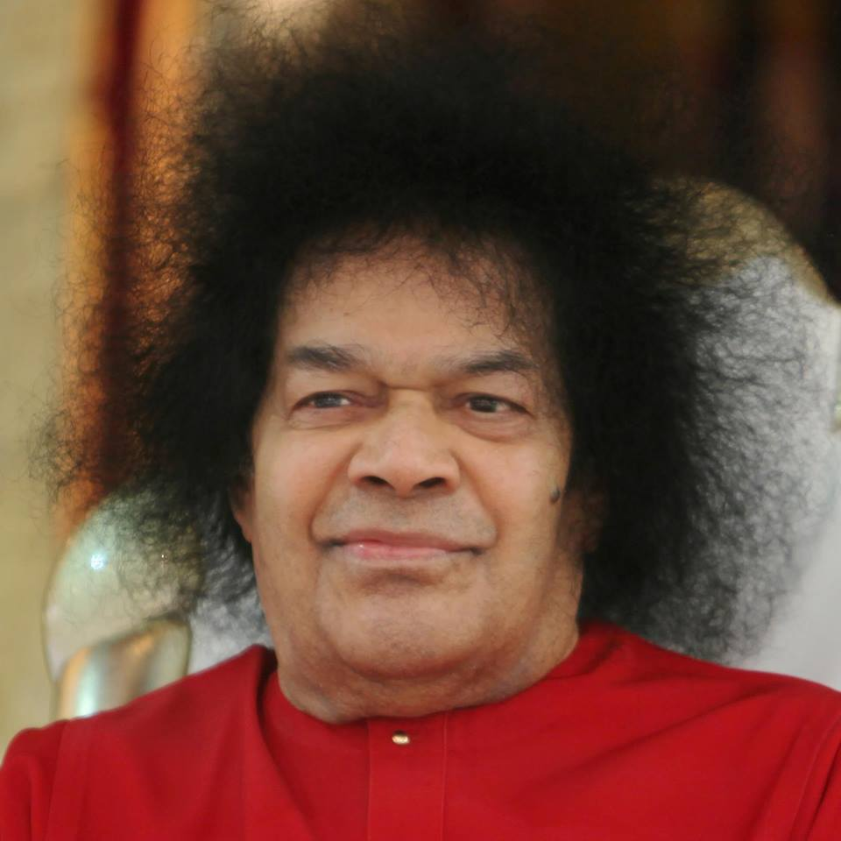
Vinayaka Adored Abroad
“There is historic evidence that the worship of Vinayaka has been in vogue even in other countries such as Thailand, Japan, Germany and U.K. Adoration of Vinayaka as Prathama Vandhana has been mentioned in the Vedas. Ganapathi Thathva finds a place in the Vedas and Upanishaths. Reference to Him is made in the Gayathri also. He is one who instills purity in body, and fearlessness in the mind. It is said- "Thanno Dhanthih Prachodayath," giving importance to his tusk. “
-12th September 1991

Slide 16
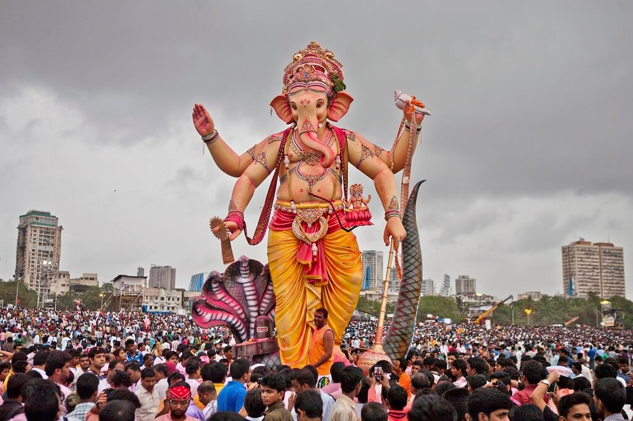
Significance of 10 days Worship
“Ganapathi, who presides over the senses, should be your guide in acquiring mastery over the senses. There is an inner meaning in worshipping Ganapathi for ten days. The idea is that each day should be dedicated to acquiring control over one of the Indriyas (sense organs).”
-7th September 1997

Slide 17
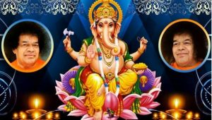
Om Sri Sai Ram
May Lord Ganesha Bless us all with Right Intelligence, Discrimination, and Sound Knowledge
THANK YOU
JAI SAI RAM

