Slide 1
PRema VAHINI
ಪ್ರೇಮ ವಾಹಿನಿ
VAHINI SWADHYAYA - Online Spiritual conference

Slide 2
ವಾಹಿನೀ ಸ್ವಾಧ್ಯಾಯ
ಸತ್ಯಸಾಯಿ ವಾಹಿನಿ
ಪ್ರೇಮ ವಾಹಿನಿ
ಪ್ರಶಾಂತಿ ವಾಹಿನಿ
ಧ್ಯಾನ ವಾಹಿನಿ
ಪ್ರಶ್ನೋತ್ತರ ವಾಹಿನಿ
ಧರ್ಮ ವಾಹಿನಿ
ಭಾಗವತ ವಾಹಿನಿ
ರಾಮಕಥಾ ರಸವಾಹಿನಿ
ಸಂದೇಹ ನಿವಾರಿಣಿ

Slide 3
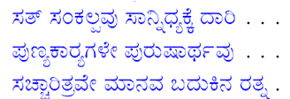
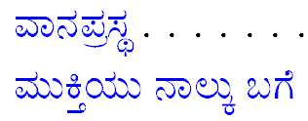
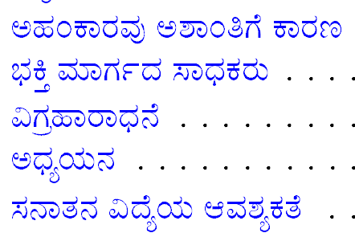
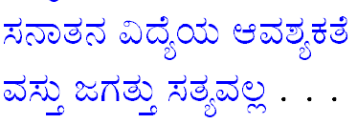
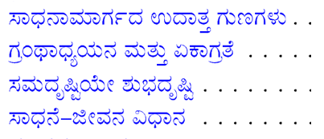
10
11
6
7
8
9
2
3
5
4
1

Slide 4
CHAPTER 1
1. Good character is spiritual power
2. Reshape character by cultivating noble qualities
3. Read life histories of saints and sages
4. Cultivate one-pointedness and equal vision
5. First search and correct faults within yourself
6. Life is a selfless loving sacrifice
7. Thou art That (Thath-twam-asi)
8. Consecrate every act as worship of the Lord
9. Fill every deed with service, devotion, wisdom
10. I and you, we, should become He
11. Shed attachment to worldly pleasures, develop attachment to God
12. Good character, virtue is wisdom
13. Reach God by the path of truth and discrimination
14. Meditate on God as truth and love

Slide 5
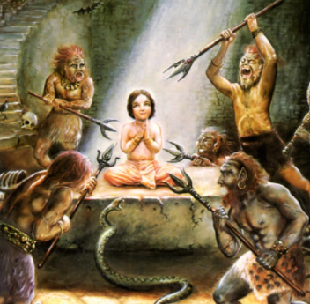
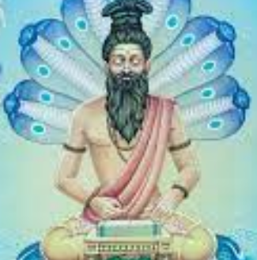
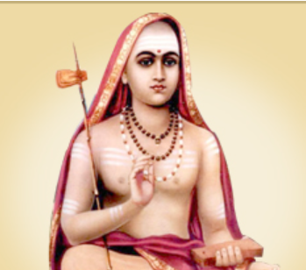
Bhakta Prahlada
Sage Pathanjali
Sri Adi Sanakaracharya
Sage Valmiki
Discourse – 31st May, Summer Course 1991

Slide 6
Sandeha Nivarini
Prasnottara Vahini
Bhakta Sabari
Take One Step towards Swami
SEVA YAGNA
DANA YAGNA
SADHANA - YAGNA
SATHYA MEVA JAYATE
Sri Harischandra Maharaj

Slide 7
CHAPTER 2
15. Eschew selfishness, conceit, and pride 16. Avoid argumentation and exhibition of scholarship
17. Avoid doubters and ignorant people 18. Develop devotion and faith 19. Cultivate love through two methods 20. See the macrocosm in the microcosm 21. Listen, contemplate, and sing God’s name

Slide 8
King Ravana
Bhakta Kannappa
Bhakta Markandeya
Swami Vivekananda

Slide 9
CHAPTER 3
22. Seek knowledge of the Eternal Truth
23. Don’t neglect the study of Sanskrit and Vedic culture
24. Don’t mistake appearance for reality
25. Understand that the objective world is as unreal as the dream world

Slide 10
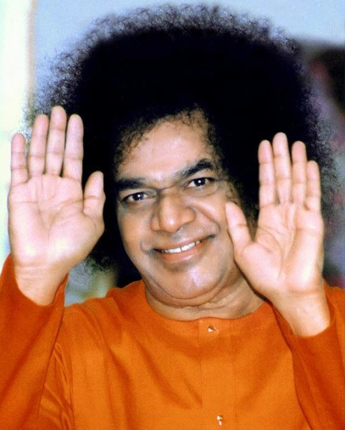
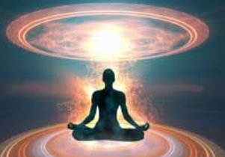
CHAPTER 5
30. Eternal Religion: the divine mother of humanity
31. Bharath is the home of the Eternal Universal Religion
32. Eternal Vedic religion is the heritage of all mankind
33. Divine personalities predominate in Bharath
34. Awake, arise, and tread the path of love and devotion

Slide 11
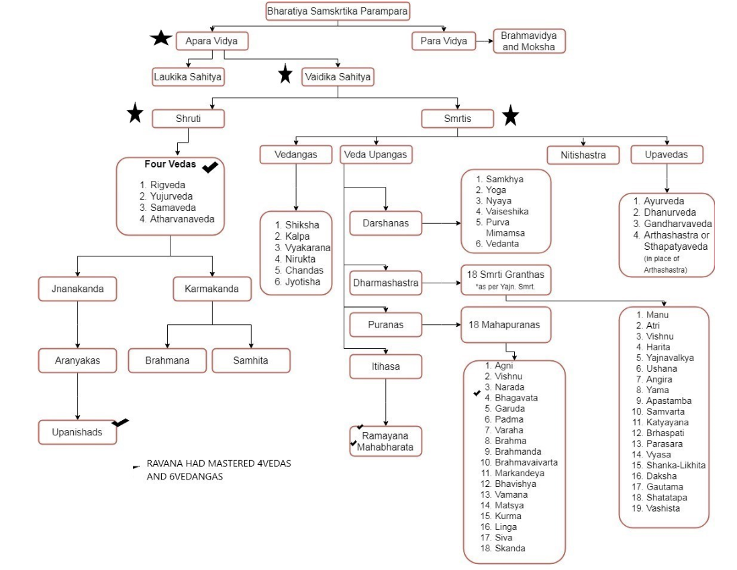

Slide 12
CHAPTER 4
26. The journey of life depends on inborn desires
27. Direct your life to acquire your last moment’s mental tendency
28. Perform good deeds and saturate the mind with God
29. Be engaged in good actions, with God in your thoughts

Slide 13
Jnanendriyas
Eye, Ears, Skin, Nose, Tongue
Pancha Tanmatra
Sabda , Sparsa, Rupa, Rasa, Gandha
Karmendriyas
Vocal organs, Hands, Legs, Genitals
12. The Gross and the Subtle
13. The Ramayana in the Heart of Man
14. The Bhagavatha: the Description of Atma
Sandeha Nivarini
Prasnottara Vahini
1. The Body and Indriyas

Slide 14
CHAPTER 6
35. The Universal Soul is One and Only One
36. Be universal in outlook
37. Incarnations reveal the universal form of the Lord

Slide 15
CHAPTER 7
38. Nondualism teaches the highest knowledge: the unity of all
39. Have firm faith in the unity of Self and Cosmic Lord
40. Start spiritual practice at the earliest moment
41. Seek the vision of the Divine, not death
42. Walk the path of spirituality and liberation
43. Let go the ego in order to reach the goal
44. Pursue the path of good and Godliness
45. Practise single-minded devotion and equanimity
46. Eschew conceit and doubt

Slide 16
Prasnottara Vahini
2. FOURTEEN LOKAS
5. PANCHA KOSAS

Slide 17
Anandamaya
Vignanamaya
Manomaya
Pranamaya
SAHASRARA Divine Bliss
AJNA Divine control
VISHUDDHA Expression of Divinity
ANAHATHA Understand and connect to Divinity
MANIPURA Ability to Channel
SWADHISTHANA Ability to Nurture
MULADHARA Eager to Learn
Sathya Loka
Thapo Loka
Jana Loka
Mahar Loka
Suvarloka
Bhuvarloka
Bhu loka

Slide 18
CHAPTER 8
47. Be humane, not demonic
48. Develop the characteristics of genuine devotees
49. Surrender completely to the Lord
50. The nine paths of devotion
51. Devotion is of two kinds: effortful devotion and self-surrender

Slide 20
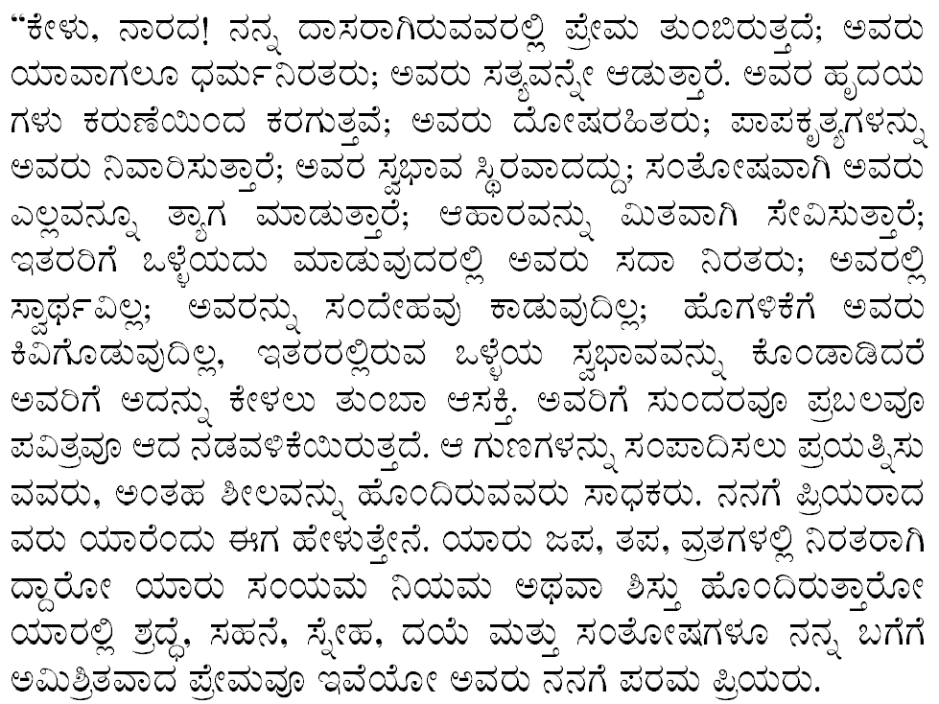

Slide 21
CHAPTER 9
52. The course of life of a forest dweller
53. External and internal disciplines are necessary for one-pointed devotion
54. The four stages of liberation
55. Perform all actions in dedication to God
56. Perform good deeds, with constant remembrance of God

Slide 22
Sathsang, Sadhana, Manthra Japa, Physical Pleasures
Basic Qualities
Daya
Astheya (Non-Stealing)
Dhee (Discrimination)
Soucha (Cleaning)
Kshama(Patience)
Dhrithi (Steadfastness)
Akrodha (No Anger)
King Parikshith
Salokya Mukti – Bhava Samadhi - Radha
Sameepya Mukti - Arjuna
Saroopya Mutki - Sage Naarada & Nandeeswara
Saayujya – Adi Sankaracharya

Slide 23
CHAPTER 10
57. Awake, arise, and attain the Highest
58. Dedicate yourself to the discovery of truth and contemplate the Everlasting
59. To reach God, be free from external and internal illusions
60. The harvest of the spiritual aspirant
61. The characteristics of the devotee and worldly person
62. Consider the name of the Lord as the breath of life
63. Watch out for your own faults and cultivate the truthful and joyful
64. Stick to the name and form of the Lord you adore

Slide 24
CHAPTER 11
65. Help ever, hurt never
66. The Lord incarnates to promote goodness and universality
67. Follow the sages of yore in contemplation of Brahman
68. Seek solitude, meditate, and acquire one-pointedness
69. Uproot internal and external foes and uphold righteousness
70. Pray to God for His incarnation
71. With faith in human divinity, service to mankind becomes service to God
72. Purify the mind by meditation and japa
73. Pray for the advent of divine personages!

Slide 25
ವಾಹಿನೀ ಸ್ವಾಧ್ಯಾಯ
ಸೌಂದರ್ಯ ಸಾರ ಸರ್ವಸ್ವಮ್
ಮಂದಸ್ಮಿತ ಮನೋಹರಂ
ವಂದಾರು ಜನ ಮಂದಾರಂ
ವಂದೇ ಸಾಯಿ ಮಹೇಶ್ವರಂ, ಸಾಯೀಶ್ವರಂ
ಸಮಸ್ತಾ ಲೋಕಾ ಸುಖಿನೋಭವಂತು
ಓಂ ಸಾಯಿರಾಂ

